Slide 1







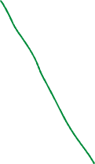

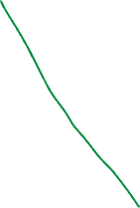






C
H
D, P, M
B, V
S

Slide 2
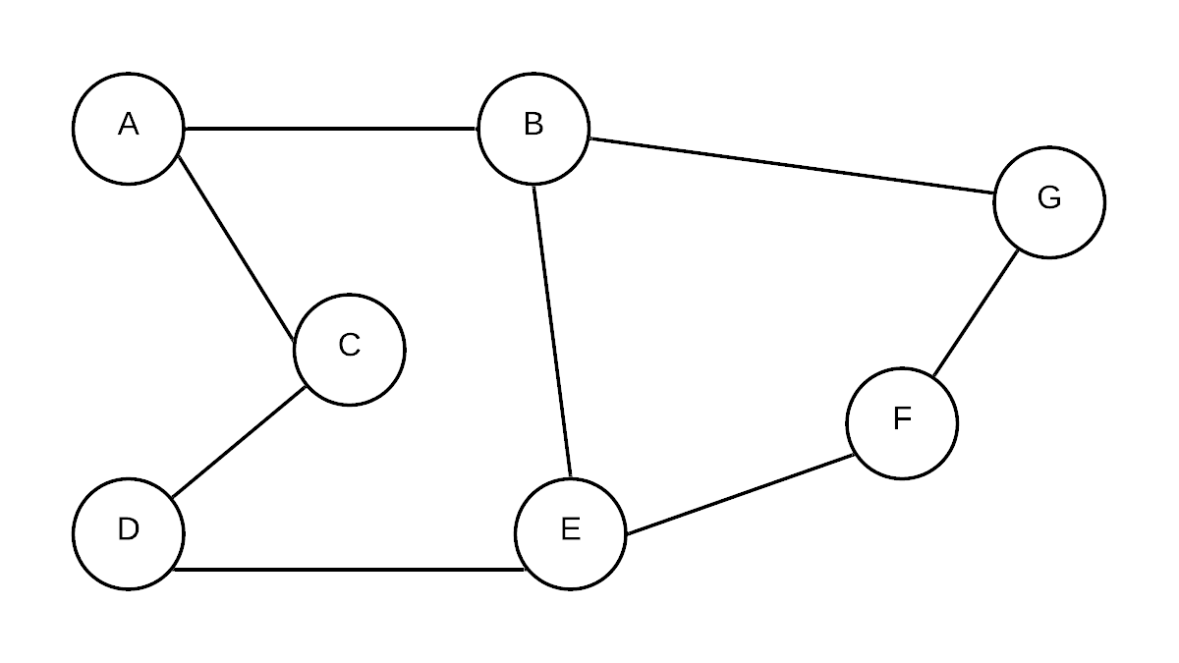
A
B, C
G, D
E
F

Slide 3
Breath First Search
B
A
2
E
5
1
1
4
7
C
3
D

Slide 4
Depth First Search
B
A
2
E
5
1
1
4
7
C
3
D

Slide 5
2
B
A
2
E
5
7
1
1
4
7
C
3
D
6
3

Slide 7
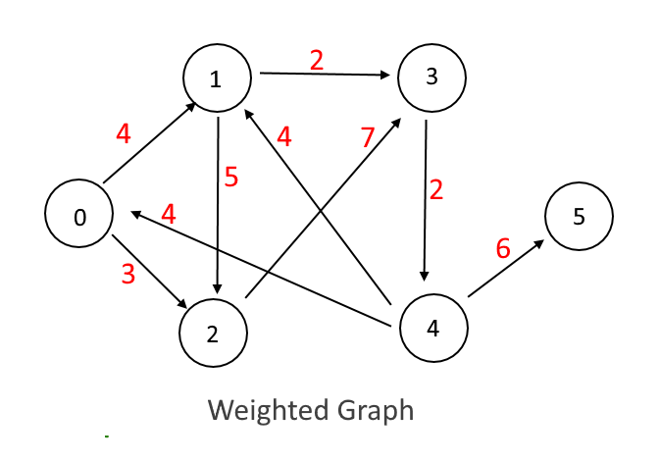
4
10
18
3
12

Slide 8



9, 8,7

Slide 9
Min Heap
6, 8, 19, 1, 3, 21, 17, 28,
1
6
3
Index = (2^(level-1) + 2^(level -2) …. 2^0)+ position
8 = 2*
8
17
19
21
28
29
21
23
31
27
32
48
61
1, 6, 3, 8, 17, 19, 21, 28, 29
8

