Slide 1
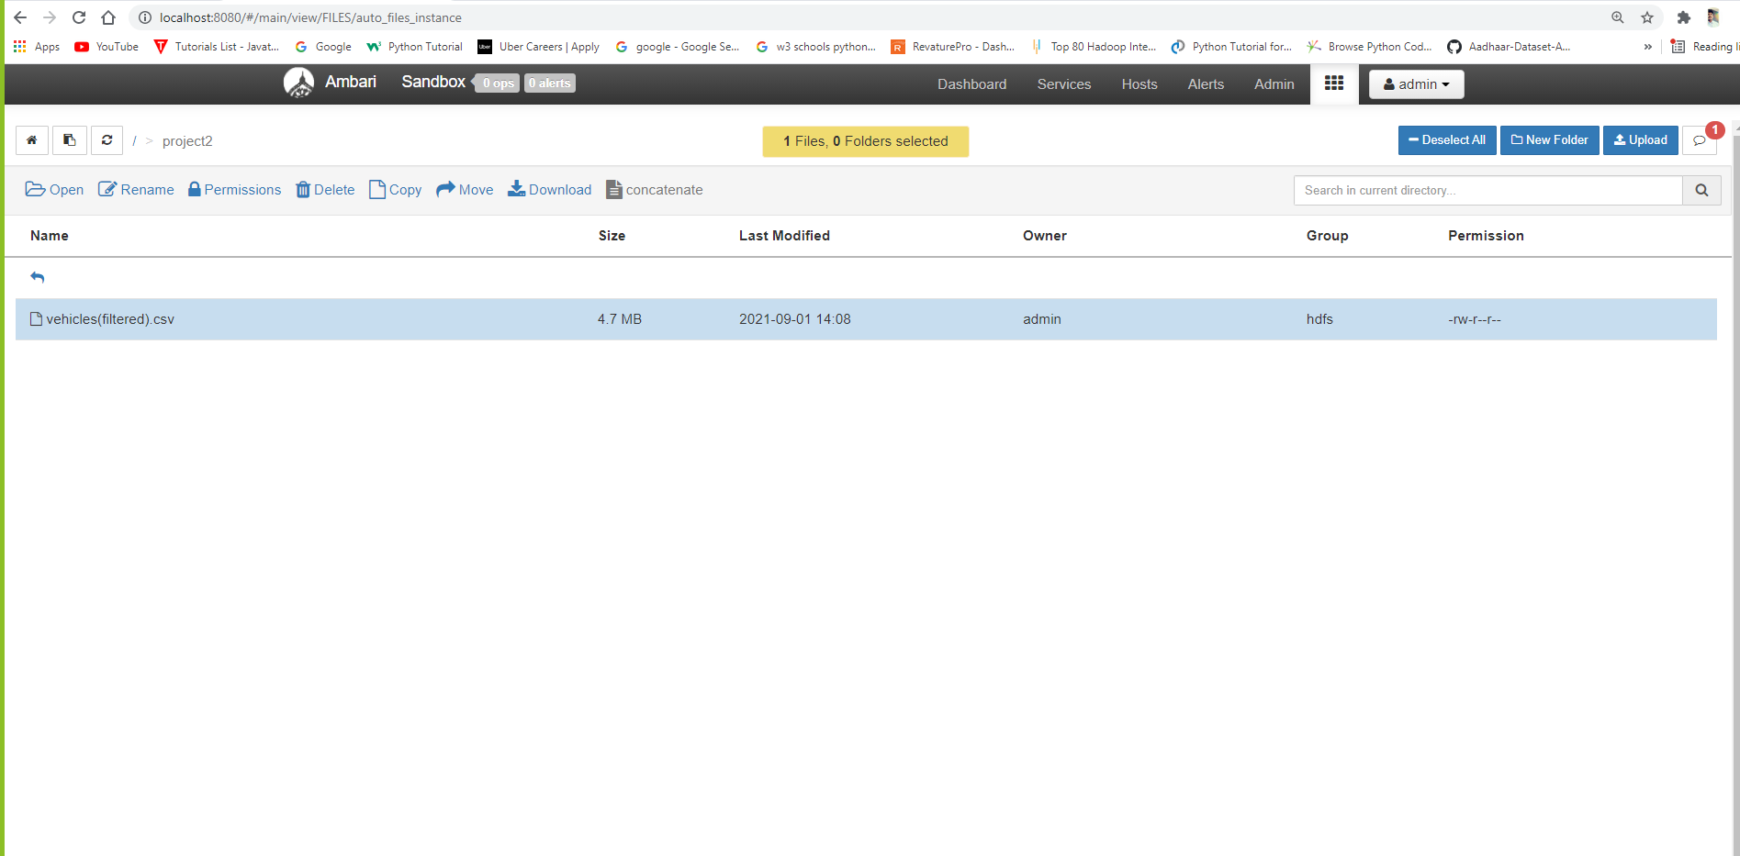
Loading data into Ambari.

Slide 2
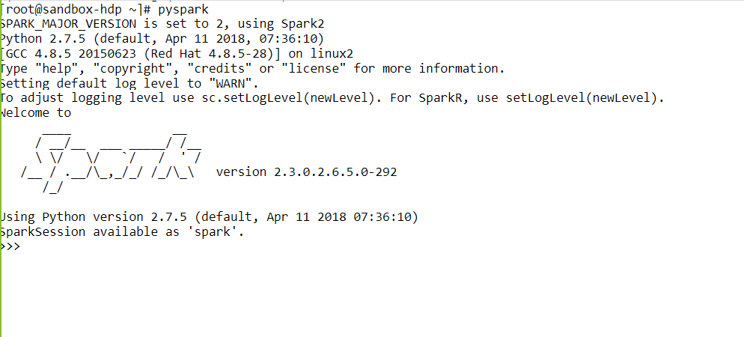
Launching Spark shell in HDP.

Slide 3
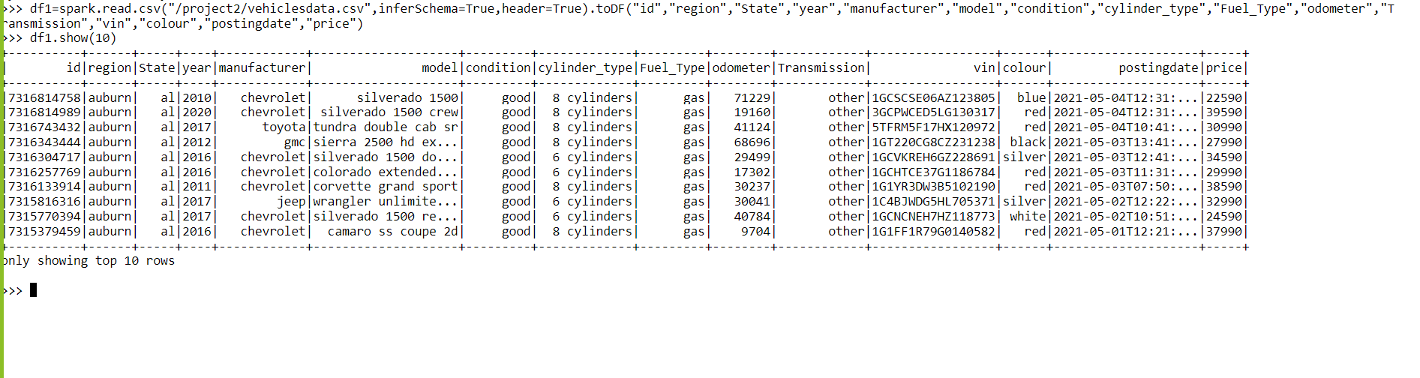
Creating the data frame and loading the dataset into it. Command: df1=spark.read.csv(“/project2/vehiclesdata.csv”,inferSchema=True,header=True).toDF(“id”,”region”,”state”,”year”,”manufacturer,”model”,”condition”,”cylinder_type”,”fuel_type”,”odometer”,”Transmission”,”vin”,”colour”,”postingdate”,”price”)

Slide 4
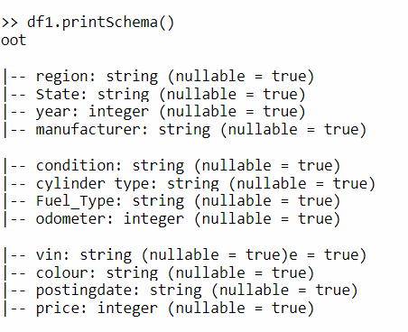
To get the Schema of the data frame. Command: df1.printSchema()

Slide 5
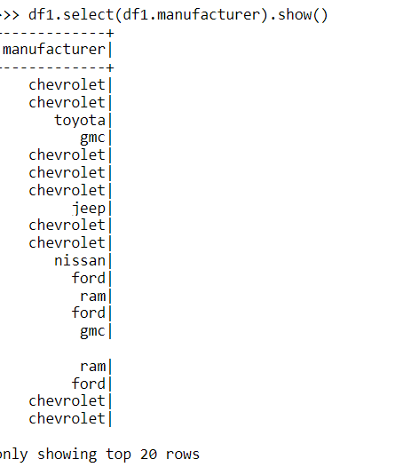
Selecting a particular column in data frame. Command : df1.select(df1.manufacturer).show()

Slide 6
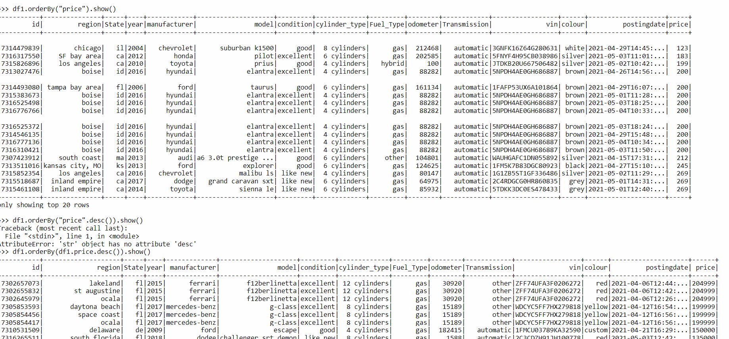
To sort the data into particular order based on a column. Command : df1.orderBy(“price”).show() ---->>ascending order. df1.orderBy(df1.price.desc()).show() -->descending.

Slide 7
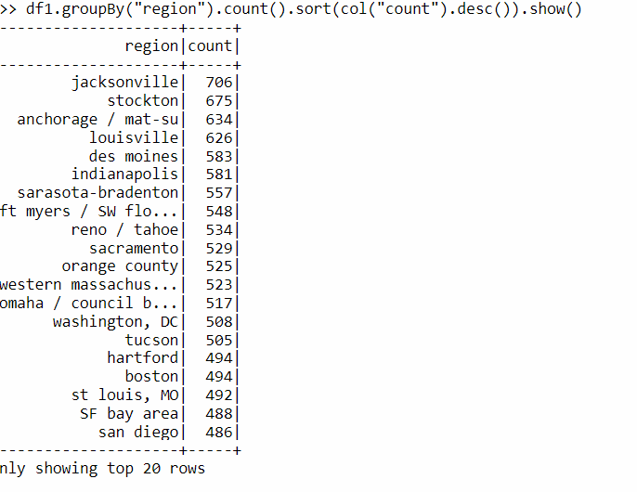
Grouping the data based on a column and sorting the count by descending order. Command : df1.groupBy(“region”).count().sort(col(“count”).desc()).show()

Slide 8
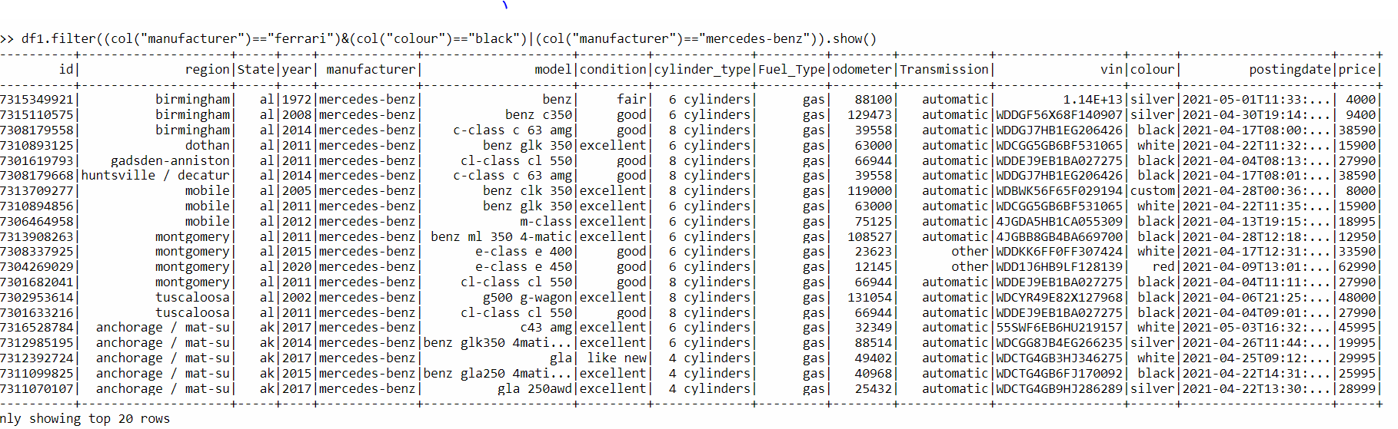
Getting the data where manufacturer=‘Ferrari’ or ‘Mercedesbenz’ and color=‘black’ using ‘FILTER’ function. Command : df1.filter((col(“manufacturer”)=“Ferrari”)&(“colur”==“black”)|(col(“manufacturer”)==“mercedesbenz”)).show()

Slide 9
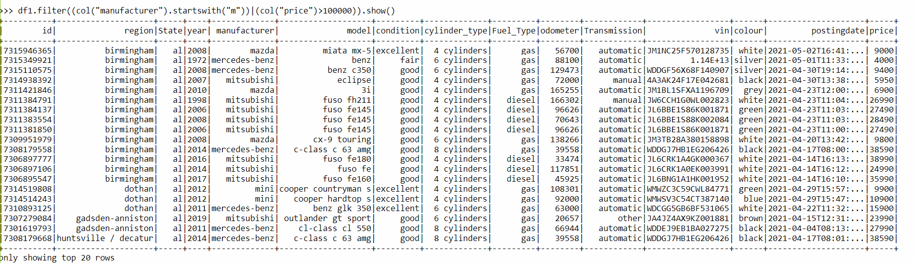
To get the data of manufacturer whose name starts with “m” and their price greater than 100000. Command : df1.filter((col(“manufacturer”).startswith(“m”))|(col(“price”)>100000)).show()

Slide 10
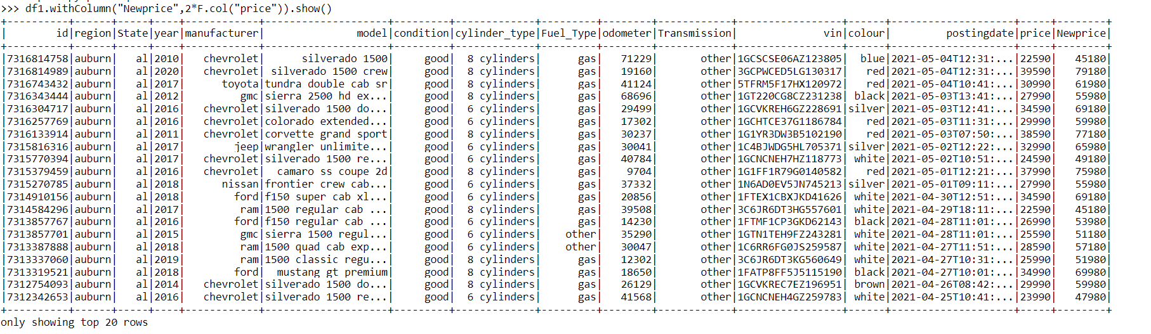
By 2021 the prices of cars increased 2 times than older prices . To add the new column for new prices. Command : df1.withColumn(“Newprice”,2*F.col(“price”)).show()

Slide 11
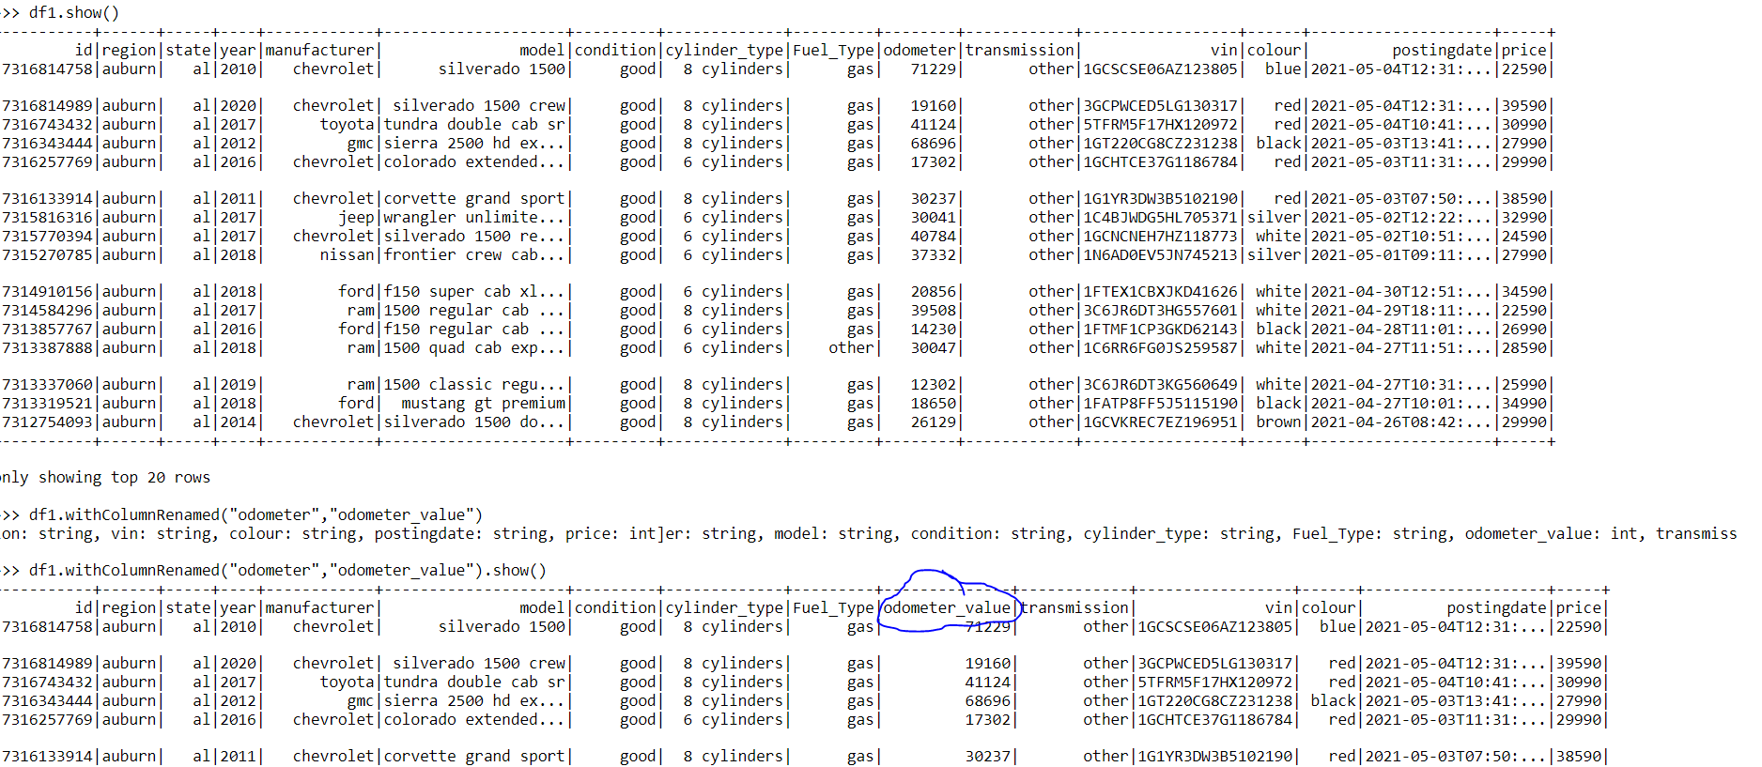
Renaming the existing column in data frame .Changed odometer column into odometer value. Command : df1.withColumnRenamed(“odometer” ,”odometer value”)

Slide 12
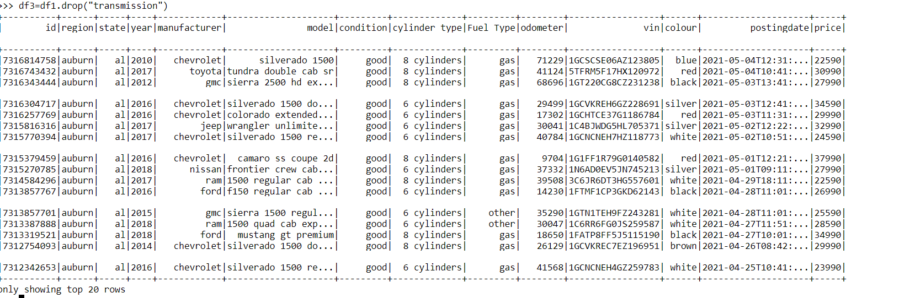
Dropping a column from the data frame. Command : df3 = df1.drop(“transmission”)

Slide 13
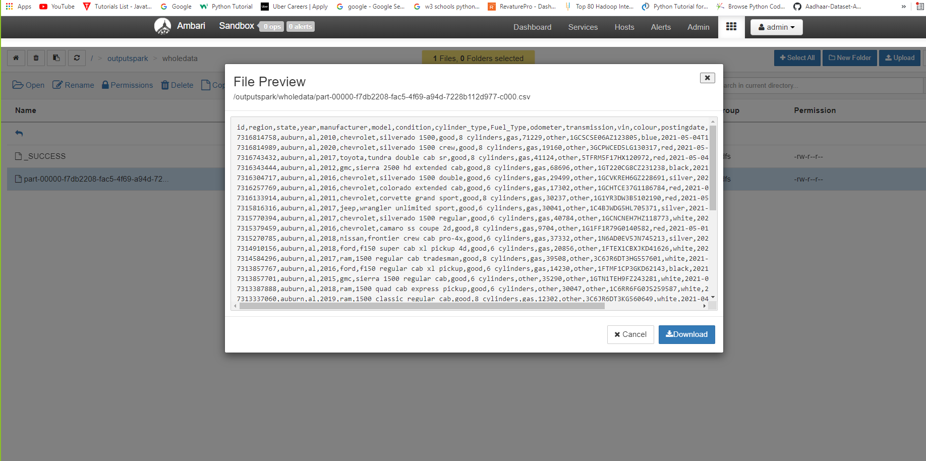
Moving data present in data frame into Ambari as a csv file. Command : df2.coalesce(1).write.options(header=‘True’,delimiter=‘,’).csv(“path”)

Slide 14
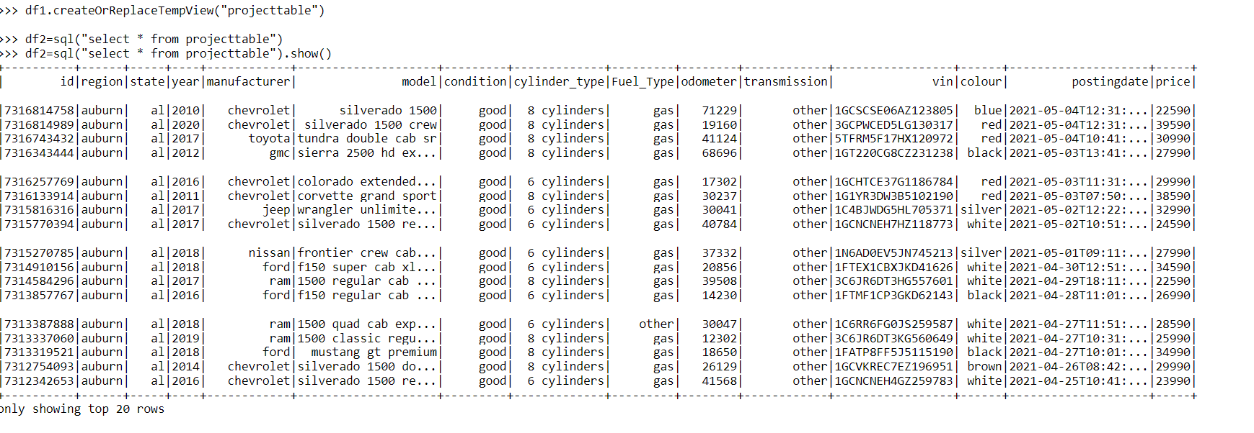
Creating a View or temporary table to perform some SQL queries on the data present in data frame. Command : df1.createOrReplaceTempView(“project table”) QUERY : df2=spark.sql(“select * from project table”)

Slide 15
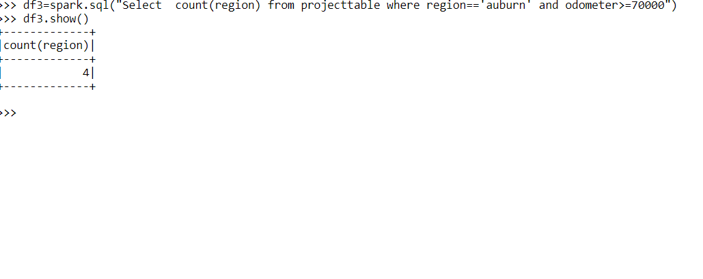
To get the count of cars from region “auburn” which covered a distance greater than 70000 using SQL query. Query : df3=spark.sql(“select count(region”) from projecttable where region=‘auburn’ and odometer > = 70000”).show()

Slide 16
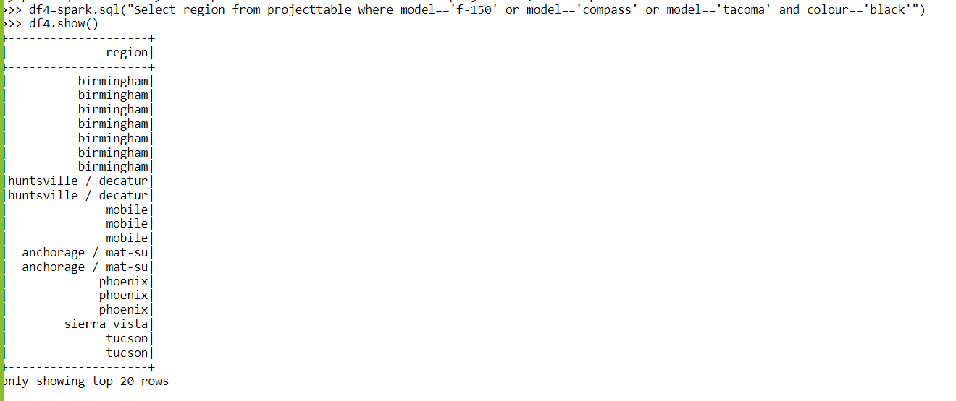
To get the region where the models ‘f-150’ or ‘compass’ , ‘Tacoma’ were available in black color using SQL query. Query : df4=spark.sql(“select region from project table where model=‘f-150’or model=‘compass’ or model = ‘tacoma’ and color = ‘black’)

Slide 17
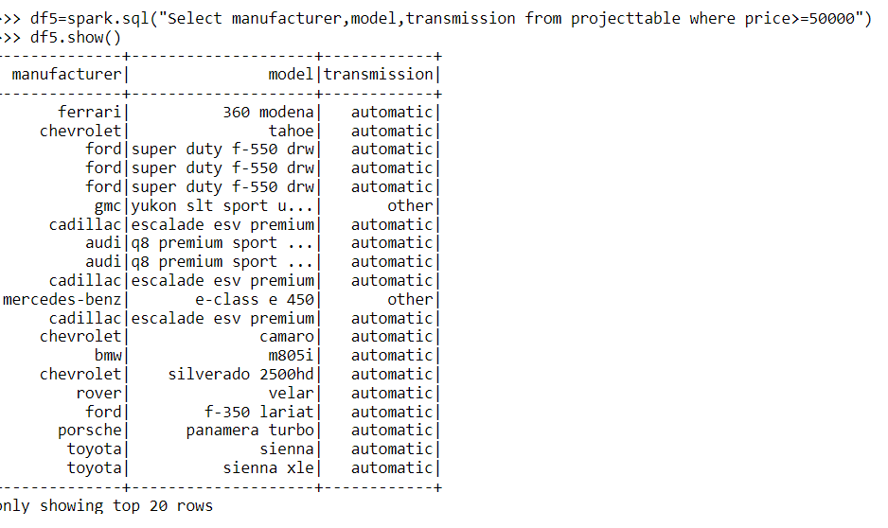
To get data of manufacturer ,model , transmission where price is greater than 50000. Query : df5=spark.sql(“select manufacturer ,model , transmission from project table where price >=50000”)

Slide 18
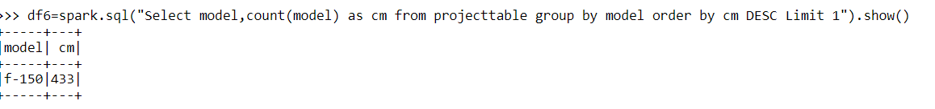
To get the model of the car which was purchased mostly. Query : df6=spark.sql(“select model , count(model) as cm from project table group by model order by cm DESC limit 1”).show()

Slide 19
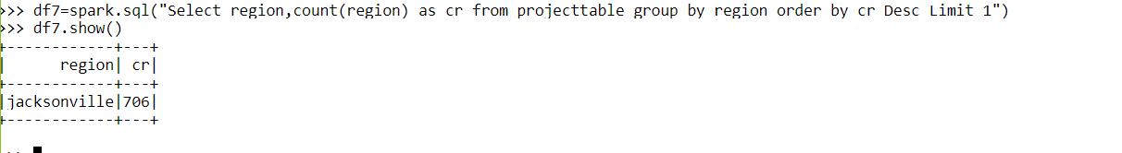
To know the region which is having the highest number of cars. Query : df7=spark.sql(“select region , count(region) as cr from project table group by region order by cr DESC Limit 1”)

Slide 20
To get the model and manufacturer mostly liked by Birmingham. Query :

Slide 21
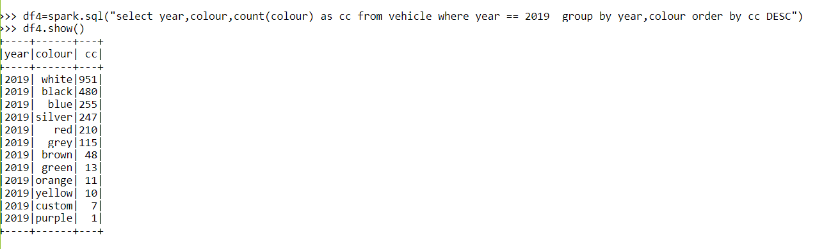
In a particular year which color cars are the most sold. Query : df4=spark.sql(“select year , color, count(color) as cc from vehicle where year==2019 group by year , color order by cc DESC”)

Slide 22
Count of cars posted in different years. Query : spark.sql(“selectsubstr(postingdate,0,4)count(substr(postingdate,0,4) from vehicle group by substr(postingdate,0,4) .show()

Slide 23
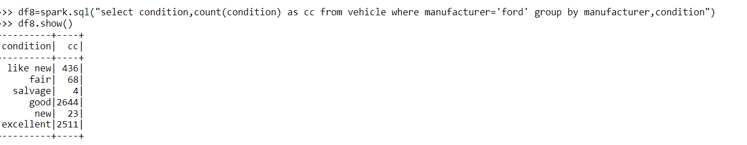
To get the count of cars according to their conditions in a particular year. Query : df8=spark.sql(“select condition , count(condition) as cc from vehicle where manufacturer=‘ford’ group by manufacturer , condition”).show()

Slide 24
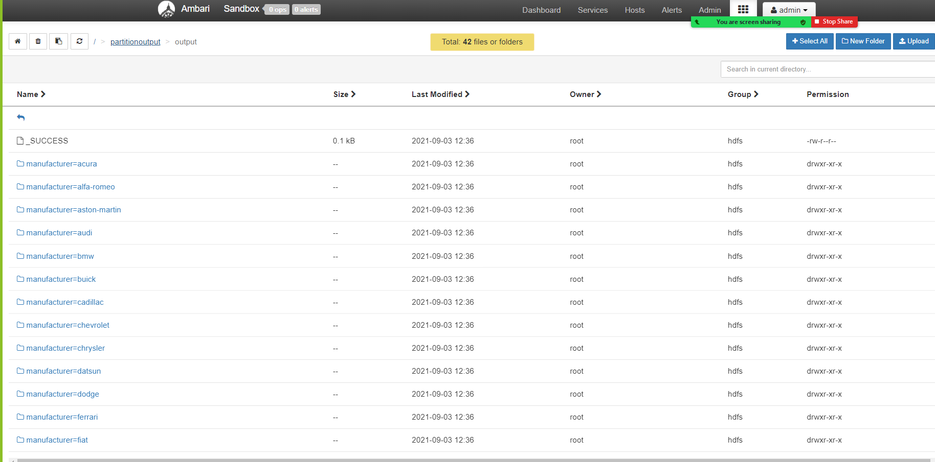
Partitioning data based on manufacturer and writing those partitioned files in the format of ‘csv’. Command : df.coalesce(1).write.partitionBy(‘manufacturer’).csv(‘path’).

Slide 25
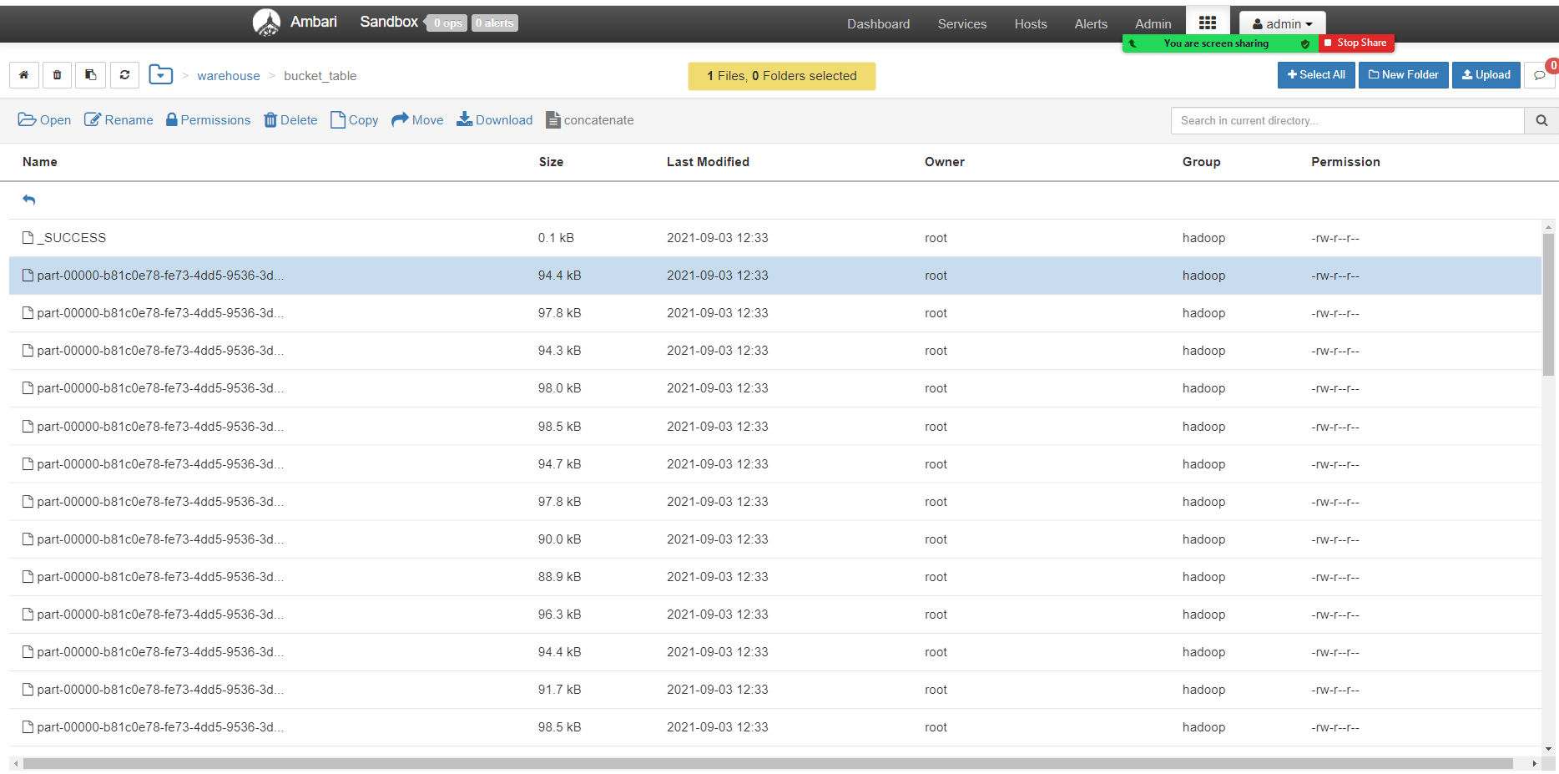
Bucketing the data into 50 buckets based on the column ‘id’. Command : df.coalesce(1).write.format(‘csv’).bucketBy(50,’id’).saveAsTable(“bucket table”)

Slide 26
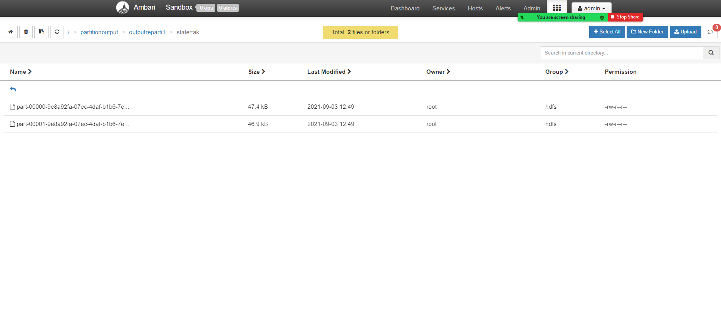
Repartitioning the partitioned file into two files using the function ‘REPARTITION’ in the data frame. Command : df.coalesce(1).repartition(2).write.option(“header”,”True”).partitionBy(‘state’).csv(“path”).

Slide 27
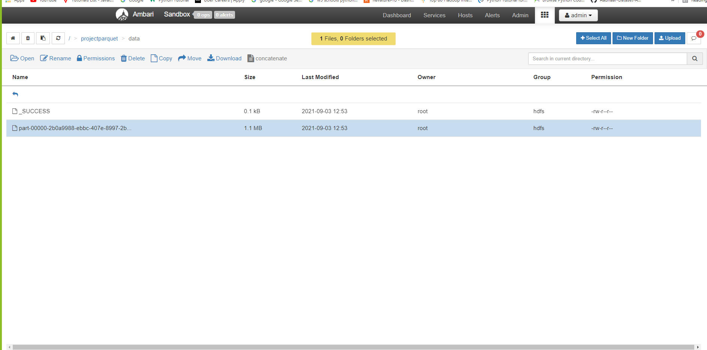
Writing the data into a parquet file. Command : df.coalesce(1).write.parquet(“/projectparquet/data”)

Slide 28
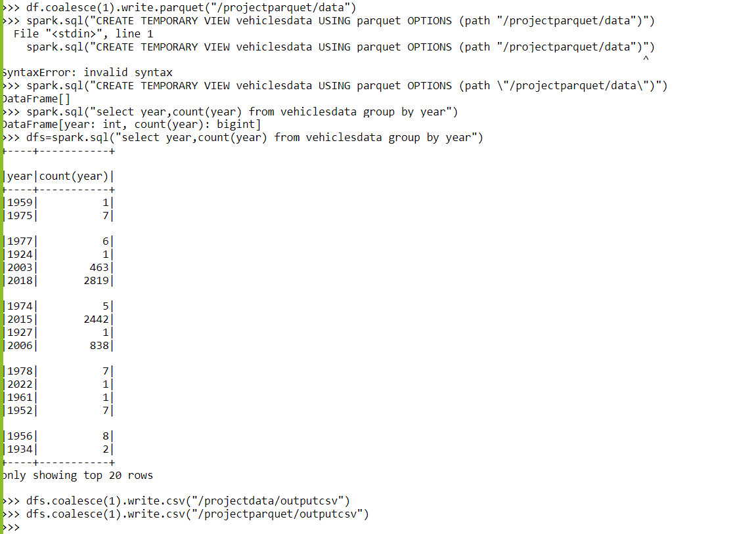
Performing some queries using SQL on the parquet file by creating a temporary table. And writing the query output into a csv file.

Slide 29
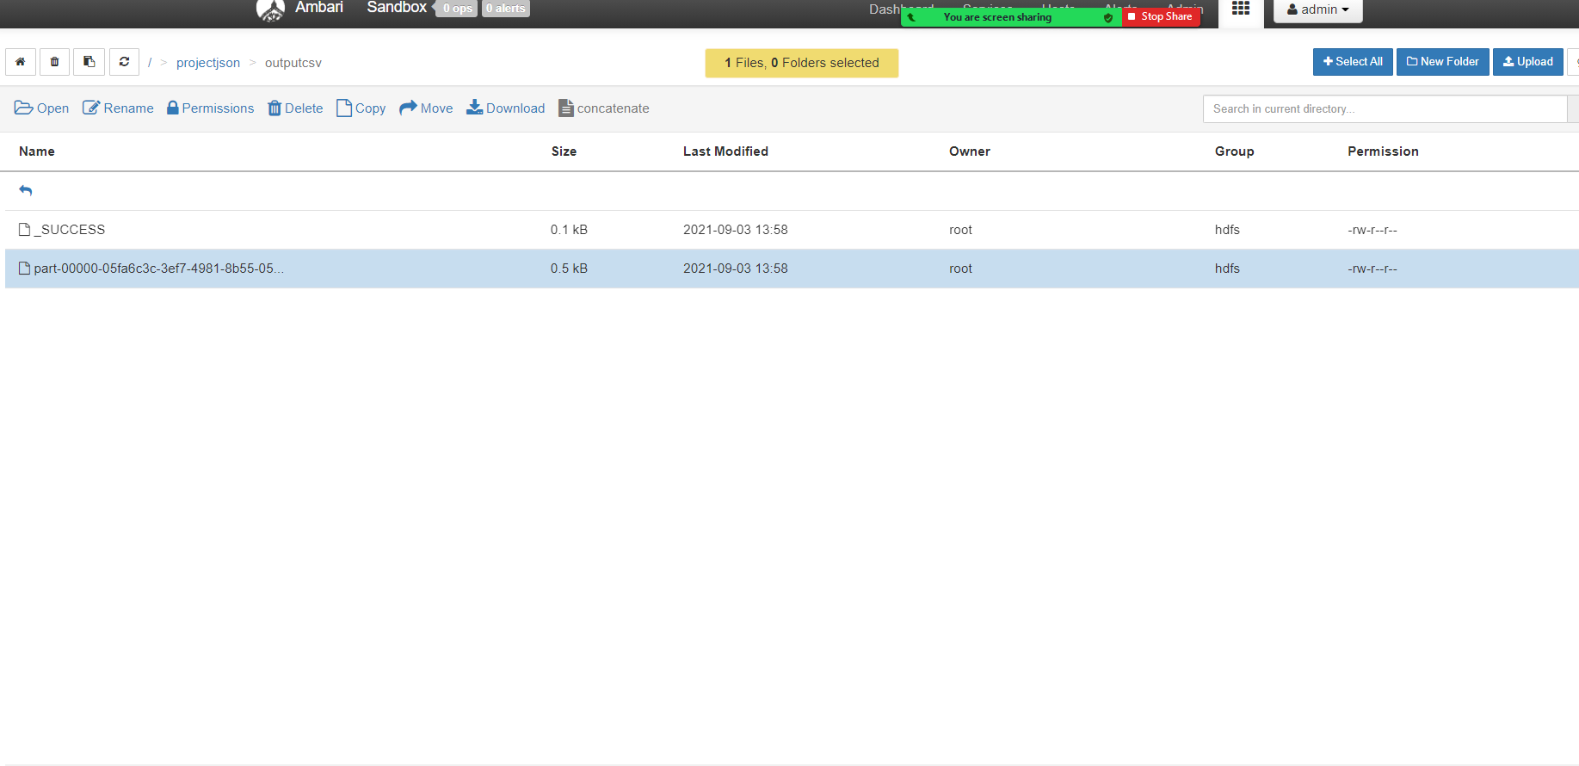
Writing the data in data frame into json file. Command : df.coalesce(1).write.json(“path”)

Slide 30
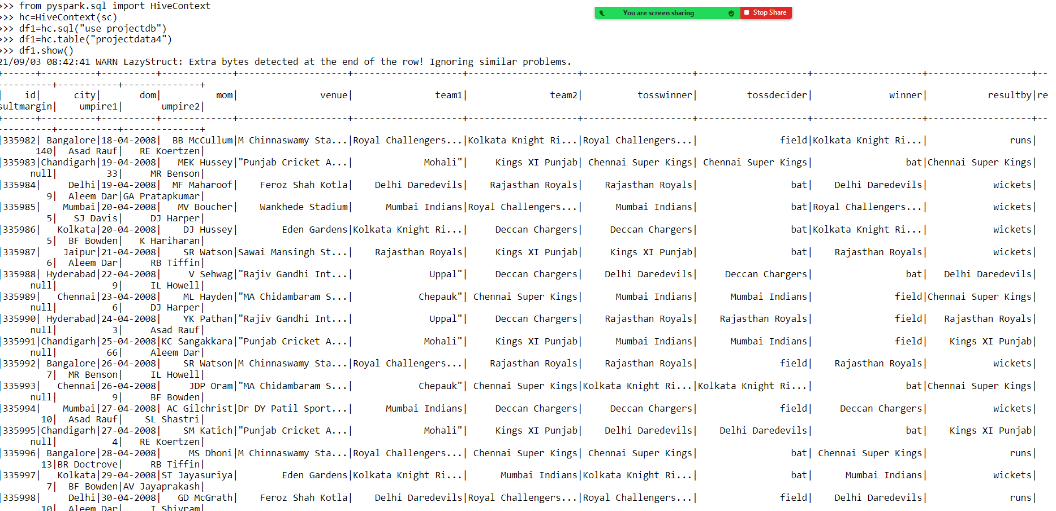
To get the data present in hive into spark data frame and perform some functions.

