Slide 1
PROJECT-1
WEATHER DATASET ANALYSIS USING HIVE AND HDFS
By:-Sunil Gupta

Slide 2
PROJECT DESCRIPTION
Here, we will write a Hive program for analyzing weather datasets to understand its data processing programming model. Weather sensors are collecting weather information across the globe in a large volume of log data. This weather data is semi-structured and record-oriented.
This data is stored in a line-oriented ASCII format, where each row represents a single record. Each row has lots of fields like longitude, latitude, daily max-min temperature, daily average temperature, etc. for easiness, we will focus on the main element, i.e. temperature. We will use the data from the National Centres for Environmental Information(NCEI). It has a massive amount of historical weather data that we can use for our data analysis.

Slide 3
INSIGHTS NEEDED-
1-To see dataset of weather
2-Total number of record in the dataset
3-Finding maximum temperature
4-Finding minimum temperature
5-Counting Total number of countries from dataset
6-Country with Maximum longitude
7-country with temp>=50 and temp<=60
8-To get the count of states in countries where fog=‘1’

Slide 4
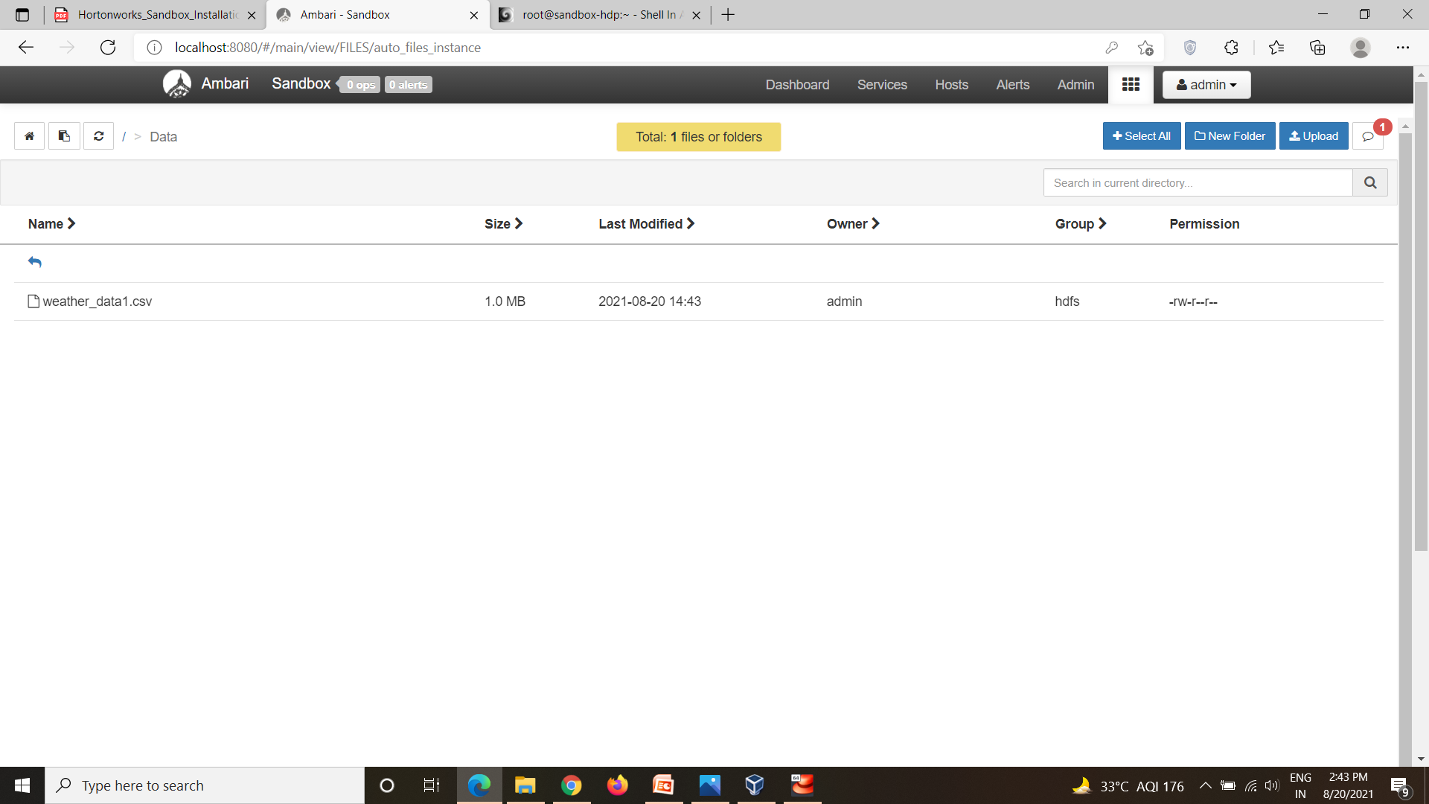
LODING DATASET INSIDE HDFS

Slide 5
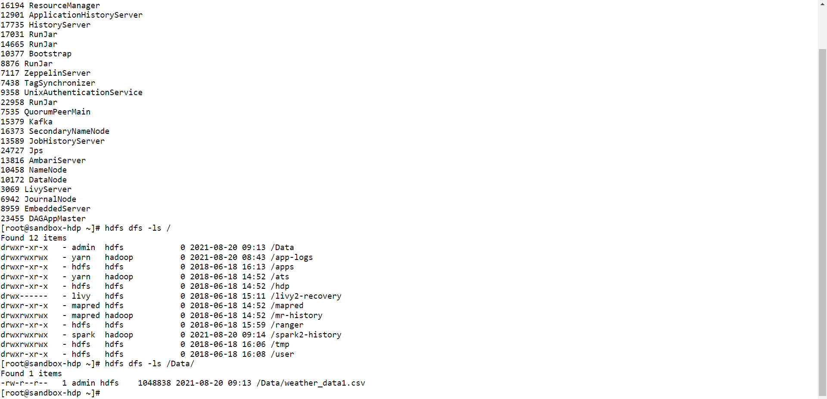
LIST OF FILES INSIDE HDFS

Slide 6
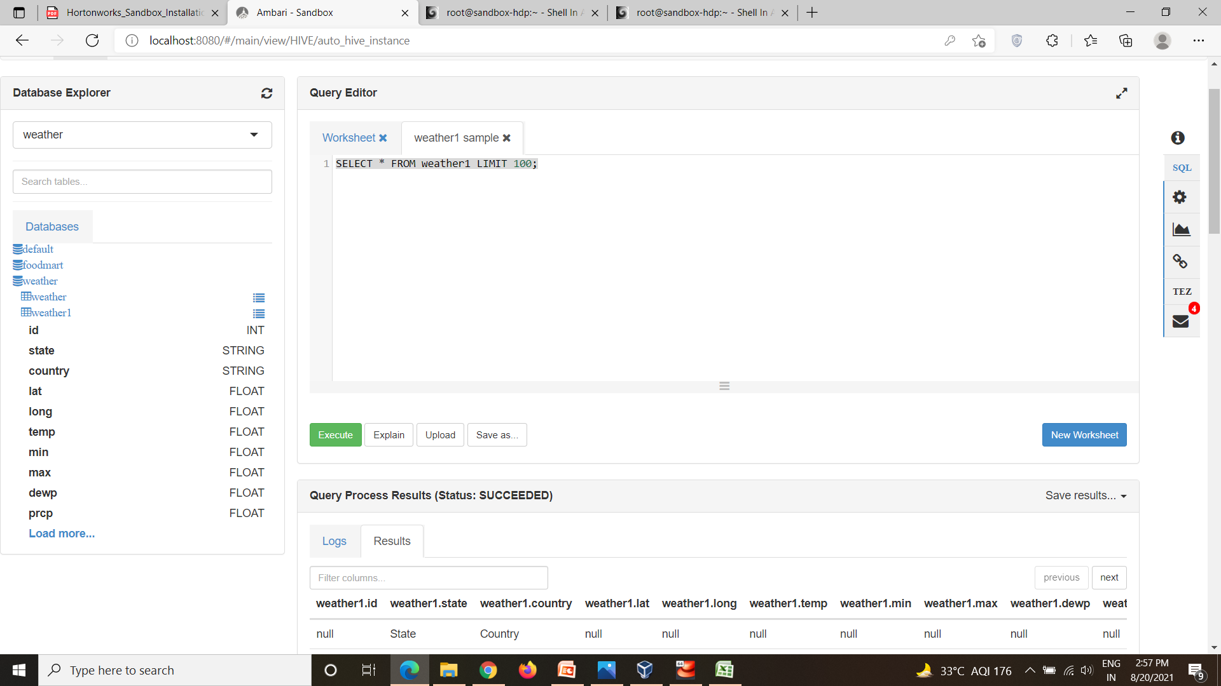
LOADING DATASET FROM HDFS TO HIVE

Slide 7
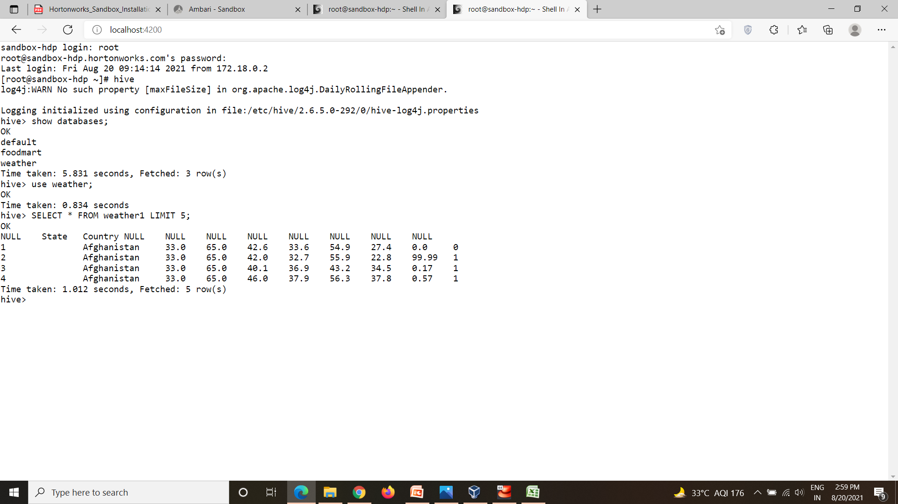
1-To see dataset of weather Syntax:-select * from weather1 limit 5;

Slide 8
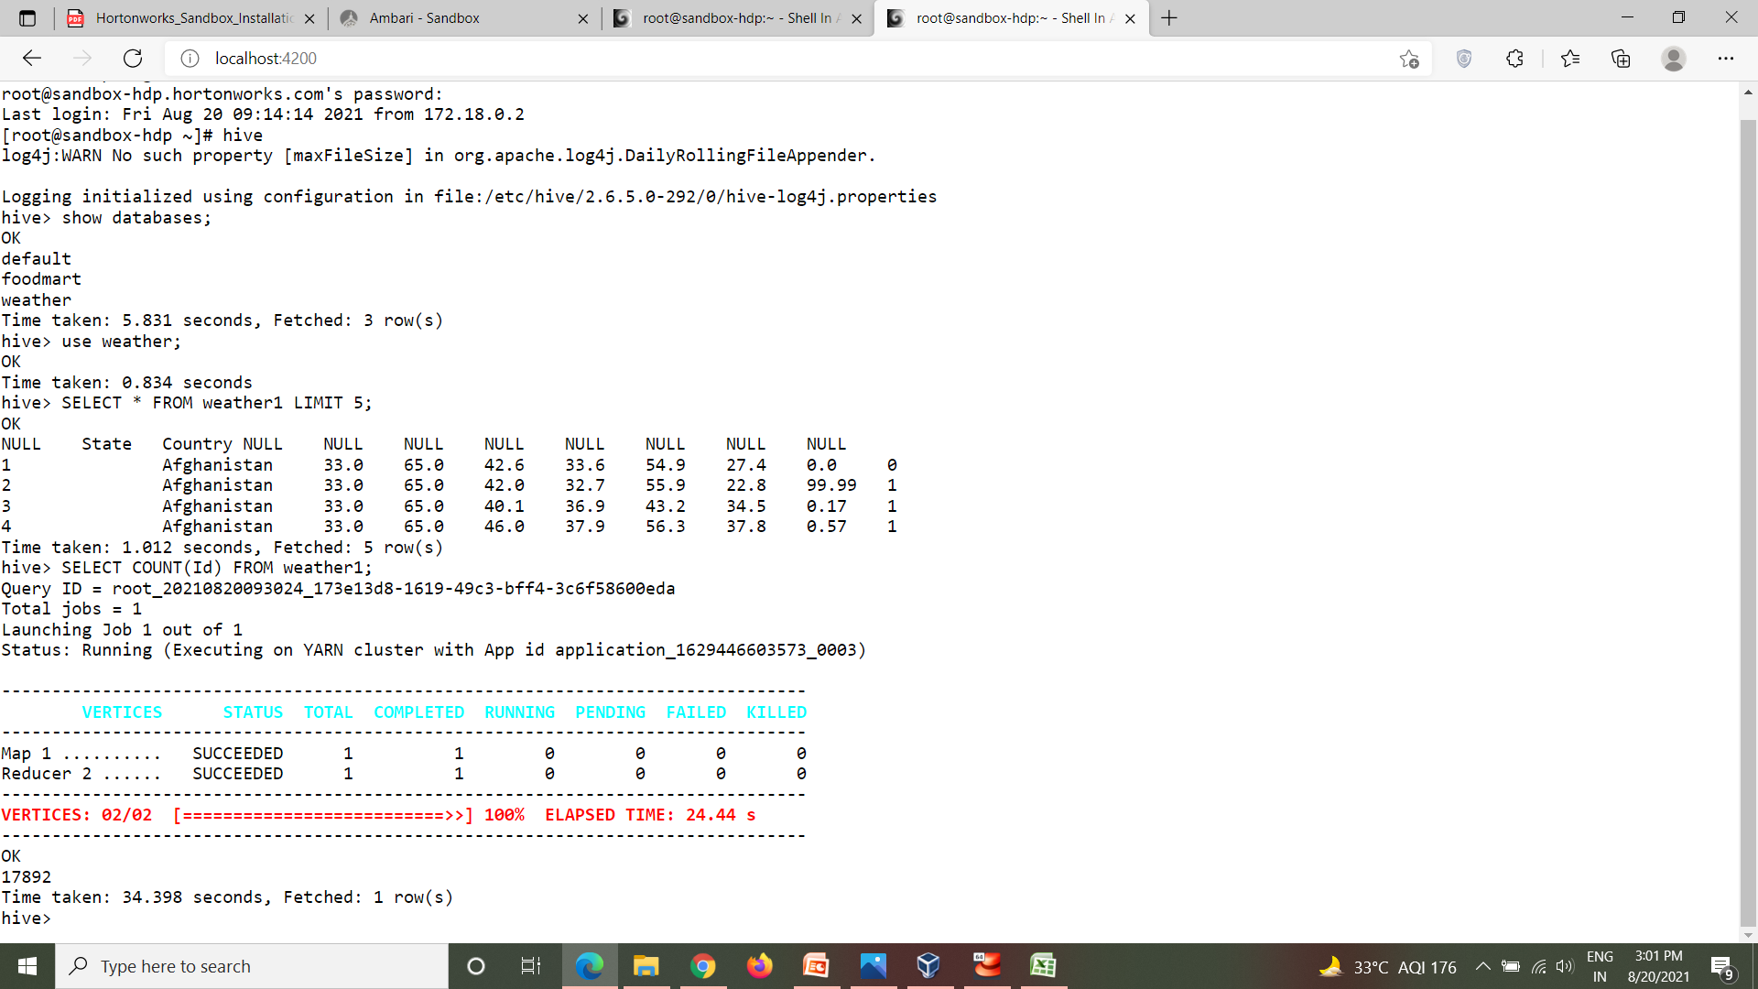
2-Total number of record in the dataset Syntax:-select count(Id) from weather1;

Slide 9
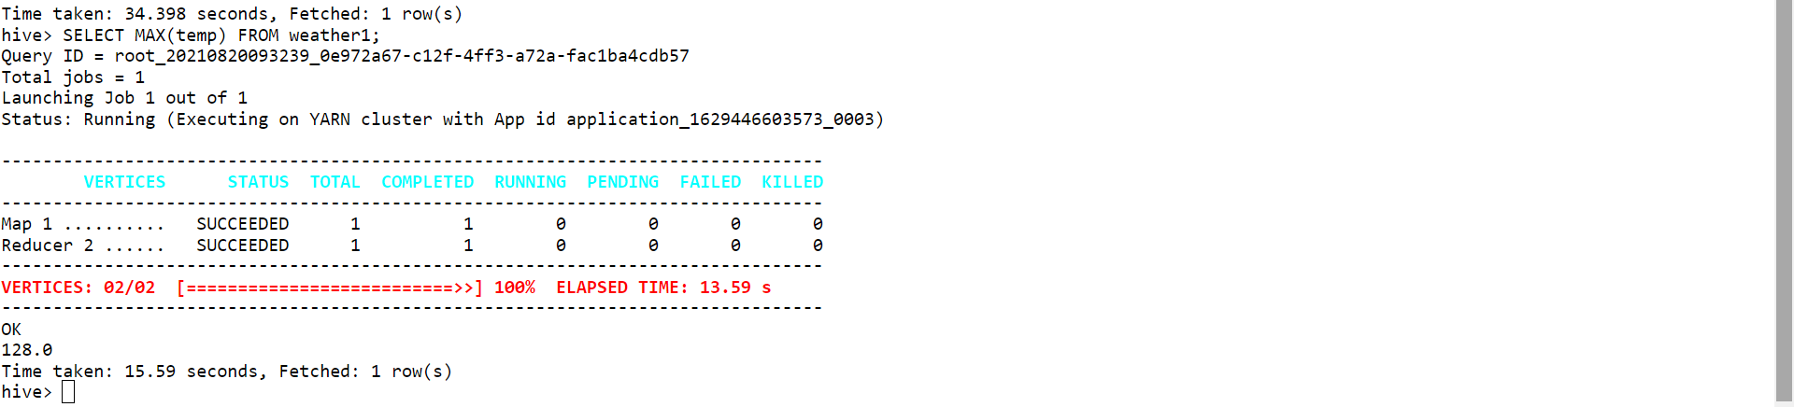
3-Finding maximum temperature Syntax:-select max(temp) from weather1;

Slide 10
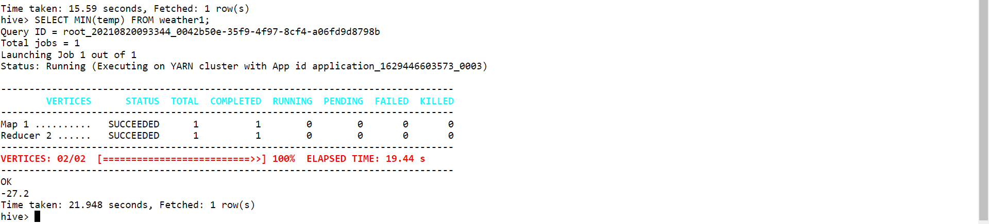
4-Finding Minimum temperature Syntax:-select min(temp) from weather1;

Slide 11
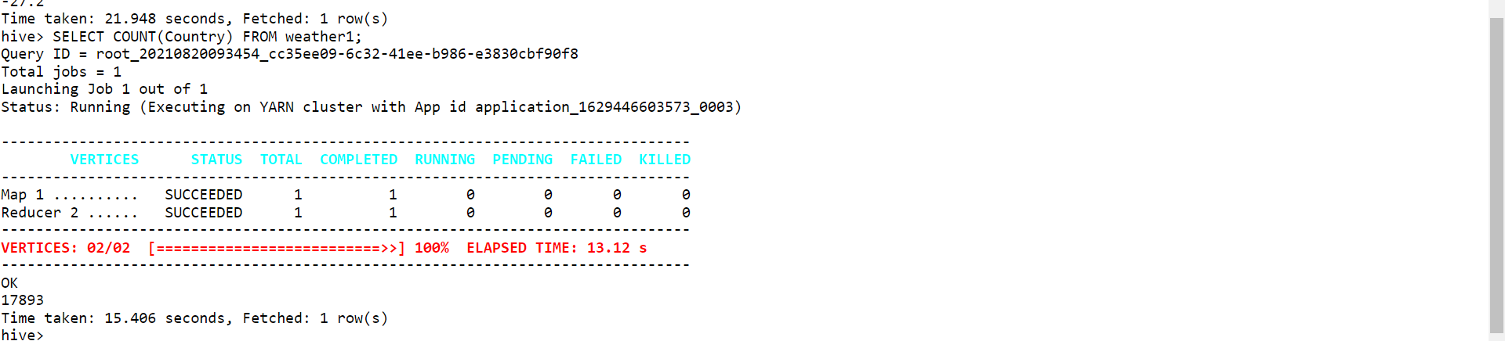
5-Counting Total number of countries from dataset Syntax:-select count(Country) from weather1;

Slide 12
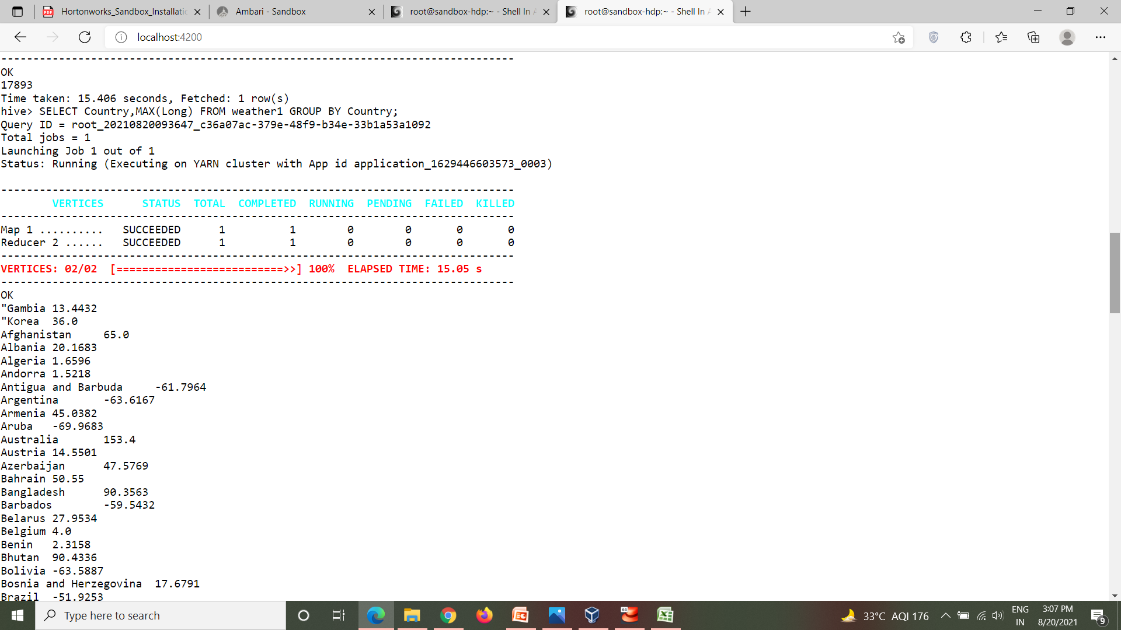
6-Country with Maximum longitude Syntax:-select country,max(Long) from weather1 group by country;

Slide 13
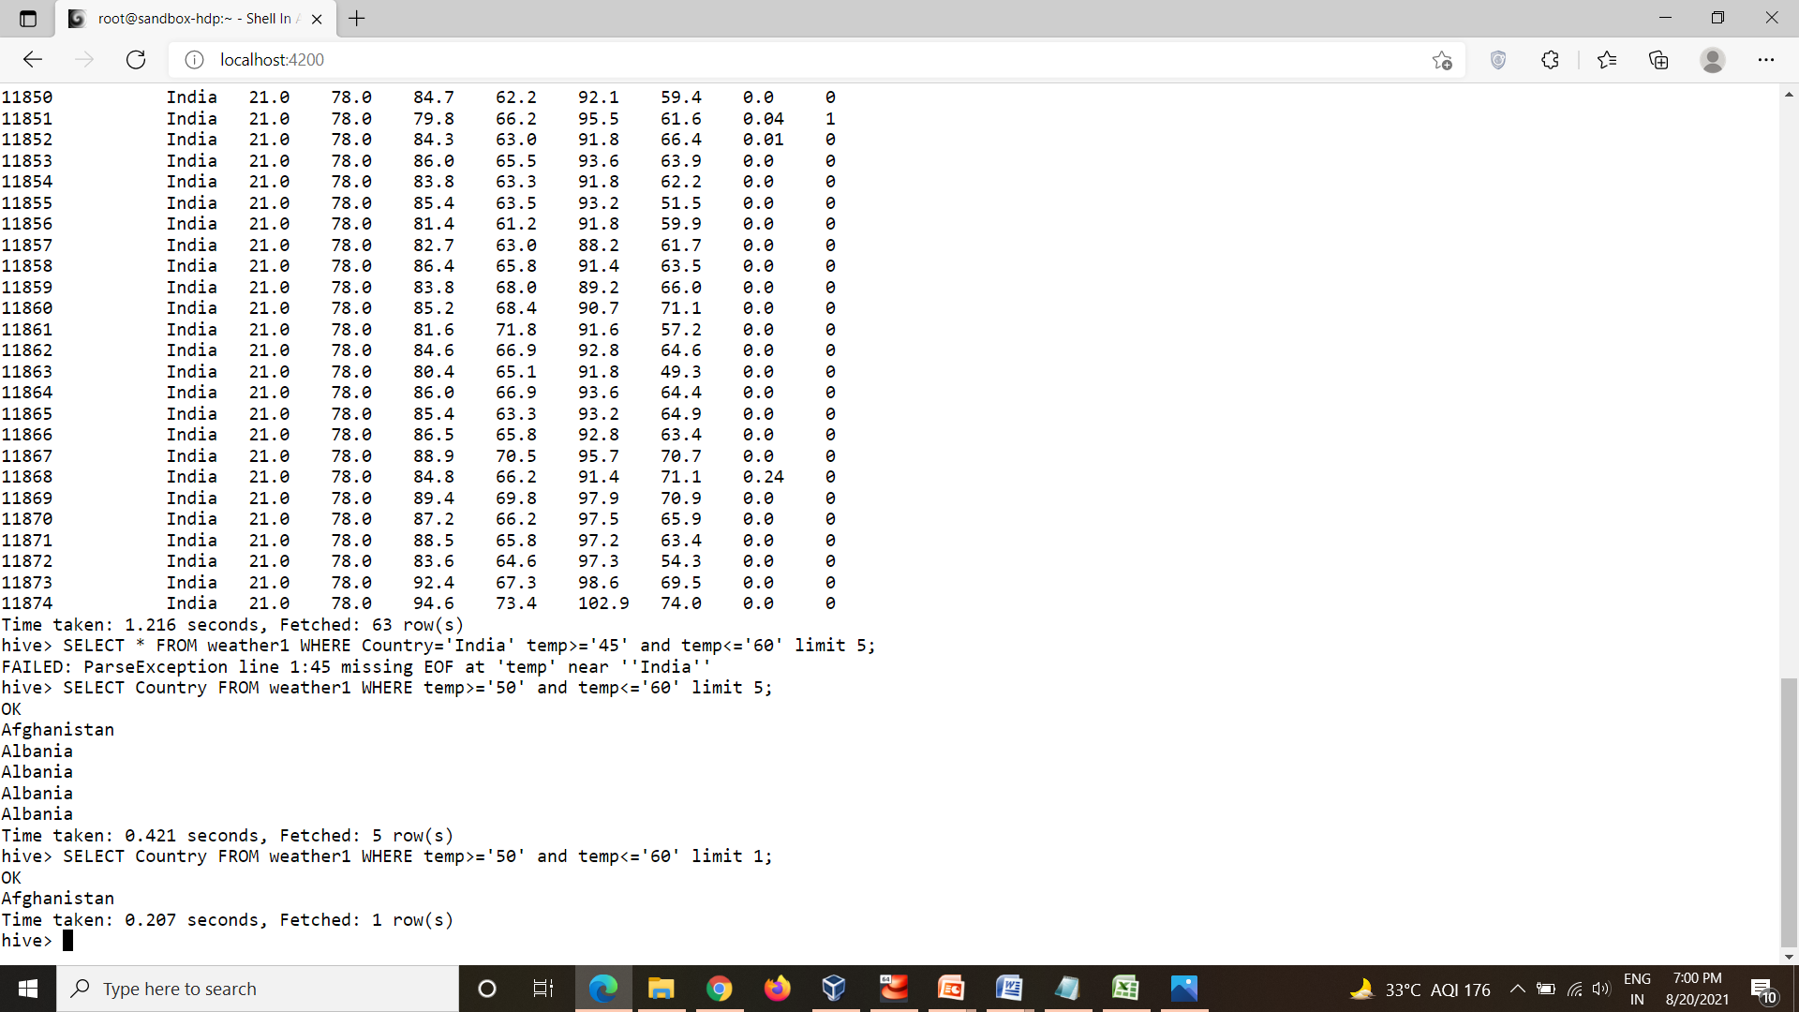
7-country with temp>=50 and temp<=60 Syntax:-select country from weather1 where temp>=‘50’ and temp<=‘60’ limit1;

Slide 14
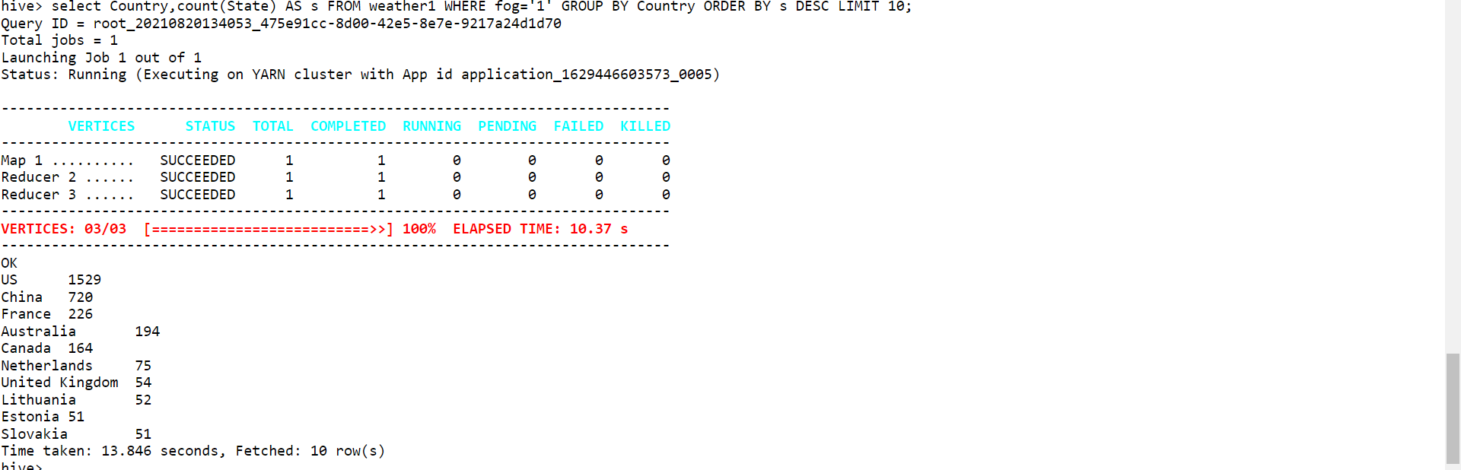
8-To get the count of states in countries where fog=‘1’ Syntax:-select country,count(state) AS s from weather1 where fog=‘1’ group by country order by s DESC limit 10;

