Slide 1

MALARIA DISEASE DETECTION
Group 17
Preksha Rai- B.Tech CSE 1805231039
Poonam Agrawal- B.Tech CSE 1805213036
Anjali Shivhare- B.Tech CSE 1805213010
Under the Supervision of
Dr Parul Yadav
Dr Jasvant Kumar
Department of Computer Science and Engineering
Institute of Engineering and Technology
Dr. A.P.J. Abdul Kalam Technical University, Lucknow, Uttar Pradesh

Slide 2
MALARIA DISEASE
Malaria is a dangerous disease that is caused by parasites that are transmitted to people through the bites of contaminated female Anopheles mosquitoes.
According to the World Health Organization, In Africa 228 million active instances, and 405000 deaths in 2020. Malaria is very severe in Africa as clearly visible from the data.
So, these facts have encouraged us to take up this project work. Malaria Detection using ML(Deep Learning) would not only benefit Healthcare but also help in our academics as Machine Learning is the new boon in the industry.

Slide 3



PROBLEM STATEMENT
The project aims to detect malaria disease based on the data set given consisting of parasitized and uninfected Images.
Firstly, we have trained and tested the VGG16 model using back propagation technique then we have implemented the MobileNet(150CNN) model.
At last, the image is Parasitized if output is ‘0’ and Uninfected if output is ‘1’.

Slide 4
MALARIA DISEASE DETECTION USING DEEP LEARNING
The technology used in our project is Deep Learning and Convolution Neural Network. Deep Learning functions just like human brain does. No explicit programming is done.
A CNN is a feed-forward neural network, often used to analyse visual images with a grid-like matrix by processing data. It is also known as ConvNet. A convolution neural network is used for classification and detection of objects in an image.
In this project, we have used 150CNN model of CNN to do the classification of images whether they are parasitized or uninfected.

Slide 5
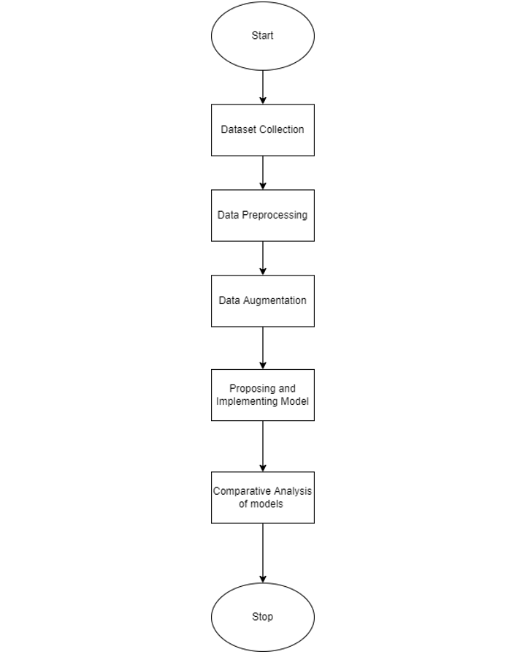
METHODOLOGY FLOWCHART

Slide 6
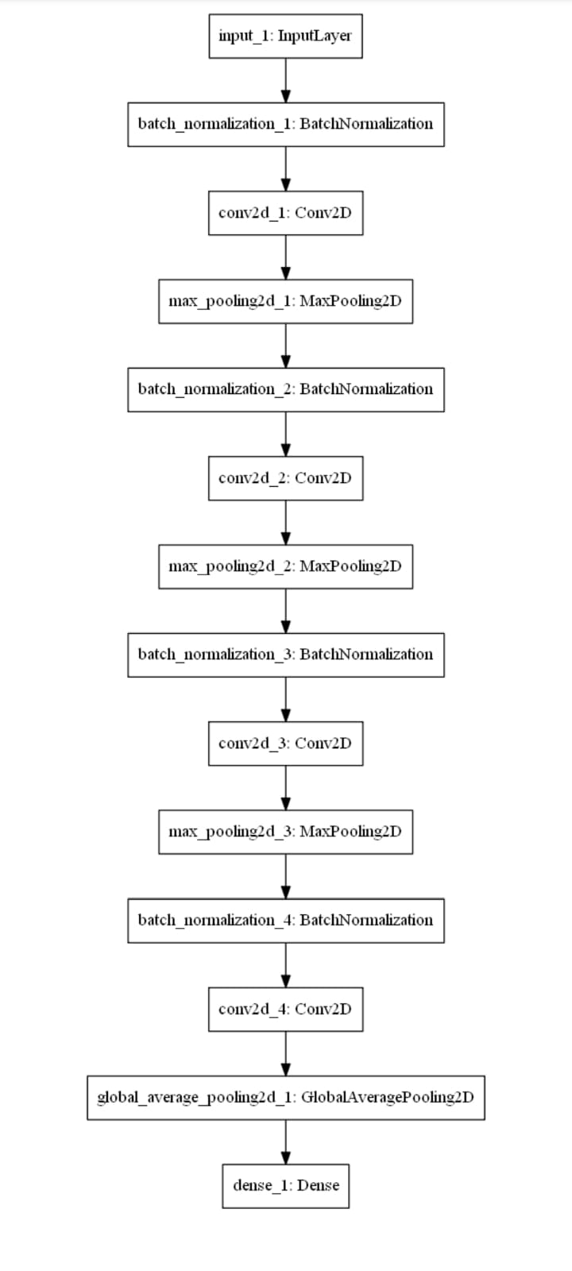
150CNN

Slide 7
MODULES
Interface of the application
01
Input dataset and perform augmentation and split it.
02
Testing of the model.
04
Experimental result.
05
Training of the model.
03

Slide 8
INTERFACE OF THE PROJECT
We have used Google Colab to run our code.
Colab allows anybody to write and execute arbitrary python code through the browser, and is especially well suited to machine learning, data analysis and education.
The output is displayed through a web application.

Slide 9
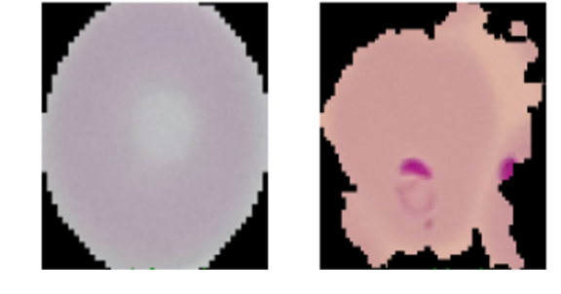
INPUT FORMAT

Slide 10
DATASET
The total size of the dataset is 27,560.
TRAINING:
Parasitized: 11,024 Uninfected: 11,024.
TESTING:
Parasitized: 2,756 Uninfected: 2,756.
Before passing the image to the model, it is augmented using techniques such as rescaling, shear, zoom and horizontal flip.

Slide 11
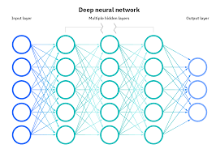
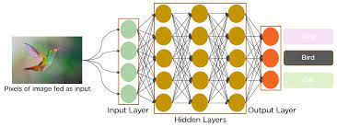
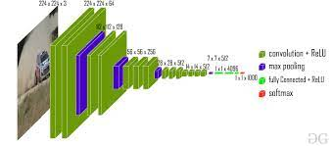
TRAINING OF THE MODEL
MobileNet model has 27 Convolution layers.
It consists of 13 depthwise Convolution, 1 Average Pool layer, 1 fully connected layer and a final layer for softmax function.
VGG16 model is composed of 13 Convolution layers, 5 max-pooling layers and 3 fully connected layers.
The models are trained using back propagation and the loss function is minimised.
Firstly, we have implemented the exisiting model , that is, VGG16 then constructed 150CNN from MobileNet by changing the 40 layers.

Slide 12
TESTING OF THE MODEL
The image of input size : (150,150,3) is provided.
After the data augmentation, the image is fed to the 150CNN model.
The input image is passed through various convolution layers, max pooling layers and Batch Pooling layers to finally classify it as to whether parasitized or uninfected.
The result is displayed at ‘0’ if Parasitized or ‘1’ if Uninfected.

Slide 13
EXPERIMENTAL WORK
Comparison of Model’s accuracy
Architecture | Training Accuracy(%) | Training Loss | Validation Accuracy(%) | Validation Loss
VGG16 | 93.99 | 0.1751 | 90.64 | 0.2976
150CNN | 94.17 | 0.1701 | 93.06 | 0.2387
150CNN model turned out to be better than VGG16 in terms of accuracy and performance.
Accuracy of 150CNN : 93.06%

Slide 14
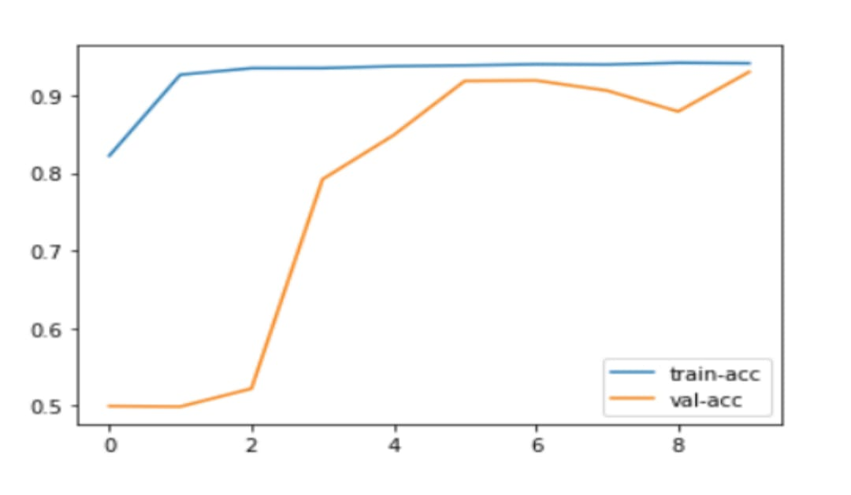
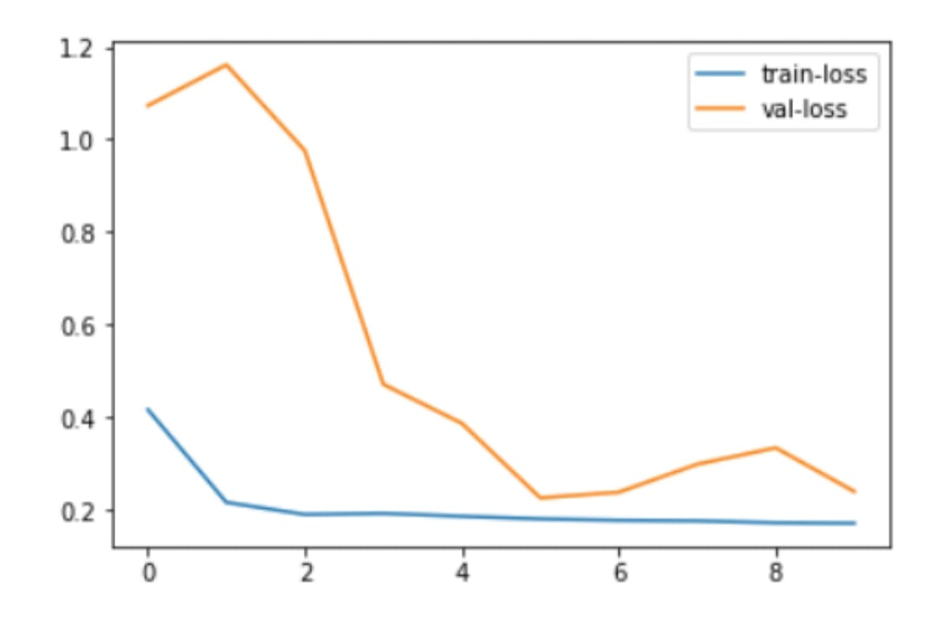
PLOT
Accuracy Plot of 150CNN Model
Loss Plot of 150CNN Model
It is the plot of accuracy vs epoch comparing training accuracy and validation accuracy of 150CNN.
It is the plot of loss vs epoch comparing training loss and validation loss of 150CNN.

Slide 15
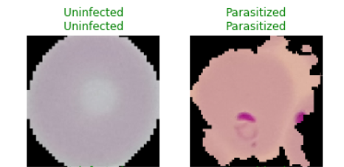
OUTPUT FORMAT

Slide 16
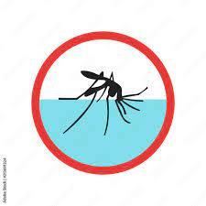
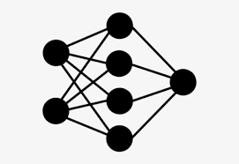

FUTURE SCOPE
IMPLEMENTING OUR PROJECT USING OTHER MODELS SUCH AS RESNET50, ALEXNET, ETC FOR BETTER ACCURACY.
USINGN THE MODEL FOR MULTI-STAGE MALARIA DETECTION.
Training the model for DETECTION OF OTHER DISEASES AS WELL.

Slide 17


