Slide 1
A PROJECT ON MULTILABEL IMAGE CLASSIFIER
Submitted By:- Gaurish Gupta 1805210021
Kashika Adarsh 1805210024
Varun Saini 1805210062
Nikhil Jamwal 1805210030
Under the Guidance Of:- Dr. Manik Chandra
Ms. Mudita Sharan

Slide 2
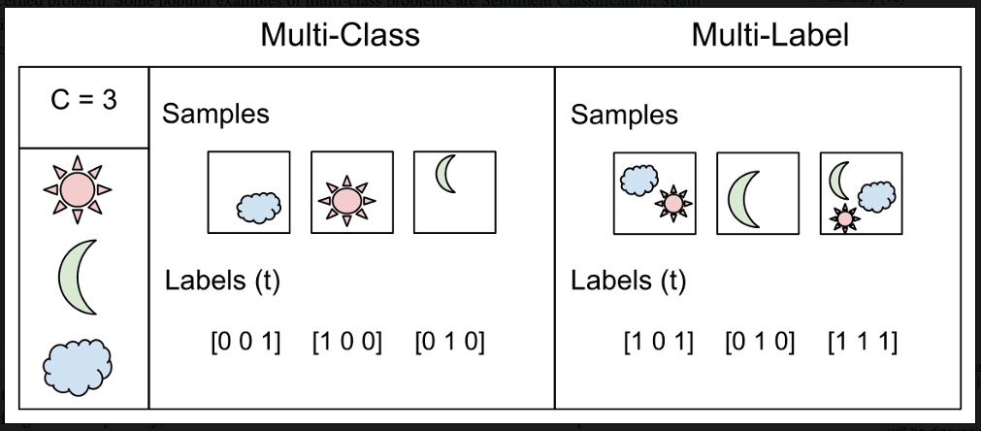
INTRODUCTION:-
Multi-label classification is a classification task where each image can contain more than one label, and some images can contain all the labels simultaneously.
Current project is aimed at using different machine learning models, to analyze different data points to help get reasonable labels to an image on different machine learning models.
Difference between Multi-class and Multi label

Slide 3
OBJECTIVE:-
To create a web-application for image classification.
By deploying a CNN with RNN model for multi-label image classifier.
Our application will predict the possible genres of a movie by taking movie poster as an input.
Filtering out the top three genres that a movie can have.

Slide 4
MOTIVATION
Huge volumes of data,differing in form is being generated which creates a need to classify them effectively.
It is very difficult to predict the genre from a single poster so our app will take use multiple posters for accurate prediction.
Using the accuracy levels of machine learning techniques image classification problem can be solved very effectively.

Slide 5
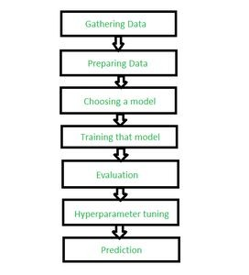
METHODOLOGY
The major steps involved in creating a Image classifier includes:
Data collection.
Models.
Training.
Testing.
Web app integration.
Deployment.

Slide 6
DATA COLLECTION
1. For Training Purpose-
-> Kaggle Dataset
For Testing-
-> Building our own dataset for testing.
-> Use bing image downloader Python Library.

Slide 7
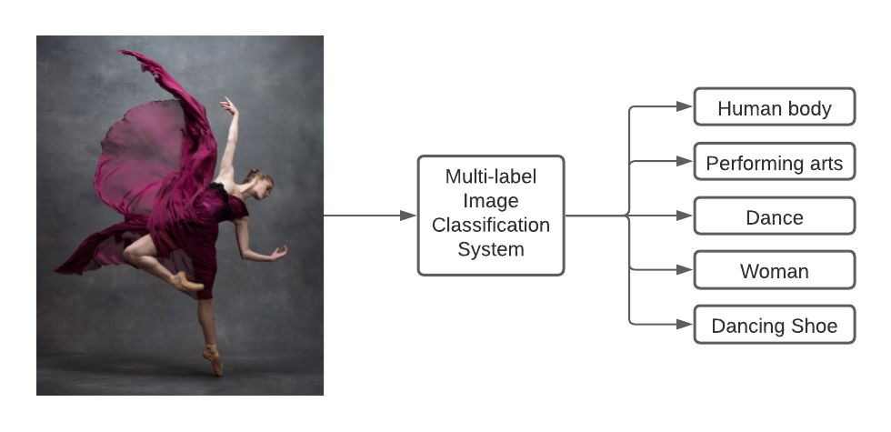

MULTILABEL IMAGE CLASSIFICATION
Action 91%
Adventure 85%
Sci-fi 72%
Fantasy 59%
War 46%

Slide 8
Models:-
There are various architectures of CNNs available and researched which have been key in building algorithms which power and shall power AI as a whole in the foreseeable future.
Three ways are there that can be used for Multi label Image Classification -
CNN
CNN with RNN
CNN with LSTM
Experimental results on public benchmark datasets demonstrate that the CNN with RNN architecture achieves better performance only CNN

Slide 9
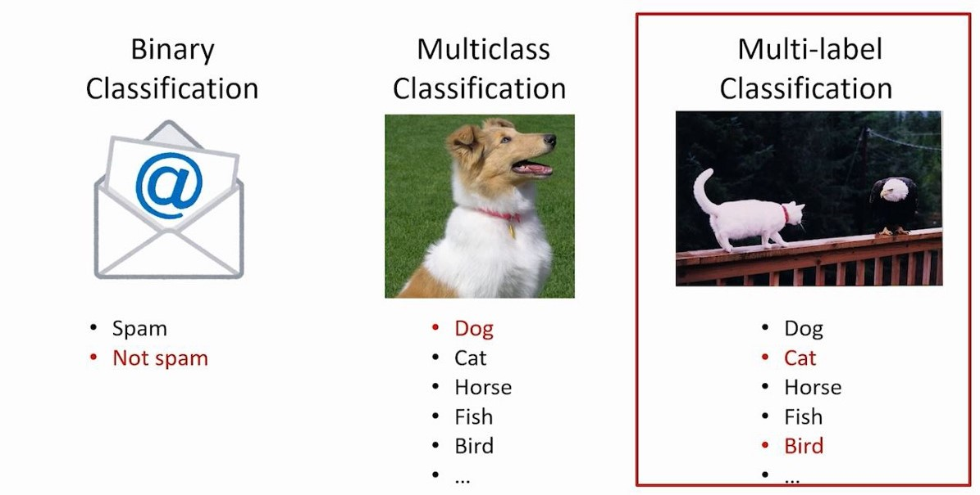
TRAINING:-
It requires majorly 4 things -
Object detection.
Image segmentation.
Image Translation.
Object tracking in real time.

Slide 10
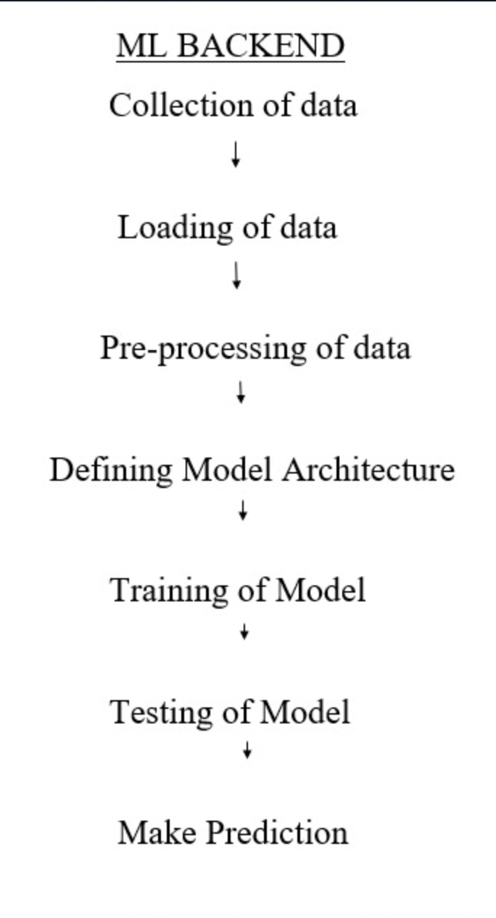
WORKING -
Load and Pre-process the data.
Define the model architecture.
Train and Test the model.
Make Prediction and filter images.
DEPLOYMENT -
It will be deployed using MERN Stack.
Users can enter multiple images at a single click and there are some predefined filters as well in the frontend to make it clear.

Slide 11
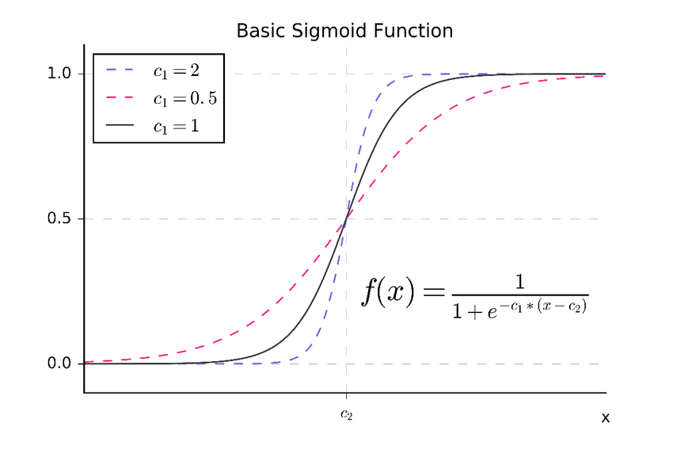
ACTIVATION FUNCTION:-
Sigmoid Function-
A Sigmoid function is a mathematical function which has a characteristic S-shaped curve. There are a number of common sigmoid functions, such as the logistic function, the hyperbolic tangent, and the arctangent.

Slide 12
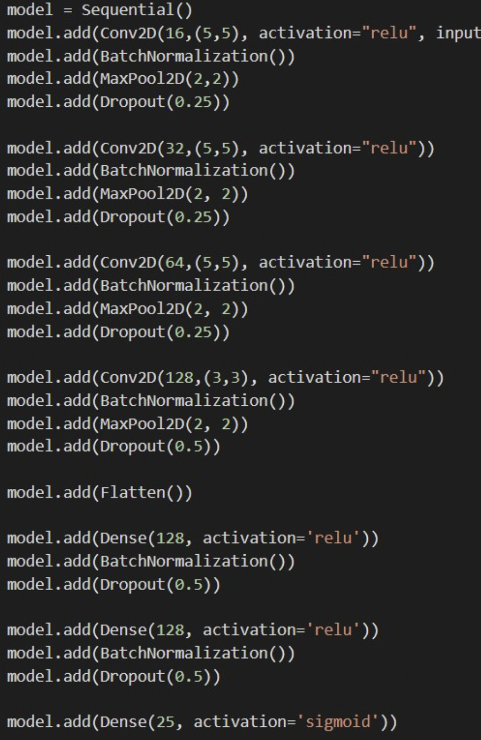
Implementation
The model is implemented using 3 CNN Layers.
Used Conv2D, Maxpool2D, Flatten and Dense as layers.
Whole Model is implemented using Kernel size of 5*5.
Used relu as Activation function as every layer.
Sigmoid for last layer.

Slide 13

LOSS FUNCTION:-
Binary Cross Entropy Function-
Cross-entropy is commonly used in machine learning as a loss function.
Cross-entropy is a measure from the field of information theory, building upon entropy and generally calculating the difference between two probability distributions. It is closely related to but is different from KL divergence that calculates the relative entropy between two probability distributions, whereas cross-entropy can be thought to calculate the total entropy between the distributions.

Slide 14
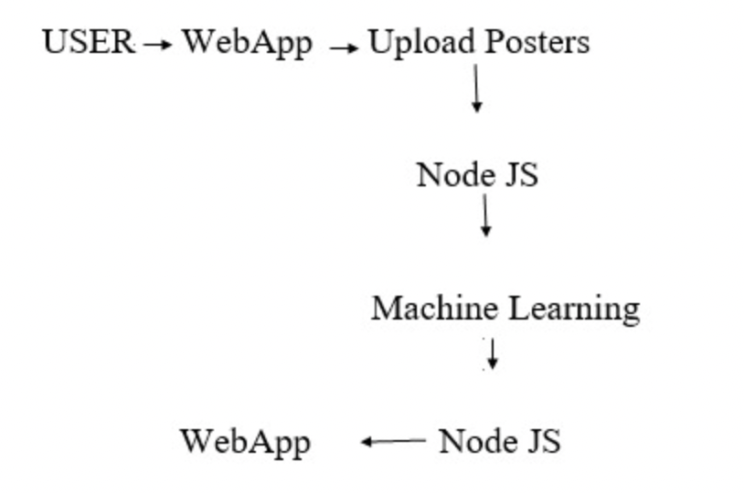
Backend Intergration & Deployment
MERN Stack is being used for web application.
API rate limiter is present on the server side.
Caching has been done on client side.
Application will be deployed on Heroku.

Slide 15
Tools And Technologies -
Python
Jupyter Notebook
Deep Learning Algorithm - CNN
Keras and Tensorflow
VGG19
Matplotlib
MERN Stack

Slide 16
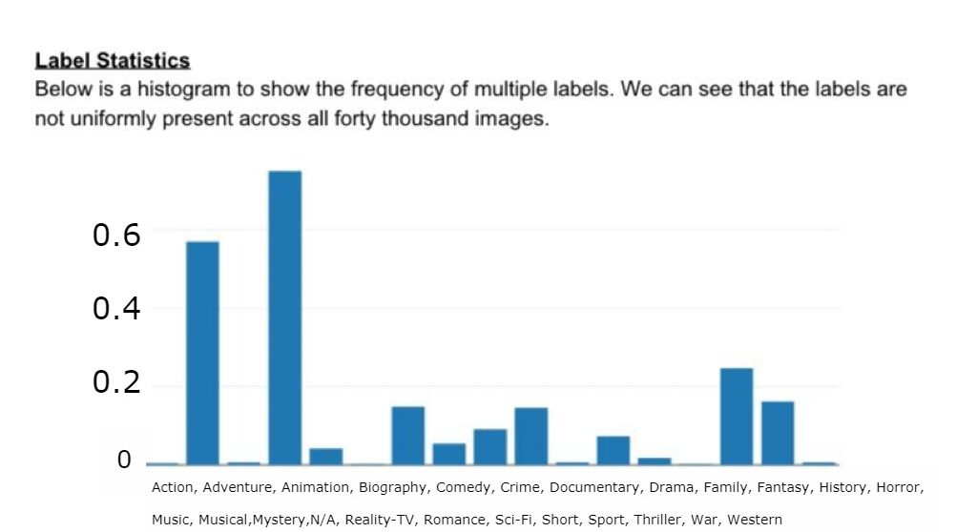
Experimental Results
The Kaggle Dataset in consists of more than 50000 images to train and test our model
We used ten thousand images for the purpose as the constraints of system software.
For which we trained our model using 85% of images for training and rest images for testing purposes.
Caption
Caption

Slide 17
CONCLUSION
After implementing the model and deploying it, the user can upload multiple posters of a movie to get accurate genre information.
It will help user to find out genre from posters instead of searching it online.
It will be useful to all kinds of movie posters.
Users can use our app to save their time or in case of no network connection.
We will be evaluating the datasets by checking the loss and accuracy of the implemented model.

Slide 18
FUTURE SCOPE
Auto training of the model
Filter to add most frequent genre on front-end
Make the model light-weight to be deployed in mobile applications.
To train the model on very large dataset.
To Auto Collect the other posters of a movie and functions on them.

Slide 19
REFERENCES
[1] CNN-RNN: A Unified Framework for Multi-Label Image Classification Jiang Wang, Yi Yang, Junhua Mao,
Zhiheng Huang, Chang Huang, Wei Xu; Proceedings of the IEEE Conference on Computer Vision
and Pattern Recognition (CVPR), 2016, pp. 2285-2294
[2] Learning Spatial Regularization With Image-Level Supervisions for Multi-Label Image Classification
Feng Zhu, Hongsheng Li, Wanli Ouyang, Nenghai Yu, Xiaogang Wang; Proceedings of the
IEEE Conference on Computer Vision and Pattern Recognition (CVPR), 2017, pp. 5513-5522
[3] Multi-Label Image Classification by Feature Attention Network Zheng Yan; Weiwei Liu; Shiping Wen;
Yin Yang;Published in the IEEE access, 18 July 2019
[4] Improving Pairwise Ranking for Multi-Label Image Classification; Yuncheng Li, YALE SONG, Jiebo Luo;
Proceedings of the IEEE Conference on Computer Vision and pattern Recognition (CVPR), 2017, pp. 3617-3625

Slide 20
THANK YOU!!

