Slide 1
DATA ANALYATICS ON AUTO MOBILE DATA

Slide 2
STEPS TO PERFORM DATA ANALYTICS
Cleaning dataset (checking and filling the missing values, data types, null values)
Checking the normality of data with help of distribution plot or kde plot.
Checking the correlation between the columns.
With help of correlation and visualization we can analyze the data with help of visualization techniques ( i.e bar plot, box plot, line plot, heatmap, distribution plot, scatter plot etc)

Slide 3
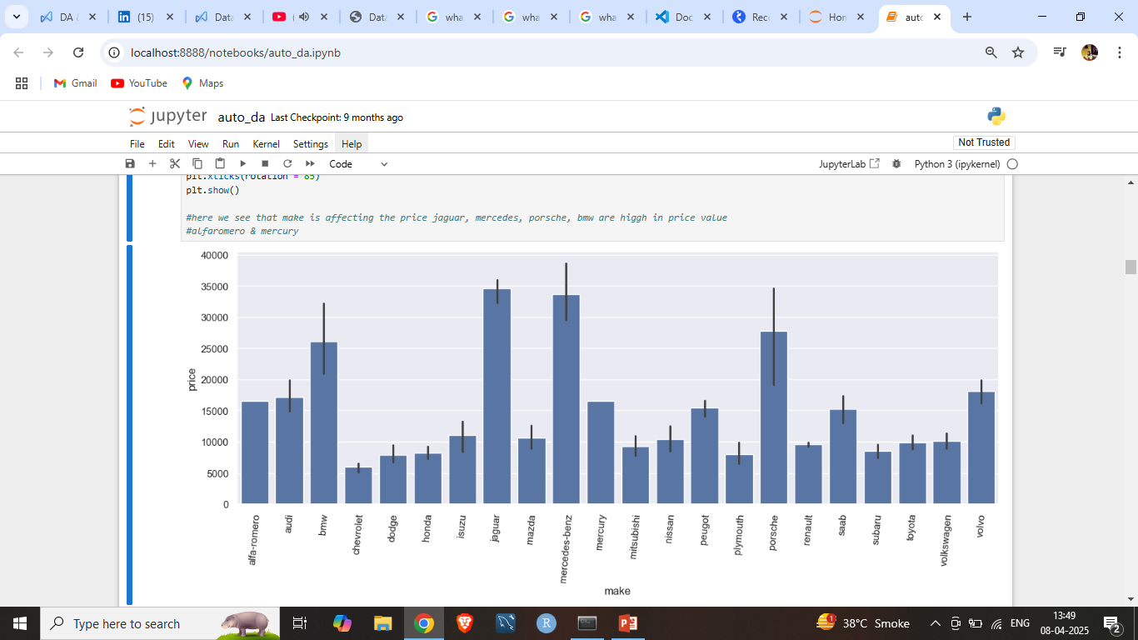
Make vs price :- here we can see that make of companies that are bmw, jaguar, Mercedes-benz, Porsche are very high compared to other cars # hypothesis testing for make and price F statistics is 29.4198 P-value is 0.000

Slide 4
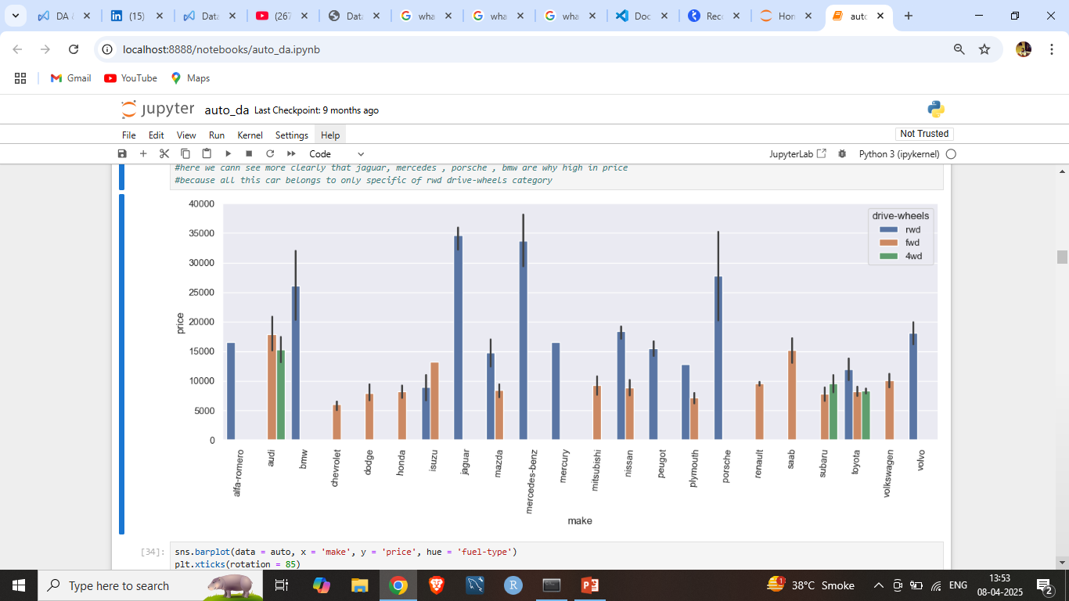
Make & drive-wheels vs price :- here we can clearly see that cars with rwd drive wheels are high in price

Slide 5
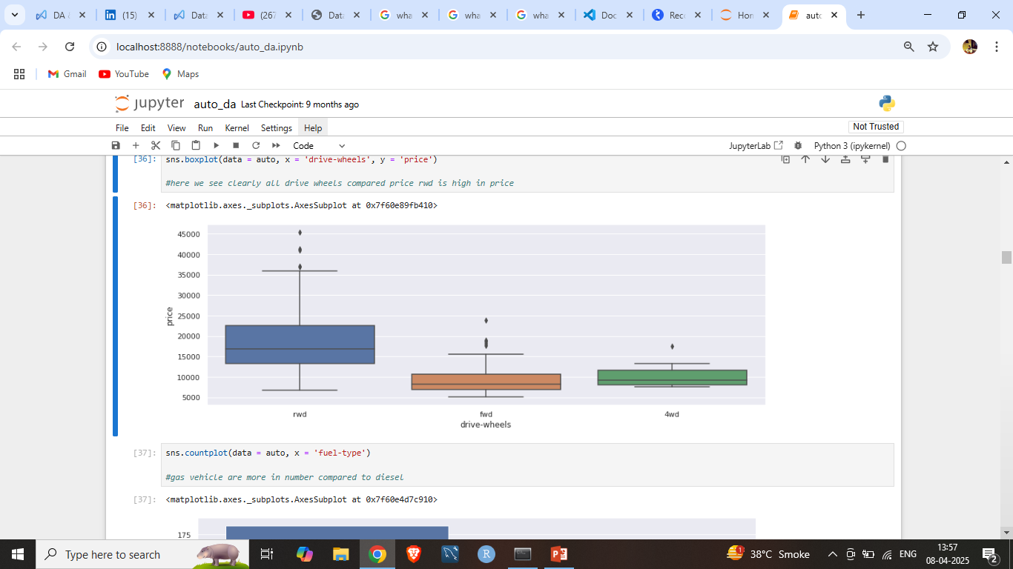
Drive-wheels vs price :- here with help of box plot we can see that price of rwd drive wheels is high # hypothesis testing for drive-wheels and price F-statistic: 68.0291 p-value: 2.7344e-23

Slide 6
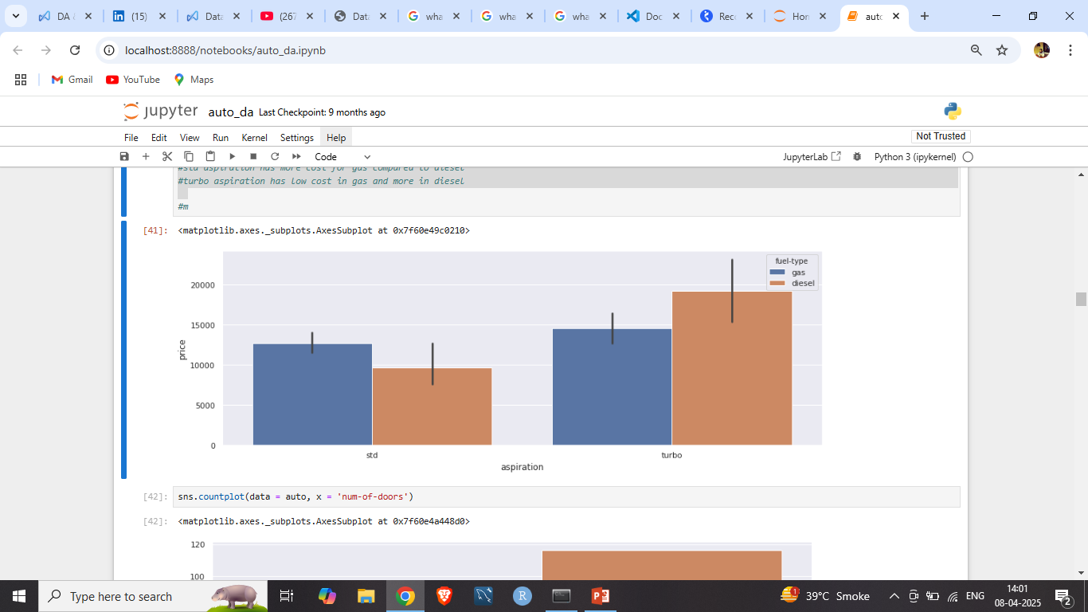
Aspiration vs price :- here we can see that the price of turbo aspiration is high # hypothesis testing T-statistic: -3.0596 P-value: 0.0032

Slide 7
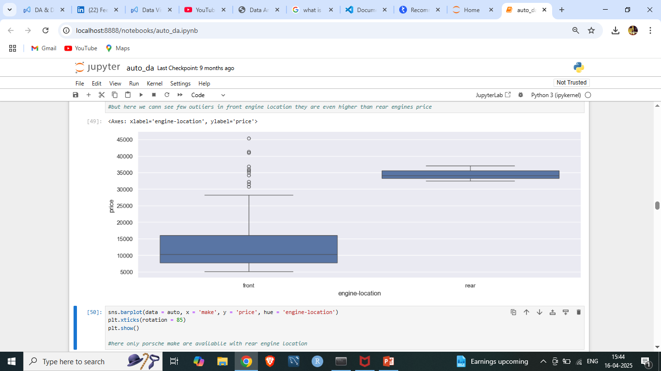
Engine location vs price :- here the rear engine location has very high price compared to front engine location # hypothesis testing T-statistic: -15.1905 P-value: 1.1026e-03

Slide 8
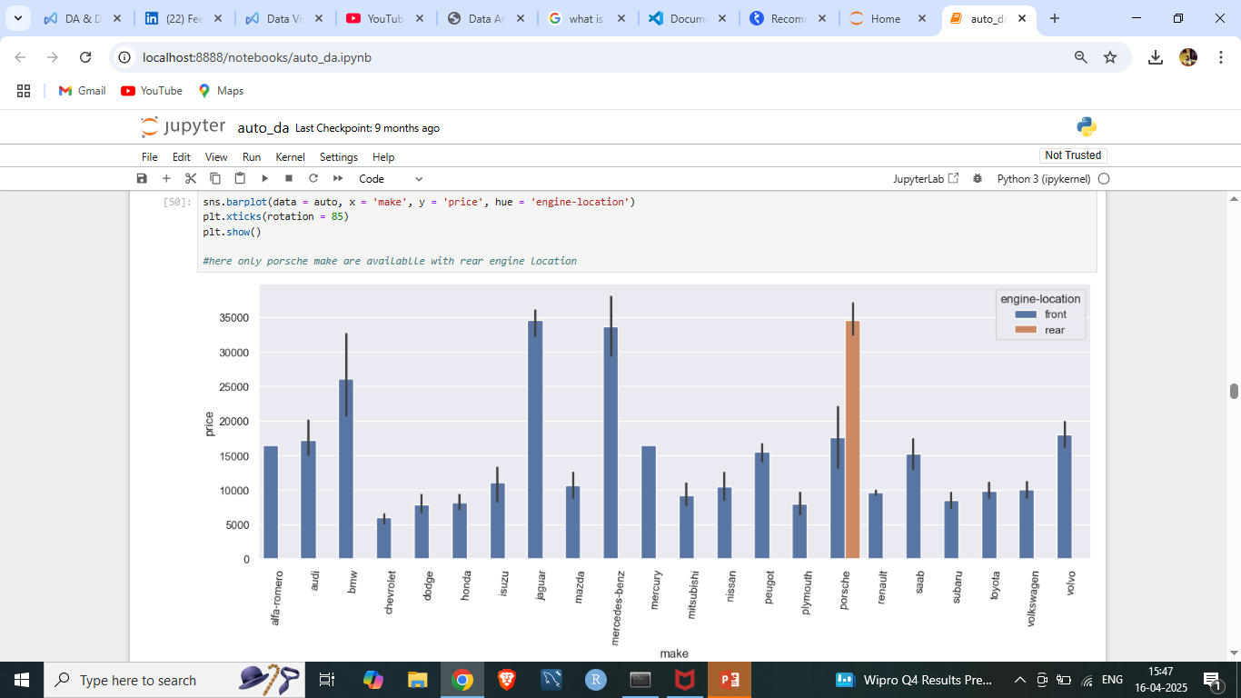
Make , engine location vs price :- here we can clearly see that only Porsche cars come with rear engine location and it as very high price.

Slide 9
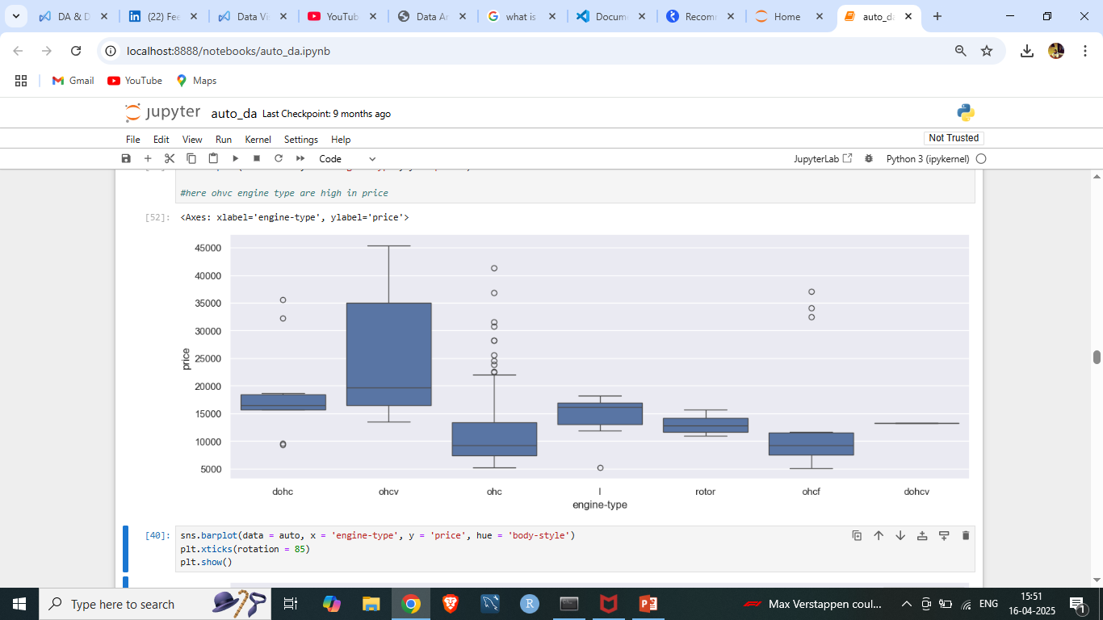
Engine-type vs price :- ohcv engine type has high price # hypothesis testing F-statistic: 8.3511 P-value: 4.4989e-08

Slide 10
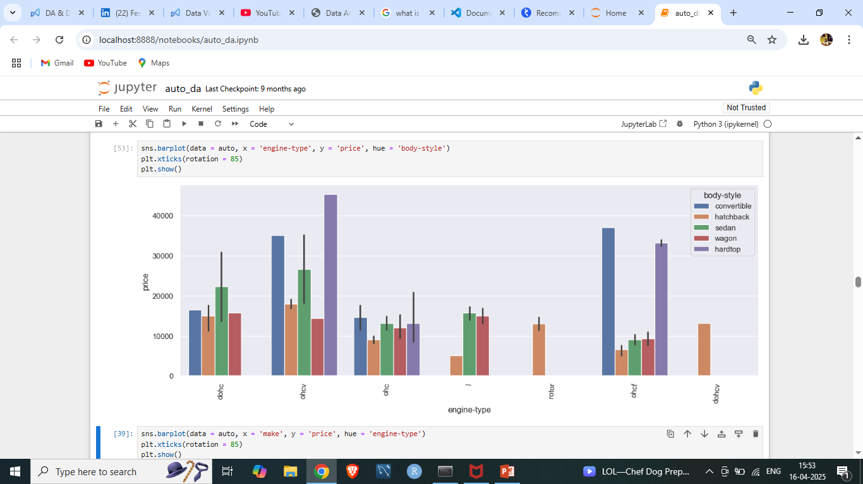
Engine-type, body-style vs price :- here we can see that convertible, sedan and hardtop body-style cars have high price compared to body-style wagon & hatchback # hypothesis testing F-statistic: 9.6082’ P-value: 4.0064e-07

Slide 11
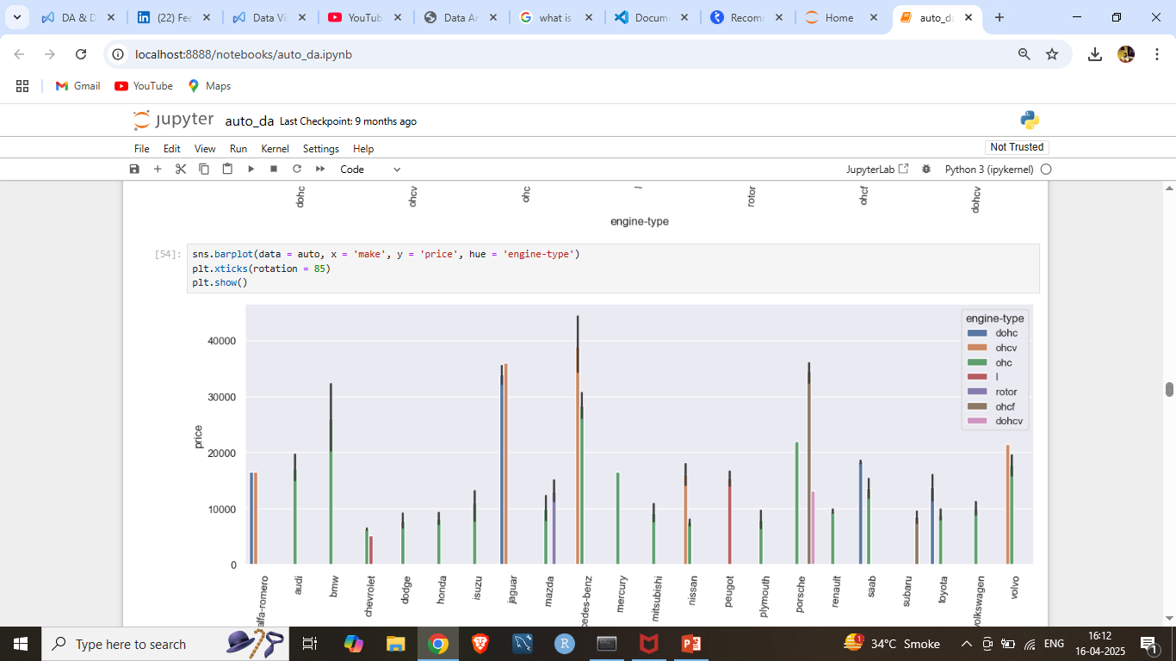
Make & engine-type vs price :- here we can see that ohcv, dohc, & ohc engine-type are high in price

Slide 12
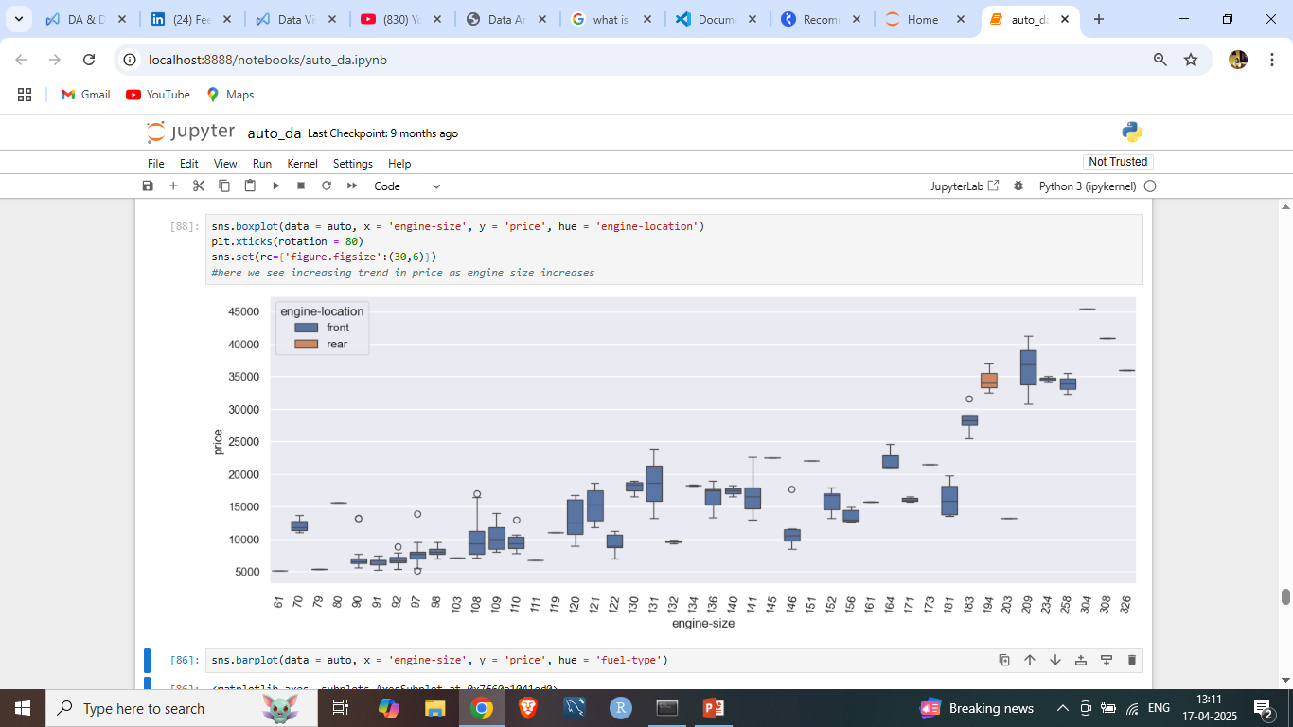
Engine-size, engine-location vs price :- as engine-size increases the price of car increases # hypothesis testing

Slide 13
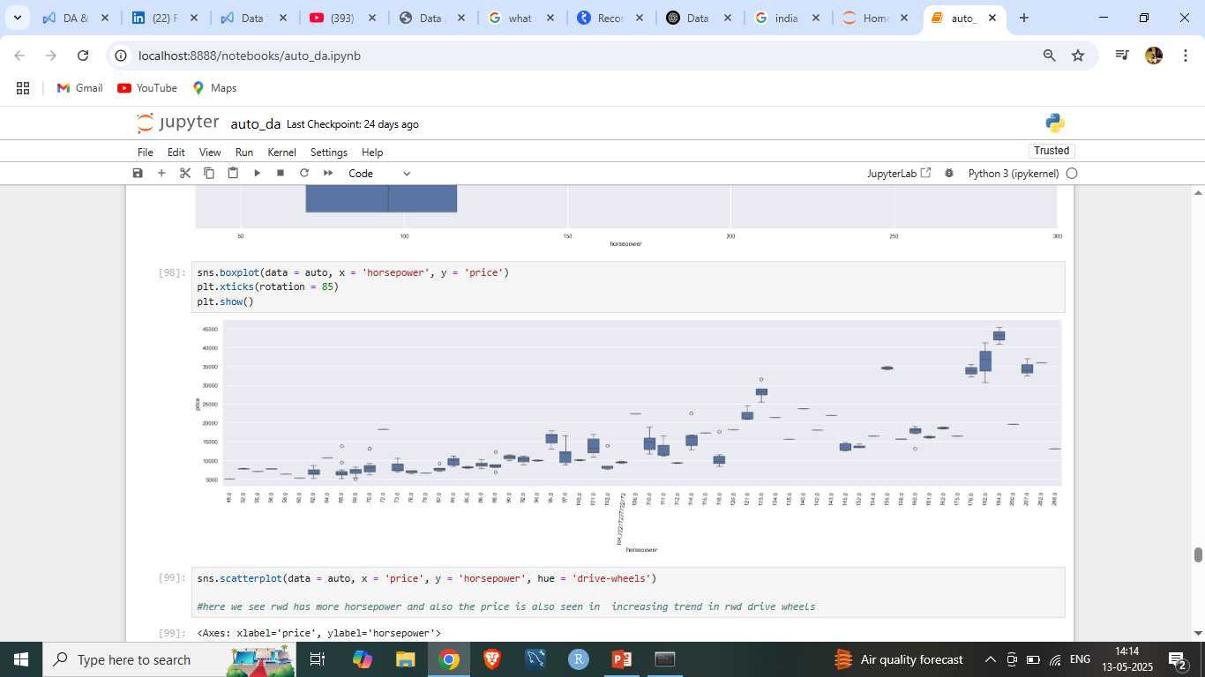
Horsepower vs price :- as horsepower increases the price of vehicle increases Pearson correlation coefficient: 0.7579 P-value: 2.4473e-39 ✅ Significant correlation between horsepower and price.

Slide 14
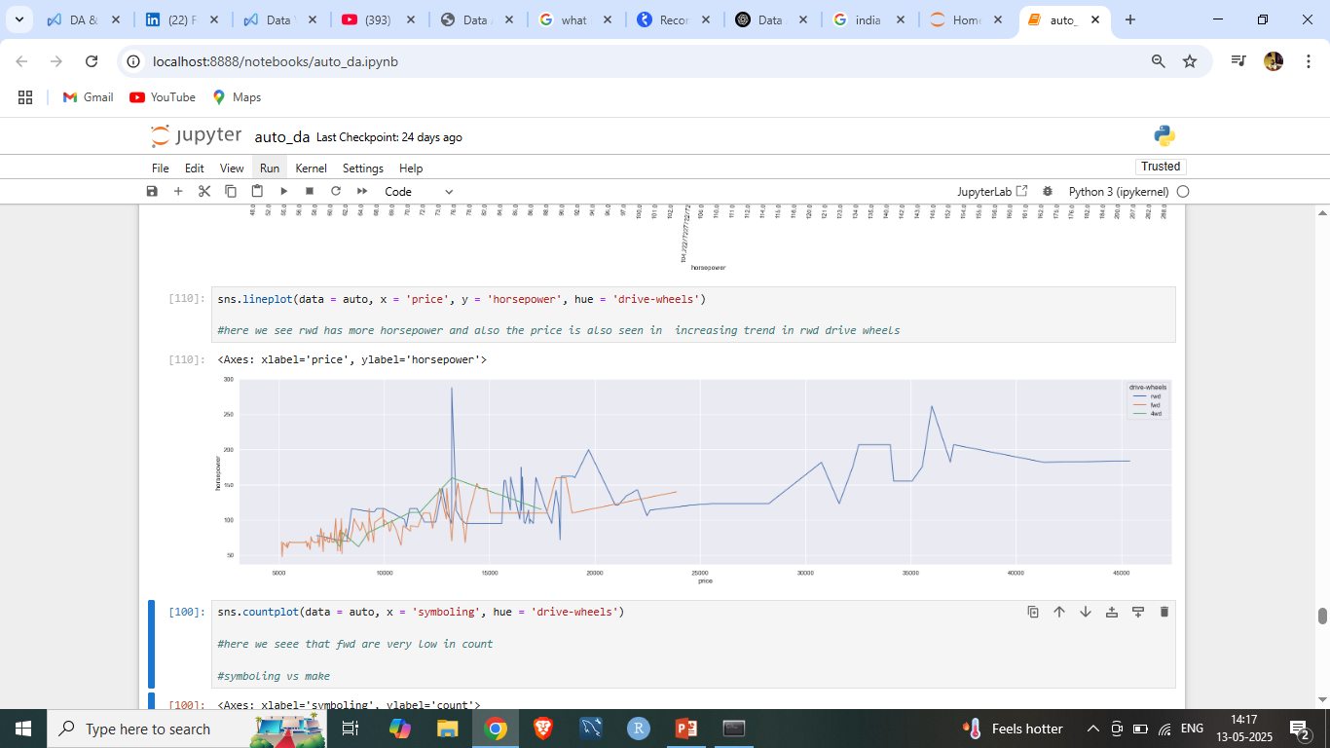
Horsepower, drive-wheels vs price:- here we can see that price of rwd drive-wheels is more than 4wd & fwd

Slide 15
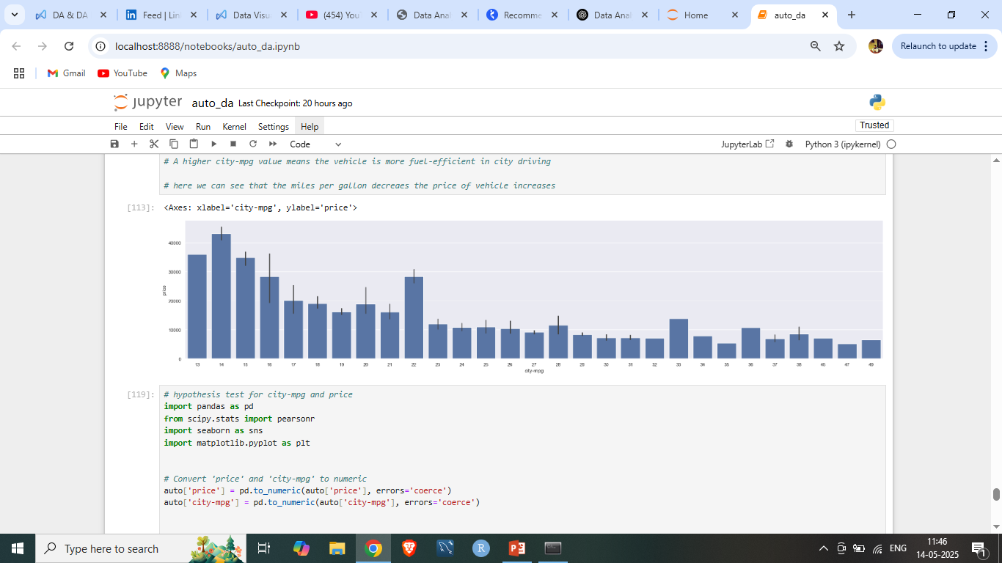
City-mpg vs price :- A higher city-mpg value means the vehicle is more fuel-efficient in city driving. here we can see that the miles per gallon decreases the price of vehicle increases Pearson correlation coefficient: -0.6680 P-value: 9.9048e-28 Significant correlation between city-mpg and price.

Slide 16
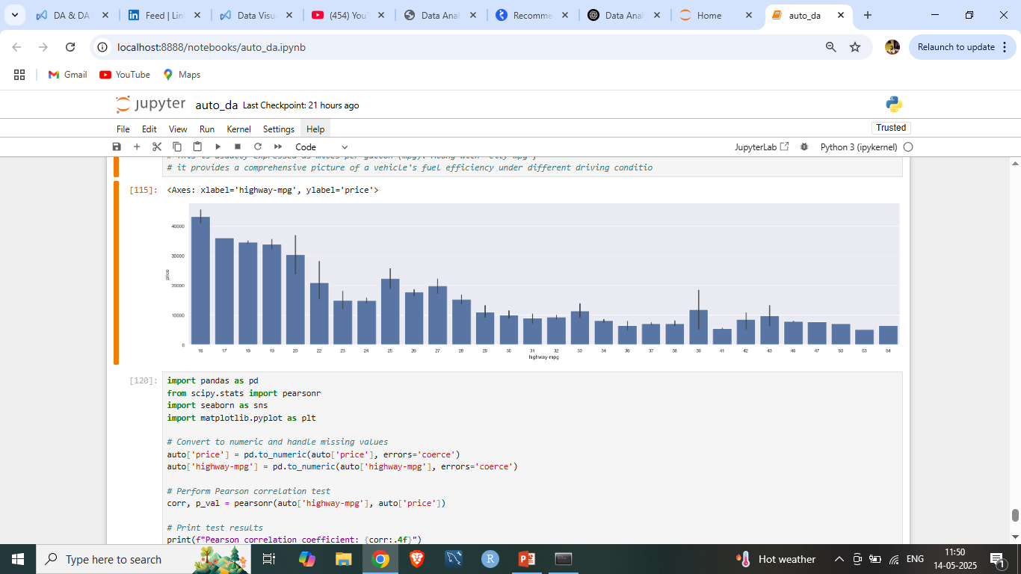
Highway-mpg vs price :- here as highway-mpg increase the price of vehicle decreases as it shows the fuel efficiency of vehicle Pearson correlation coefficient: -0.6909 P-value: 2.7711e-30 Significant correlation between highway-mpg and price.

Slide 17
Hypothesis testing
Make vs price
Drive-wheels vs price
Aspiration vs price
Engine-location vs price
Engine-type vs price
Body-style vs price
Engine-size vs price

