Slide 1
Data analytics on credit default dataset by :- Sunil Birappa Khandale

Slide 2
Index
Data understanding (checking the data for null values and errors negative values)
Checking the normality of data
Checking the outliers and treating
Visualizing the data

Slide 3
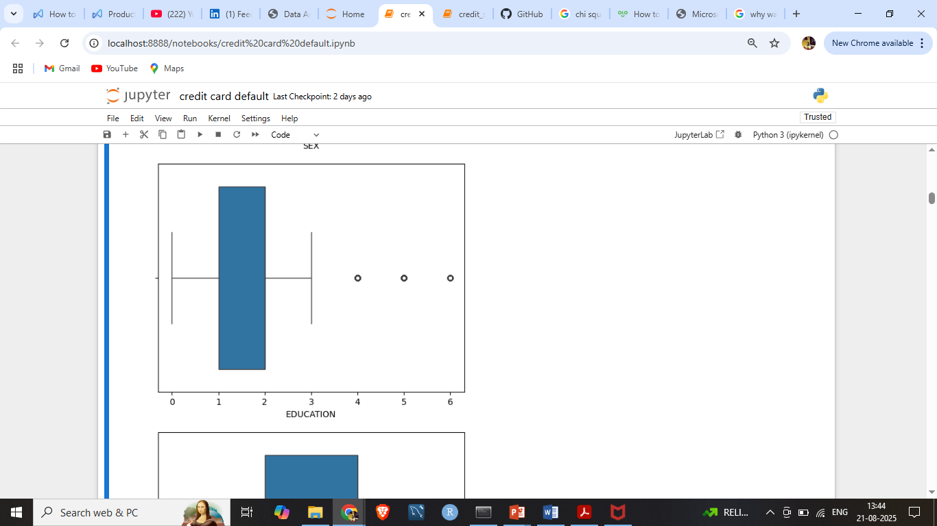
Identify the errors in dataset
Outliers in the following column
Education : only (1 = graduate school; 2 = university; 3 = high school; 4 = others) are given but we have 0, 5, 6 in the education column which is been treated by central limit theorem using mode because education is discrete data

Slide 4
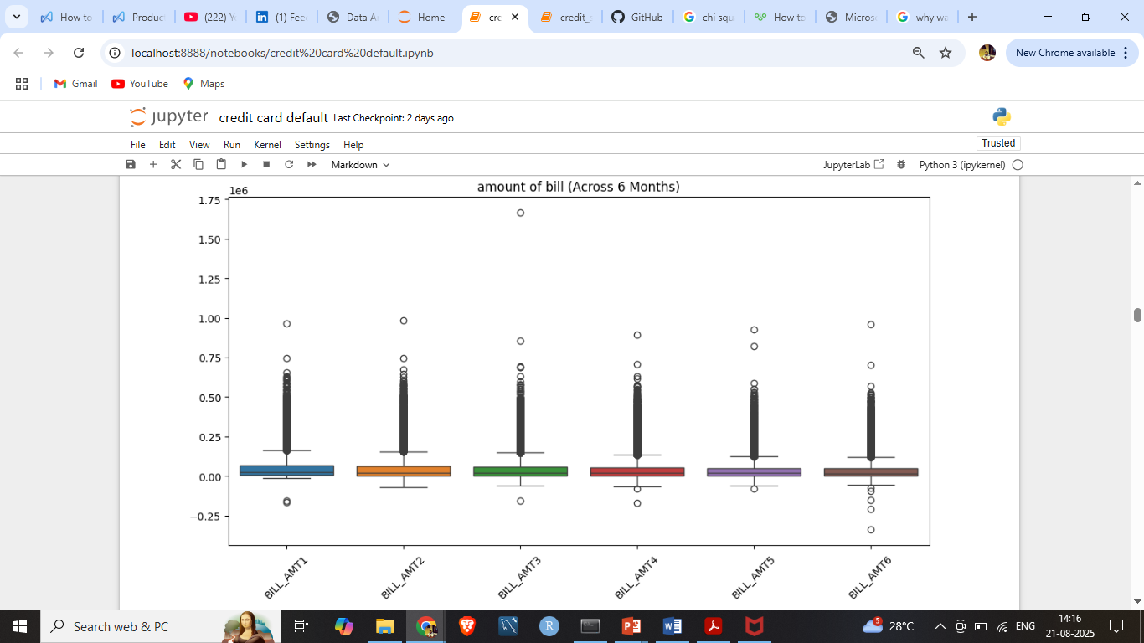
Negative values is bill_amt column
Bill_amt column has negative values as amount of bill cannot be in negative value , but we
As we see that were there is bill amt is zero the pay amt column has zero amt so here we can treat th eoutlier i.e negative values with the zero

Slide 5
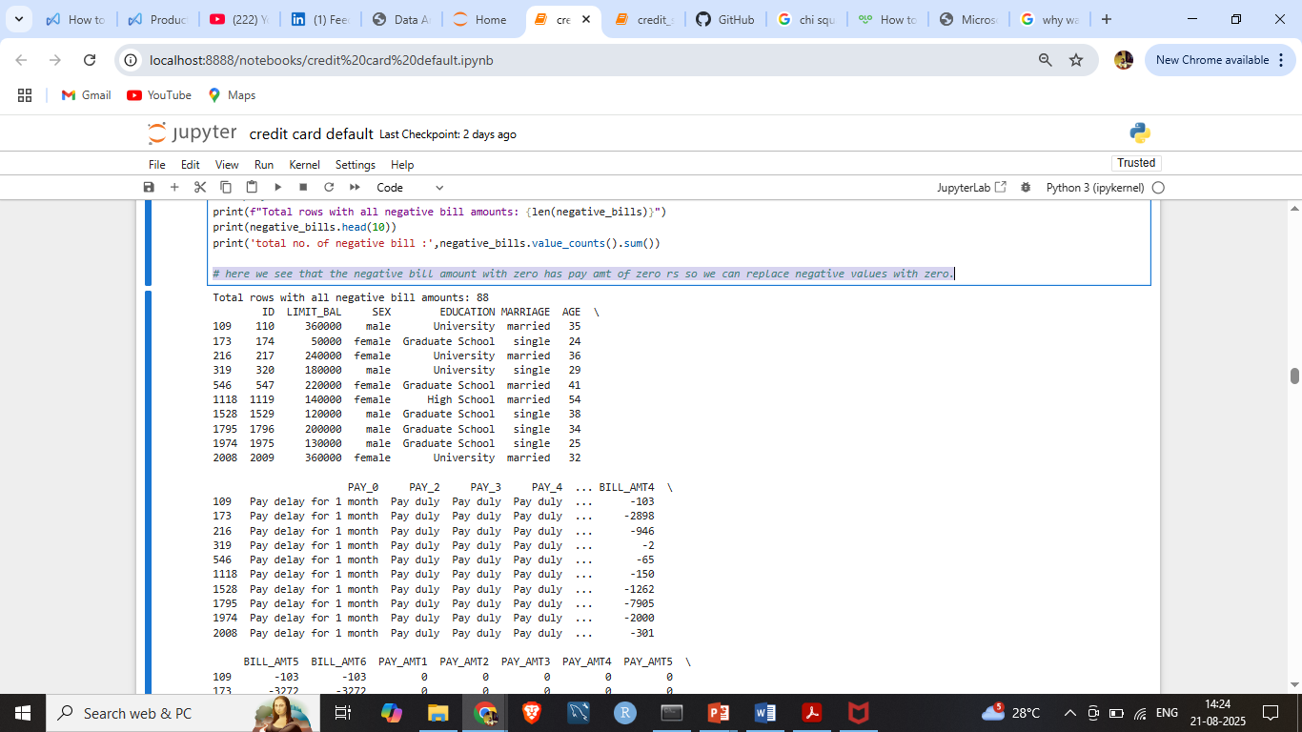
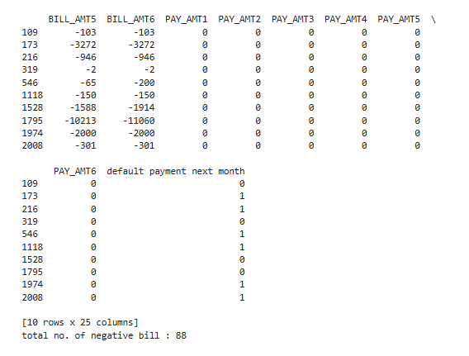
Here we see that the negative bill amount with zero has pay_amt of zero amount so we can replace negative values with zero.

Slide 6
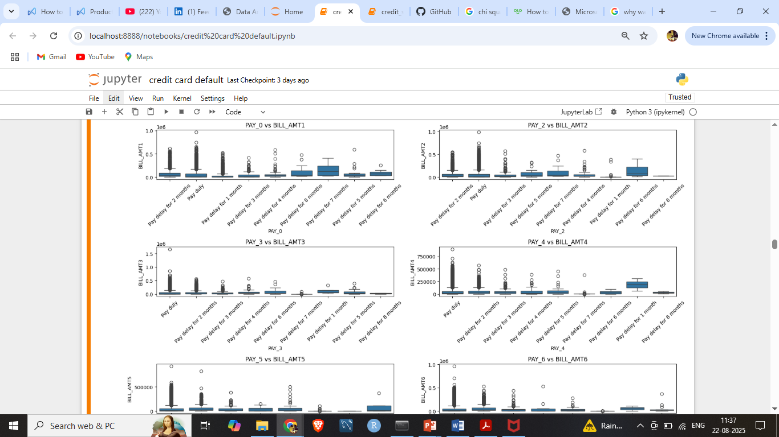
Pay_amt vs bill_amt :- here we see that in pay_amt column the customer which pay amount duly has the more chances of been in the default category

Slide 7
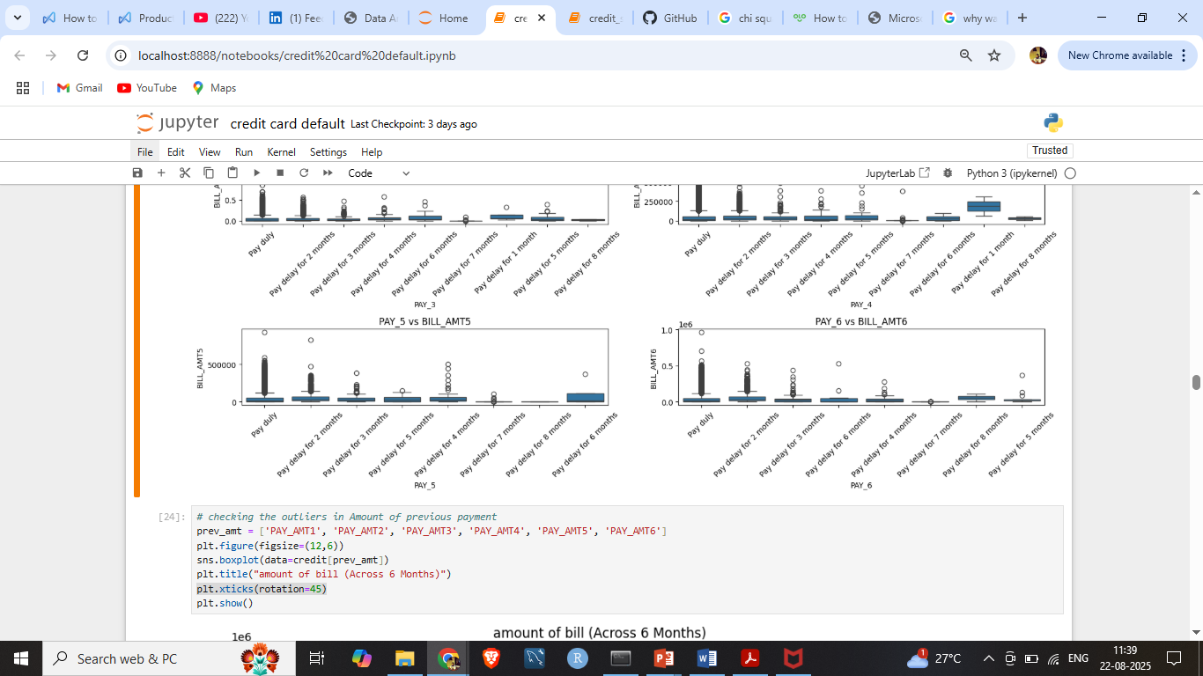
Pay_amt vs bill_amt : here we see that in pay_amt column the customer which pay amount duly has the more chances of been in the default category

Slide 8
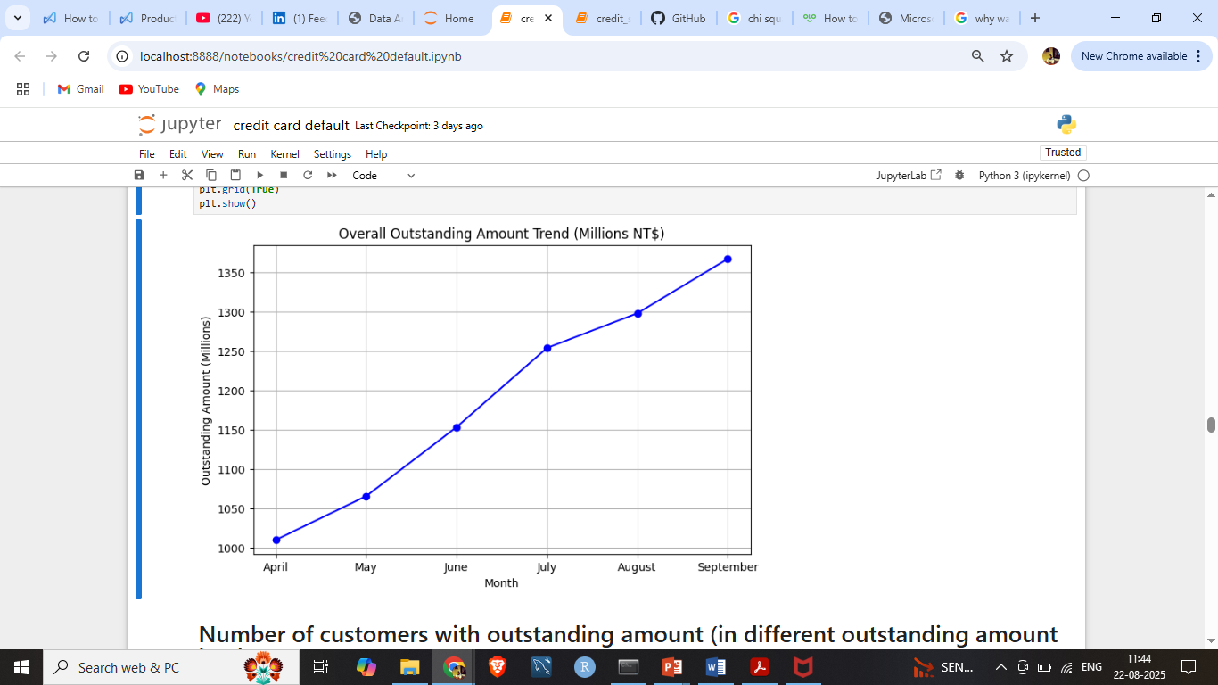
Analyze the trend on outstanding amount for the bank Overall outstanding amount trends Here Outstanding = Bill Amount − amount paid (for each month)
Here we see that as month increases the outstanding amount also increases

Slide 9
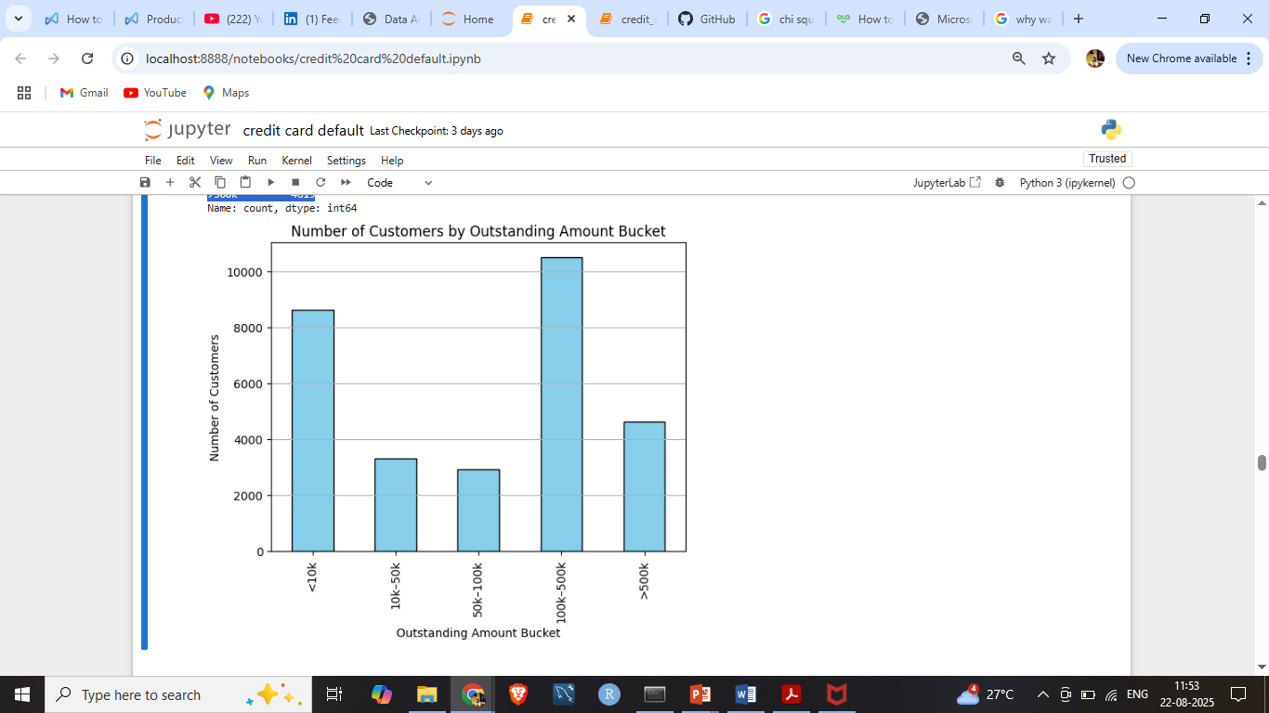
Number of customers with outstanding amount (in different outstanding amount buckets)
Outstanding bucket
<10k = 8635
10k–50k = 3325
50k–100k = 2912
100k–500k = 10509
>500k = 4619

Slide 10
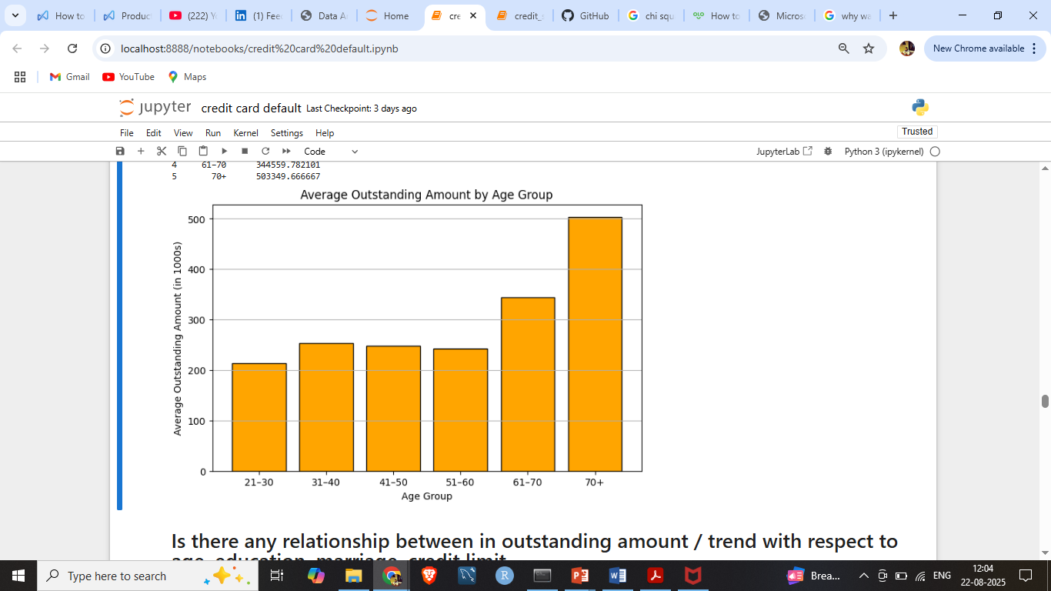
Age of outstanding amount analysis
Age group total outstanding
21–30 214295.694180
31–40 253500.923738
41–50 247964.845129
51–60 243056.323986
61–70 344559.782101
70+ 503349.666667

Slide 11
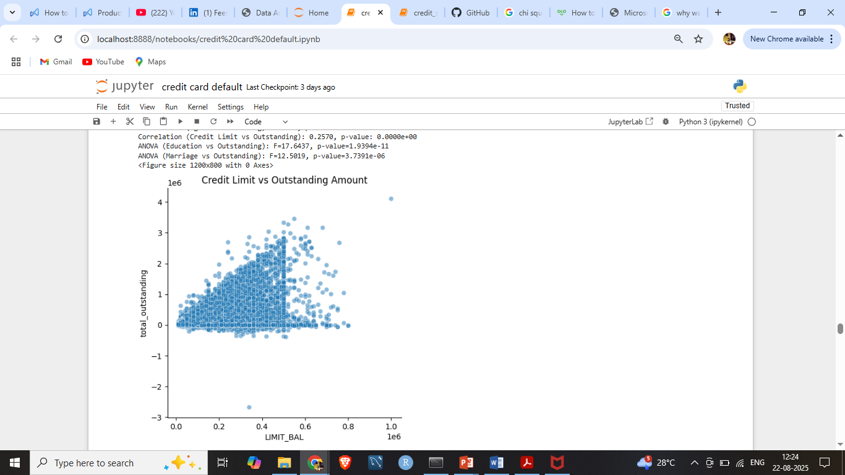
Is there any relationship between in outstanding amount / trend with respect to age, education, marriage, credit limit
Correlation (Credit Limit vs Outstanding) = 0.2566
p-value = 0.0000e+00

Slide 12
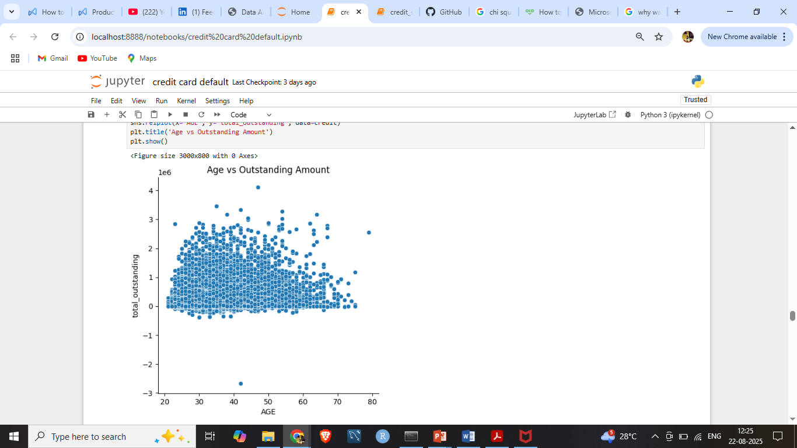
Relationship between the Age and outstanding amount
Correlation (Age vs Outstanding) = 0.0506,
p-value = 1.7046e-18
There is no such relationship can be seen in the graph

Slide 13
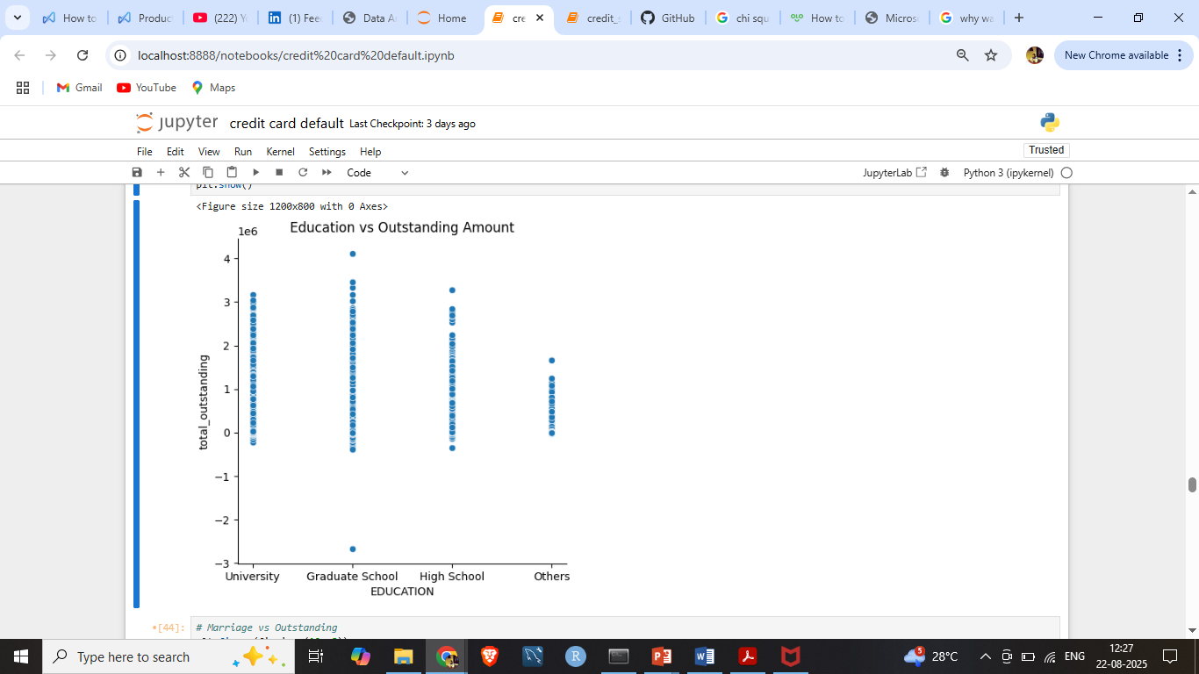
Relationship between the Education and outstanding amount
ANOVA (Education vs Outstanding):
F = 17.7044,
p-value = 1.7739e-11
No such relationship can be seen in the education and total outstanding column

Slide 14
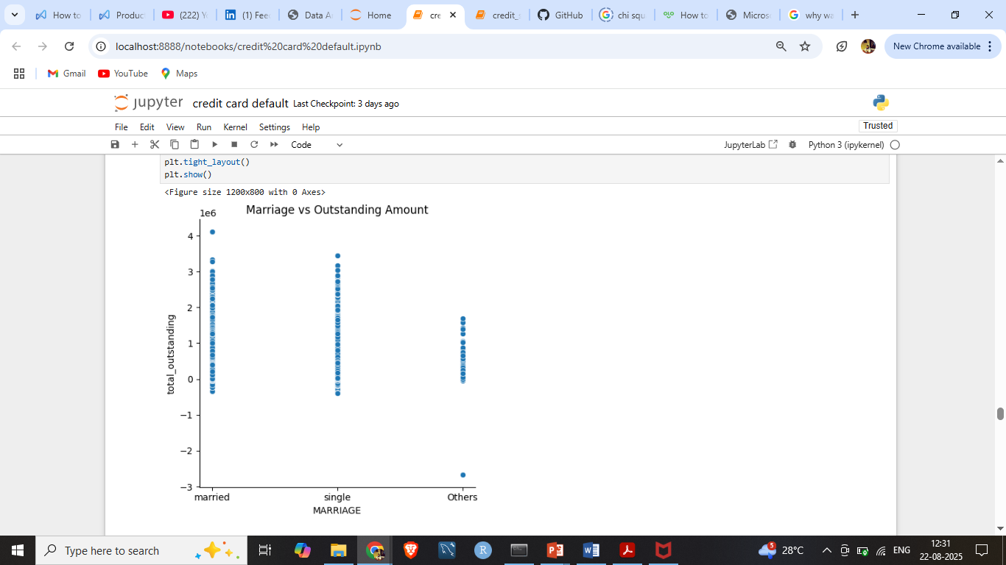
Relationship between the Marriage and outstanding amount
ANOVA (Marriage vs Outstanding):
F = 12.5019
p-value = 3.7391e-06
Here we see that married and singles are given more outstanding amount compared to the others

Slide 15
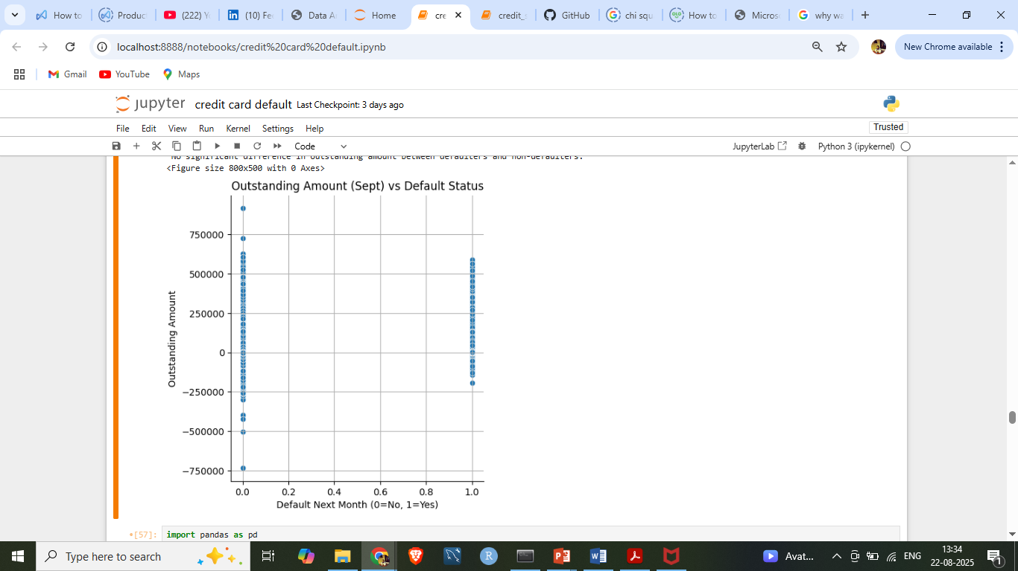
Does outstanding amount / trend affect the default behavior in next month
T-statistic: -0.5917
P-value: 5.5406e-01
Hence there is No significant difference in outstanding amount between defaulters and non-defaulters.

Slide 16
Thank you

