Slide 1
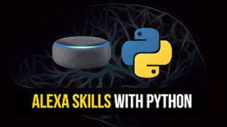
Personal Assistant using python
-
By
-G.Hemasai - 21711A0482
-U.Bhanu Prakash - 21711A0473
- L.Sunil Reddy - 21711A0489
- J.Santhosh Joel - 21711A0484
Under The Guidance Of:
Mr. M. MURALIDHAR, M Tech

Slide 2
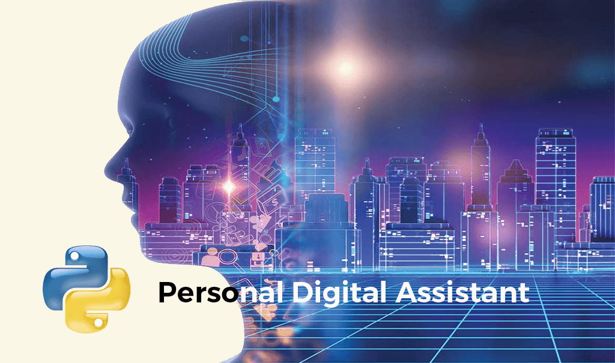
Building a Python-Based Personal Assistant (Alexa-type)

Slide 3
CONTENT
What is personal assistant
How does it works
Why we use python
Key python libraries
How speech recognition works
How does it recognize
System Architecture

Slide 4
CONTENT
Core Functionalities of the personal assistant
Demo and use cases
Future Scope
Conclusion

Slide 5
What is a Personal Assistant?
Definition:personal assistant using Python is a software program that can perform tasks for a user based on verbal or written commands
A software agent that performs tasks or services for individuals.
Popular Examples: Alexa, Siri, Google Assistant.

Slide 6
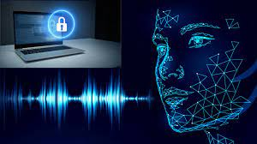
How Does It Work?
1).Listens to voice commands
2).Processes requests.
3).Provides output (response or action).

Slide 7
Why Use Python?
Easy to Learn and Use:
- Simple syntax, beginner-friendly.
Extensive Library Support: - Speech processing, and automation.
Cross-Platform Compatibility: - Works on multiple platforms (Windows, Mac, Linux).

Slide 8

Key Python Libraries
SpeechRecognition
Pyttsx3
pywhatkit
Datetime
Wikipedia
Tkinter
PIL
OS
Web browser

Slide 9
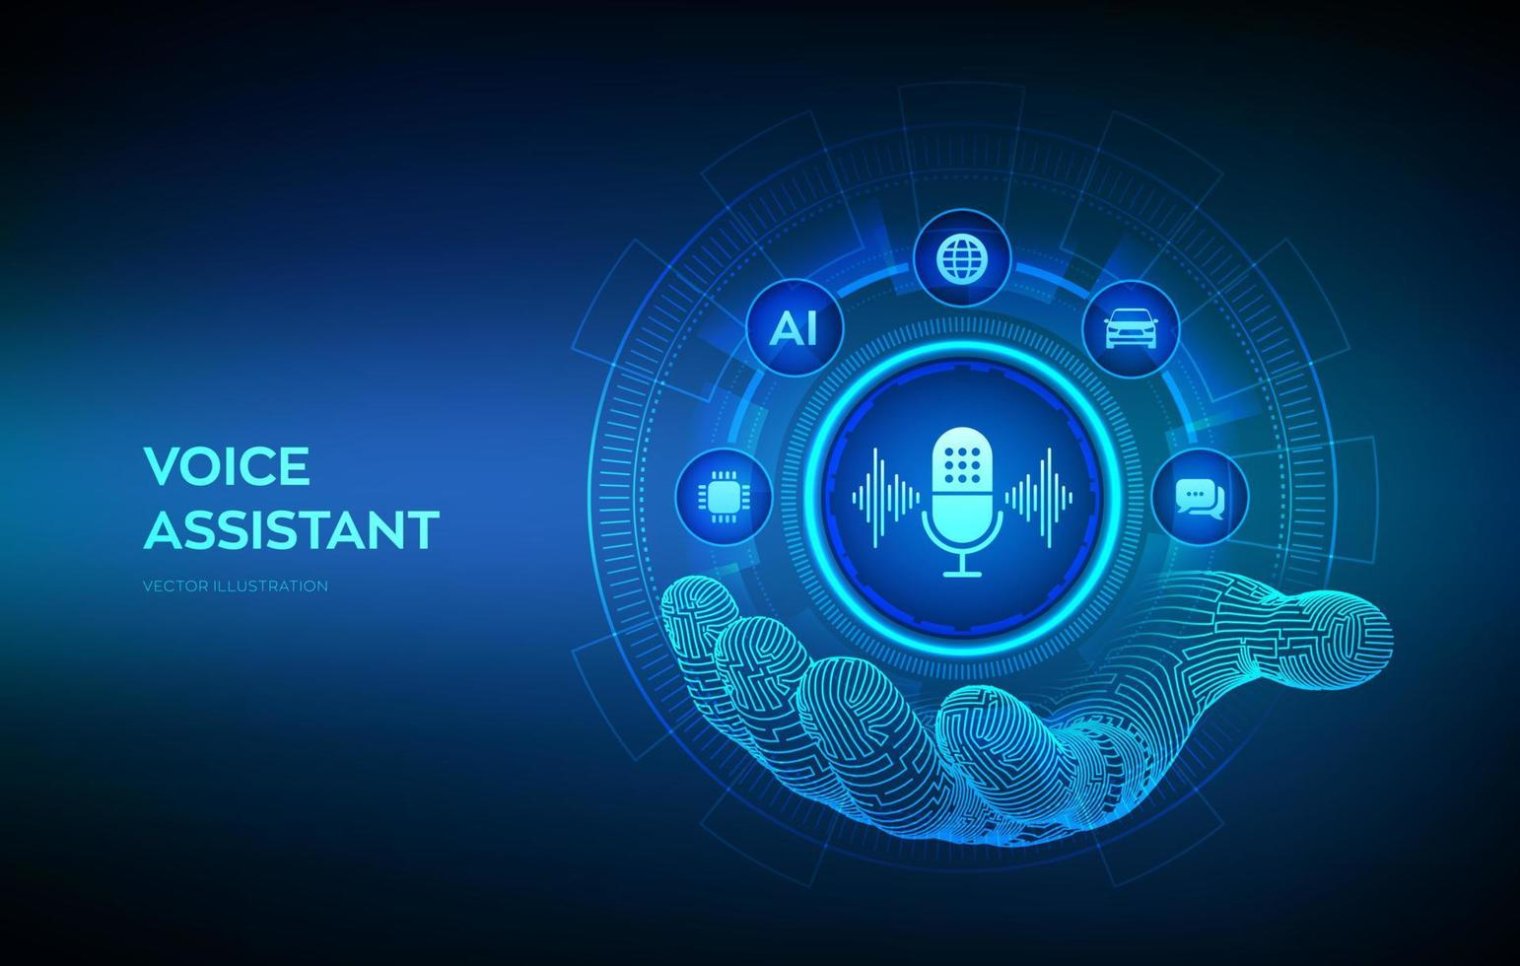
How Speech Recognition Works
Record the user's voice.
Convert voice to text using SpeechRecognition API.
Challenges: - Accents,
- Background noise,
- Speech clarity.

Slide 10
Sample Code Snippet
import speech_recognition as sr
import pyttsx3
import webbrowser
def personal_assistant():
recognizer = sr.Recognizer()
engine = pyttsx3.init()
with sr.Microphone() as source:
engine.say("How can I assist you?")
engine.runAndWait()
print("Listening...")
voice = recognizer.listen(source)
command = recognizer.recognize_google(voice).lower()
if "open youtube" in command: webbrowser.open("http://youtube.com")
engine.say("Opening YouTube")
engine.runAndWait()

Slide 11
System Architecture

Slide 12
Core Functionalities of the Personal Assistant
Speech Recognition:
- Captures voice input and converts it to text.
Command Parsing: - Analyzes the text to determine the user’s intent.
Task Execution: - Executes tasks such as opening applications, checking weather, etc.

Slide 13
Demo & Use Cases
Live demonstration of voice commands.
Use cases:
Office Automation: Automate repetitive tasks like email drafting and calendar management.
Smart Home Control: Control IoT devices like lights, thermostats, and security cameras.
Virtual Assistance: Schedule appointments, set reminders, and answer general queries.
Customer Service Bots: Assist customers in answering FAQs and guiding them through processes.

Slide 14
Future Scope
AI-powered chatbot integration
Voice-controlled IoT automation
Multi-language support
Facial recognition for security

Slide 15
Conclusion
Python makes building a personal assistant easy with its powerful libraries.
A well-designed assistant can enhance productivity and efficiency.
Future improvements can make it more intelligent and user-friendly

Slide 16


