Slide 1
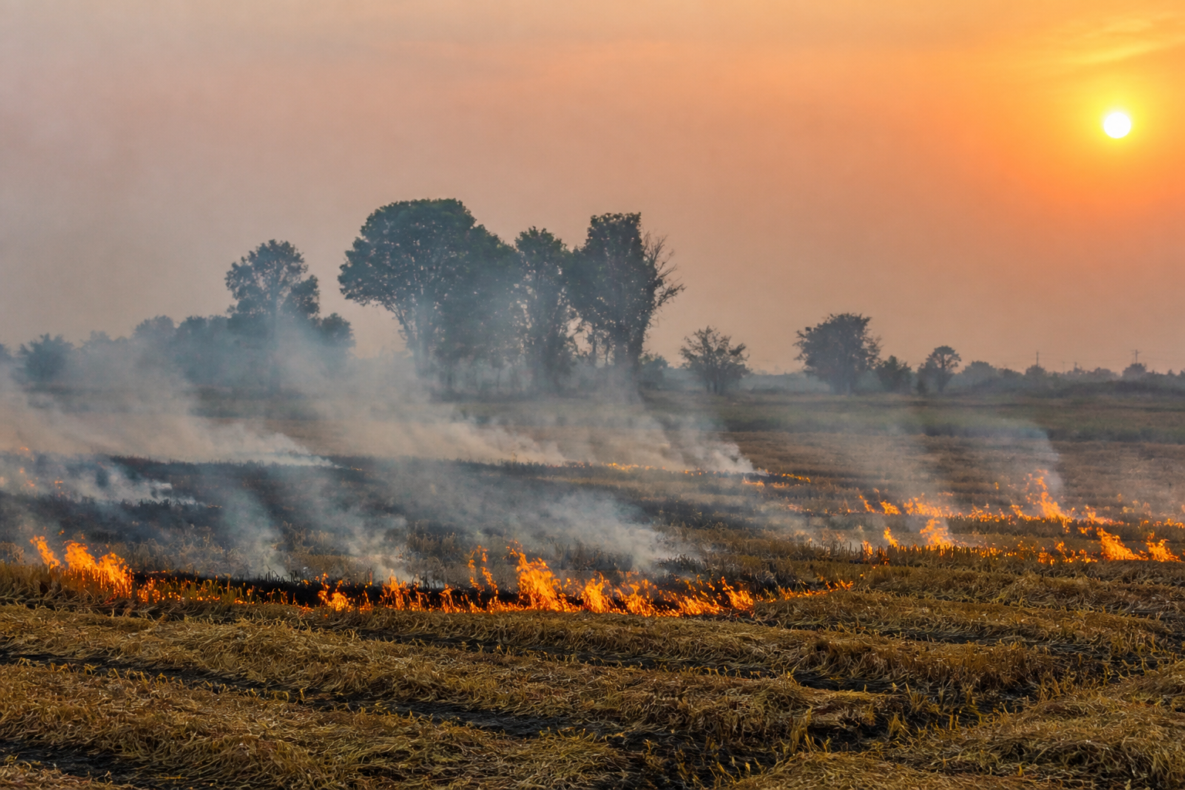
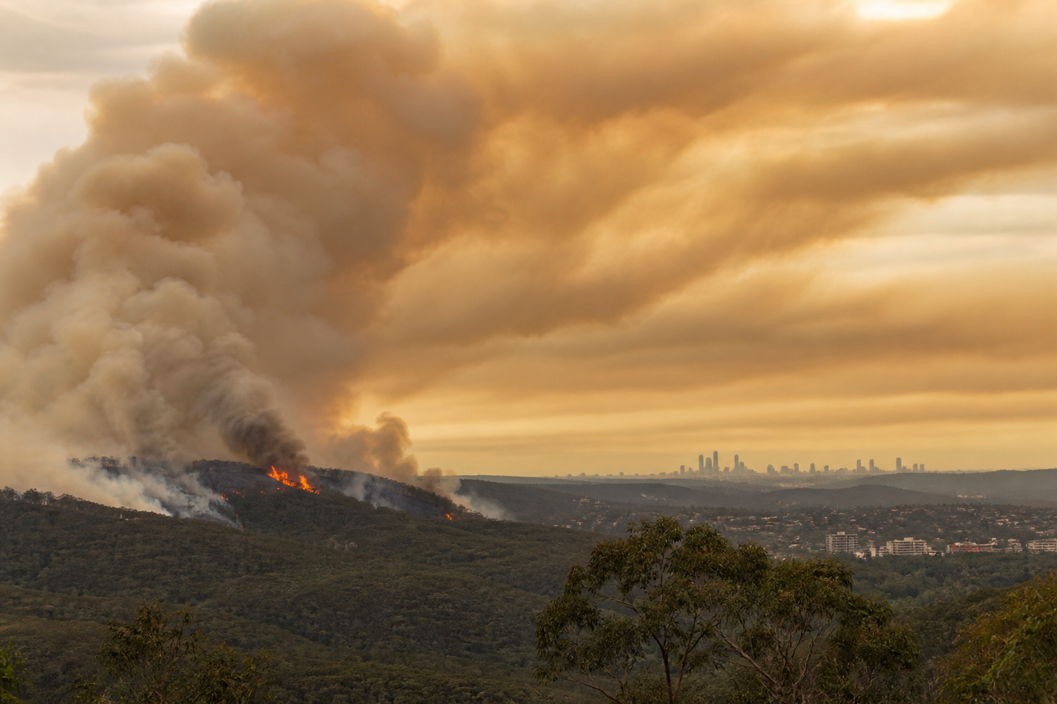
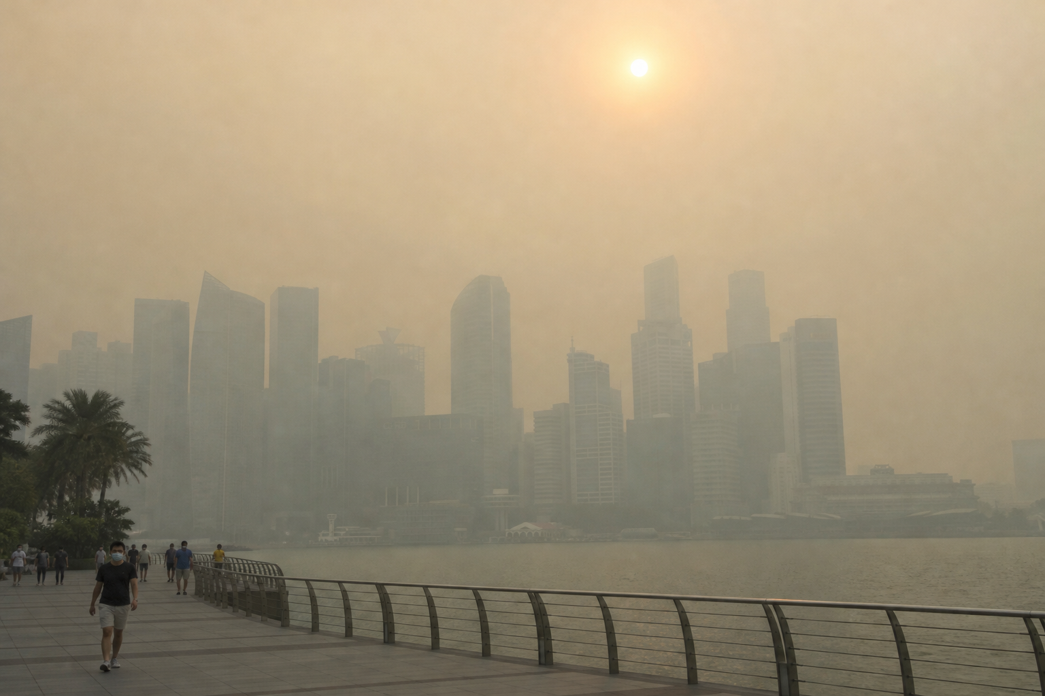
AeroPulse: Source-to-People Air-Quality Intelligence for the Asia-Pacific
Fusing ground stations, satellite fire detections and weather forecasts to warn people before smoke arrives
Team AeroPulse
Hackathon submission · Built and deployed on Google Cloud
Crop-residue burning
Bushfire smoke
Transboundary haze
Illustrative images (AI-generated). Region packs: North India · Singapore · New South Wales.
AeroPulse — Source-to-People Air-Quality Intelligence · Hackathon 2026
1 / 18
Notes:
AeroPulse turns air quality from a number into a story: where the smoke comes from, where the wind takes it, and who it reaches. It runs on Google Cloud for three APAC regions.

Slide 2
Abstract and Index Terms
Abstract—Smoke from crop-residue burning, bushfires and transboundary haze crosses administrative borders, yet the public is usually warned by an Air Quality Index that reports air which has already arrived. We present AeroPulse, an environmental-intelligence system that fuses ground stations, satellite fire detections, a satellite aerosol index and weather forecasts on a ~1 km H3 grid, links each pollution episode to its plausible source, projects where the smoke travels with a Lagrangian particle ensemble, and names the places in its path. Region knowledge (geography, sources, hazards and the official AQI standard) lives in declarative region packs, so a region is added by configuration. PM2.5 forecasts are trained per region and served only after they beat persistence on time-ordered holdouts; every served value carries its provenance, model version and degraded flag. A language model is confined to a grounded assistant and a schema-constrained citizen-photo observation that cannot create events. The system runs serverlessly on Google Cloud and is built with Cloud Build and deployed with Terraform.
Built in this submission
3
region packs
North India, Singapore, New South Wales
6
connector types enabled
stations, fires, weather, aerosol index
~1 km
H3 resolution-8 cells
one grid for every source
Per region
gated ML forecasts
served only after beating persistence
Index Terms—air quality, PM2.5 forecasting, smoke transport, Lagrangian ensemble, data fusion, H3 grid, responsible AI, serverless, Google Cloud.
200
particle plume ensemble
P50 / P90 smoke footprints
AeroPulse — Source-to-People Air-Quality Intelligence · Hackathon 2026
2 / 18
Notes:
One-paragraph summary in IEEE form. The panel on the right lists what is built, with counts taken from the repository configuration.

Slide 3
I. INTRODUCTION
Smoke Travels Farther Than Warnings Do
North India — crop-residue burning
New South Wales — bushfire smoke
Singapore — transboundary haze
Post-harvest stubble fires in Punjab and Haryana
Smoke drifts across state lines toward Delhi NCR
Forest fires on the edge of Greater Sydney
Plumes reach suburbs far from the fire front
Vegetation and peat fires elsewhere in the region
Haze crosses national borders
Fig. 1. Three smoke regimes covered by AeroPulse region packs (illustrative, AI-generated images).
Common pattern: the source is far from the people it affects, and the wind decides who breathes it.
Fine particulate matter (PM2.5) is a leading environmental health risk [1]; warning time matters most for children, older adults and outdoor workers.
AeroPulse — Source-to-People Air-Quality Intelligence · Hackathon 2026
3 / 18
Notes:
Three regions, three smoke regimes, one pattern. In North India, post-harvest stubble fires in Punjab and Haryana; in New South Wales, bushfires on the urban fringe; in Singapore, haze from regional vegetation and peat fires. In each case the fire is far from the people who breathe the smoke, and the wind decides who that is. Fine particulate matter is a leading environmental health risk (WHO, reference 1).

Slide 4
I-B. MOTIVATION
Why an AQI Number Is Not Enough
SOURCE
Fire, burning field, haze origin
WIND
Transport over hours to days
PEOPLE
Towns, schools, hospitals
Satellites detect the fire here [3]
Weather models forecast the path here [4]
A conventional AQI is measured here — after exposure begins
Warning window AeroPulse targets
Fig. 2. The source-to-people chain. An AQI reading sits at the end of the chain.
TABLE I
AQI REPORTING VERSUS AEROPULSE
Conventional AQI view | AeroPulse view
One number for a station or city, after the hour | PM2.5 per ~1 km cell plus the next 1–24 h (48 h for haze and bushfire)
No link to the cause | Evidence graph linking fires, wind, plume and anomaly
Silent about where smoke goes next | P50 / P90 plume footprints and the places they reach, with ETA
Model fields can look like measurements | Every value labelled measured, model-derived, predicted, simulated …
AeroPulse — Source-to-People Air-Quality Intelligence · Hackathon 2026
4 / 18
Notes:
An AQI reading describes air that has already reached a monitor. Satellites see the fire hours earlier, and weather models know where the wind is going. Nobody joins those three on one grid with one clock. AeroPulse targets the window between the fire being visible and the smoke arriving.

Slide 5
II. PROBLEM DEFINITION
Problem Statement and Objectives
Problem statement
Given heterogeneous and partially available observations — ground stations, satellite fire detections, a satellite aerosol index and numerical weather forecasts — produce, for every ~1 km cell and every 15-minute cycle, an explainable picture of current PM2.5, where elevated air is coming from, where it will travel, and which places it will reach, labelled with its provenance and model version.
O1
Now PM2.5 on each cell — ground stations first, model fields only where needed
O2
Unusual? Is this hour anomalous for this place against its own history?
O3
Where from? Which source is plausible — a ranked list with evidence, never a percentage
O4
Where next? Where the smoke travels in the next hours, with P50 / P90 uncertainty
O5
Who? Which towns are in the path, and when the smoke is expected to arrive
Design constraints
No invented numbers — every figure comes from data or a tool
Official AQI scale of each region, from its region pack
No language model on detection, forecast, plume or events
A missing feed reports “not configured”, never fake data
AeroPulse — Source-to-People Air-Quality Intelligence · Hackathon 2026
5 / 18
Notes:
We frame the problem as five operator questions, each answered per cell and per cycle, under four design constraints that keep the system honest.

Slide 6
III. PROPOSED SOLUTION
Proposed Solution: Observe → Understand → Predict → Reason → Act
Observe
Understand
Predict
Reason
Act
Stations (OpenAQ, NEA, CPCB)
NASA FIRMS fires
Open-Meteo weather + CAMS
Sentinel-5P aerosol index
Normalize to shared contracts
QC, dedup, H3 r8 cells
Anomaly rules
Pollution events
Per-region PM2.5 forecast (P10/P50/P90)
24 h hazard (calibrated where gated)
Plume ensemble P50/P90
Source ranking with evidence
Incident graph
Places reached, with ETA
Command centre map
Alerts to a pluggable sink
Citizen reports + watch
Ask AeroPulse (grounded)
Fig. 3. AeroPulse processing stages for one region and one cycle.
Provenance on every value
measured · model-derived · predicted · simulated · heuristic · AI observation · citizen
Configuration, not code
places, sources, hazards, seasons, thresholds and AQI scale live in region packs
Deterministic event path
Gemini is used only by Ask AeroPulse and the citizen-photo observation
AeroPulse — Source-to-People Air-Quality Intelligence · Hackathon 2026
6 / 18
Notes:
Five stages. Observe brings data in through connectors. Understand places it on the grid and detects events with rules. Predict runs the gated per-region models and the plume ensemble. Reason ranks sources and builds the incident graph. Act puts it in front of operators and citizens. The three principles underneath are what make the output trustworthy.

Slide 7
IV-A. ARCHITECTURE
System Architecture
Ingest
Region pack
region.yaml · hazards · AQI std
aeropulse-cycle
one job per region
Connector plugins
OpenAQ · FIRMS · Open-Meteo · EE · NEA
Normalize
vendor JSON → contracts
Ingest prep
validate · QC · H3 r8 [11] · dedup
raw payloads → object store
Intelligence
Plume engine
200-particle ensemble, fwd / back
Source likelihood
heuristic ranking + evidence
Model resolver
gated model or rule (degraded)
Feature pipeline
same code as training
Analytics store
observations · meteo forecast
Serve
reviewed promotion
Graph + incidents
events · plumes · places · ETA
Snapshot store
region/cycle.json → latest.json
API
FastAPI /api/v1 · JWT
Web: Demo | Live
Gemini + tools + grounding check; it cannot write an event
Ask AeroPulse
Train (offline)
History + datasets
provider archives
Features + train
HistGradientBoosting [12]
Evaluate
purged rolling-origin · season
Gate report
gate.json · SHA-256 pinned
model_serving.yaml
edited only by promotion PR
Fig. 4. AeroPulse runtime for one region and cycle (snake order), plus offline training.
Rule / code
Store
Trained model
LLM
Config
AeroPulse — Source-to-People Air-Quality Intelligence · Hackathon 2026
7 / 18
Notes:
One cycle per region, read in snake order. Top lane: the region pack configures a cycle job, connector plugins fetch data, normalize converts vendor JSON into shared contracts, and the ingest step validates, de-duplicates and places each record on an H3 resolution-8 cell. Middle lane, right to left: observations land in the analytics store, the same feature code used in training builds features, the model resolver serves a gated model or a rule marked degraded, then source likelihood and the plume engine. Bottom lane: the incident graph is written as a snapshot, which is all the API reads. The training lane at the bottom can only reach serving through a reviewed edit of model_serving.yaml.

Slide 8
IV-B. DATA SOURCES
Data Ingestion and Provenance
TABLE II
CONNECTORS ENABLED IN THE REGION PACKS
Ground truth per region
North India: openaq, cpcb
Singapore: openaq, nea
NSW: openaq
Source | Data | Provenance | Cadence | Regions | Credential
OpenAQ [2] | Ground-station PM2.5, PM10 | measured | 15 min | all three | key (Secret Manager)
NEA, data.gov.sg [9] | 1-h PM2.5 per reporting region | measured | hourly | Singapore | none
CPCB [8] | Station PM2.5 (replay fixture) | measured | replay only | North India | none
NASA FIRMS [3] | VIIRS active fires (NOAA-20, S-NPP) | measured | 15 min | all three | key (Secret Manager)
Open-Meteo [4], [5] | Weather + CAMS air quality, 48 h forecast | model-derived | hourly | all three | none
Earth Engine [6], [7] | Sentinel-5P UV aerosol index | measured | daily | all three | GCP project + ADC
Source health on the Data sources page
healthy
degraded
failing
not_configured
disabled
provenance_class
measured · model_derived · predicted · simulated · heuristic · ai_observation · citizen
Simulated, heuristic and AI-observation values are never presented as measured.
Vendor JSON stops at normalize — only shared contracts continue downstream
Ground station outranks CAMS for the same cell-hour
Missing key → “not configured”, zero records; never a silent fixture under a Live banner
IMD stays off — Open-Meteo already covers the same weather sites
AeroPulse — Source-to-People Air-Quality Intelligence · Hackathon 2026
8 / 18
Notes:
Every row in this table is read from the region packs. OpenAQ, FIRMS, Open-Meteo and Earth Engine run in all three regions; NEA only in Singapore; CPCB in North India as a replay fixture. Open-Meteo air quality is CAMS model output, so it is labelled model-derived and a ground station outranks it for the same cell and hour. A source without its key shows not configured with zero records, as on the Data sources page.

Slide 9
IV-C. REGION PACKS
Plug-and-Play Region Packs
config/regions/in-north/region.yaml
TABLE III
REGION PACKS IN THIS BUILD
region_id: in-north
timezone: Asia/Kolkata
aqi_standard: cpcb_in
hazards: [crop_residue_burning,
urban_pollution, dust]
sources:
- id: openaq
- id: cpcb
- id: firms
- id: openmeteo
- id: earthengine
ground_truth_sources: [openaq, cpcb]
Region | AQI standard (status) | Hazard profiles | Ground truth
North India (Punjab, Haryana, Delhi) | CPCB National AQI (India) (confirmed) | Crop residue burning, Urban pollution, Dust | openaq, cpcb
Singapore | Singapore NEA (unconfirmed) | Transboundary haze, Urban pollution | openaq, nea
New South Wales (Greater Sydney) | NSW Air Quality Categories (unconfirmed) | Bushfire smoke, Urban pollution, Dust | openaq
aeropulse-region init
scaffold a pack
Edit YAML
bbox, sources, hazards, AQI
aeropulse-region validate
schema + cross-checks
Add to region_ids
Terraform adds a cycle job
Abridged from the repository pack.
Fig. 5. Adding a region is configuration plus one deploy — no code change.
AQI labels follow the pack’s official standard [8]–[10]. Bands not yet confirmed are shown as “—” with a reason, never borrowed from another country.
AeroPulse — Source-to-People Air-Quality Intelligence · Hackathon 2026
9 / 18
Notes:
A region pack is a YAML folder: bounding box, timezone, hazards, sources, ground-truth sources and the official AQI standard. The code never names a place. To add a region an operator runs aeropulse-region init, fills the YAML, runs validate, and deploys a cycle job for it. Singapore and NSW band tables are marked unconfirmed until copied from the official source with two-person review, so the UI shows a dash instead of borrowing another country's scale.

Slide 10
IV-D. MACHINE LEARNING
Per-Region Models and Promotion Gates
Why not one APAC model?
Train
HGB quantile P10/P50/P90 [12]
Purged rolling-origin
5 time folds, 1-day purge
Season check
one held-out season
Beat persistence?
per region, every horizon
Gate report
gate.json, artifact SHA-256
Promotion PR
model_serving.yaml
Different AQI scales and hazard thresholds per region
Different hazards and seasons: stubble burning, haze, bushfire
Uneven ground truth — NSW has no gated model yet
A pooled score can hide a failing region, so the gate is per region
Leave-region-out evaluation unavailable: “only one region has ground truth”
Fig. 6. Promotion pipeline. The resolver re-checks the gate, feature version and SHA-256 at startup.
TABLE IV
WHAT IS SERVED (CONFIG/MODEL_SERVING.YAML)
Region | Family | Served version | Calibrated | Status
North India | PM2.5 forecast | hgbq-forecast-202610120929 | no | gate passed
North India | 24 h hazard | hgb-hazard-202610120919 | yes | gate passed
Singapore | PM2.5 forecast | hgbq-forecast-202610130250 | no | gate passed
NSW | all | rules | — | degraded = true
Families without an entry (anomaly, source likelihood, NSW) answer with a deterministic rule and state degraded = true with a reason. An uncalibrated hazard score is shown as a rank.
AeroPulse — Source-to-People Air-Quality Intelligence · Hackathon 2026
10 / 18
Notes:
Why not one APAC model? Each region has its own AQI scale and thresholds, its own hazards and seasons, and very different ground truth: NSW has no trained model yet. A pooled score can hide a region that fails, so the gate is evaluated per region. Models are histogram gradient boosting with quantile loss for P10, P50 and P90 of the change from current PM2.5. Splits are time-ordered with a one-day purge, plus a held-out season. The gate report is pinned by SHA-256 and the serving file is edited only by a reviewed promotion.

Slide 11
IV-E. TRANSPORT AND ATTRIBUTION
Plume Engine and Source Likelihood
forecast wind
Plume engine
lagrangian-ens-1.0: 200-particle ensemble driven by forecast winds
P50 / P90 footprints per horizon
Horizons from the hazard profile — longest: bushfire smoke 48 h; crop residue burning 24 h; dust 12 h; transboundary haze 48 h
Forward (where smoke goes) and backward (where an anomaly came from)
Labelled “Predicted smoke transport — experimental”, provenance = simulated
Place B · reached, ETA
Place A · reached, ETA
Fire cluster (FIRMS)
Place C · outside P90
Source likelihood
Heuristic evidence-weights ranking until a labelled gold set exists
Shown as an ordered list with its evidence (fire nearby, upwind, on plume path, PM2.5 elevated)
Never shown as a percentage
P50 footprint
P90 envelope
Schematic, not to scale
Fig. 7. Forward plume: ensemble footprints create “reaches” edges with an ETA.
AeroPulse — Source-to-People Air-Quality Intelligence · Hackathon 2026
11 / 18
Notes:
The plume engine releases a 200-particle Lagrangian ensemble at each active fire cluster and advects it with the forecast winds. The P50 footprint is where half the ensemble agrees; P90 is the wide envelope. Footprints intersect the gazetteer to create 'reaches' edges with an ETA. Backward runs from an anomaly show where the air came from. The output is labelled predicted smoke transport, experimental. Source likelihood is a heuristic ranking with its evidence, never a percentage, until a gold set exists.

Slide 12
IV-F. RESPONSIBLE AI
Responsible AI Boundary: Where Gemini Is Allowed
Citizen photo report
Upload
photo → private bucket
Sanitize + geo-trust
EXIF stripped, location checked
Gemini observation
schema-constrained, no numbers, “requires corroboration”
Corroboration
FIRMS nearby · bearing · upwind · plume path · PM2.5 · aerosol index · active event
Decision
seed_plume · operator_queue · stored_operators_only
✕ cannot create or edit an event
seed_plume only:
starts a plume run
Deterministic event path — no language model
detection · anomaly · forecast · plume · source likelihood · pollution events
read-only
Ask AeroPulse
Question
operator or citizen
Gemini + tools
Vertex AI, service account
Tools over stored evidence
events · forecasts · plumes · sources
Grounding validator
every figure must come from a tool
Answer
or retrieval fallback with the reason
Fig. 8. The two Gemini surfaces sit outside the event path; they read evidence and cannot write events.
The AI observation is labelled “requires corroboration”, contains no figures, and acts only through deterministic environmental corroboration.
AeroPulse — Source-to-People Air-Quality Intelligence · Hackathon 2026
12 / 18
Notes:
Gemini appears in exactly two places. For a citizen photo it writes a schema-constrained observation: no numbers, always labelled requires corroboration. Deterministic checks then test the report against FIRMS, wind, plume footprints, PM2.5, the aerosol index and active events. Only the seed_plume decision lets a report act, and even then it seeds a plume run; it never creates or changes a pollution event. Ask AeroPulse may only state figures returned by tools, and a grounding validator rejects anything else.

Slide 13
V-A. CLOUD ARCHITECTURE
Deployment on Google Cloud
Google Cloud project · region asia-south1 · Terraform (infrastructure/gcp)
aeropulse-web
Cloud Run · nginx static · public
Cloud Scheduler
*/15 min per region
Cloud Run jobs
aeropulse-cycle-<region>
in-north, sg-singapore, au-nsw
External data
OpenAQ · NASA FIRMS · Open-Meteo · data.gov.sg · Earth Engine
HTTPS pulls
Users
browser
aeropulse-api
Cloud Run · public · JWT on /api/v1 · reads snapshots + BigQuery
Vertex AI Gemini
service account, no API key
Cloud Storage
raw · citizen · models · serving
BigQuery
raw · predictions · eval · graph · citizen · ops
OBJECT_FINALIZE
incoming/
citizen-analyzer
Cloud Run · private invoker
Pub/Sub
aero.citizen.reports (+ DLQ) → push with OIDC · aero.alerts
aeropulse-train
Cloud Run job (optional)
Secret Manager
OpenAQ · FIRMS · JWT · salt
Artifact Registry: app image + web image, built by Cloud Build — every service and job pulls from here
Fig. 9. Google Cloud deployment. Public: web and API. Private: citizen analyzer (invokers: sa-push, sa-api).
AeroPulse — Source-to-People Air-Quality Intelligence · Hackathon 2026
13 / 18
Notes:
Everything is serverless and defined in Terraform. Cloud Scheduler starts one Cloud Run job per region every 15 minutes. Each job pulls the external feeds, writes raw payloads and snapshots to Cloud Storage and history to BigQuery. The public web service is static nginx; the API is public but every /api/v1 route needs a JWT. Citizen photos land in a private bucket; the object-finalize notification goes to Pub/Sub, which pushes with an OIDC token to the private citizen analyzer. Gemini is reached through Vertex AI with a service account, so there is no API key. Secrets live in Secret Manager.

Slide 14
V-B. CI/CD AND SECURITY
Build, Deploy and Security
gcloud builds submit
.gcloudignore drops .env and tfvars
Cloud Build (sa-build)
app image: uv --extra gcp
Web build
Vite → nginx; mints read-only viewer token
Artifact Registry
app:<tag> · web:<tag>
terraform apply
services · jobs · scheduler · IAM
Public URL
aeropulse-web on Cloud Run
Fig. 10. Build and deploy pipeline (infrastructure/gcp/cloudbuild/app.yaml, web.yaml).
TABLE V
SECURITY CONTROLS
Control | Implementation
Workload identity | One service account per workload: sa-cycle, sa-citizen, sa-api, sa-train, sa-push (+ sa-build); grants on the specific bucket, dataset, topic or secret
Secrets | Secret Manager (OpenAQ, FIRMS, JWT signing key, reporter salt); never in images or git
API access | HS256 JWT on every /api/v1 route; public site holds a viewer-role, read-only token with an expiry (14 days by default); OIDC is planned
Private analyzer | No public invoker; Pub/Sub push with an OIDC token from sa-push; dead-letter topic
Gemini access | Vertex AI through the service account — no API key to leak
Citizen privacy | EXIF stripped before analysis; reporter identity salted; moderation before anything is public
AeroPulse — Source-to-People Air-Quality Intelligence · Hackathon 2026
14 / 18
Notes:
Images are built in Google Cloud, not on a laptop. Cloud Build runs as a dedicated sa-build account: the app image includes the gcp extra; the web image is a Vite build into nginx. For the public site the web build mints a read-only, viewer-role demo token from the JWT secret in Secret Manager, so no token is written to git. Terraform then deploys Cloud Run services, jobs, Scheduler, Pub/Sub, BigQuery and buckets. Each runtime identity is scoped to its own resources.

Slide 15
VI. RESULTS
Evaluation Results from the Gate Reports
TABLE VI
FORECAST RMSE SKILL VS PERSISTENCE
Region / split | 1 h | 3 h | 6 h | 12 h | 24 h | Gate
North India · rolling | +0.037 | +0.120 | +0.151 | +0.169 | +0.108 | PASS
North India · season | +0.035 | +0.140 | +0.187 | +0.240 | +0.050
Singapore · rolling | +0.021 | +0.101 | +0.130 | +0.143 | +0.122 | PASS
Singapore · season | +0.058 | +0.147 | +0.196 | +0.203 | +0.177
TABLE VII
NORTH INDIA 24 H HAZARD, ROLLING-ORIGIN MEAN OF 5 FOLDS
Predictor | PR-AUC | ROC-AUC | Brier | ECE
Model (HGB + isotonic) | 0.690 | 0.943 | 0.033 | 0.028
Baseline: current PM2.5 | 0.515 | 0.854 | — | —
Baseline: already above threshold | 0.575 | 0.788 | — | —
Fig. 11. PM2.5 forecast skill, purged rolling-origin mean of 5 folds.
Skill = 1 − RMSE(model) / RMSE(persistence); positive means the model beats persistence. Values are read from config/models/<region>/<run>/gate.json.
Data: North India forecast: 624,105 labelled rows, 2026-08-13 to 2026-10-11; Singapore forecast: 407,131 labelled rows, 2022-10-22 to 2025-01-07; North India hazard: 897,900 rows, 2025-10-01 to 2026-10-11.
Caveats: station history was loaded from provider archives (live lags may differ); leave-region-out unavailable; NSW serves rules marked degraded; not station-certified accuracy.
AeroPulse — Source-to-People Air-Quality Intelligence · Hackathon 2026
15 / 18
Notes:
All numbers on this slide are read from the gate reports pinned in model_serving.yaml. Skill is one minus the model RMSE over the persistence RMSE: positive means the model beats 'tomorrow looks like now'. Both regions beat persistence at every horizon on the rolling-origin folds and on the held-out season. The North India hazard model is isotonic-calibrated and beats both baselines on PR-AUC. Caveats: station history came from provider archives, leave-region-out was unavailable, and NSW has no served model.

Slide 16
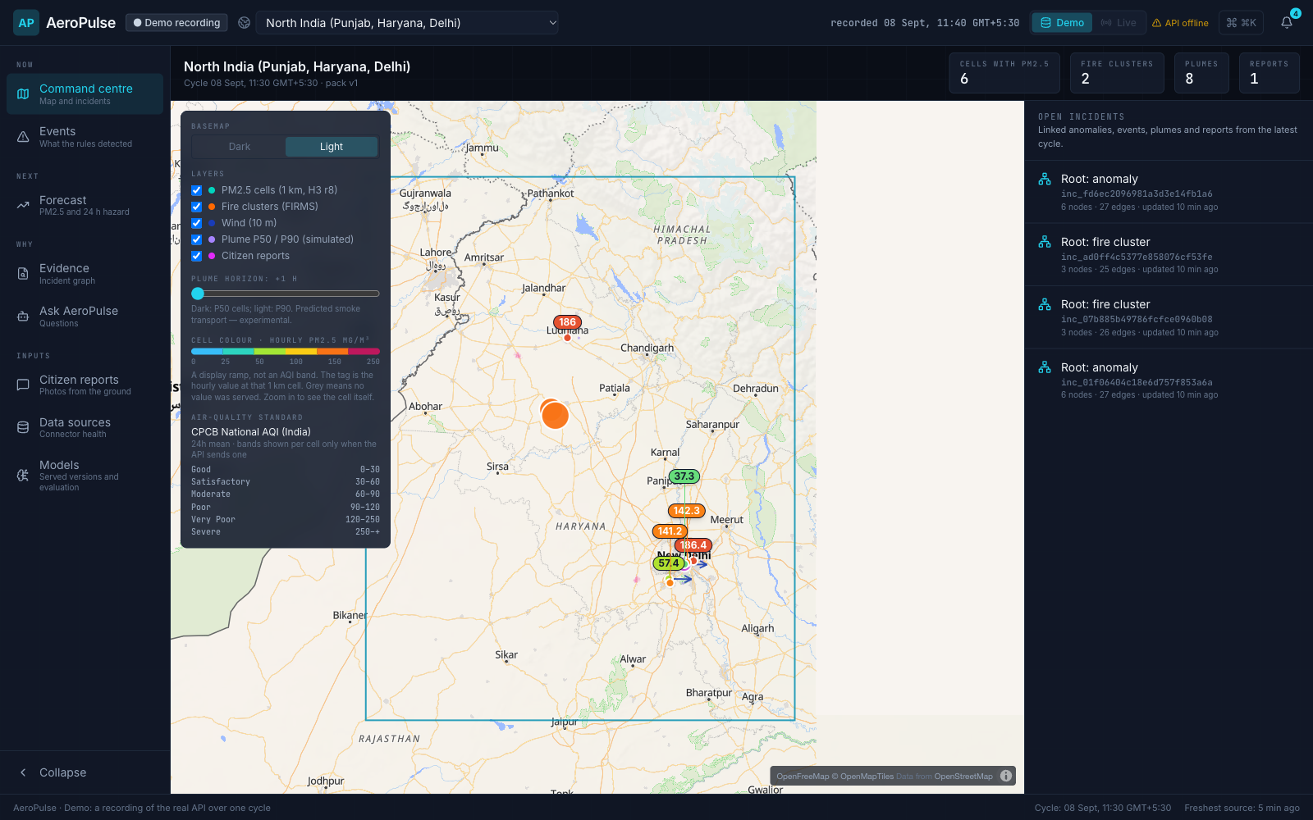
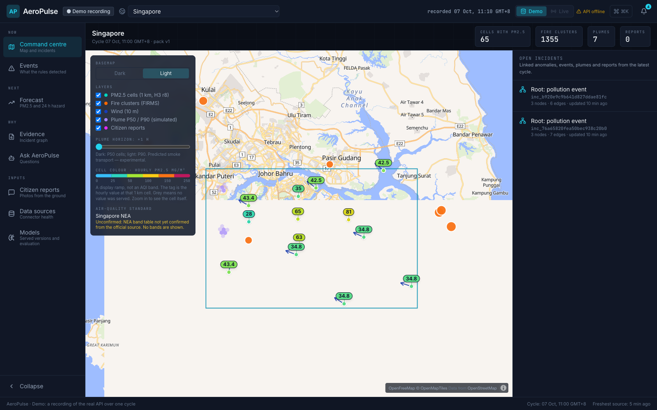
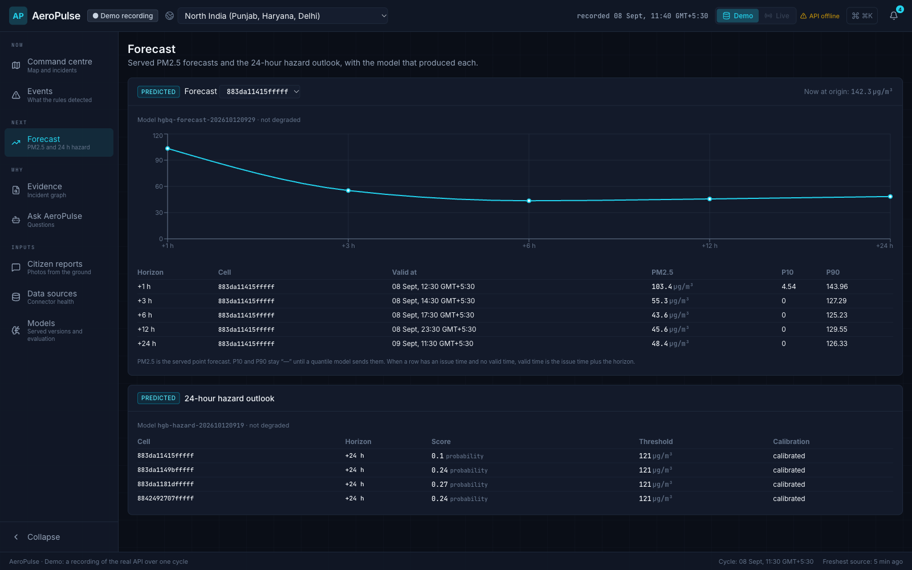
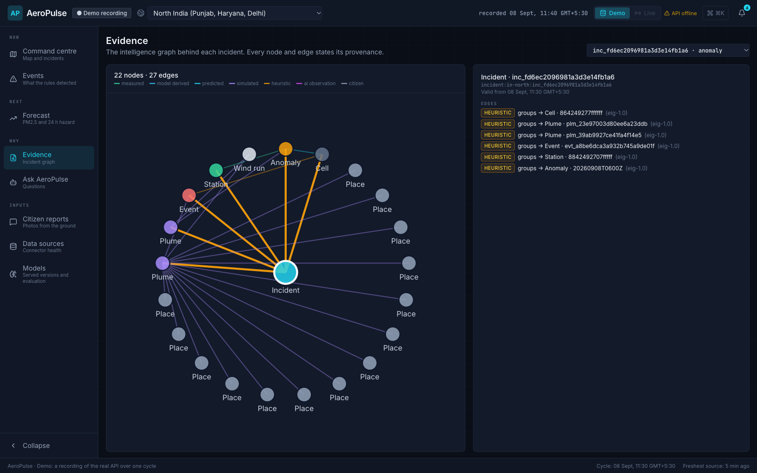
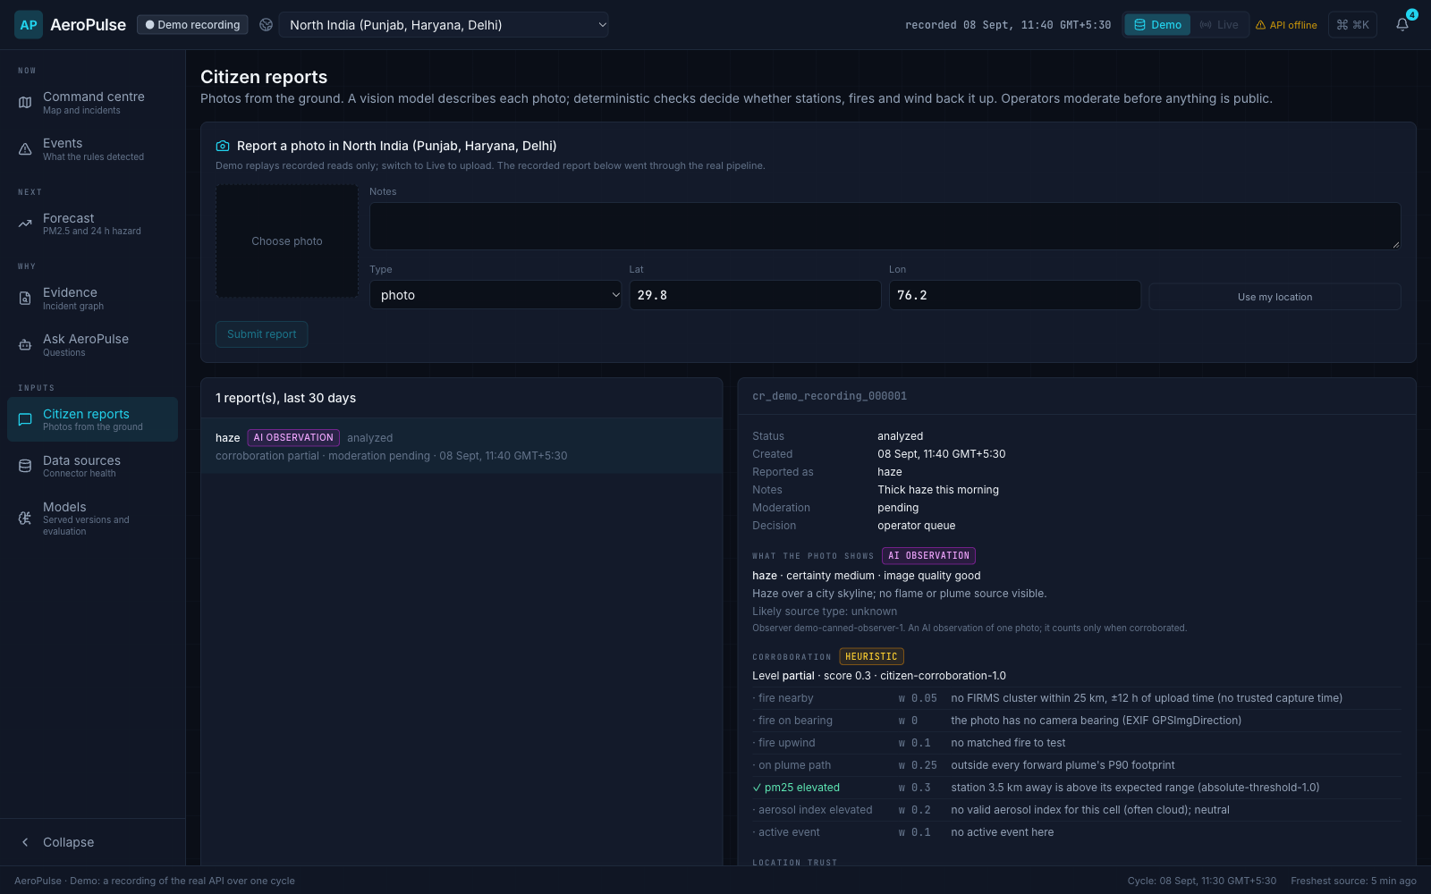
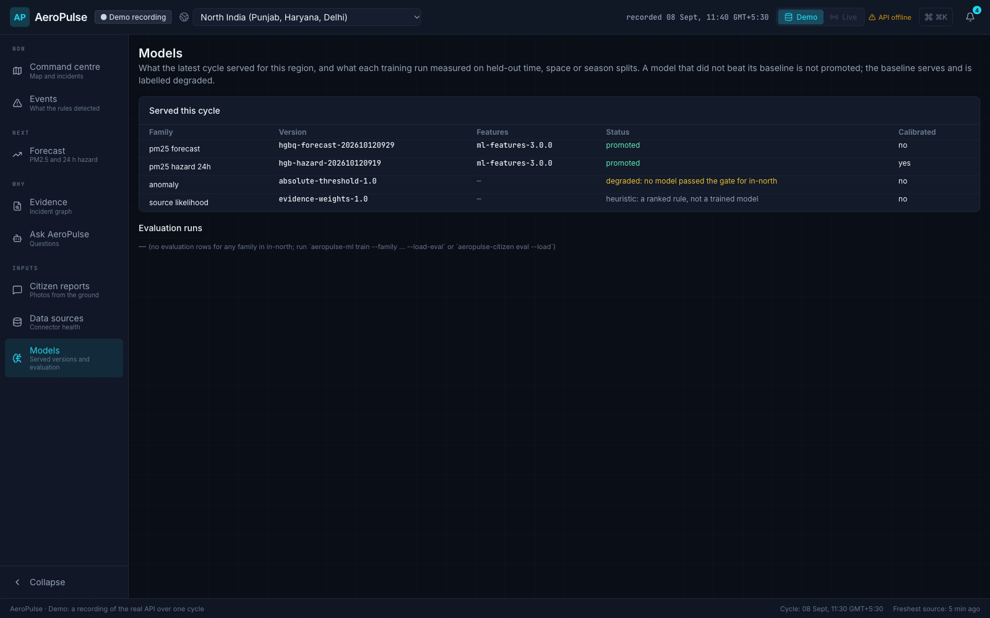
VII. PROTOTYPE
Product Walkthrough
(a) Command centre, North India
(b) Command centre, Singapore
(c) Forecast with served model version
(d) Evidence graph with provenance
(e) Citizen report corroboration
(f) Served models and status
Fig. 12. AeroPulse console in Demo mode (a recorded cycle of the real API; no backend needed).
AeroPulse — Source-to-People Air-Quality Intelligence · Hackathon 2026
16 / 18
Notes:
All six screens are from Demo mode, which replays one recorded cycle of the real API and works with no backend. (a) North India command centre with PM2.5 cells, FIRMS clusters, wind, plume footprints and incidents. (b) The same screen for Singapore, driven only by a different region pack. (c) Forecast with the served model version and 'not degraded'. (d) The evidence graph; every edge states its provenance. (e) A citizen report: AI observation plus the corroboration table. (f) Served models and their status.

Slide 17
VIII. DISCUSSION
Limitations and Future Work
Current limitations
Future work
NSW serves rules marked degraded — no gated model yet
CPCB connector is replay-only; live CPCB access is pending
Forecast P10/P90 quantiles are not yet calibrated (only the North India hazard is)
Source likelihood is a heuristic ranking until a gold set exists
Plume transport is labelled experimental
Leave-region-out evaluation unavailable with one ground-truth region per run
Alerts go to a pluggable sink — no push or SMS yet
Singapore and NSW AQI band tables await confirmation from the official source
Calibrated quantile forecasts and hazard calibration in every region
Gated models for NSW once station history is sufficient
Live CPCB connector to strengthen North India ground truth
A labelled gold set so source attribution can move beyond heuristics
Volcanic-ash hazard profile (e.g., Indonesia) as a new region pack
Licensed population data for exposure estimates
Push / SMS alert sinks and OIDC sign-in
Live Sentinel / MODIS / CAMS ingestion; trace export and load tests
AeroPulse — Source-to-People Air-Quality Intelligence · Hackathon 2026
17 / 18
Notes:
We are explicit about what is not done. NSW has no gated model; CPCB is replay only; forecast quantiles are not calibrated yet; source likelihood is heuristic; alerts go to a pluggable sink with no push or SMS; population exposure needs licensed data. The roadmap follows directly.

Slide 18
IX. CONCLUSION
Conclusion and References
AeroPulse links source → wind → people on a ~1 km grid, every 15 minutes
Region packs make a new geography a configuration change
Per-region forecasts are served only after beating persistence; NSW honestly serves rules
Gemini is confined to grounded Q&A and corroborated citizen photos
Serverless on Google Cloud: Cloud Run, Scheduler, BigQuery, Cloud Storage, Pub/Sub, Vertex AI
References
[1] World Health Organization, “WHO global air quality guidelines: particulate matter (PM2.5 and PM10), ozone, nitrogen dioxide, sulfur dioxide and carbon monoxide,” WHO, Geneva, 2021.
[2] OpenAQ, “OpenAQ API documentation.” [Online]. Available: https://docs.openaq.org
[3] NASA LANCE, “FIRMS: Fire Information for Resource Management System (VIIRS active fires).” [Online]. Available: https://firms.modaps.eosdis.nasa.gov
[4] Open-Meteo, “Weather forecast and air quality APIs.” [Online]. Available: https://open-meteo.com
[5] Copernicus Atmosphere Monitoring Service, “Global atmospheric composition forecasts,” ECMWF. [Online]. Available: https://atmosphere.copernicus.eu
[6] N. Gorelick, M. Hancher, M. Dixon, S. Ilyushchenko, D. Thau, and R. Moore, “Google Earth Engine: Planetary-scale geospatial analysis for everyone,” Remote Sens. Environ., vol. 202, pp. 18–27, 2017.
[7] European Space Agency, “Sentinel-5P TROPOMI UV aerosol index, NRTI L3 (COPERNICUS/S5P/NRTI/L3_AER_AI),” Earth Engine Data Catalog. [Online].
[8] Central Pollution Control Board, “National Air Quality Index,” Govt. of India, New Delhi, 2014.
[9] National Environment Agency, Singapore, “PM2.5 readings,” data.gov.sg. [Online]. Available: https://data.gov.sg
[10] NSW Government, “Air quality categories.” [Online]. Available: https://www.airquality.nsw.gov.au
[11] Uber Technologies, “H3: A hexagonal hierarchical geospatial indexing system.” [Online]. Available: https://h3geo.org
[12] F. Pedregosa et al., “Scikit-learn: Machine learning in Python,” J. Mach. Learn. Res., vol. 12, pp. 2825–2830, 2011.
[13] Google Cloud, “Cloud Run” and “Generative AI on Vertex AI” documentation. [Online]. Available: https://cloud.google.com/run, https://cloud.google.com/vertex-ai
Next: live demo of the AeroPulse console
AeroPulse — Source-to-People Air-Quality Intelligence · Hackathon 2026
18 / 18
Notes:
AeroPulse joins source, wind and people on one grid and one clock, labels every number with what produced it, serves a model only where it beat persistence, keeps the language model off the event path, and runs on Google Cloud for three regions. Now the live demo.

