Slide 1
Classification of date fruits.
By using python jupyter notebook
Presented by:
Sunil Nagar

Slide 2
Content
Introduction
Libraries used in the project
Tasks preformed in project
1. Loading dataset
2. Checking null values
3. Pie Chart for type of date fruits count
5. Finding correlation between variables
Machine Learning Algorithms
1. Logistic Regression
2. Decision Tree Classifier
3. K-Neighbors Classifier
4. Random Forest Classifier
5. XGB Classification
Pandas-Profiling
Conclusion

Slide 3
Introduction
Dataset of date fruits:
There are variety of fruits around the world. A date is a stone fruit, meaning it has a single seed surrounded by an outer fleshy fruit. They're grown on date palm trees, mostly found in dry areas.
Dates are of many types. Each of them having their own benefits. In this project, a few of date fruit breeds are described. The factors that determine the type of fruit are the external appearance features such as color, length, diameter, and shape.
The aim of this is to classify the types of date fruit, that are, Barhee, Deglet Nour, Sukkary, Rotab Mozafati, Ruthana, Safawi, and Sagai by using different machine learning algorithms.

Slide 4




Libraries Used in the project
Pandas
NumPy
Matplotlib
Statistics

Slide 5
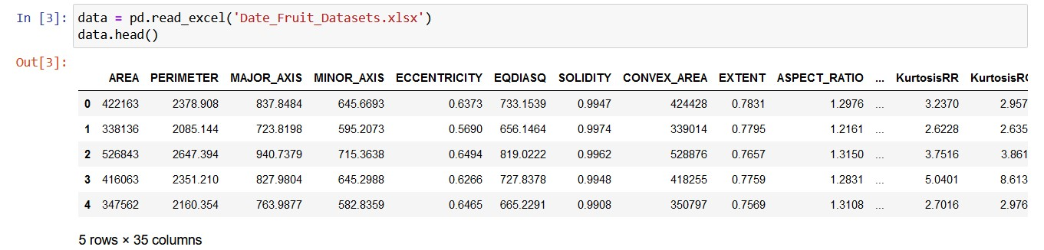
Loading dataset

Slide 6
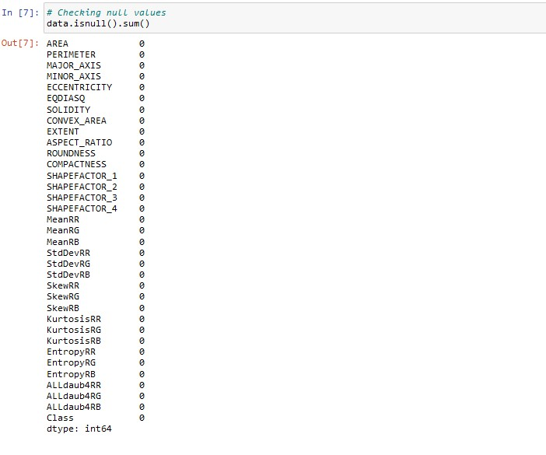
Checking null values

Slide 7
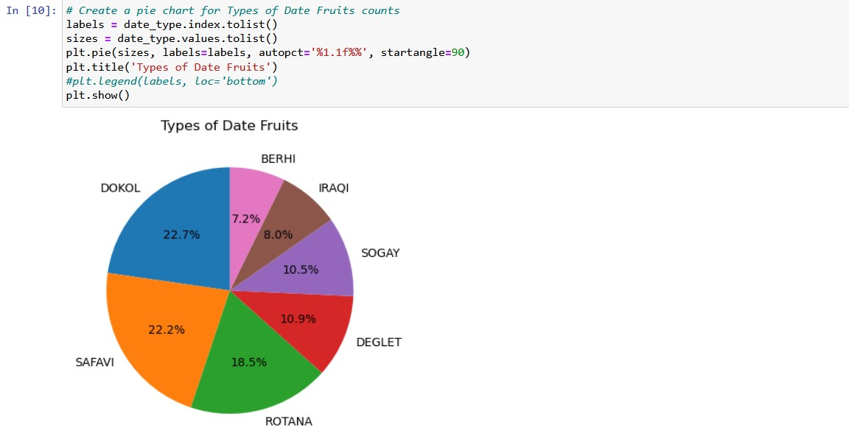
Pie Chart for album type counts

Slide 8
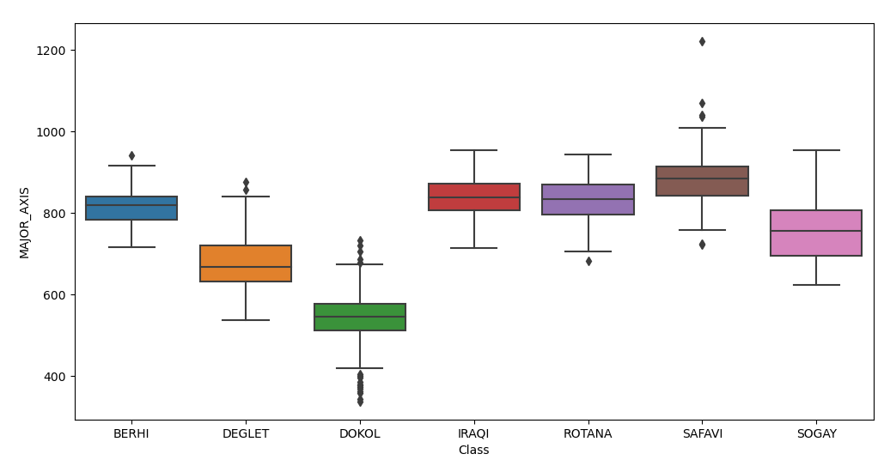
Checking outliers using box plot

Slide 9
Machine Learning Algorithm
Logistic Regression
Decision Tree
K- Neighbours Classifier
Random Forest Classifier
XGB Classifier

Slide 10
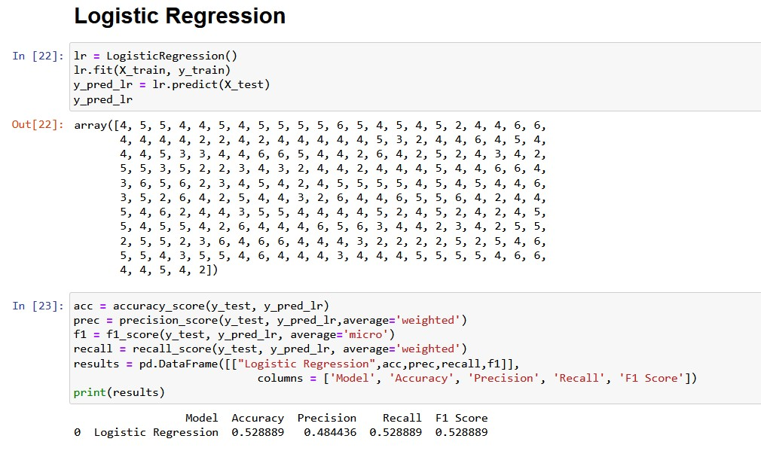
Logistic Regression

Slide 11
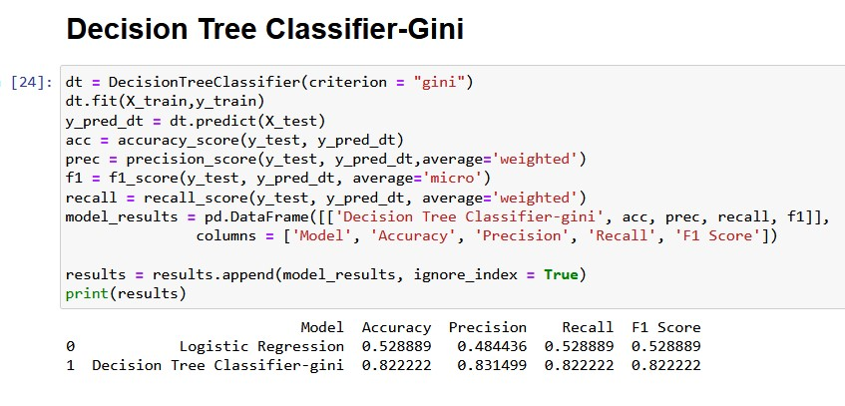
Decision Tree Algorithm

Slide 12
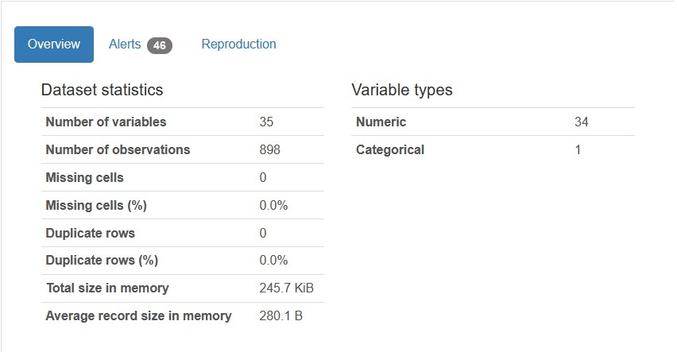
Pandas Profiling

Slide 13
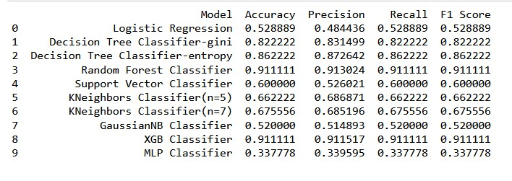
Conclusion
After applying different Machine Learning Algorithms we got different ACCURACY, PRECISION, RECALL AND F1_SCORE But in Random Forest Classifier we got ACCURACY= 0.911111, PRECISION=0.915482 , RECALL= 0.911111 AND F1_SCORE= 0.911111, but with the help of XGB Classifier(Advance version of Random Forest Classifier) we got we got ACCURACY= 0.911111, PRECISION= 0.911517, RECALL= 0.911111 AND F1_SCORE= 0.911111, because it used boosting method(It combines weak learners into strong learners by creating sequential models such that the final model has highest accuracy).

Slide 14


