Slide 1
Test driven development
Unrestricted

Slide 2
Agenda
Why test
Why Automated test
Test Driven Development
Testable design
Code Coverage
Q & A

Slide 3
“If it's worth building, it's worth testing. If it's not worth testing, why are you wasting your time working on it?“
Notes:
Question audience why test then based on the answer explain
Requirement validation using tests
Feedback loop

Slide 4
Building the right feedback loop
Notes:
Explain feedback loops created by tests
The ideal feedback loop has several properties:
Talk about Agile development
It's fast. No developer wants to wait hours or days to find out if their change works. Sometimes the change does not work - nobody is perfect - and the feedback loop needs to run multiple times. A faster feedback loop leads to faster fixes. If the loop is fast enough, developers may even run tests before checking in a change.
It's reliable. No developer wants to spend hours debugging a test, only to find out it was a flaky test. Flaky tests reduce the developer's trust in the test, and as a result flaky tests are often ignored, even when they find real product issues.
It isolates failures. To fix a bug, developers need to find the specific lines of code causing the bug. When a product contains millions of lines of codes, and the bug could be anywhere, it's like trying to find a needle in a haystack.

Slide 5
Building the right feedback loop
Tests create a feedback loop that informs the developer whether the product is working or not.
Notes:
Explain feedback loops created by tests
The ideal feedback loop has several properties:
Talk about Agile development
It's fast. No developer wants to wait hours or days to find out if their change works. Sometimes the change does not work - nobody is perfect - and the feedback loop needs to run multiple times. A faster feedback loop leads to faster fixes. If the loop is fast enough, developers may even run tests before checking in a change.
It's reliable. No developer wants to spend hours debugging a test, only to find out it was a flaky test. Flaky tests reduce the developer's trust in the test, and as a result flaky tests are often ignored, even when they find real product issues.
It isolates failures. To fix a bug, developers need to find the specific lines of code causing the bug. When a product contains millions of lines of codes, and the bug could be anywhere, it's like trying to find a needle in a haystack.

Slide 6
Ideal feedback loop properties
It's fast
It's reliable
It isolates failures
Notes:
It's fast. No developer wants to wait hours or days to find out if their change works. Sometimes the change does not work - nobody is perfect - and the feedback loop needs to run multiple times. A faster feedback loop leads to faster fixes. If the loop is fast enough, developers may even run tests before checking in a change.
It's reliable. No developer wants to spend hours debugging a test, only to find out it was a flaky test. Flaky tests reduce the developer's trust in the test, and as a result flaky tests are often ignored, even when they find real product issues.
It isolates failures. To fix a bug, developers need to find the specific lines of code causing the bug. When a product contains millions of lines of codes, and the bug could be anywhere, it's like trying to find a needle in a haystack.

Slide 7
Why automated test
Test Early.
Test Often.
Test Automatically.
Notes:
Why automated tests
Humans are bad in repetitive tasks
Tests document behavior of SW
Unit tests lead to more testable code which usually is less coupled and cleaner
Tests save from breaking code, i.e. when refactoring

Slide 8
Fear of making change
Notes:
Why don’t you fix bad code when you see it? Your first reaction upon seeing a messy function is “This is a mess, it needs to be cleaned.” Your second reaction is “I’m not touching it!” Why? Because you know that if you touch it you risk breaking it; and if you break it, it becomes yours.
But what if you could be sure that your cleaning did not break anything? What if you had the kind of certainty that I just mentioned? What if you could click a button and know within 90 seconds that your changes had broken nothing, and had only done good?
This is one of the most powerful benefits of TDD. When you have a suite of tests that you trust, then you lose all fear of making changes. When you see bad code, you simply clean it on the spot. The code becomes clay that you can safely sculpt into simple and pleasing structures.
When programmers lose the fear of cleaning, they clean! And clean code is easier to understand, easier to change, and easier to extend. Defects become even less likely because the code gets simpler. And the code base steadily improves instead of the normal rotting that our industry has become used to.
What professional programmer would allow the rotting to continue?

Slide 9
Fear of making change
Unit tests enable to gain confidence in code over time . As test accumulate , we gain confidence in the behavior of the system.
Fear of making change disappear
Notes:
Why don’t you fix bad code when you see it? Your first reaction upon seeing a messy function is “This is a mess, it needs to be cleaned.” Your second reaction is “I’m not touching it!” Why? Because you know that if you touch it you risk breaking it; and if you break it, it becomes yours.
But what if you could be sure that your cleaning did not break anything? What if you had the kind of certainty that I just mentioned? What if you could click a button and know within 90 seconds that your changes had broken nothing, and had only done good?
This is one of the most powerful benefits of TDD. When you have a suite of tests that you trust, then you lose all fear of making changes. When you see bad code, you simply clean it on the spot. The code becomes clay that you can safely sculpt into simple and pleasing structures.
When programmers lose the fear of cleaning, they clean! And clean code is easier to understand, easier to change, and easier to extend. Defects become even less likely because the code gets simpler. And the code base steadily improves instead of the normal rotting that our industry has become used to.
What professional programmer would allow the rotting to continue?

Slide 10
Continuous integration and Continuous delivery

Slide 11
Continuous integration
Continuous Integration is a software development practice where members of a team integrate their work frequently
each person integrates at least daily - leading to multiple integrations per day.
Each integration is verified by an automated build (including test) to detect integration errors as quickly as possible.

Slide 12
continuous delivery
reduce the cost , time , and risk of delivering incremental changes
to users

Slide 13
Executable Documentation
Notes:
You should be able to delete all your code and rebuild it using understanding of your tests .
Have you ever used a third-party framework? Often the third party will send you a nicely formatted manual written by tech writers. The typical manual employs 27 eight-by-ten color glossy photographs with circles and arrows and a paragraph on the back of each one explaining how to configure, deploy, manipulate, and otherwise use that framework. At the back, in the appendix, there’s often an ugly little section that contains all the code examples.
Where’s the first place you go in that manual? If you are a programmer, you go to the code examples. You go to the code because you know the code will tell you the truth. The 27 eight-by-ten color glossy photographs with circles and arrows and a paragraph on the back might be pretty, but if you want to know how to use code you need to read code.
Each of the unit tests you write when you follow the three laws is an example, written in code, describing how the system should be used. If you follow the three laws, then there will be a unit test that describes how to create every object in the system, every way that those objects can be created.
There will be a unit test that describes how to call every function in the system every way that those functions can meaningfully be called. For anything you need to know how to do, there will be a unit test that describes it in detail.
The unit tests are documents. They describe the lowest-level design of the system. They are unambiguous, accurate, written in a language that the audience understands, and are so formal that they execute. They are the best kind of low-level documentation that can exist. What professional would not provide such documentation?

Slide 14
Executable Documentation
Create a suite of documents that fully describe the low level behavior of the system .
Low level documentation that executes
Notes:
You should be able to delete all your code and rebuild it using understanding of your tests .
Have you ever used a third-party framework? Often the third party will send you a nicely formatted manual written by tech writers. The typical manual employs 27 eight-by-ten color glossy photographs with circles and arrows and a paragraph on the back of each one explaining how to configure, deploy, manipulate, and otherwise use that framework. At the back, in the appendix, there’s often an ugly little section that contains all the code examples.
Where’s the first place you go in that manual? If you are a programmer, you go to the code examples. You go to the code because you know the code will tell you the truth. The 27 eight-by-ten color glossy photographs with circles and arrows and a paragraph on the back might be pretty, but if you want to know how to use code you need to read code.
Each of the unit tests you write when you follow the three laws is an example, written in code, describing how the system should be used. If you follow the three laws, then there will be a unit test that describes how to create every object in the system, every way that those objects can be created.
There will be a unit test that describes how to call every function in the system every way that those functions can meaningfully be called. For anything you need to know how to do, there will be a unit test that describes it in detail.
The unit tests are documents. They describe the lowest-level design of the system. They are unambiguous, accurate, written in a language that the audience understands, and are so formal that they execute. They are the best kind of low-level documentation that can exist. What professional would not provide such documentation?

Slide 15
Test Readability

Slide 16
Test Readability
Teams that adopt TDD usually see an early boost in productivity because the tests let them add features with confidence and catch errors immediately. For some teams, the pace then slows down as the tests themselves become a maintenance burden.
For TDD to be sustainable, the tests must do more than verify the behavior of the code; they must also express that behavior clearly—they must be readable
Notes:
but with differences in style since the two types of code serve different purposes. Test code should describe what the production code does.
That means that it tends to be concrete about the values it uses as examples of what results to expect, but abstract about how the code works

Slide 17
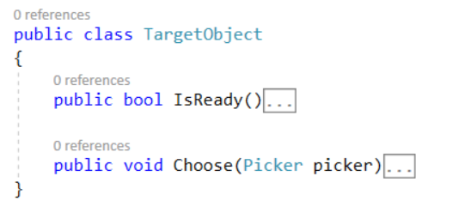
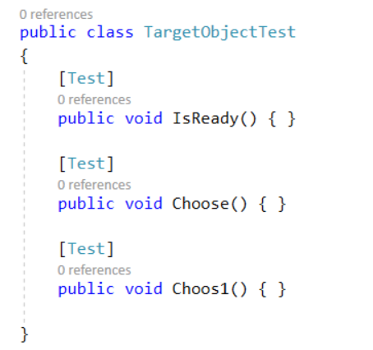
Code Example

Slide 18
Test Readability
such names duplicate the information a developer could get just by looking at the target class; they break the “Don’t Repeat Yourself” principle [Hunt99].
We don’t need to know that TargetObject has a choose() method—we need to know what the object does in different situations, what the method is for.

Slide 19
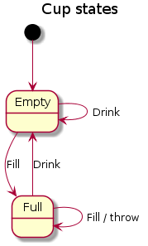
Test cases by states

Slide 20
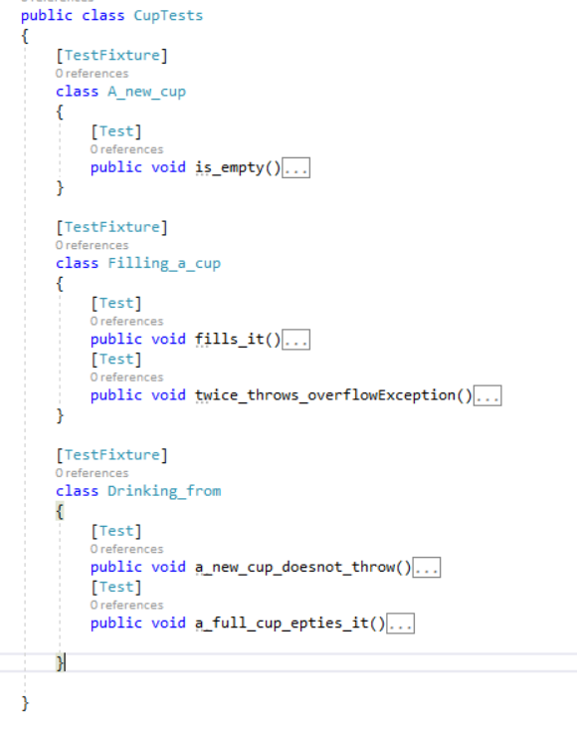

Slide 21
Test Readability
These names can be as long as we like because they’re only called through reflection—we never have to type them in to call them.
The point of the convention is to encourage the developer to think in terms of what the target object does, not what it is.

Slide 22
Keeping Test Clean
Test code is just as important as production code. It is not second class citizen.
What makes test clean
Readability , Clarity , simplicity and density of expression
Notes:
If test is not readable , it’s difficult to understand for new developer . We write test so that it fail in the future when something goes wrong so readability is very important so that we can fix it easily
Follow “Arrange , Act , Assert”

Slide 23
Different type of Test
Acceptance: Does the whole system work?
Integration: Does our code work against the code we can't change?
Unit: Do our objects do the right thing, are they convenient to work with?

Slide 24
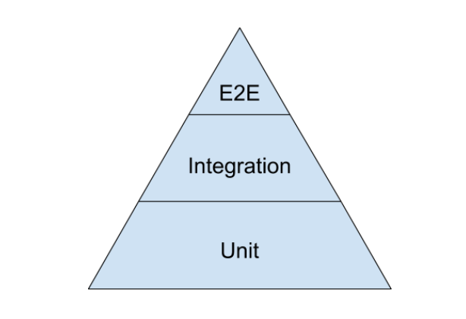
Test pyramid
Notes:
For much of my career test automation meant tests that drove an application through its user-interface. Such tools would often provide the facility to record an interaction with the application and then allow you to play back that interaction, checking that the application returned the same results. Such an approach works well initially. It's easy to record tests, and the tests can be recorded by people with no knowledge of programming.
But this kind of approach quickly runs into trouble, becoming an ice-cream cone. Testing through the UI like this is slow, increasing build times. Often it requires installed licences for the test automation software, which means it can only be done on particular machines. Usually these cannot easily be run in a "headless" mode, monitored by scripts to put in a proper deployment pipeline.
Most importantly such tests are very brittle. An enhancement to the system can easily end up breaking lots of such tests, which then have to be re-recorded. You can reduce this problem by abandoning record-playback tools, but that makes the tests harder to write. [1] Even with good practices on writing them, end-to-end tests are more prone to non-determinism problems, which can undermine trust in them. In short, tests that run end-to-end through the UI are: brittle, expensive to write, and time consuming to run. So the pyramid argues that you should do much more automated testing through unit tests than you should through traditional GUI based testing. [2]
The pyramid also argues for an intermediate layer of tests that act through a service layer of an application, what I refer to asSubcutaneousTests. These can provide many of the advantages of end-to-end tests but avoid many of the complexities of dealing with UI frameworks. In web applications this would correspond to testing through an API layer while the top UI part of the pyramid would correspond to tests using something like Selenium or Sahi.
The test pyramid comes up a lot in Agile testing circles and while its core message is sound, there is much more to say about building a well-balanced test portfolio. A common problem is that teams conflate the concepts of end-to-end tests, UI tests, and customer facing tests. These are all orthogonal characteristics. For example a rich javascript UI should have most of its UI behavior tested with javascript unit tests using something like Jasmine. A complex set of business rules could have tests captured in a customer-facing form, but run just on the relevant module much as unit tests are.
I always argue that high-level tests are there as a second line of test defense. If you get a failure in a high level test, not just do you have a bug in your functional code, you also have a missing or incorrect unit test. Thus I advise that before fixing a bug exposed by a high level test, you should replicate the bug with a unit test. Then the unit test ensures the bug stays dead

Slide 25
Unit Tests
A test is not a unit test if:
It talks to the database
It communicates across the network
It touches the file system
It can't run at the same time as any of your other unit tests
You have to do special things to your environment (such as editing config files) to run it.
Michael Feathers, "A Set of Unit Testing Rules"

Slide 26
F.I.R.S.T
Fast
Tests should be fast. They should run quickly.
When tests run slow, you won’t want to run them frequently. If you don’t run them frequently, you won’t find problems early enough to fix them easily. You won’t feel as free to clean up the code. Eventually the code will begin to rot.
Independent
Tests should not depend on each other.
One test should not set up the conditions for the next test. You should be able to run each test independently and run the tests in any order you like.

Slide 27
Repeatable
Tests should be repeatable in any environment. You should be able to run the tests in the production environment, in the QA environment, without a network.
If your tests aren’t repeatable in any environment, then you’ll always have an excuse for why they fail. You’ll also find yourself unable to run the tests when the environment isn’t available.
Self-Validating
The tests should have a boolean output. Either they pass or fail.
You should not have to read through a log file to tell whether the tests pass. If the tests aren’t self-validating, then failure can become subjective and running the tests can require a long manual evaluation.

Slide 28
Timely
The tests need to be written in a timely fashion. Unit tests should be written just before the production code that makes them pass.
If you write tests after the production code, then you may find the production code to be hard to test. You may decide that some production code is too hard to test. You may not design the production code to be testable.

Slide 29
The TDD mantra
Green
Refactor
Red
Write a failing test for a new feature, i.e., specify a new behavior
Write enough code to pass the test
Simplify, consolidate and generalize code and tests
Notes:
Discuss about feedback loop

Slide 30
TDD step size
Do not write more code than you need
Write tests that test small portions of functionality
Step “size“ can be adjusted according to convenience

Slide 31
Unit Tests != TDD
Code can also be driven by automated integration tests (UI tests, DB tests, …)
TDD is a practice, unit tests are automated tests with specific properties

Slide 32
Why TDD
TDD sets priority for tests
Deign feedback
Notes:
Feedback about architecture
Unit test takes too long to execute which indicates that tests Is not unit test
TDD is about feedback; if a test is painful to write, make the SUT easier to use. Unfortunately, some people tolerate pain too well.
Writing a unit test first makes developers anticipate concerns. A simple unit test, as the one presented in Listing 1, makes developers think about the expected behavior from the class. Developers decide about its public interface, name, return types, or even exceptions thrown, before writing the actual class.

Slide 33
Why TDD
Most of the tests feedback on design is based on the fact that if it is hard to test a class in an isolated way, then it may have a problem with its design.
The harder to write a unit test, the bigger the possibility to find a design smell.

Slide 34
Testable design
Dependency injection
Programming to interface
LSP – mock *
Single responsibility principle
Adapter
Notes:
Hard-to-Test Code

Slide 35
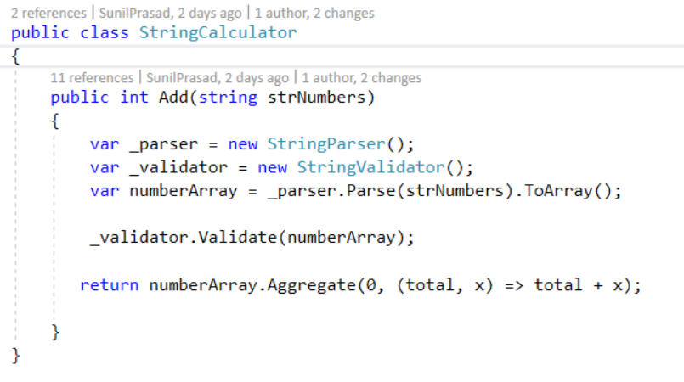
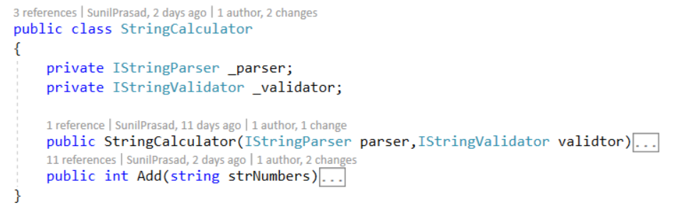
Dependency Injection

Slide 36
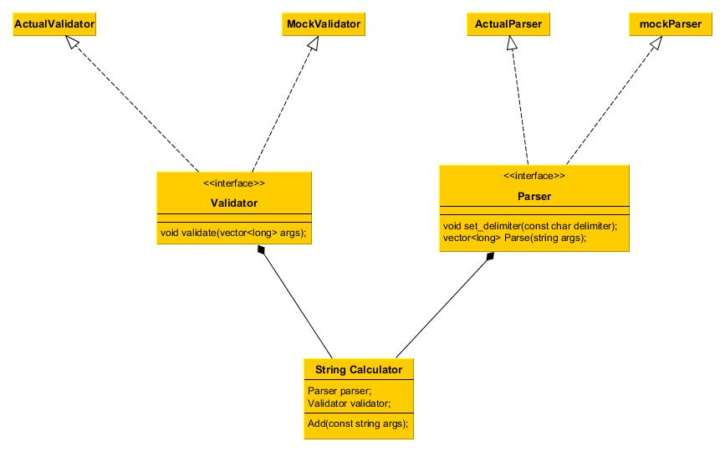

Slide 37
Common test smells
Hard-to-Test Code
Fragile Test
Test Code Duplication
Slow Tests
Conditional Test Logic

Slide 38
Code Coverage
Notes:
If you make a certain level of coverage a target, people will try to attain it. The trouble is that high coverage numbers are too easy to reach with low quality testing. At the most absurd level you have AssertionFreeTesting. But even without that you get lots of tests looking for things that rarely go wrong distracting you from testing the things that really matter.
TDD is a very useful, but certainly not sufficient, tool to help you get good tests
I would say you are doing enough testing if the following is true:
You rarely get bugs that escape into production, and
You are rarely hesitant to change some code for fear it will cause production bugs.
http://www.developertesting.com/archives/month200705/20070504-000425.html
Testivus On Test Coverage
Early one morning, a programmer asked the great master:
“I am ready to write some unit tests. What code coverage should I aim for?”
The great master replied:
“Don’t worry about coverage, just write some good tests.”
The programmer smiled, bowed, and left.
...
Later that day, a second programmer asked the same question.
The great master pointed at a pot of boiling water and said:
“How many grains of rice should put in that pot?”
The programmer, looking puzzled, replied:
“How can I possibly tell you? It depends on how many people you need to feed, how hungry they are, what other food you are serving, how much rice you have available, and so on.”
“Exactly,” said the great master.
The second programmer smiled, bowed, and left.
...
Toward the end of the day, a third programmer came and asked the same question about code coverage.
“Eighty percent and no less!” Replied the master in a stern voice, pounding his fist on the table.
The third programmer smiled, bowed, and left.
...
After this last reply, a young apprentice approached the great master:
“Great master, today I overheard you answer the same question about code coverage with three different answers. Why?”
The great master stood up from his chair:
“Come get some fresh tea with me and let’s talk about it.”
After they filled their cups with smoking hot green tea, the great master began to answer:
“The first programmer is new and just getting started with testing. Right now he has a lot of code and no tests. He has a long way to go; focusing on code coverage at this time would be depressing and quite useless. He’s better off just getting used to writing and running some tests. He can worry about coverage later.”
“The second programmer, on the other hand, is quite experience both at programming and testing. When I replied by asking her how many grains of rice I should put in a pot, I helped her realize that the amount of testing necessary depends on a number of factors, and she knows those factors better than I do – it’s her code after all. There is no single, simple, answer, and she’s smart enough to handle the truth and work with that.”
“I see,” said the young apprentice, “but if there is no single simple answer, then why did you answer the third programmer ‘Eighty percent and no less’?”
The great master laughed so hard and loud that his belly, evidence that he drank more than just green tea, flopped up and down.
“The third programmer wants only simple answers – even when there are no simple answers … and then does not follow them anyway.”
The young apprentice and the grizzled great master finished drinking their tea in contemplative silence.

Slide 39
Q & A

