Slide 1



Slide 2
Model building – life cycle
We can broadly divide the model building life cycle in six stages:
Problem Definition
Data Extraction / Collection
Data Exploration and Transformation
Predictive Modeling
Hypothesis Generation
Model Deployment/ Implementation
1
2
3
4
5
5

Slide 3
Predictive Modeling
It is a process to create statistical model for estimating/ predicting the future behaviour based on past data.

Slide 4
Predictive Modeling
Example:
A retail bank wants to know the default behaviour of its credit card customers. They want to predict the probability of default for each customer with in next 3 months.
Probability of default would lie between 0 and 1.
Assume 10% of customers will default in the next 3 months (based on historic data)
1
0

Slide 5
Predictive Modeling
Example:
A retail bank wants to know the default behaviour of their credit card customers like “Predict the probability of default for customers?”
Probability of default for each customer in next 3 months = 0.1
1
Now, what these “Predictive Models” do?
0.5
0.1
0

Slide 6
Predictive Modeling
Example:
A retail bank wants to know the default behaviour of their credit card customers like “Predict the probability of default for customers?”
Probability of default for each customer in next 3 months = 0.1
1
It moves the probability towards one of the two extremes based on attributes from past information
0.5
0.1
0

Slide 7
Predictive Modeling
Example:
A retail bank wants to know the default behaviour of their credit card customers like “Predict the probability of default for customers?”
Probability of default for each customer in next 3 months = 0.1
1
It moves the probability towards one of the two extremes based some given attributes
0.5
A customer with volatile income is more likely (closer to 1) to default
0.1
0

Slide 8
Predictive Modeling
Example:
A retail bank wants to know the default behaviour of their credit card customers like “Predict the probability of default for customers?”
Probability of default for each customer in next 3 months = 0.1
1
It moves the probability towards one of the two extremes based some given attributes
0.5
OR, A customer with healthy credit history for last 10 years has low chances of default (closer to 0)
0.1
0

Slide 9
Steps of Predictive Modeling
Algorithm Selection
Training Model
Prediction/ Scoring
Notes:
Broadly three steps of predictive modeling after data exploration i.e. having cleaned data.

Slide 10
Steps of Predictive Modeling
Have dependent variable?
Algorithm Selection
Training Model
Prediction/ Scoring
Y
N
Example:
Customer segmentation for defining right product
Common Algorithms:
K-means
Spectral Clustering
Example:
Estimate the total sales by an insurance agent in next 3 months
Algorithms:
Simple Linear Regression
Multiple Regression
Example:
Predict the customer will buy product or not
Common Algorithms:
Logistics Regression
Decision Tree
Random Forest
Supervised Learning
Unsupervised Learning
Is dependent variable continuous?
Clustering
Y
Regression
Classification
Notes:
Algorithm selection is broadly based on dependent variable, like “is there any dependent variable or what is the data type of dependent variable?”

Slide 11
Steps of Predictive Modeling
Algorithm Selection
Training Model
Prediction/ Scoring
It is a process to learn relationship/ correlation between independent and dependent variables

Slide 12
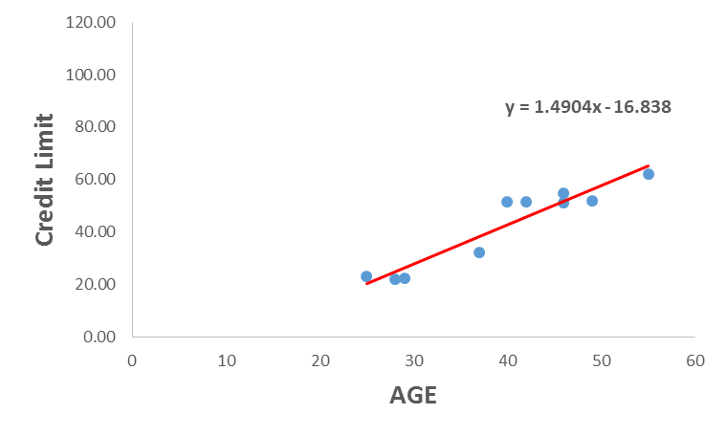
Steps of Predictive Modeling
Algorithm Selection
Training Model
Prediction/ Scoring
Equation:
Credit Limit = f(Age)
Credit Limit= 1.4904*Age - 16.838
Here, you can see predictive model (linear equation) based on single variable
Notes:
Explain about the relationship between variables

Slide 13
Steps of Predictive Modeling
Algorithm Selection
Training Model
Prediction/ Scoring
Equation:
Credit Limit = f(Age)
Credit Limit= 1.4904*Age - 16.838
We can also use other algorithms to estimate/ predict the value of dependent variable.
Notes:
Talk about other algorithms like regression, decision tree, Random forest and others

Slide 14
Steps of Predictive Modeling
Algorithm Selection
Training Model
Prediction/ Scoring
Equation:
Credit Limit = f(Age)
Credit Limit= 1.4904*Age - 16.838
Where will we use this equation?
Notes:
Explain about the relationship between variables

Slide 15
Steps of Predictive Modeling
Algorithm Selection
Training Model
Prediction/ Scoring
Equation:
Credit Limit = f(Age)
Credit Limit= 1.4904*Age - 16.838
This equation is used to predict/ estimate dependent variable of test data set
Notes:
Explain about the relationship between variables

Slide 16
Steps of Predictive Modeling
Algorithm Selection
Training Model
Prediction/ Scoring
Equation:
Credit Limit = f(Age)
Credit Limit= 1.4904*Age - 16.838
What is test data set?
Notes:
Explain about the relationship between variables

Slide 17
Steps of Predictive Modeling
Algorithm Selection
Training Model
Prediction/ Scoring
Dataset
Train
Test
Past data (Known dependent variable)
Used to train model
Future data (Unknown dependent variable)
Used to score
Notes:
Explain Train and Test data set

Slide 18
Steps of Predictive Modeling
Algorithm Selection
Training Model
Prediction/ Scoring
It is a process to estimate/ predict dependent variable of test data set by applying model rules

Slide 19
Steps of Predictive Modeling
Algorithm Selection
Training Model
Prediction/ Scoring
Equation:
Credit Limit = f(Age)
Credit Limit= 1.4904*Age - 16.838
Use above equation to score “Credit Limit” for “Age” 40 and 50

Slide 20
Steps of Predictive Modeling
Algorithm Selection
Training Model
Prediction/ Scoring
Equation:
Credit Limit = f(Age)
Credit Limit= 1.4904*Age - 16.838
For “Age” 40, Credit Limit = 1.4904*40 -16.838 = 42.778

Slide 21
Steps of Predictive Modeling
Algorithm Selection
Training Model
Prediction/ Scoring
Equation:
Credit Limit = f(Age)
Credit Limit= 1.4904*Age - 16.838
Similarly, for “Age” 50, Credit Limit = 1.4904*50 -16.838 = 57.682

Slide 22
Steps of Predictive Modeling
Algorithm Selection
Training Model
Prediction/ Scoring
Equation:
Credit Limit = f(Age)
Credit Limit= 1.4904*Age - 16.838
We always apply training learning to test data set for prediction/ estimation

Slide 23
Model building – life cycle
We can broadly divide the model building life cycle in six stages:
Problem Definition
Data Extraction / Collection
Data Exploration and Transformation
Predictive Modeling
Hypothesis Generation
Model Deployment/ Implementation
1
2
3
4
5
6

Slide 24
Model Deployment/ Implementation
It is a process to serve model estimation to users
&
We can also deploy model results to develop data driven products

Slide 25
Model Deployment/ Implementation
Examples:

Slide 26

Model Deployment/ Implementation
Building recommendation engine for e-commerce companies
Notes:
Talk about problem…Higher relevant product for a specific customer

Slide 27
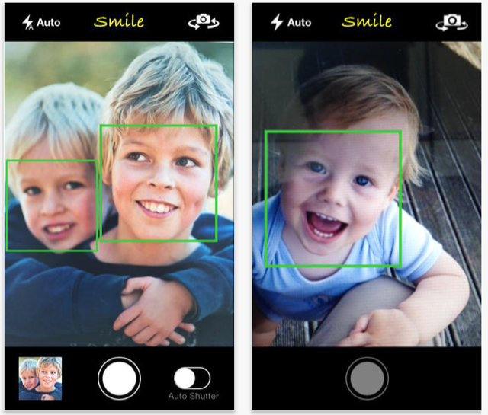
Model Deployment/ Implementation
The face detection feature in mobile cameras is an example of what machine learning can do
Notes:
Talk about problem…Smile Yes/ No

Slide 28

Model Deployment/ Implementation
Machine learning is used in Anti-viruses to improve detection of malicious software on computer devices
Notes:
Talk about problem…Is this file fall into virus category or not?

Slide 29
Thanks

