Slide 1
Theory Of Computation
Subject : -To Convert NFA to DFA by Epsilon Closure
Presented By : -
Sunil Sharma(36013)
Pranay Kamtekar(36014)
Guided by :Ms. Sarika Chavan

Slide 2

MSPM’S
DEOGIRI INSTITUTE OF ENGINEERING
AND MANAGEMENT STUDIES
Department of Computer Science and Engineering.
THEORY OF COMPUTATION
Presentation on:
To Convert NFA to DFA by Epsilon Closure
Submitted by:
Name : Sunil Sharma(36013)
Pranay Kamtekar(36014)
Under the Guidance of
prof. S.M. Chavan
Asst. prof. Department of CSE
(Deogiri Institute of Engineering And Management Studies)

Slide 3
Non-determinestic Finite Automata (NFA) : NFA is a finite automaton where for some cases when a single input is given to a single state, the machine goes to more than 1 states, i.e. some of the moves cannot be uniquely determined by the present state and the present input symbol. An NFA can be represented as M = { Q, ∑, ∂, q0, F} Q → Finite non-empty set of states. ∑ → Finite non-empty set of input symbols. ∂ → Transitional Function. q0 → Beginning state. F → Final State NFA with (null) or ∈ move : If any finite automata contains ε (null) move or transaction, then that finite automata is called NFA with ∈ moves

Slide 4
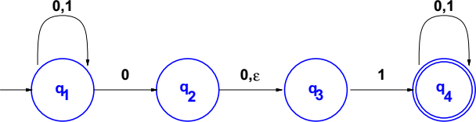
Non-Deterministic Finite Automata (NFA)
an NFA may have more than one transition labeled with a certain symbol an NFA may have no transitions labeled with a certain symbol
transitions may be labeled with ε, the empty string.
NFAs are usually easier to design than equivalent DFAs
Every DFA is also a non-deterministic finite automata (NFA)

Slide 5
NFA
Q = {q₁, q₂, q₃, q₄}, Σ = {0, 1},
 | 0 | 1 | ε
q₁ | {q₁, q₂} | {q₁} | Ø
q₂ | {q₃} | Ø | {q₃}
q₃ | Ø | {q₄} | Ø
q₄ | {q₄} | {q₄} | Ø
δ is
q₁ is the start state, and F = {q₄}.

Slide 6
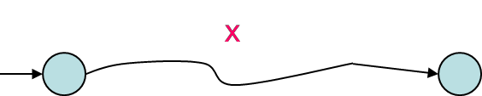
NFA v/s DFA
DFA: For every string x, there is a unique path from initial state and associated with x. x is accepted if and only if this path ends at a final state.
NFA: For any string x, there may exist none or more than one path from initial state and associated with x.

Slide 7
Epsilon Closure
Epsilon closure of a state is simply the set of all states we can reach by following the transition function from the given state that are labeled ε.
Example:
ε-closure(q) = { q }
ε-closure(r) = { r, s}

Slide 8
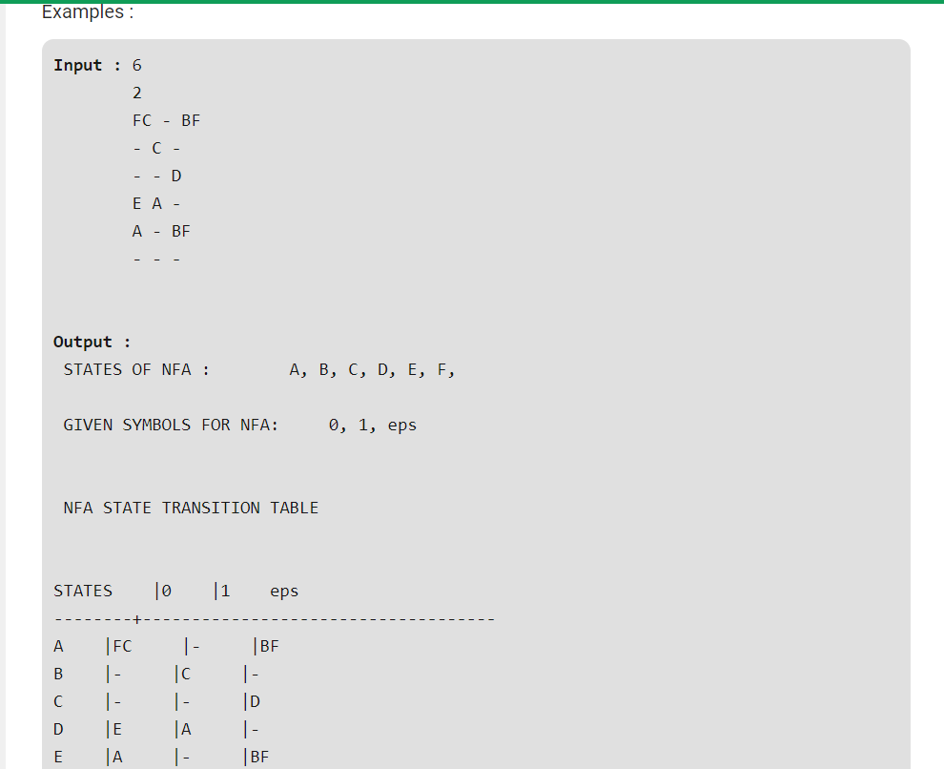

Slide 9
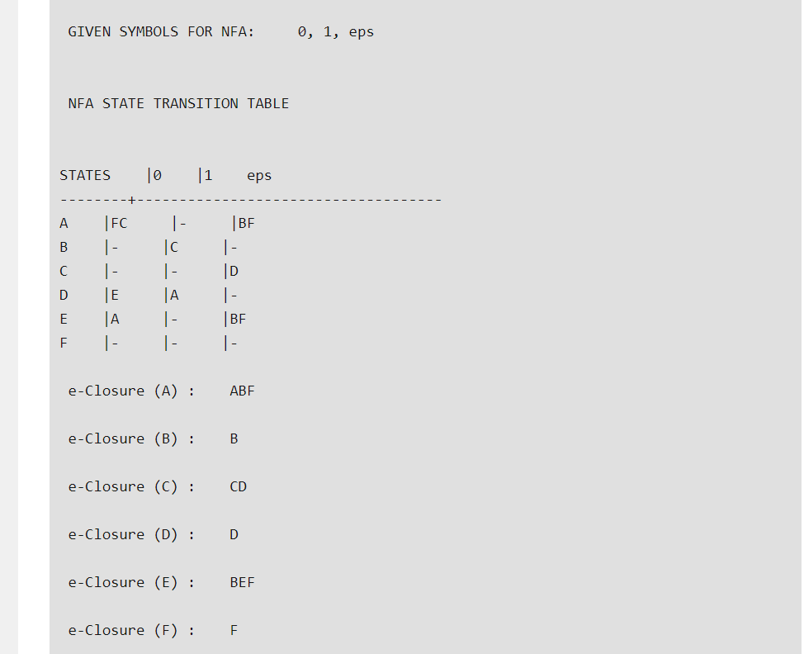

Slide 10
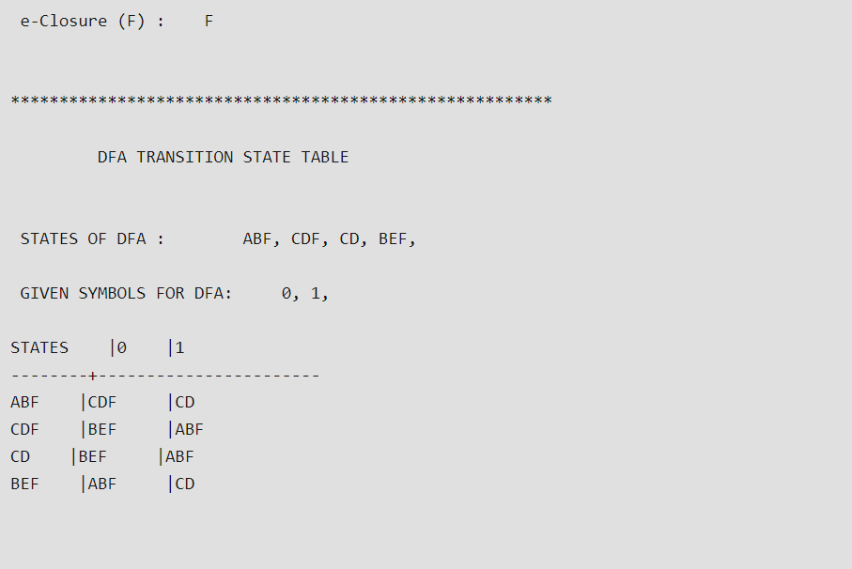

Slide 11
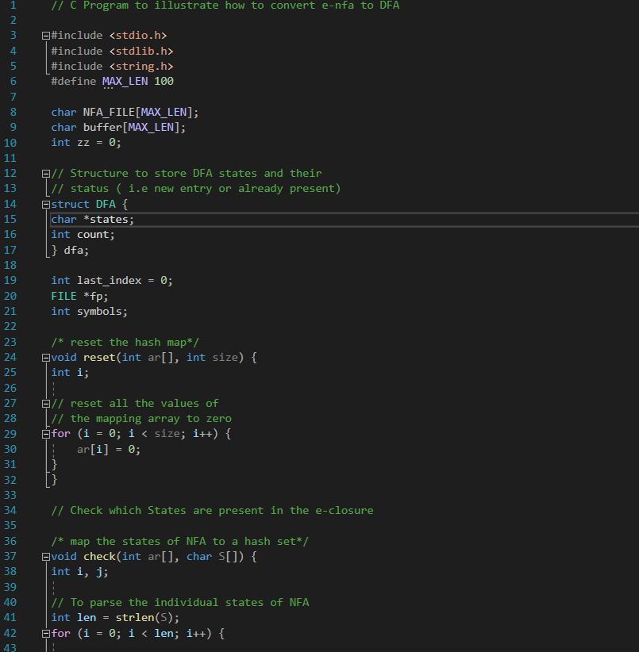
Code For Conversion from NFA To DFA

