Slide 1

DISSERTATION
From Black Box to Regulatory Guardian
An Explainable, Guardrailed Agentic AI Platform for Multi-Modal Banking Contract Review and Automated Regulatory Lifecycle Management (LRR)
CANDIDATE INFORMATION
Kattamuri Sunil Kumar
BITS ID: 2024AA05522
MTech AIML WILP Program
INDUSTRY SUPERVISION
Yedluri Praveen
Kesani Krishna Chaitanya
Bank of America, Hyderabad

Slide 2
Agenda
01
Problem & Context
Core operational pain points in banking compliance.
02
Literature & Gaps
Limitations of existing standalone AI models.
03
System Architecture
The 6-layer enterprise framework overview.
04
Module Workflows
Detailed component and agent flow diagrams.
05
Experimental Results
Model evaluation, RAG metrics, and ablation.
06
Conclusion
Research impact and future scope.
h impact and future scope.

Slide 3

Problem Statement & Research Motivation
Banking Compliance Workflow
Key Challenges
Upload Contract
Manual contract review
Multiple overlapping regulations
High vulnerability to human errors
Slow and inefficient compliance turnaround
Limited explainability in standard models
Severe hallucination risks in off-the-shelf LLMs
Legal Team
Compliance Review
Policy Validation
Regulatory Approval
Need for an Explainable, Trustworthy and Automated AI Platform
Develop a secure, explainable, and autonomous AI platform that can automate contract review while ensuring transparency, regulatory compliance, and enterprise governance.

Slide 4
Research Gap Analysis
Although significant research exists in Document AI, Legal NLP, Retrieval-Augmented Generation (RAG), and Agentic AI, current solutions address only isolated aspects of banking compliance. No single framework provides an integrated solution that combines multimodal understanding, autonomous reasoning, explainability, AI safety, and continuous regulatory monitoring.
Capability | Traditional OCR | Legal NLP | RAG Systems | Agentic AI | Proposed Platform
Text Extraction | ✅ | ✅ | ✅ | ✅ | ✅
Document Layout Understanding | ❌ | ❌ | ⚠️ | ⚠️ | ✅
Legal Clause Extraction | ⚠️ | ✅ | ⚠️ | ⚠️ | ✅
Enterprise Knowledge Retrieval | ❌ | ❌ | ✅ | ✅ | ✅
Multi-Step Reasoning | ❌ | ❌ | ⚠️ | ✅ | ✅
Explainable AI | ❌ | ❌ | ❌ | ⚠️ | ✅
Hallucination Prevention | ❌ | ❌ | ⚠️ | ⚠️ | ✅
Continuous Regulatory Monitoring | ❌ | ❌ | ❌ | ⚠️ | ✅
Banking Compliance Ready | ❌ | ⚠️ | ⚠️ | ⚠️ | ✅

Slide 5
Literature Review
The proposed research builds upon advances in Document AI, Legal NLP, Explainable AI, Retrieval-Augmented Generation, Agentic AI, and AI Safety to develop a unified enterprise compliance platform
Reference | Key Contribution | Limitation | Relevance to This Research
Bommarito et al. (2021) – CUAD | Expert-annotated legal contract dataset for clause extraction | Dataset only; no reasoning or compliance workflow | Used as the primary benchmark for Legal-BERT fine-tuning and clause extraction.
Li et al. (2022) – DocLayNet | Multimodal document-layout dataset | Focuses on layout analysis only | Used for LayoutLMv3 training to preserve document structure.
Chalkidis et al. (2020) – LEGAL-BERT | Domain-specific transformer for legal NLP | Does not support enterprise orchestration | Used for legal clause classification after document parsing.
Lundberg & Lee (2017) – SHAP | Model explainability through feature attribution | Limited to explaining model predictions | Provides transparent and auditable clause classification.
Weidinger et al. (2022) | Identifies risks of LLMs, including hallucinations | Does not propose runtime enforcement | Motivates the use of Guardrails AI for safe deployment.
Yao et al. (2023) – ReAct | Combines reasoning and tool usage | Not tailored to regulated banking workflows | Forms the basis for the agent reasoning strategy.
Anthropic (2024) – Model Context Protocol | Standardized protocol for secure tool integration | Generic framework | Enables secure enterprise access to policies and knowledge sources.
RBI & Basel III Guidelines | Define banking compliance requirements | Human-driven implementation | Drive the compliance use cases and evaluation scenarios.

Slide 6
Research Gap Identification
A comprehensive analysis of the existing literature reveals that current approaches solve isolated compliance challenges but fail to provide an integrated, explainable, and enterprise-ready solution for banking contract review.
Existing Research
Identified Limitations
Research Gap
Proposed Regulatory Guardian
📄 OCR Document digitization and text recognition.
📚 Legal NLP Clause extraction and legal classification.
🔍 RAG Enterprise knowledge retrieval.
🤖 Agentic AI Multi-step reasoning and autonomy.
🛡️ Explainable AI Feature attribution and model audits.
❌ Unable to understand complex layouts
❌ Independent components
❌ No enterprise orchestration
❌ Weak explainability
❌ Hallucination risks
❌ No continuous regulatory monitoring
No existing solution simultaneously provides:
✅ Multi-modal understanding
✅ Autonomous reasoning
✅ Secure enterprise tool integration
✅ Explainability
✅ Hallucination prevention
✅ Continuous regulatory lifecycle management
LayoutLMv3
↓
Legal-BERT
↓
LangGraph Agents
↓
Model Context Protocol
↓
Guardrails AI
↓
SHAP
↓
React Dashboard
Continuous LRR

Slide 7
Research Questions
Based on the identified research gap, this dissertation aims to answer the following research questions related to trustworthy and explainable AI for banking contract compliance.
RQ1
Multimodal Understanding
Research Question
How can multimodal AI improve the extraction of contractual clauses from complex banking documents compared to traditional OCR-based approaches?
Motivation
Evaluate whether LayoutLMv3 preserves document structure and improves clause extraction accuracy.
RQ2
Autonomous Reasoning
Research Question
Can Agentic AI automate regulatory obligation extraction and compliance assessment with minimal human intervention?
Motivation
Assess the effectiveness of LangGraph-based autonomous agents in performing multi-step legal reasoning.
RQ3
Enterprise Integration
Research Question
How can Model Context Protocol (MCP) securely integrate AI agents with enterprise knowledge repositories while maintaining governance?
Motivation
Evaluate secure access to policy repositories, regulatory feeds, and legal databases.
RQ4
Trustworthy AI
Research Question
Can Explainable AI and Guardrails AI improve transparency, reduce hallucinations, and increase trust in decisions?
Motivation
Measure explainability using SHAP and safety validation using Guardrails AI.
RQ5
Enterprise Readiness
Research Question
Can the proposed integrated architecture reduce manual effort while maintaining enterprise-grade regulatory compliance?
Motivation
Evaluate the overall effectiveness of the proposed Regulatory Guardian Platform.

Slide 8
Research Methodology
The proposed research follows a systematic methodology comprising data acquisition, multimodal document intelligence, autonomous reasoning, explainability, AI safety validation, and comprehensive performance evaluation.
PHASE 1
Data Collection
📂 Public legal datasets
CUAD v1
DocLayNet
RBI Circulars
Synthetic Banking Policies
PURPOSE
Provide high-quality legal documents while preserving confidentiality.
PHASE 2
Multi-modal Intelligence
LayoutLMv3
↓
OCR + Layout Analysis
↓
Legal-BERT
↓
Clause Extraction
PURPOSE
Preserve document structure and accurately classify legal clauses.
PHASE 3
Agentic AI Reasoning
LangGraph
↓
Obligation Extraction
↓
Risk Analysis Agent
↓
Compliance Reporting
↓
MCP Tools
PURPOSE
Automate multi-step compliance reasoning and enterprise knowledge retrieval.
PHASE 4
Explainability & Safety
SHAP + Guardrails AI
↓
Validation
↓
Hallucination Prevention
↓
Audit Trail
PURPOSE
Ensure every AI decision is explainable, trustworthy, and policy compliant.
PHASE 5
System Evaluation
Metrics Box
Precision • Recall • F1
↓
RAGAS Framework
↓
Hallucination Rate
Latency • Completion
PURPOSE
Quantitatively validate framework accuracy, efficiency, and safety boundaries.
METHODOLOGY FLOW:Data ➔ Understanding ➔ Reasoning ➔ Validation ➔ Evaluation

Slide 9


Technology Capabilities & Synthesis
Comprehensive mapping of compliance technologies highlights individual strengths and the necessity of unified orchestration.
Technology
Primary Purpose
Major Strength
Key Limitation
Proposed Role
IDP
Document digitization
Structured extraction
Limited legal reasoning
Ingestion
MDU
Joint text-layout-image
Improved comprehension
Limited governance
Perception
Legal LLMs
Semantic understanding
Domain-specific knowledge
Static knowledge base
Interpretation
RAG
Knowledge grounding
Reduced hallucinations
Retrieval dependency
Retrieval
Agentic AI
Workflow execution
Multi-step reasoning
Limited governance
Orchestration
XAI
Decision transparency
Trust & interpretability
Limited process-level
Explainability
Guardrails
Runtime governance
Policy enforcement
Output-focused
Validation
MCP
Standardized interoperability
Vendor-neutral integration
Emerging ecosystem
Connectivity
Core Gap Identified & Platform Synthesis
The Integration Imperative: No standalone technology currently integrates these features. Existing banking systems remain siloed, executing isolated stages—document extraction, Q&A, and compliance checks—independently.
Unified Framework: Banking operations mandate end-to-end auditability and absolute traceability. Our proposed platform bridges these structural gaps, dynamically binding ingestion, retrieval, reasoning, and governance into a singular, cohesive regulatory workflow.

Slide 10




Proposed Explainable Agentic AI Architecture
The proposed Regulatory Guardian platform integrates multimodal document understanding, autonomous AI agents, secure enterprise tool integration, explainability, and AI safety into a unified architecture for banking contract review and continuous regulatory lifecycle management.
1Input Layer
📄 Banking Contracts
📄 RBI Circulars
📄 Internal Policies
2Doc Intelligence
LayoutLMv3 + OCR
Visual Layout Analysis
Legal-BERT
Clause Classification
3Agentic AI Layer (LangGraph Orchestrator)
Obligation Extraction
Extracts commitments
Risk Analysis
Identifies compliance gaps
Compliance Reporting
Generates audit ready PDFs
SHARED AGENT STATE (THREADING & CONTEXT)
5Trust, Explainability & Safety Layer
SHAP Explainability
Feature Attribution Engine
Calculates token-level contribution scores to explain why specific clauses were flagged as high-risk.
Guardrails AI
Runtime Validation Shield
Intercepts and validates structured LLM outputs to prevent hallucinations and enforce schema compliance.
4Enterprise Integration (Model Context Protocol - MCP)
Policy Repository
Internal operational & lending rules
Legal Database
Jurisprudence & contract templates
Regulatory Feed
Live RBI updates & circular feeds
🔒 Verifiable Decision Boundary Protection
HALLUCINATION SHIELD
Validates facts directly against verified sources via strict citation mapping.
SECURE AUDIT TRAIL
Generates mathematical proof of compliance steps for regulators.
6Presentation Layer (Interactive React Dashboard)
📄 Contract Review & Summaries
Interactive extraction workspace with side-by-side legal source alignment.
⚠️ Risk Assessment Reports
Visual compliance scorecards mapped to strict internal policy limits.
📊 SHAP Attribution & Audit Trail
Transparent, verifiable model reasoning pathways for compliance audit.

Slide 11
Enterprise Architecture Overview
Layer | Key Components
1. Presentation | React, Vite, Syncfusion UI
2. API Layer | FastAPI REST Endpoints
3. App Services | Contract, Agent, XAI, MCP Services
4. AI Intelligence | LayoutLMv3, LegalBERT, LangGraph
5. Knowledge | Pinecone Vector Store (RAG)
6. Integration | FastMCP Tools & Policy DB
Architecture Principles
Modularity: Each function is a standalone service with REST interfaces.
Privacy: Deploys Llama 3.1 locally via Ollama. No external exposure.
Continuous Learning: LRR service updates Knowledge Layer without model retraining.

Slide 12
Integrated Workflow Pipeline
01
Contract Processing
Extract Text & Layout (LayoutLMv3 + LegalBERT)
02
Agent Orchestration
LangGraph Supervisor + Specialized AI Agents + MCP Tools
03
Semantic Retrieval (RAG)
Pinecone Vector Search & Context Augmentation
04
Guardrails Validation
PII Masking, Hallucination Detection, Policy Checks
05
Explainable Output
SHAP Feature Attribution & Compliance Report

Slide 13
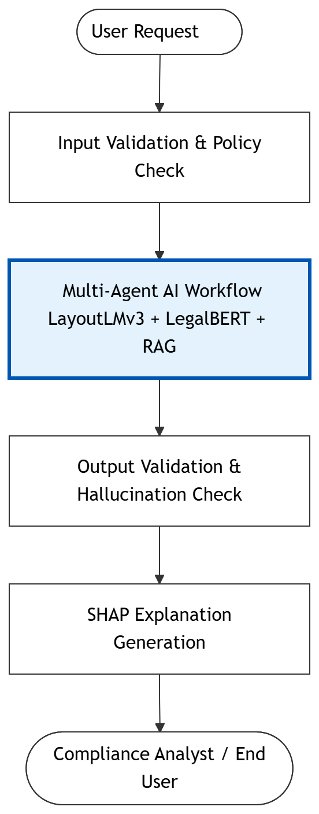
Multimodal Doc Understanding
Banking contracts rely heavily on layout (tables, nested lists, margins) to convey meaning. OCR alone destroys this context.
Visual Perception (LayoutLMv3): Jointly models text, image, and layout coordinates. Preserves spatial relationships.
Semantic Reasoning (LegalBERT): Fine-tuned on the CUAD benchmark to identify 41 specific clause categories.
Engineering Interventions: Addressed severe class imbalance ("CLS shortcut") using staged training and custom forward-walk algorithms.

Slide 14





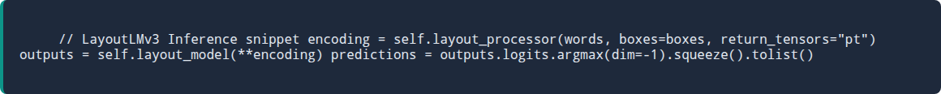
Workflow: Document Processing
PDF Input
Parsing / OCR
LayoutLMv3
Chunking
Output
Raw Contract Upload
PyMuPDF or EasyOCR
Visual Layout Analysis
512 Token Segments
Structured Representation

Slide 15
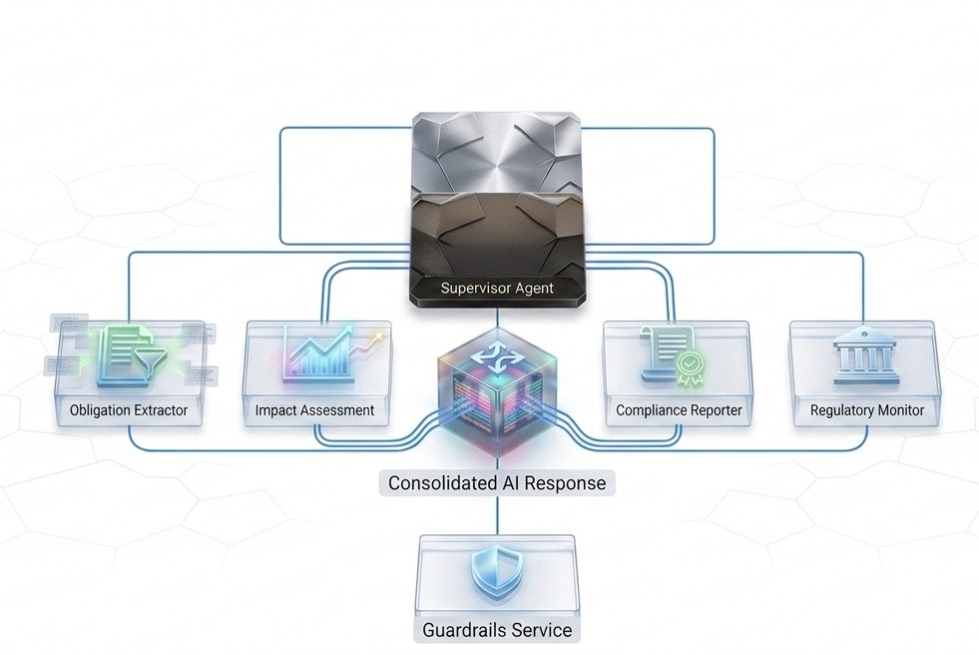
Agentic Orchestration
Stateful Reasoning with LangGraph
Instead of relying on a single LLM, the platform utilizes a Supervisor-based multi-agent architecture.
Supervisor Agent: Maintains conversational context and routes sub-tasks based on keywords.
Cyclic Execution: Enables agents to self-correct and iteratively refine compliance reports.
Shared State: TypedDict maintains active regulatory policies across interactions.

Slide 16



Collaborative Multi-Agent Cognitive Workflow
Unlike traditional linear AI pipelines, the proposed platform employs a stateful multi-agent architecture in which specialized AI agents collaborate through a shared workflow state to perform iterative compliance analysis and autonomous decision-making.
COLLABORATIVE ARCHITECTURE & DATA FLOW
AGENT RESPONSIBILITIES
WHY MULTI-AGENT?
📄 Banking Contract
📋 RBI Circular / Policy
📄 Agent 1: Obligation Extractor Responsibility:
Extract regulatory obligations & key deadlines.
Convert unstructured legal clauses into schema-compliant JSON.
Inputs / Outputs: 📥 LayoutLMv3 Output ➔ 📤 Structured Obligations
WORKLOAD SEGREGATION COMPARISON
Single LLM
Multi-Agent
Single reasoning chain
Specialized reasoning
LayoutLMv3 + Legal-BERT (Document Understanding Layer)
Black box / hard to debug
Highly explainable steps
🧠 Shared Workflow State (LangGraph)
⚠️ Agent 2: Risk Analyzer Responsibility:
Compare extracted obligations against internal policy banks.
Identify non-compliance, gaps, and regulatory exposure.
Inputs / Outputs: 📥 Shared State + Policy DB ➔ 📤 Structured Risk Matrix
No collaboration features
Shared, stateful coordination
> active_context: "Page 4, Clause 12" > parsed_clauses: 3 obligations found > retrieved_regs: "RBI/2024/15-Circular" > agent_decisions: Extractor: OK | Risk: PENDING > validation_status: Guardrails PASS
Single failure point
Dynamic self-correction
WHY LANGGRAPH ORCHESTRATION?
Stateful Cyclic Execution Traditional pipelines run one-way. LangGraph enables loops for iterative self-correction. Coordinated Core Capabilities
Planning ➔ Tool Use ➔ Memory ➔ State Control ➔ Self-Correction ➔ Automation
Obligation Extractor Reads & Writes
Risk Analyzer Agent Reads & Writes
Compliance Reporter Reads & Writes
📊 Agent 3: Compliance Reporter Responsibility:
Synthesize risk matrix and validation steps into executive summaries.
Generate publication-grade compliance audits.
Inputs / Outputs: 📥 Validated Shared State ➔ 📤 Audit-Ready Report PDF
🔌 MCP Enterprise Tool Layer: Policy DB | RBI Feed | Legal Repository
🛡️ Guardrails AI + SHAP Validation (Compliance Dashboard)

Slide 17
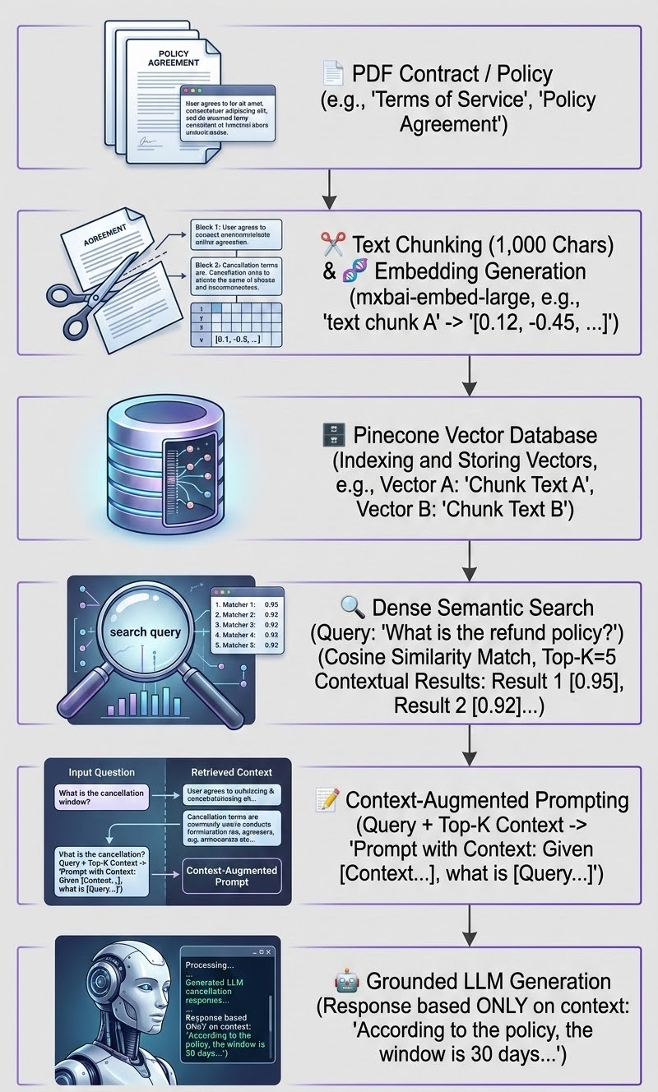

Semantic Retrieval (RAG)
Grounding AI in Enterprise Knowledge
The Vector Store Service facilitates RAG by processing contract text into 1,000-character chunks with a 100-character overlap. These chunks are then transformed into high-dimensional semantic embeddings using the mxbai-embed-large model and subsequently indexed within Pinecone.
Accuracy: Responses are grounded in retrieved contractual and regulatory information.
Continuous Updates: New contracts and regulations indexed independently of the LLM.
Optimizing Performance: Achieving low-latency through dense semantic search, leveraging Pinecone’s cosine-similarity indexing combined with precise score-threshold filtering.

Slide 18
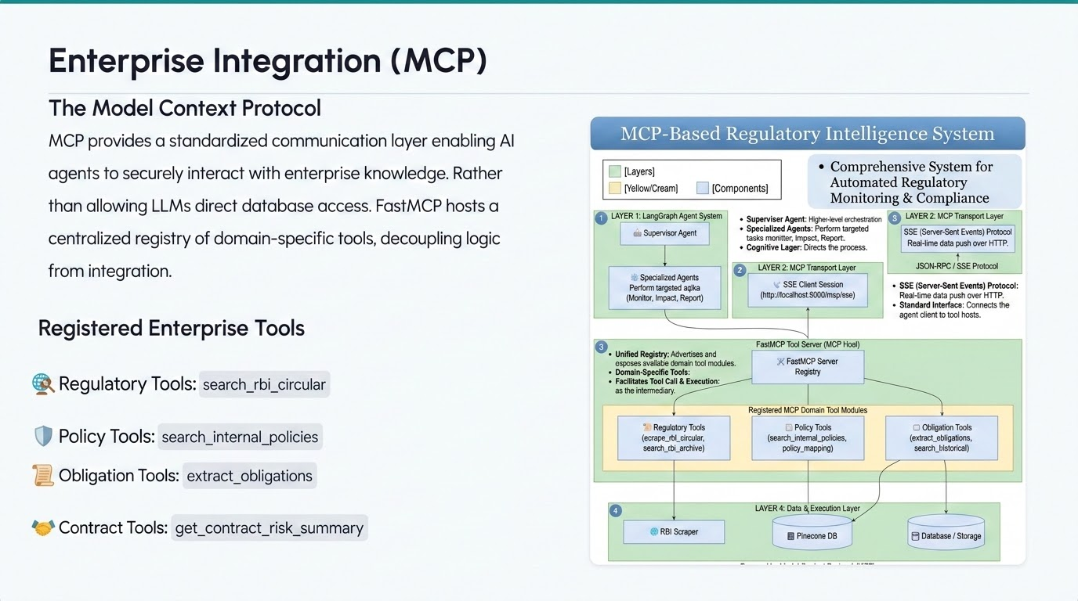

Slide 19




AI Governance & Safety
The Guardrails Service performs runtime validation on inputs and AI outputs before presentation, enforcing strict regulatory boundaries.
PII Filter Validator
Restricted Terms Validator
Detects and automatically masks sensitive data (Aadhaar, PAN, IFSC) to prevent leakage.
Blocks prohibited legal terminology (e.g., "zero risk") to prevent unsafe legal commitments.
Hallucination Detector
Disclaimer Validator
Verifies RBI circular references formats, detecting future years or invalid fiscal pairs.
Ensures responses containing regulatory guidance include appropriate legal disclaimers.

Slide 20
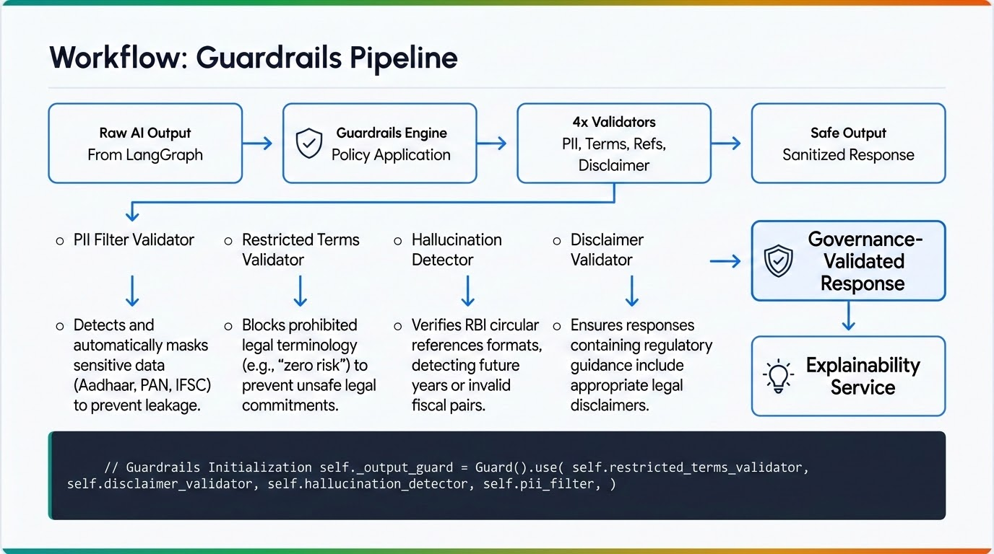

Slide 21

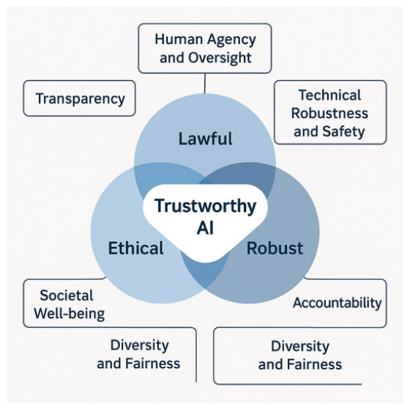
Explainable AI (SHAP)
Token-Level Feature Attribution
To satisfy auditability mandates under Basel III, the platform uses SHapley Additive exPlanations (SHAP) to interpret opaque AI decisions.
Mathematical Proof: Computes exact contribution of each term to the compliance decision.
Model-Agnostic: Uses a SHAP Text Masker to systematically hide portions of text and measure confidence changes.
Visual Heatmaps: Highlights terms driving risk up (positive attribution) or down.

Slide 22
Resource Management Strategy for Explainable AI
Computational Efficiency & UX
THE CHALLENGE
THE SOLUTION
Iterative SHAP Bottleneck
Exponential Scale: SHAP works by masking words and running the neural network iteratively, resulting in an O(N) or exponentially scaling operation.
The GPU Killer: Running SHAP on upload for a 50-page contract with 40 clauses locks the server's CPU/GPU for minutes, severely degrading system throughput.
"Lazy Loading" UX Architecture
Asynchronous Processing: Separating the SHAP API reduces initial Time-to-First-Value from 3 minutes down to just 10-15 seconds.
On-Demand Triggers: Avoids wasting expensive compute resources explaining standard clauses. GPU cycles are spent only when an auditor clicks a high-risk anomaly.
Architecture Decision: Dual-Layer Explainability (XAI)
⚡ Level 1 (Upload): Cognitive Reasoning
Agentic Chain-of-Thought provides instant, human-readable legal context for business users. Zero latency impact.
🔍 Level 2 (On-Demand): Mathematical SHAP
Neural feature attribution provides rigorous auditing for regulators, decoupled to optimize scaling.
# Optimization Framework: self.lazy_load_shap(clause_id) if user.clicks_inspect(clause_id) else self.render_cognitive_rationale()

Slide 23
Regulatory Lifecycle (LRR)
LRR Component | Function
Regulatory Monitor | Detects new RBI notifications via APScheduler.
Doc Processing | Extracts textual info from raw regulations.
Obligation Extractor | Identifies mandatory compliance rules.
Impact Engine | Evaluates organizational/policy impact.
Knowledge Updater | Updates Pinecone Semantic DB for RAG.
Proactive Compliance
By continuously scraping new RBI guidelines and updating the vector database automatically, future contract analyses benefit from the latest regulatory context without requiring manual updates to the AI models.

Slide 24




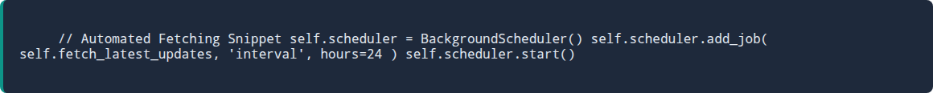
Workflow: LRR Automation
RBI Sources
Obligation Extraction
Impact Assess
Pinecone DB
Web Scraper
Rule-Based Detection
Policy Mapping
Knowledge Updated

Slide 25
Experimental Scenarios
The platform was evaluated through functional experiments using real banking contracts and simulated policies.
Exp 1 (Contract Upload): A typical manual review for a 42-page franchise agreement takes a legal associate approximately 3 to 4 days. Our system processes it in 5 minutes, representing a 99% reduction in initial processing time, allowing human reviewers to focus solely on the 194 flagged risks rather than reading boilerplate
Exp 2 (Compliance Agent + MCP): Agent successfully invoked MCP tools to retrieve live RBI feed data, passed Guardrails hallucination checks, and returned a structured summary.
Exp 3 (Policy Impact): Queried "maximum allowed DLG percentage". Impact Assessor retrieved Policy POL-002 via MCP and mapped the 20% limit constraint.

Slide 26
Data Collection & Dataset Preparation
To ensure reproducibility, privacy, and scientific validity, the proposed framework uses publicly available benchmark datasets, regulatory documents, and synthetic enterprise policies instead of proprietary banking data.
THREE-LAYER DATA & PIPELINE ARCHITECTURE
DATASET METRICS & RECORDS
DATA LAYER 1: PUBLIC DATASETS
DATA LAYER 2: REGULATORY KNOWLEDGE
DATA LAYER 3: SYNTHETIC DATA
Dataset Name
Records
Framework Usage
CUAD (Contract Understanding)
500+ Contracts
Clause Extraction & BERT Training
📘 CUAD Dataset
• Extract legal obligations & expert clauses
• Supports supervised Legal-BERT training
📘 DocLayNet
• Tables, headers, paragraph visual analysis
• Multimodal layout annotations for LayoutLMv3
🏦 RBI Circulars & Guidelines
• Focus on Digital Lending, Outsourcing, Risk
• Acts as primary external compliant ground truth
🌐 Basel III Accord
• International banking regulations & standards
• Mapped strictly to the LRR safety module
🛡️ Synthetic Banking Policies
• Replaces highly sensitive internal policies
• Simulates operational risk & limits
Advantage Profile
✅ 100% Privacy preserving
✅ Standardized & reproducible research
DocLayNet (Document Layout)
80,000+ Pages
Multi-modal Layout Parsing
RBI Circulars (Regulatory)
Multiple Public Docs
Compliance Monitoring base
Synthetic Policies (Enterprise)
Custom Mock banks
Isolated Enterprise Evaluation
DATA PREPROCESSING PIPELINE (AUTOMATED ENGINE)
Raw Documents ➔ OCR Validation ➔ Bounding Box Extraction ➔ Layout Normalization ➔ Clause Annotation ➔ Chunking ➔ Embedding Generation
DATA DECOUPLING ADVANTAGE
• Legal-BERT Fine-Tuning: Enabled by precise token boundaries of the CUAD answer segments.
• Document Intelligence: Visual bounding boxes trained over DocLayNet's multi-class pages.
• RAG Alignment Layer: Live context retrieval evaluated over synthetic internal enterprise policy constraints.
AI MODEL TRAINING & COMPLIANCE EXECUTION PIPELINE
Multi-Modal Inputs ➔ LayoutLMv3 Visual Features ➔ Legal-BERT Semantic Classifiers ➔ LangGraph Orchestrator ➔ RAG Loop ➔ Shield Guardrails
🛡️
Strict Privacy & Confidentiality Strategy
No proprietary Bank of America data is used. The research relies exclusively on public datasets, publicly available RBI regulations, and synthetic enterprise policies, ensuring absolute confidentiality while enabling highly realistic evaluations.

Slide 27
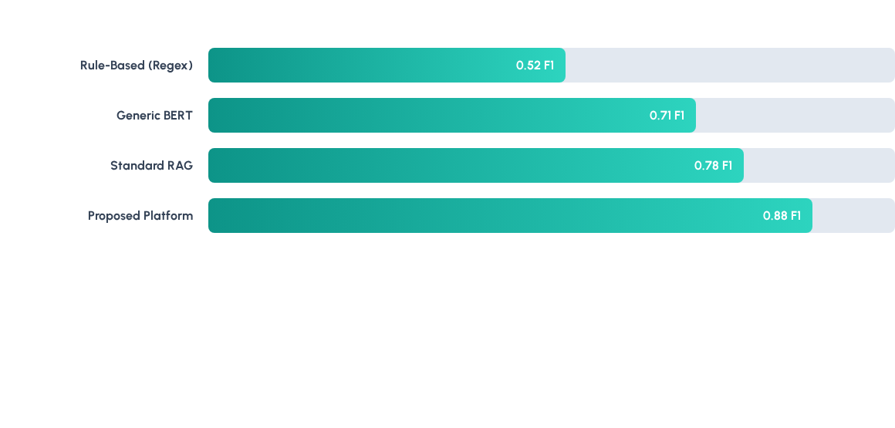
Model Evaluation (LegalBERT)
LegalBERT was fine-tuned on the CUAD dataset (41 clause types). The best checkpoint achieved a validation loss of 0.5088.
LegalBERT significantly outperforms rule-based systems (high false negatives) and generic NLP models lacking domain-specific legal vocabulary.

Slide 28
Ablation Study & Analysis
Quantifying the contribution of each major component to overall system performance.
Configuration | Clause F1 | Retrieval Prec | Hallucination Rate | Report Accuracy
Full System | 0.88 | 0.94 | 0.8% | 92.5%
- RAG | 0.71 | 0.61 | 4.5% | 68.2%
- LayoutLMv3 | 0.69 | 0.82 | 1.2% | 78.4%
- Guardrails | 0.88 | 0.94 | 4.2% | 85.3%
Key finding: RAG handles hallucination reduction, LayoutLMv3 handles clause accuracy (19-point drop without it), and Guardrails acts as the final safety net.

Slide 29
System Limitations
Data & Extraction Quality
Regulatory & Integration Scope
Scale & Deployment
OCR Quality Limitations: Document understanding depends heavily on OCR accuracy, particularly for scanned or low-resolution documents.
Impact: May reduce extraction and interpretation quality for poor-quality scans.
Single Regulatory Context: Current implementation focuses strictly on RBI regulations (Indian context).
MCP Tool Coverage: Enterprise tools rely on simulated policy data and public RBI feeds.
Impact: Adaptation is required for other jurisdictions (EU, US, UK), and full integration needs direct internal policy connections.
Production Deployment: Platform has not been deployed in a live, production banking environment.
Evaluation Scale: Benchmarks relied on publicly available or synthetic data, with limited access to proprietary files.
Impact: Live system performance and behavior may differ from experimental results.
System Latency & Performance Bottleneck
Key Performance Limitation: Agent reasoning processes dominate the end-to-end processing pipeline, requiring an average of 5 minutes to complete analysis.
Strategic Impact:
May restrict the system's suitability for real-time compliance checks or immediate transaction authorization.
Requires architectural optimizations, such as query parallelization or prompt caching, to make live deployment feasible.

Slide 30
Dissertation Conclusion
This dissertation proposes an Explainable, Guardrailed Agentic AI platform that combines multimodal document understanding, autonomous reasoning, secure enterprise integration, and trustworthy AI to automate banking contract review and regulatory lifecycle management.
🎯 RESEARCH PROBLEM
🤖 PROPOSED SOLUTION
🏦 EXPECTED IMPACT
🎓 CONTRIBUTIONS
Traditional manual banking contract review is extremely:
• Time-consuming: loops take hours or days.
• Expensive: requires expert legal resources.
• Risk-prone: susceptible to costly compliance gaps.
An Explainable Agentic AI platform integrating:
LayoutLMv3 (Layout)
Legal-BERT (Semantic)
LangGraph (Workflow)
MCP (Enterprise Tools)
SHAP (Explainability)
Guardrails AI (Safety)
✔️ Faster Review: Shrinks loops from days to minutes.
✔️ Better Transparency: Explains visual & semantic features.
✔️ Reduced Effort: Cuts down manual audit fatigue.
✔️ AI Governance: Enterprise-ready guardrail limits.
A unified framework integrating:
Document AI
Legal NLP
Agentic AI
Explainable AI
AI Safety
Regulatory Lifecycle
Coordinated into a single enterprise banking platform.
"Building Trustworthy AI for the Future of Banking Compliance."

Slide 31
Future Work
Key Contributions
Future Research Directions
Unified Architecture: Integrating Document AI, Agentic AI, MCP, Guardrails, and SHAP.
Multi-Jurisdictional Scaling: Extending LRR to monitor FCA (UK) and Fed (US).
Operational Efficiency: Shrinks assessment loops from days to automated verification cycles.
Advanced Architectures: Meta-learning for adaptive agent behavior.
Trust & Auditability: Strict Guardrail enforcement.
Continuous Learning: Updating vector weights dynamically based on user feedback.

Slide 32


THANK YOU
QUESTIONS & DISCUSSION
"AI is most valuable when it is Explainable, Trustworthy, and Responsible."
Kattamuri Sunil Kumar
M.Tech (AI & ML) • BITS Pilani • ID: 2024AA05522

