Slide 1
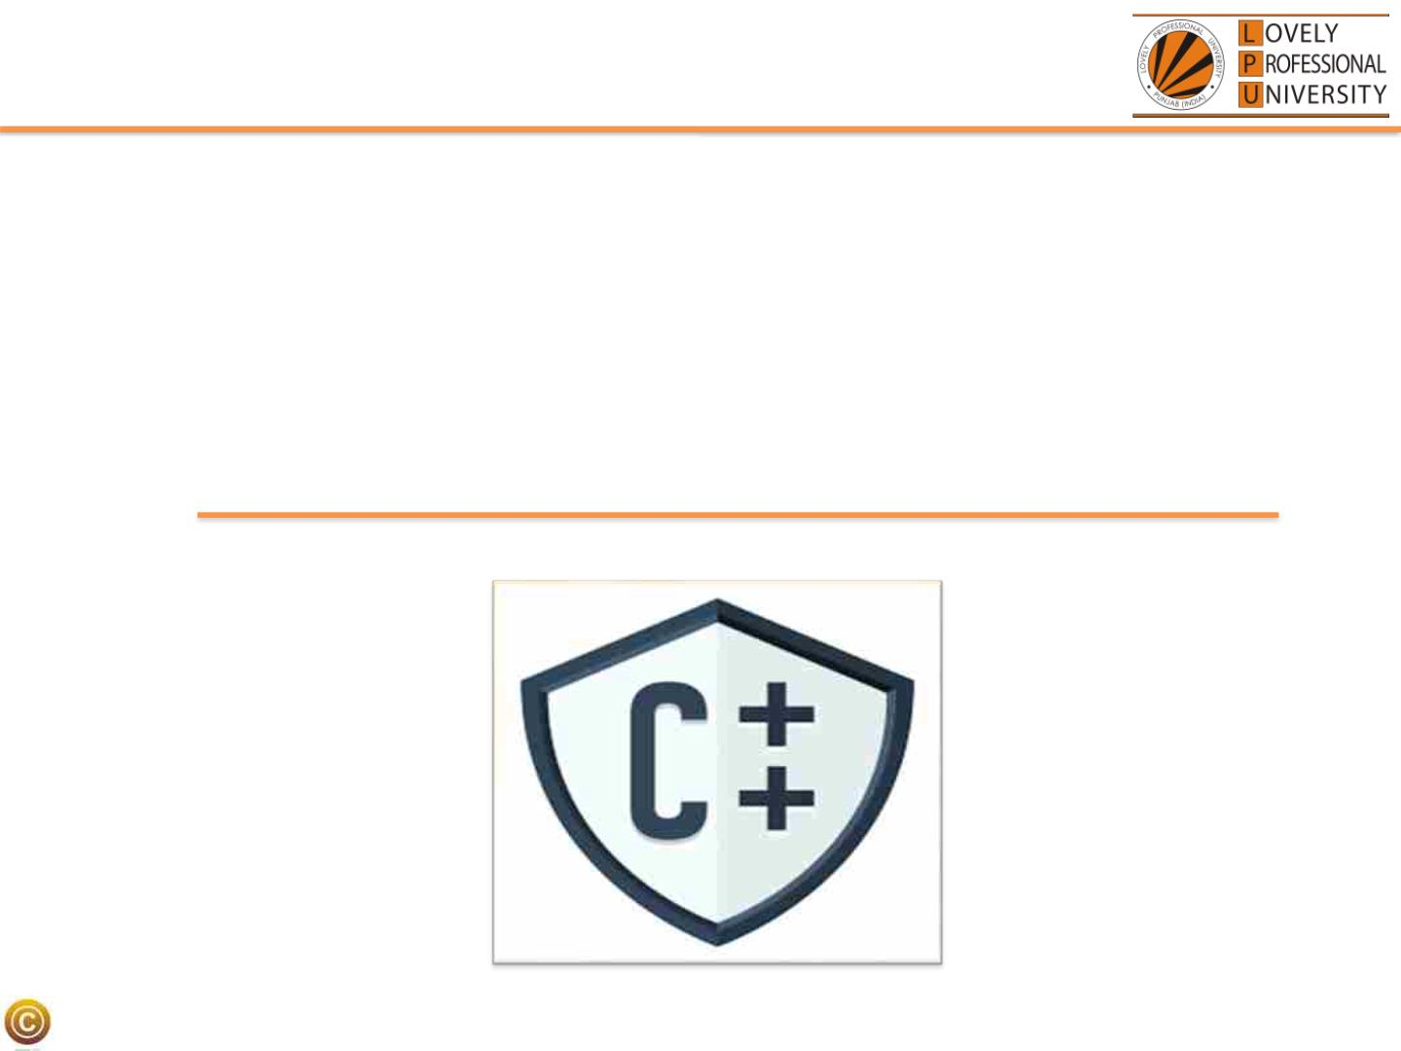
CSE202
OBJECT ORIENTED
Programming
LPU:: CSE202: OBJECT ORIENTED PROGRAMMING

Slide 2
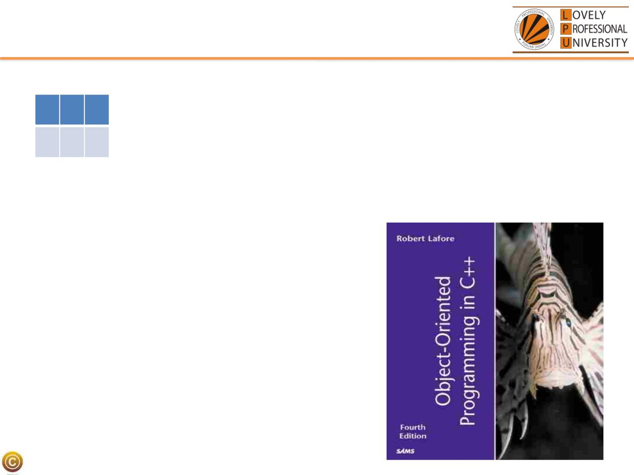
Course Details
•
L T P
3 0 2
[Five Hours/week]
• Text Book
“OBJECT ORIENTED
PROGRAMMING IN C++”
by
Robert Lafore
LPU:: CSE202: OBJECT ORIENTED PROGRAMMING

Slide 3
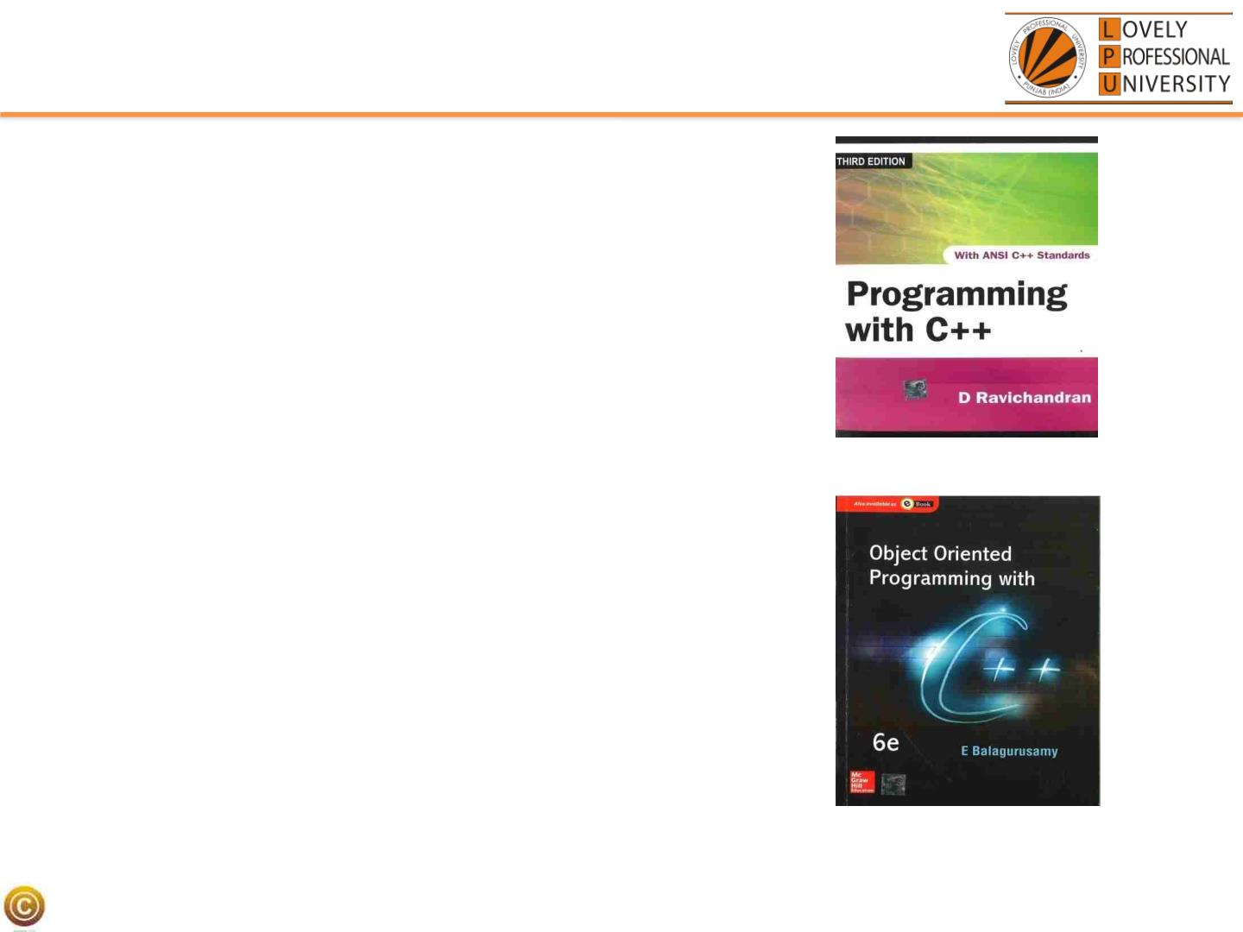
Reference Books
• PROGRAMMING WITH C++
by
D RAVICHANDRAN
• OBJECT ORIENTED
PROGRAMMING IN C++
by
E BALAGURUSAMY
LPU:: CSE202: OBJECT ORIENTED PROGRAMMING

Slide 4

Course Outcomes
CO1 :: identify basic programming constructs and use the
newly acquired skills to solve extensive programming
problems.
CO2 :: discuss the mechanism of code reusability by creating
own libraries of functions.
CO3 :: validate the logic building and code formulation by
designing code capable of passing various test cases.
CO4 :: interpret the principles of the object-oriented model
and apply it in the implementation in C++ language.
CO5 :: develop accurate, reliable and efficient software
applications.
CO6 :: apply the knowledge acquired to develop software
applications
LPU:: CSE202: OBJECT ORIENTED PROGRAMMING

Slide 5

Course Assessment Model
• CSE205
Marks break up*
• Attendance
5
20
30
45
100
• Daily Practice Problems
• CA (Two best out of Three ATs)
• ETP (Practical /Laptop)
• Total
LPU:: CSE202: OBJECT ORIENTED PROGRAMMING

Slide 6
Academic Task
Component
1. Test 1
Week
5th
2. Test 2
10th
12th
3. Test 3
LPU:: CSE202: OBJECT ORIENTED PROGRAMMING

Slide 7

CA
• Programming Practice using IamNeo Platform
• Best 2 out of 3 Academic Task
50
• Programming practice is a compulsory requirement
ETP
• Will be conducted on IamNeo Platform
LPU:: CSE202: OBJECT ORIENTED PROGRAMMING

Slide 8

Practice Problems
• In the Practice Problems marks are only for coding Problems.
• MCQs are only for practice.
Sequence locking:
• Student must has completed all the problems of lecture 1, to
complete the problems of lecture 2.
LPU:: CSE202: OBJECT ORIENTED PROGRAMMING

Slide 9
Academic Task
1. Each Academic task will contain 2 coding questions
and 10 MCQs
2. The weightage of programming practice which is
spread across 150 problems with 25 problems per
unit will be 20%.
LPU:: CSE202: OBJECT ORIENTED PROGRAMMING

Slide 10

Marks Calculation for Programming Practice
• In order to qualify for programming practice marks, the
student must solve a minimum of 50% (75 Coding Problems)
problems (eligibility condition)
• No marks for MCQs.
Scoring Criteria:
I. If the student scores ≥ 81% in all CA's (best 2 out of 3), they
will be eligible for 100% of the programming practice marks.
II. If the student scores between 71% - 80% (inclusive) in all
CA's (best 2 out of 3), they will be eligible for 70% of the
programming practice marks.
LPU:: CSE202: OBJECT ORIENTED PROGRAMMING

Slide 11
Marks Calculation for Programming Practice
III. If the student scores between 51% - 70% (inclusive) in all
CA's (best 2 out of 3), they will be eligible for 50% of the
programming practice marks.
IV. If the student scores between 30% - 50% (inclusive) in all
CA's (best 2 out of 3), they will be eligible for 30% of the
programming practice marks.
V. If the student scores less than 30% in the CA's (best 2 out of
3), they will not be eligible for any benefit.
LPU:: CSE202: OBJECT ORIENTED PROGRAMMING

Slide 12

Daily Practice Problems
S.
Unit
Question
Tentative Dates for Completion
No
1 Unit-1
27th August 2023
25 Multiple Choice
Questions and 25
Practical Implementation
problems in each unit
2 Unit-2
3 Unit-3
4 Unit-4
5 Unit-5
6 Unit-6
10th September 2023
24th September 2023
22nd October 2023
5th November 2023
12th November 2023
Note:- Most Important for the improvement of Performance
in Course Assessments.
LPU:: CSE202: OBJECT ORIENTED PROGRAMMING

Slide 13
End Term Practical (45 Marks)
• Coding Problems [70%]
• Viva [30%]
LPU:: CSE202: OBJECT ORIENTED PROGRAMMING

Slide 14

Platform Used
• Live Demostration of IamNeo Platform
• URL: https://lpucolab438.examly.io/login
• UserName: RegistrationNumber@neocolab.ai
• Password: Registration Number
LPU:: CSE202: OBJECT ORIENTED PROGRAMMING

Slide 15
Why a Star Course?
• This course Serves as the basis for the product
based pathways
• This course is a star course as it has direct
bearing with the placements.
LPU:: CSE202: OBJECT ORIENTED PROGRAMMING

Slide 16

The hitch……
Some burning questions in mind......
• Is C the only language behind the development of
all these powerful softwares
• Why C++?
• How C++ is different from C language?
• Is there no scope of this language in industry?
LPU:: CSE202: OBJECT ORIENTED PROGRAMMING

Slide 17
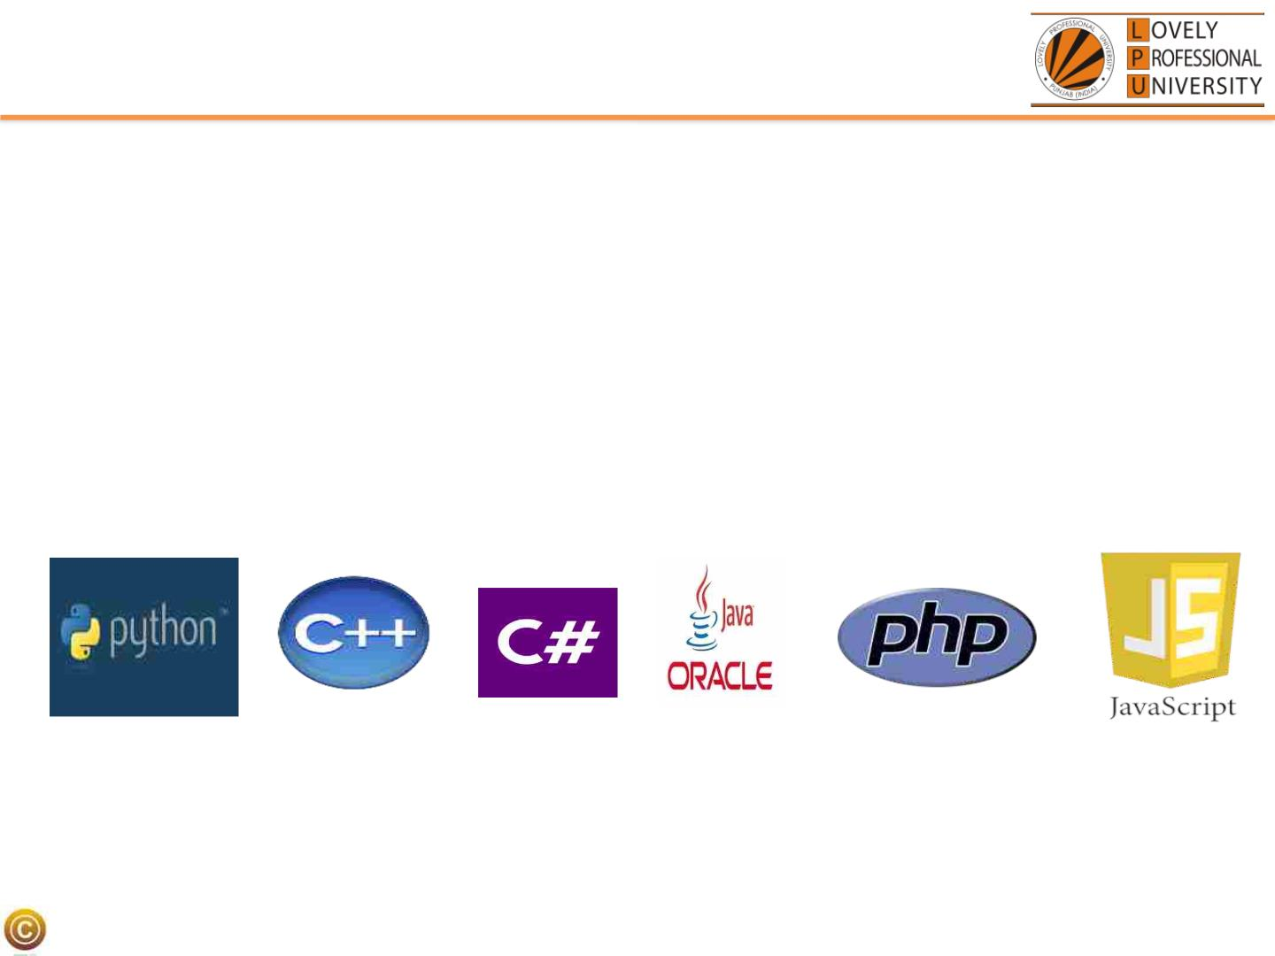
Flashback………..
What C language can do?????
• Device drivers are written in C language.
• All these modern programming languages are influenced by C language
• Compilers for Python and PHP language are also written in C language
• Embedded systems are also developed with the help of C language
LPU:: CSE202: OBJECT ORIENTED PROGRAMMING

Slide 18

Is C only language?????
Lets answers your questions
ØNo, C is not the only language for the development
of all these powerful system
ØIf we talk about Windows operating system, only
Kernel is written in C language rest all other features
are provided with the help of C++ language
LPU:: CSE202: OBJECT ORIENTED PROGRAMMING

Slide 19
How does it differ from C
ØC uses top down approach for problem solving
ØThere are no means of providing security.
ØC doesn't support inheritance, makes it more complex to
use because everything has to be written from scratch.
ØC is not able to represent real world modelling
LPU:: CSE202: OBJECT ORIENTED PROGRAMMING

Slide 20

No scope of language in Industry
Top rated Companies which has a dearth of C++ programmers
LPU:: CSE202: OBJECT ORIENTED PROGRAMMING

Slide 21
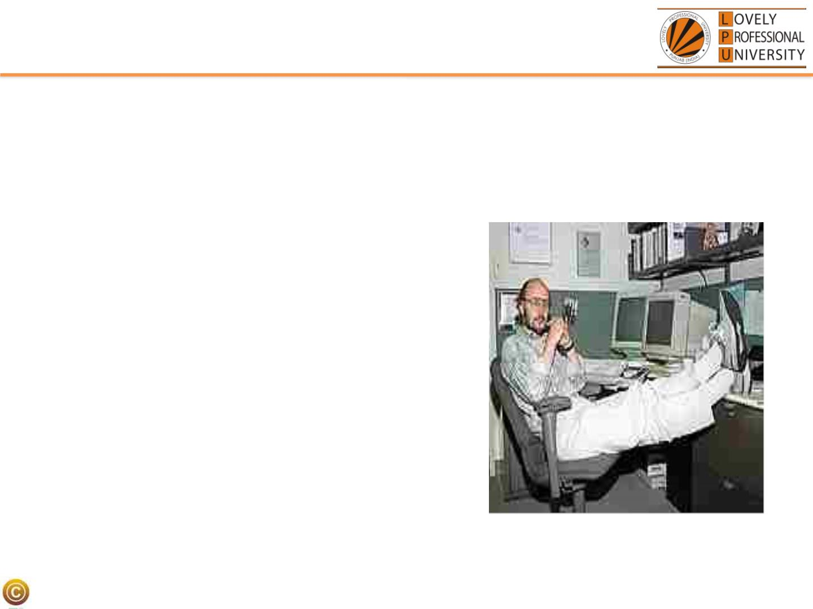
Introduction to C++
ØIn 1979, Bjarne Stroustrup, began work on "C with Classes”
ØThe motivation for creating a new language originated from Stroustrup's
experience in programming for his Ph.D. thesis.
ØStroustrup found that Simula had features
that were very helpful for large software
development, but the language was too
slow for practical use, while BCPL was fast but
too low-level to be suitable for large
software development.
LPU:: CSE202: OBJECT ORIENTED PROGRAMMING

Slide 22
Q1
Major objective for C++ is to:
A. Represent real world entities in the form of
objects
B. Implement procedural approach
C. Implement top down approach
D. Implement functional programming
LPU:: CSE202: OBJECT ORIENTED PROGRAMMING

Slide 23
Q2
Initial name of C++ was:
A. C++ with classes
B. C with classes
C. Objects with C++
D. C with objects
LPU:: CSE202: OBJECT ORIENTED PROGRAMMING

Slide 24
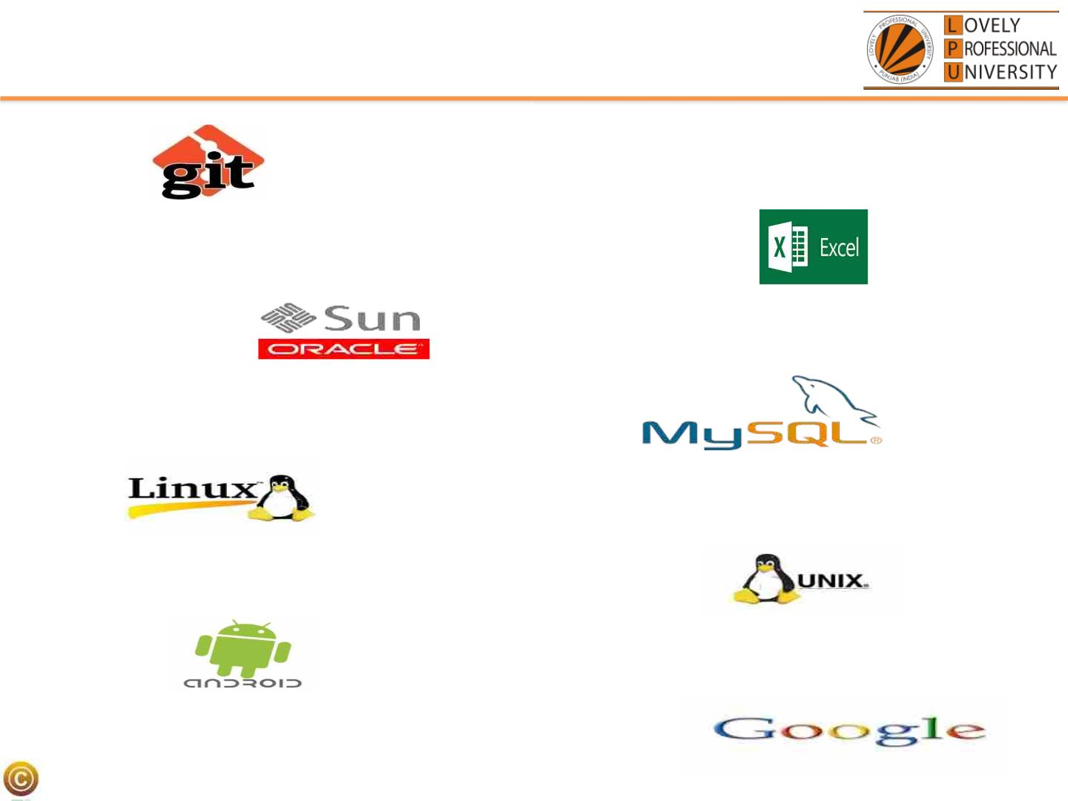
Applications
•Git
•Microsoft Excel
•MySql
•Oracle Database
•Linux
•Unix
•Android
•Google
LPU:: CSE202: OBJECT ORIENTED PROGRAMMING

Slide 25
• WHY C++?????
Lets see
LPU:: CSE202: OBJECT ORIENTED PROGRAMMING

Slide 26
Key features of C++
ØObject and Classes
Real world modelling
ØEncapsulation
Wrapping
ØData Abstraction
Hiding of non required information
ØInheritance
Reusability
LPU:: CSE202: OBJECT ORIENTED PROGRAMMING

Slide 27
Key features of C++
ØPolymorphism
Many forms
ØData Hiding
Security
ØMessage Passing
Communication
LPU:: CSE202: OBJECT ORIENTED PROGRAMMING

Slide 28

(Objects)Daily Analysis
Look around you and identify some objects
Everything is an OBJECT
©LPLUP U:::C: SCES2E20022: CO+B+JEPCroTgOraRmImENingTED PROGRAMMING

Slide 29

Object ,Object and Object
A student, a professor
A desk, a chair, a classroom, a building
A university, a city, a country
A subject such as CS, Math, History, …
©LPLUP U:::C: SCES2E20022: CO+B+JEPCroTgOraRmImENingTED PROGRAMMING

Slide 30
Procedural Approach(C Language)
• Focus is on procedures
• All data is shared: no protection
• More difficult to modify
• Hard to manage complexity
LPU:: CSE202: OBJECT ORIENTED PROGRAMMING

Slide 31
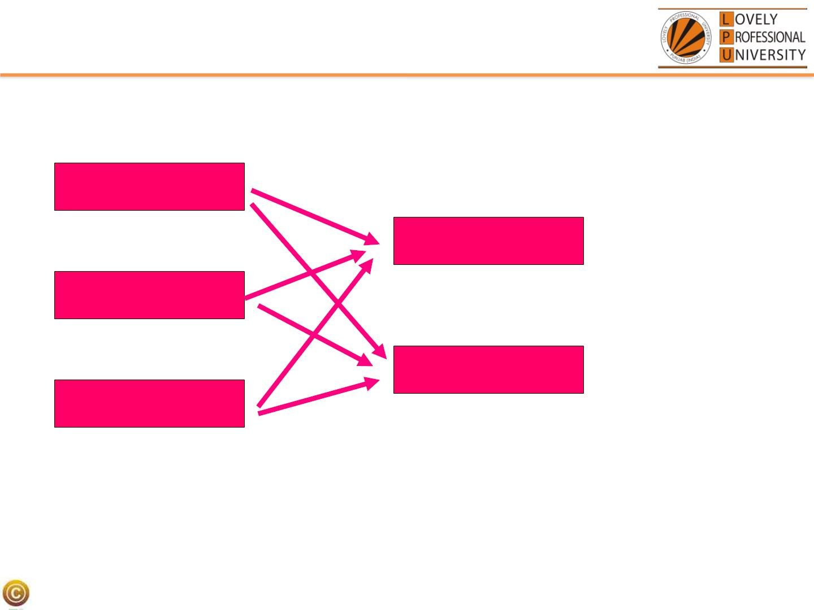
Data is not secure……..
FUNCTION 1
FUNCTION 2
FUNCTION 3
DATA 1
DATA 2
LPU:: CSE202: OBJECT ORIENTED PROGRAMMING

Slide 32
Object Oriented Approach
• Emphasis is on data rather than procedure
• Programs are divided into what are known as
objects
• Data is hidden and cannot be accessed by
external functions
• New data and functions can be easily added
whenever necessary
LPU:: CSE202: OBJECT ORIENTED PROGRAMMING

Slide 33
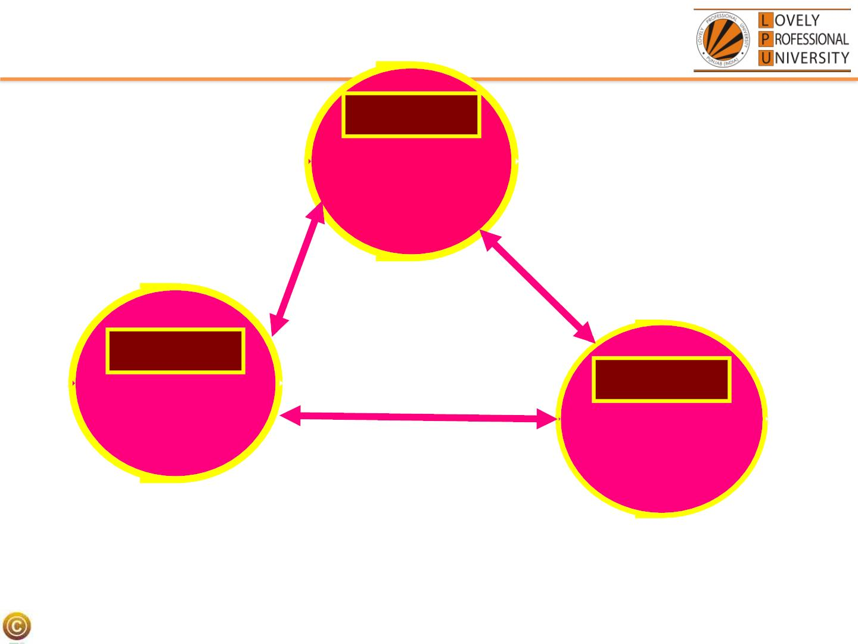
DATA
MEMBER
FUNCTIONS
DATA
DATA
MEMBER
FUNCTIONS
MEMBER
FUNCTIONS
OBJECT ORIENTED APPROACH
LPU:: CSE202: OBJECT ORIENTED PROGRAMMING

Slide 34
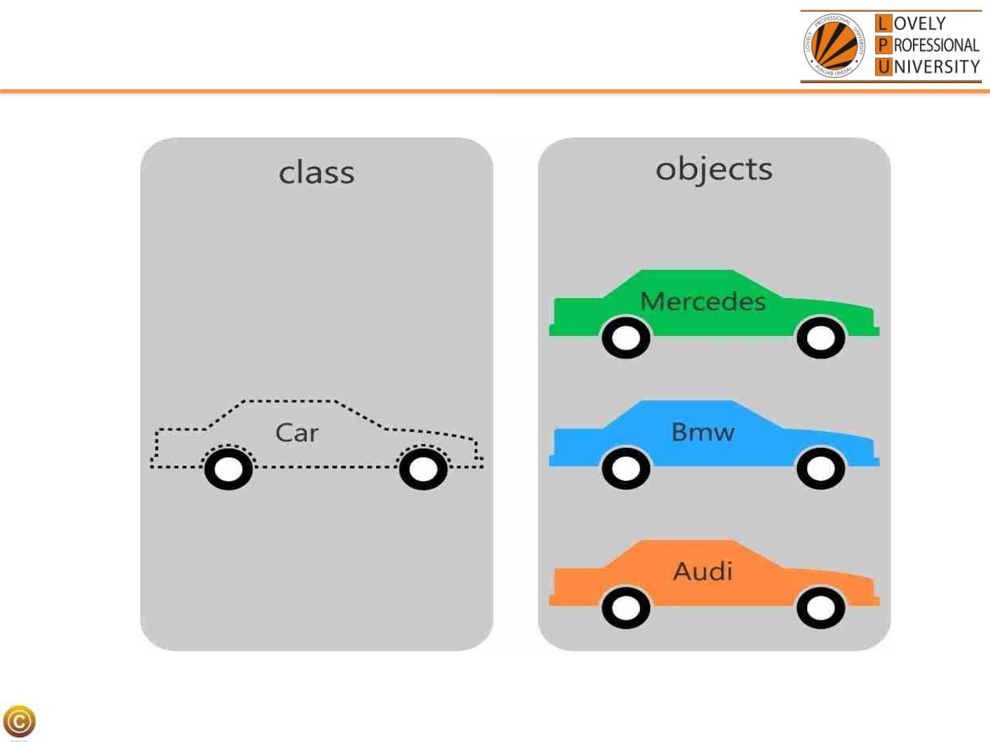
Classes and Objects(Example 1)
LPU:: CSE202: OBJECT ORIENTED PROGRAMMING

Slide 35
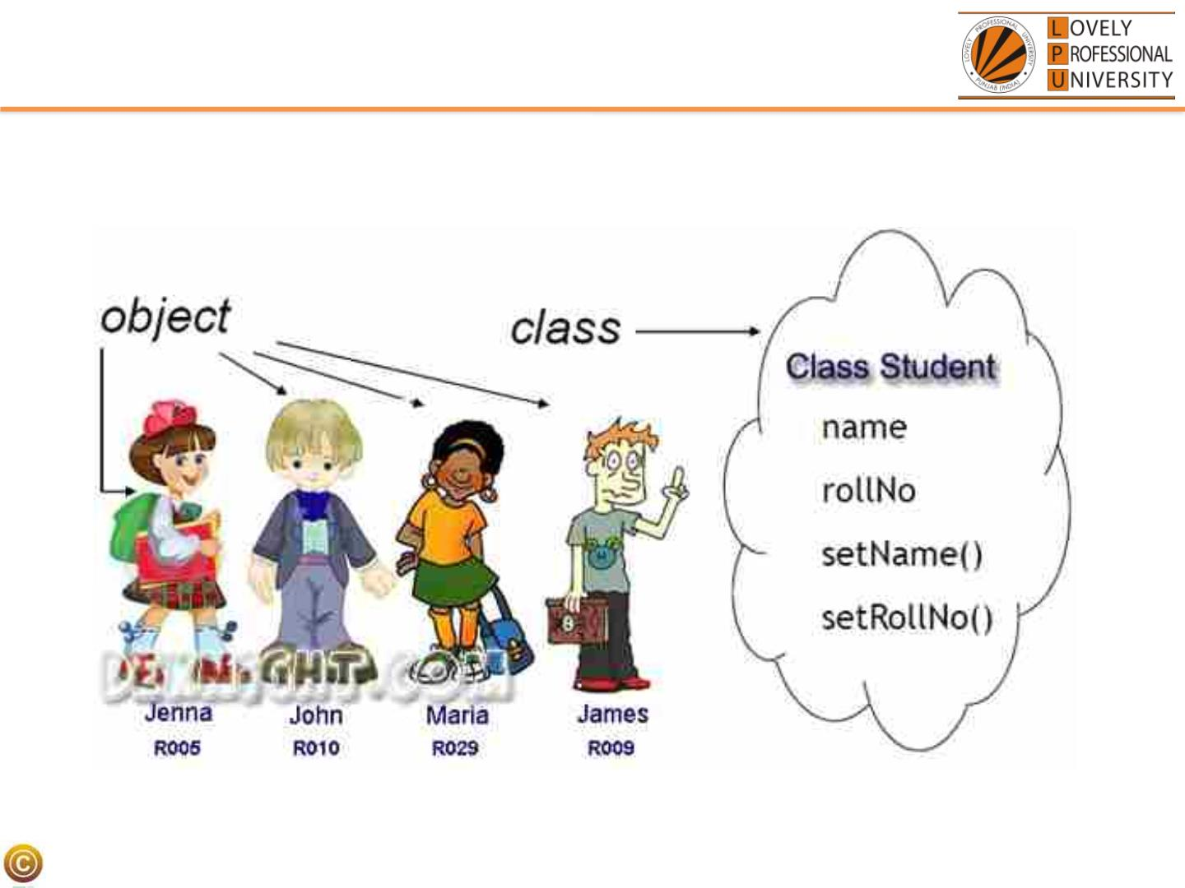
Classes and Objects(Example 2)
LPU:: CSE202: OBJECT ORIENTED PROGRAMMING

Slide 36
Classes and Objects
• A class is a prototype or blueprint for
creating objects
• When we write a program in an object-
oriented languages like C++,Java, we
define classes, which in turn are used to
create objects
LPU:: CSE202: OBJECT ORIENTED PROGRAMMING
36

Slide 37
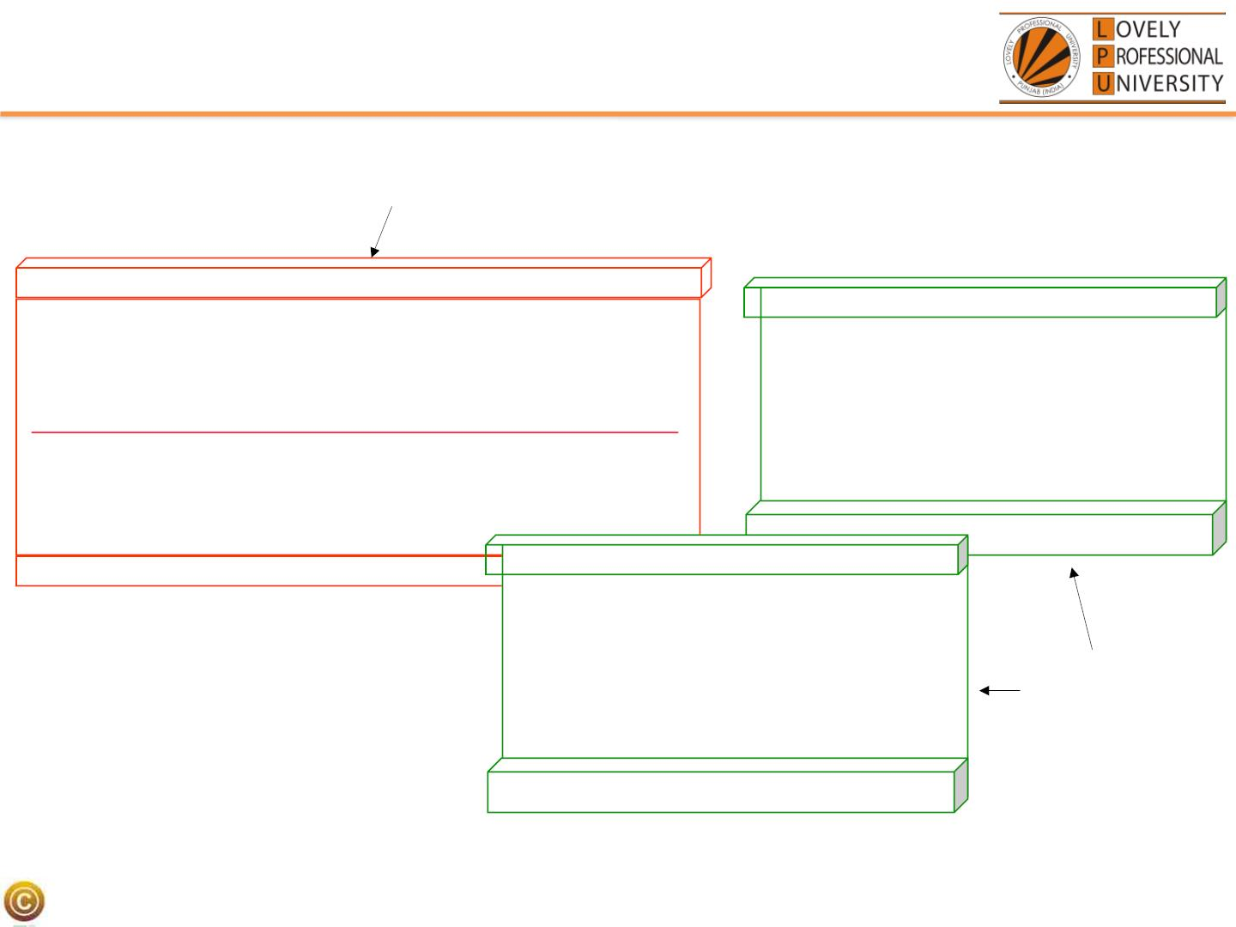
Classes and Objects(Technical Example)
class
Time
inTime
hour
minute
Attributes:
hour = 8
minute = 30
Methods:
void addMinutes( int m )
void addMinutes(int m)
outTime
Attributes:
hour = 17
minute = 35
Methods:
objects
void addMinutes(int m)
LPU:: CSE202: OBJECT ORIENTED PROGRAMMING
37

Slide 38
History of Object-Oriented Programming
• Started out for simulation of complex man-
machine systems, but was soon realized that it
was suitable for all complex programming
projects
• SIMULA I (1962-65) and Simula 67 (1967) were
the first two object-oriented languages
– Developed at the Norwegian Computing Center,
Oslo, Norway by Ole-Johan Dahl and Kristen
Nygaard
– Simula 67 introduced most of the key concepts of
object-oriented programming: objects and classes,
subclasses (“inheritance”), virtual procedures
LPU:: CSE202: OBJECT ORIENTED PROGRAMMING
38

Slide 39
The Ideas Spread
• Alan Kay, Adele Goldberg and colleagues at
Xerox PARC extend the ideas of Simula in
developing Smalltalk (1970’s)
• Bjarne Stroustrup develops C++ (1980’s) at AT
&T Bell Labs in Murray Hill, New Jersey, USA
– Brings object oriented concepts into the C
programming language
– Earlier name was C with Classes
– Later in 1983 the name changed to C++(The idea
of ++ is taken from the increment operator of C)
– In 1997, the ANSI/ISO made changes into the
language and it was standardised
LPU:: CSE202: OBJECT ORIENTED PROGRAMMING
39

Slide 40
Features Continued…
qEncapsulation
qAbstraction
qReusability
qInheritance
qPolymorphism
LPU:: CSE202: OBJECT ORIENTED PROGRAMMING

Slide 41
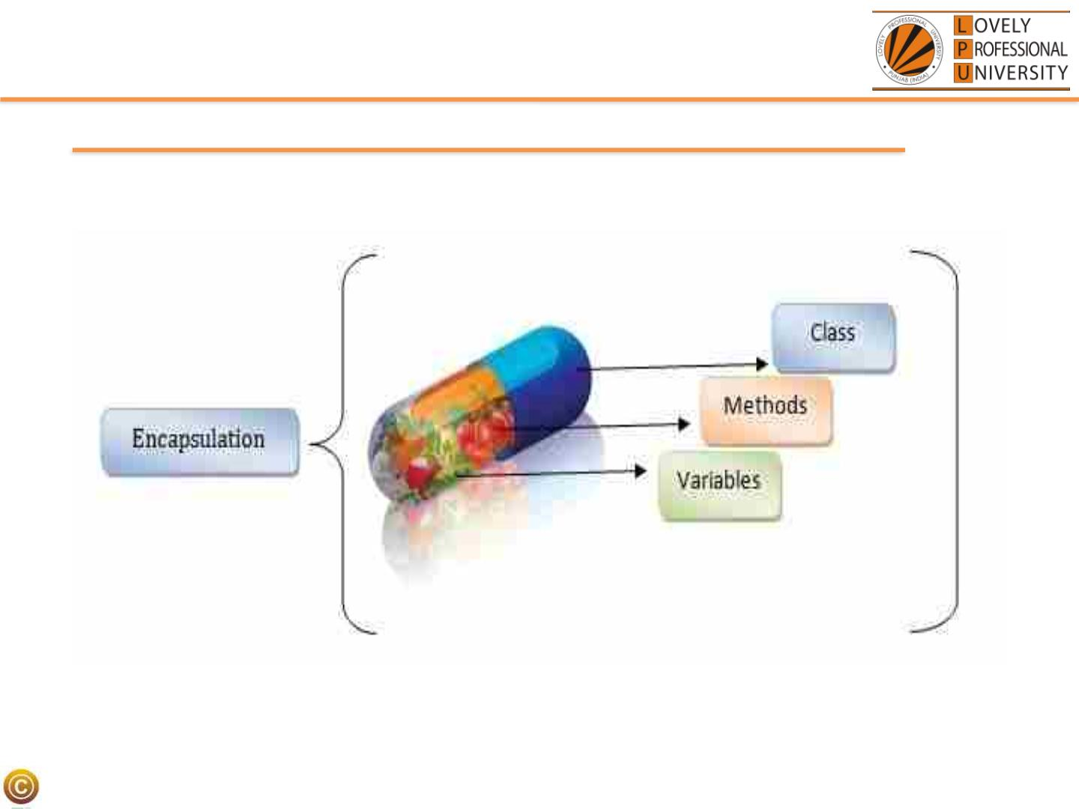
Encapsulation
©LPLUP U:::C: SCES2E20022: OObBjeJcEtCOTriOenRteI EdNPTroEgDraPmRmOinGgRAMMING

Slide 42
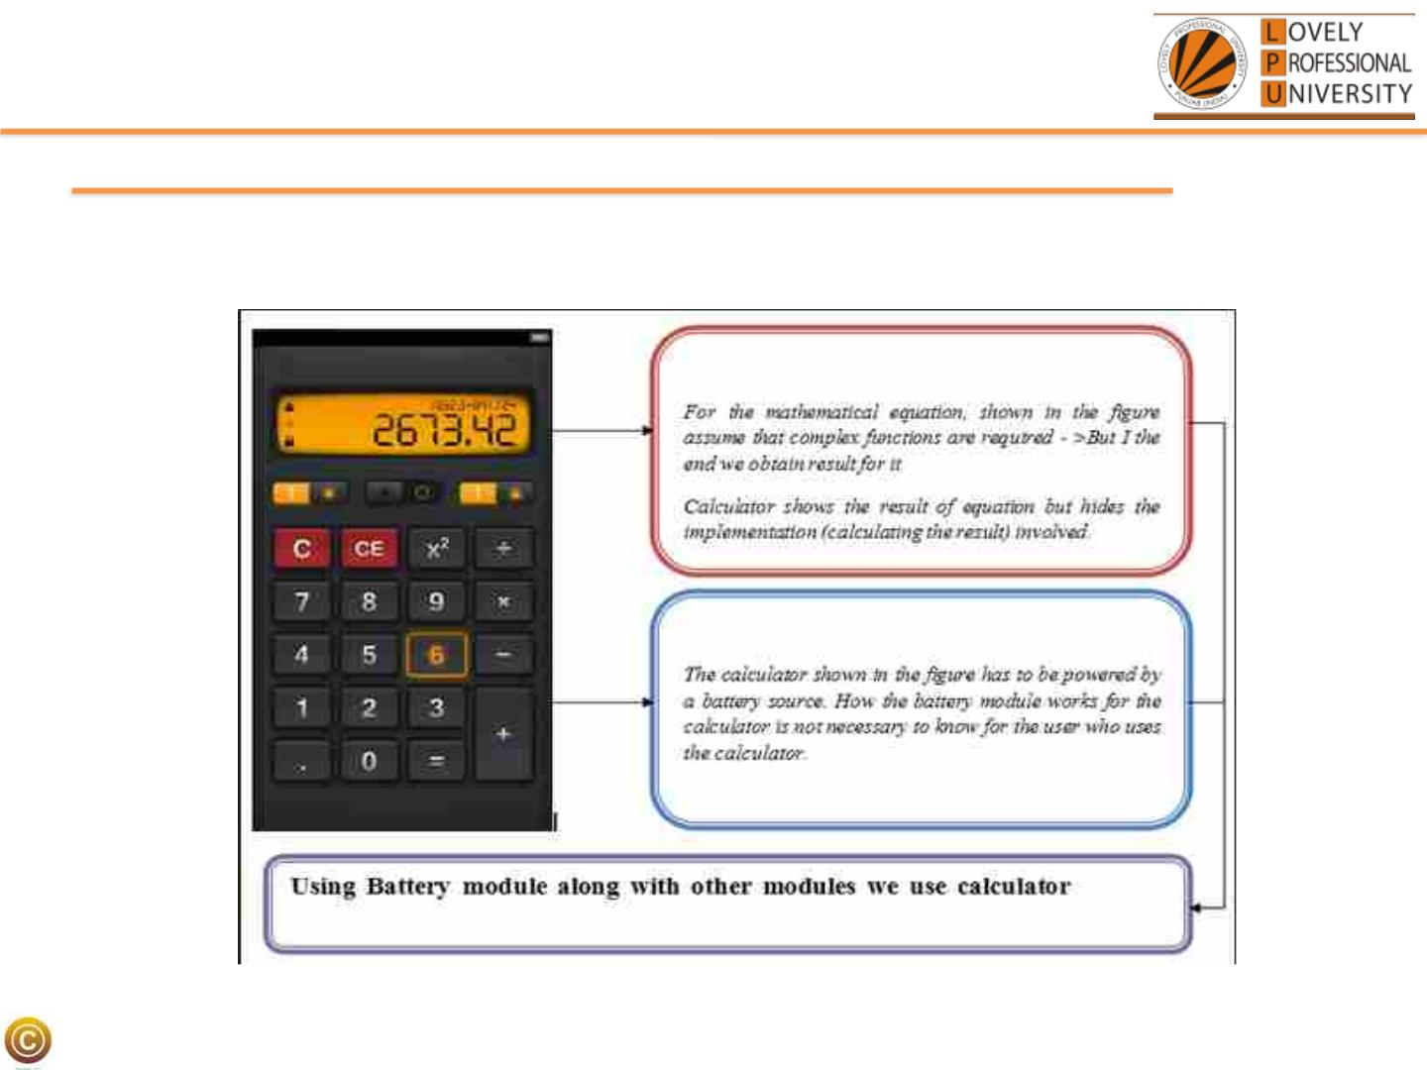
Abstraction(Hiding Details)
© LPU :: CSE202 C++ Programming
LPU:: CSE202: OBJECT ORIENTED PROGRAMMING

Slide 43
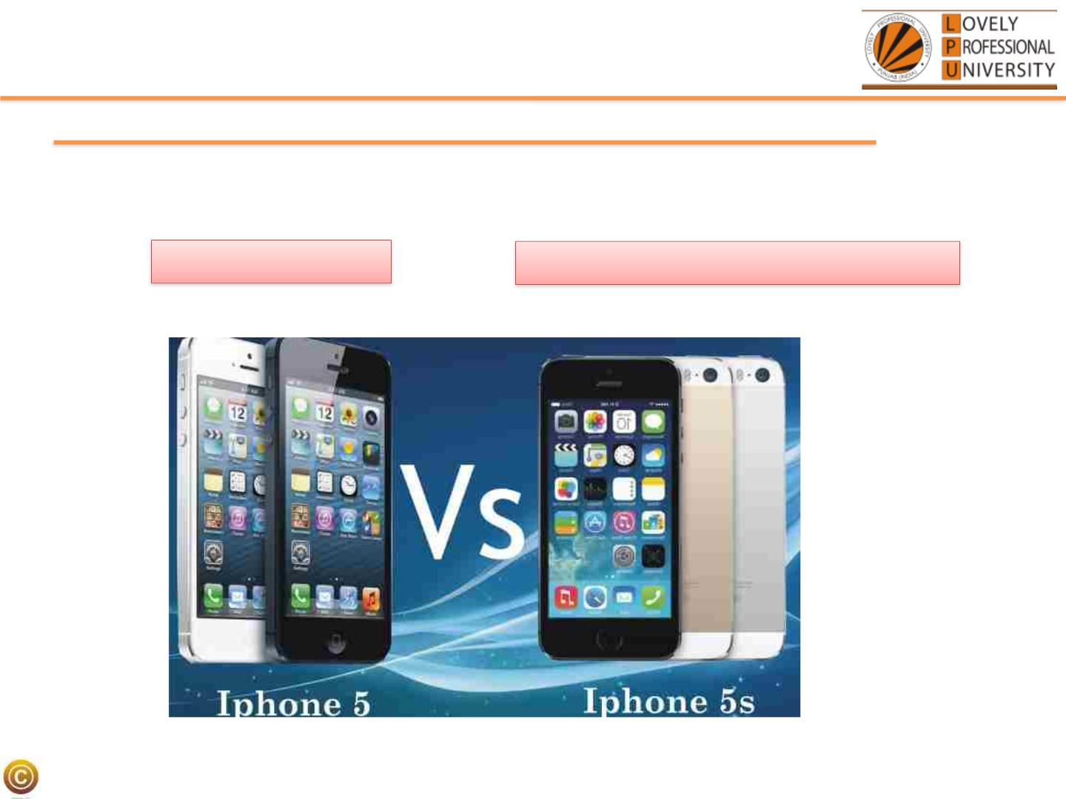
Reusability
Existing Features
Existing Features + Additional Features
© LPU :: CSE202 C++ Programming
LPU:: CSE202: OBJECT ORIENTED PROGRAMMING

Slide 44
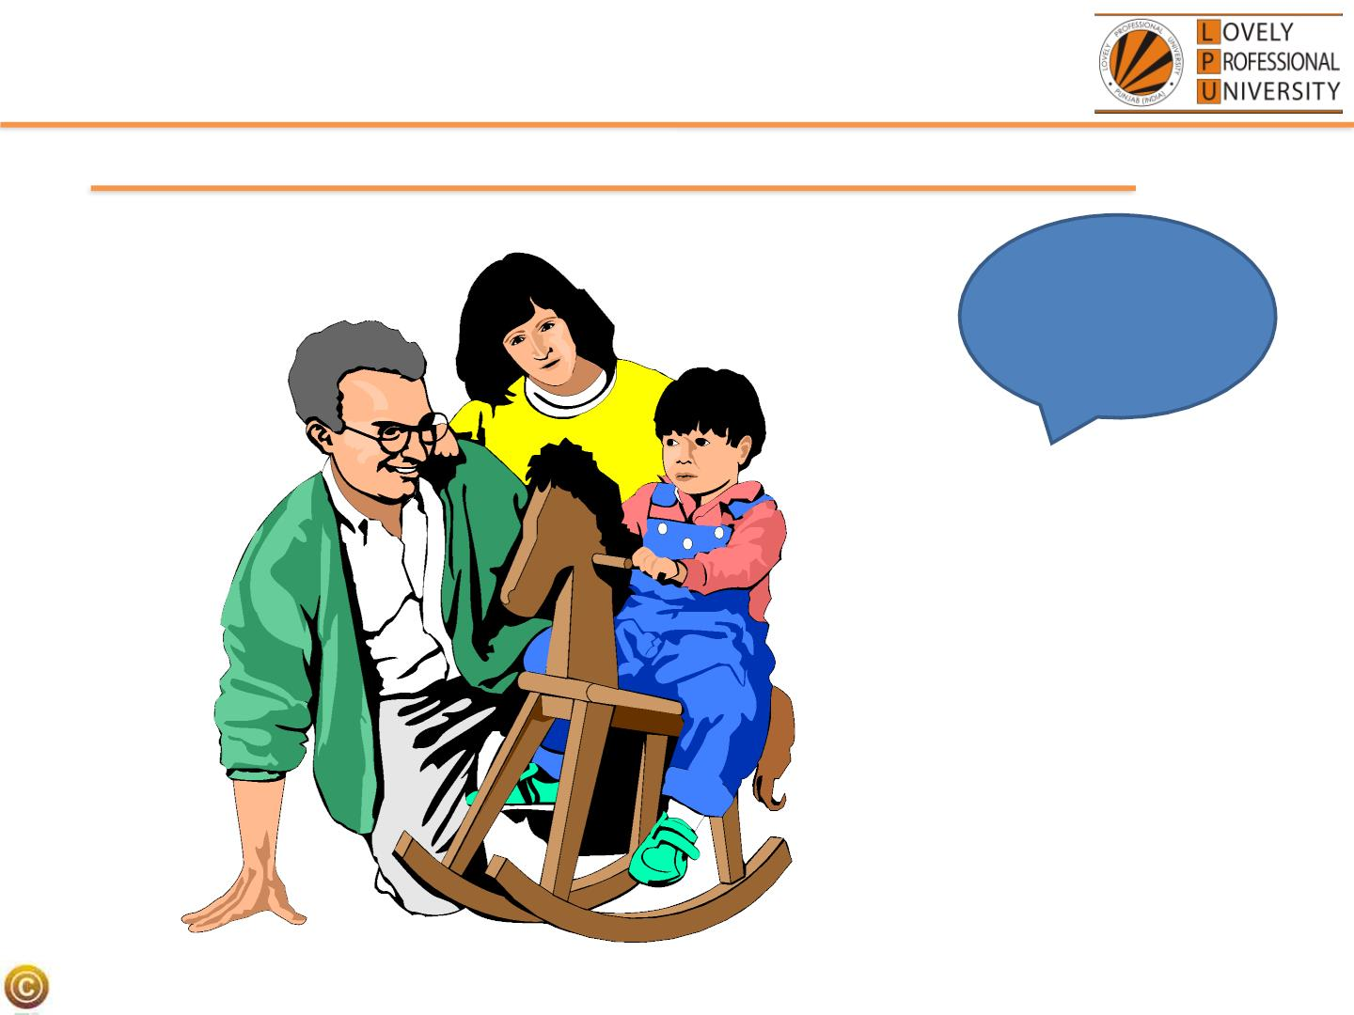
Inheritance
But Mummy,
where did my
blue eyes
come from?
©LPLUP U:::C: SCES2E20022: CO+B+JEPCroTgOraRmImENingTED PROGRAMMING

Slide 45
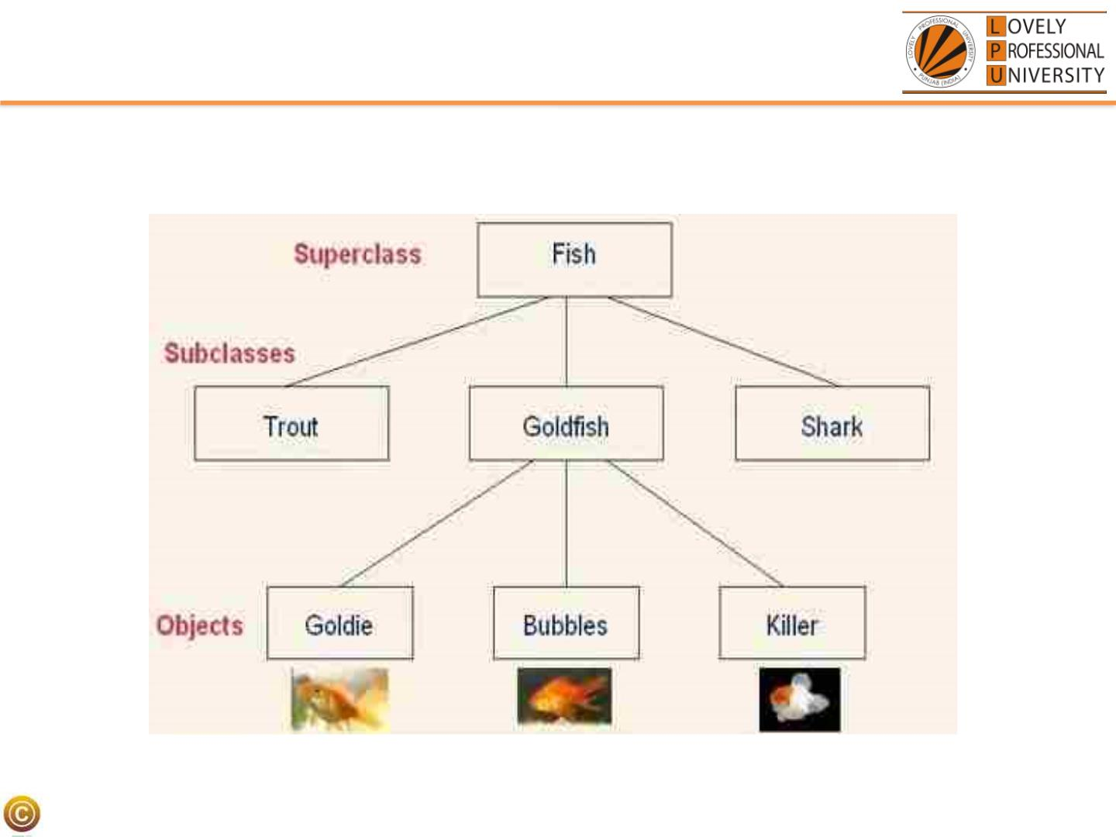
Inheritance….
LPU:: CSE202: OBJECT ORIENTED PROGRAMMING

Slide 46
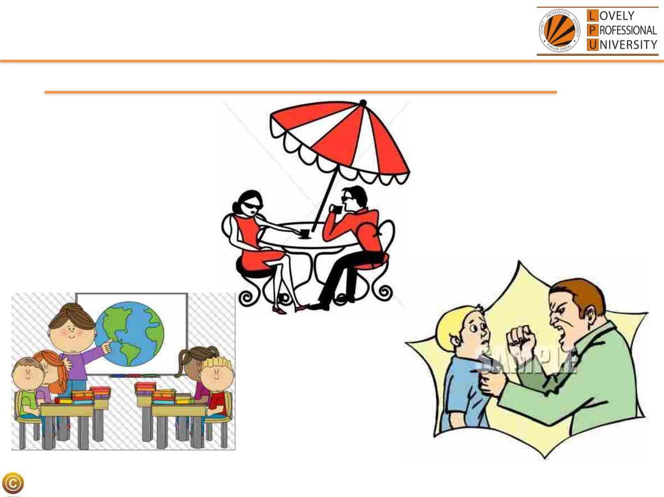
Polymorphism
In front of father
In class
In CCD
One thing and many forms
©LPLUP U:::C: SCES2E20022: CO+B+JEPCroTgOraRmImENingTED PROGRAMMING

Slide 47
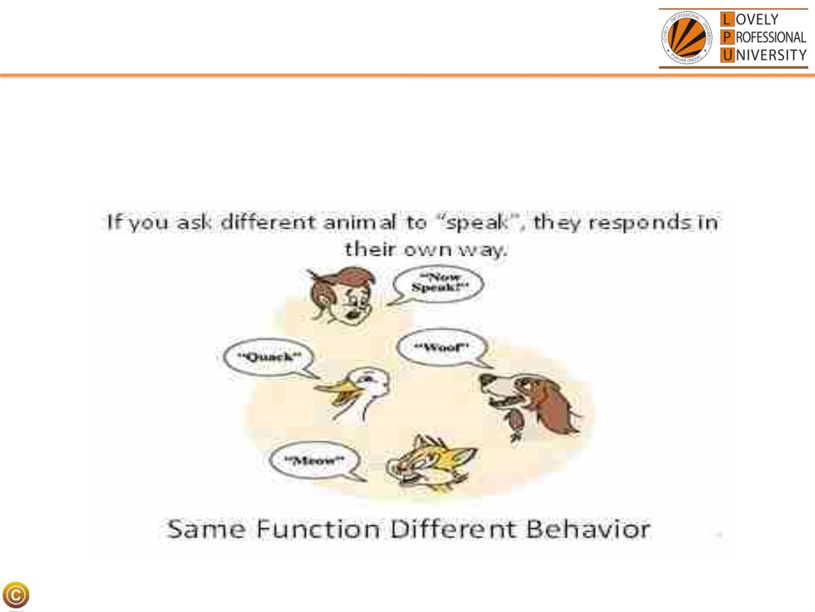
Polymorphism
• Ability to appear in many forms…
LPU:: CSE202: OBJECT ORIENTED PROGRAMMING

Slide 48
Course Contents
•Classes and Objects
•Functions
•Operator Overloading
•Type Conversion
•Pointer
•Array
•String
•Inheritance
•DMA
•Polymorphism
•Constructor and Destructor •Exception Handling
•File Handling
•Templates and STL
LPU:: CSE202: OBJECT ORIENTED PROGRAMMING

