Slide 1
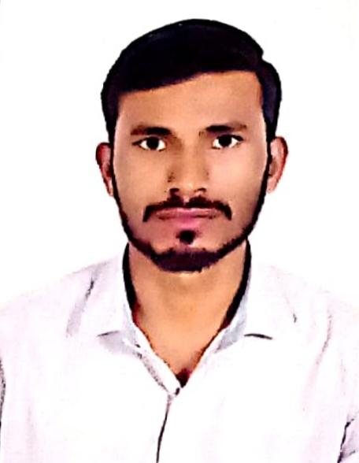
PROFILE - Mr. SUNIL SUMER - IELEKTRON
EXPERIENCE: 1.5 YEAR in Automotive Software Engineering
Software Engineer, IELEKTRON Technologies , Chennai
Vector India, Hyderabad
EDUCATION:
B.Tech in Electronics and communication Engineering from AKTU
CORE COMPETENCIES:
Programming Language : C,C++,Embedded C.
Communication Protocols : UART, I2C, SPI, CAN, UDS.
Tools : STM32 Cube IDE, CS+, VectorCAST, CANalyzer, G Test,
PTC Integrity, Enterprise Architect.
Others : Github.
PROJECTS:
1. Unit Testing in ADAS Feature:
Hands on experience in Vector CAST Tool
Developing Test cases for Statement Coverage and MCDC.
Generating Regression scripts and Full report for the features.
Creating PR in Git Repository.
2. Time-based device control system : Aim of this project is to control devices using RTC based on real time.
For user security I2C based EEPROME is incorporated for user authentication.
3. Phone book management system : Aim to provide user friendly program to store manage and access their contact efficiently.
4. UDS_Stack Development : UDS Stack to communicate between client and server in automotives.

