Slide 1

*Python Overview (Introduction) *
Python was created by Guido van Rossum, and released in 1991 and It is one of the most popular programming languages.it is used in various areas of applications such as Machine Learning, Artificial Intelligence, web development, IoT, and more. Python works on different platforms (Windows, Mac, Linux, Raspberry Pi, etc). The most recent major version of Python is Python 3.
Easy to Learn and Use
Mature and Supportive Python Community
Support from Renowned Corporate Sponsors
Hundreds of Python Libraries and Frameworks
Versatility, Efficiency, Reliability, and Speed
Big data, Machine Learning and Cloud Computing

Slide 2
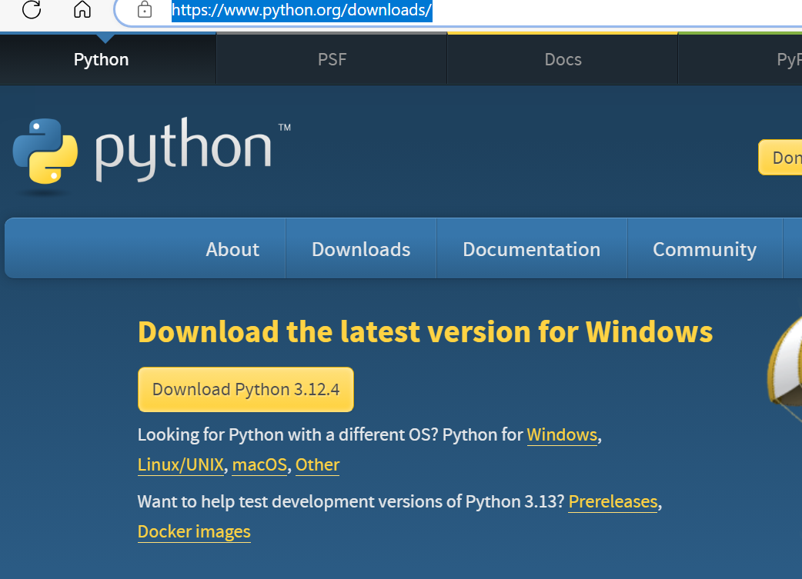
Python Installation (Environment Setup) :-
It can be downloaded from its official website Download Python | Python.org

Slide 3
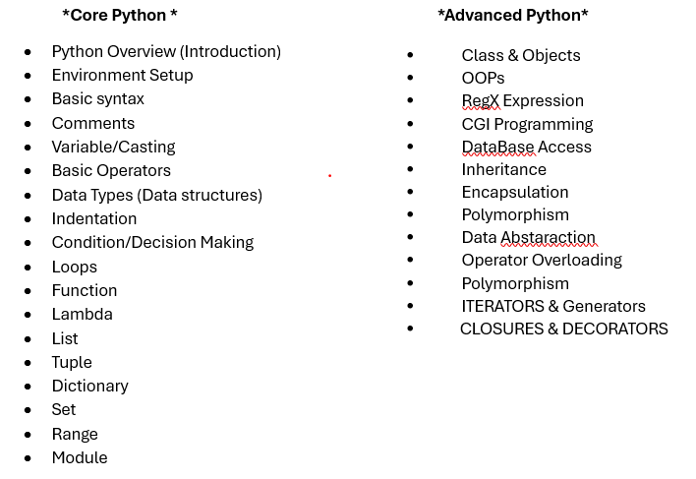
Python Syllabus

Slide 4
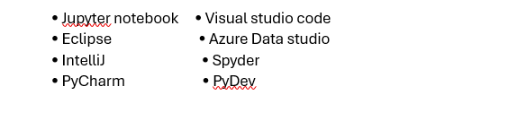
Python IDE & Code Editors:- (Integrated Development Editors)

Slide 5
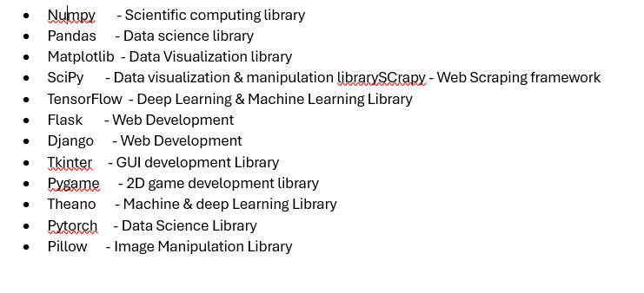
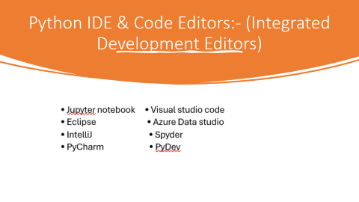
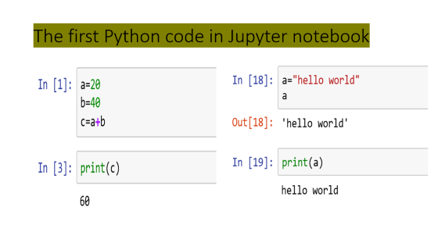
*Python Libraries/Frameworks *

Slide 6

*Career options in Python*

Slide 7
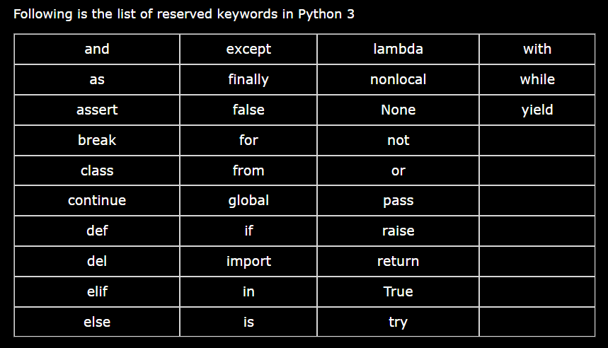
Reserved Keyword in Python

Slide 8
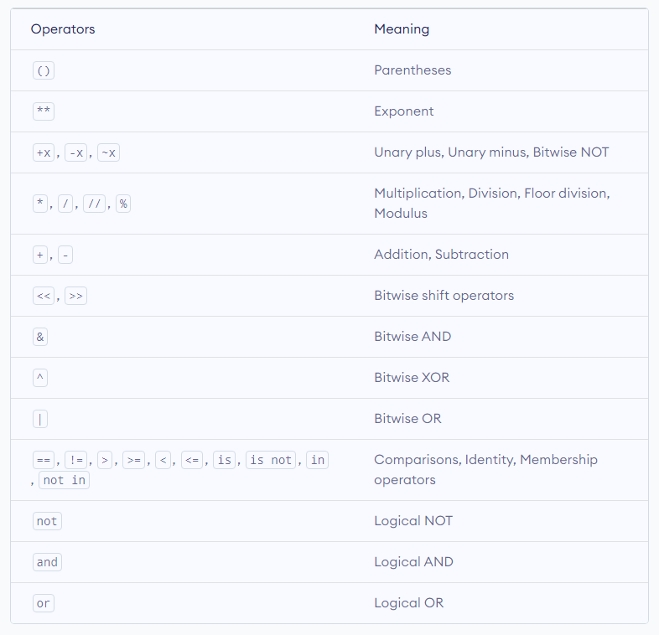
Precedence and Associativity The operator precedence in Python is listed in the following table. It is in descending order (upper group has higher precedence than the lower ones).

Slide 9
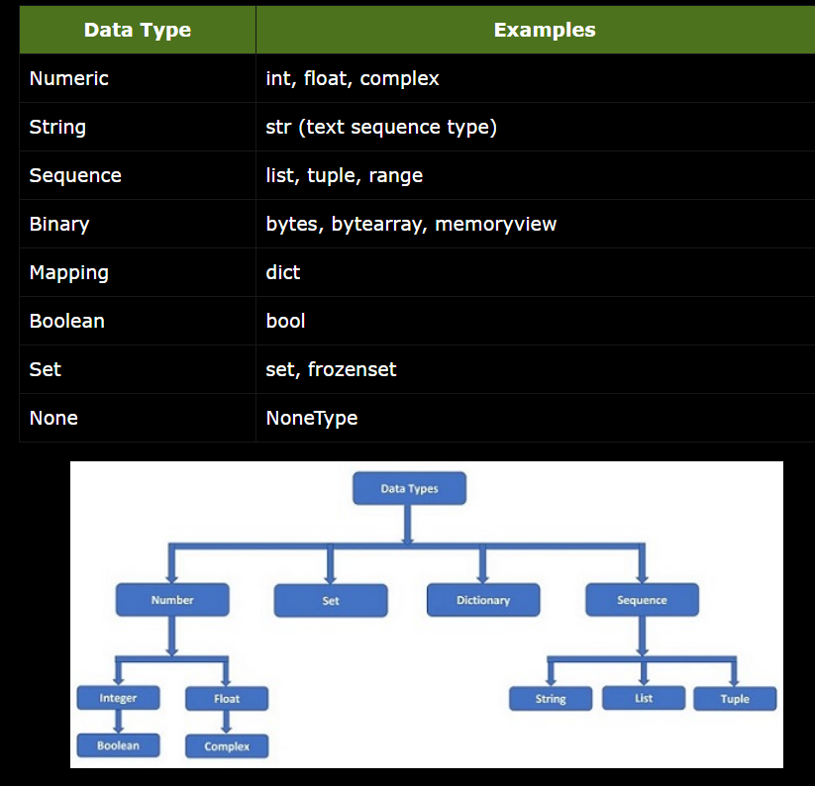
Data Type in Python

Slide 10

Python Collections (Arrays)
There are four collection data types in the Python programming language:
List is a collection which is ordered and changeable. Allows duplicate members.
Tuple is a collection which is ordered and unchangeable. Allows duplicate members.
Set is a collection which is unordered, unchangeable*, and unindexed. No duplicate members.
Dictionary is a collection which is ordered** and changeable. No duplicate members.

Slide 11
The commonalities between lists and tuples are: List [] vs Tuple()
Both are sequence data types.
Each item stored in a list can be of any data type.
Elements can be accessed by indexing and slicing.
Both allow duplicates.

Slide 12
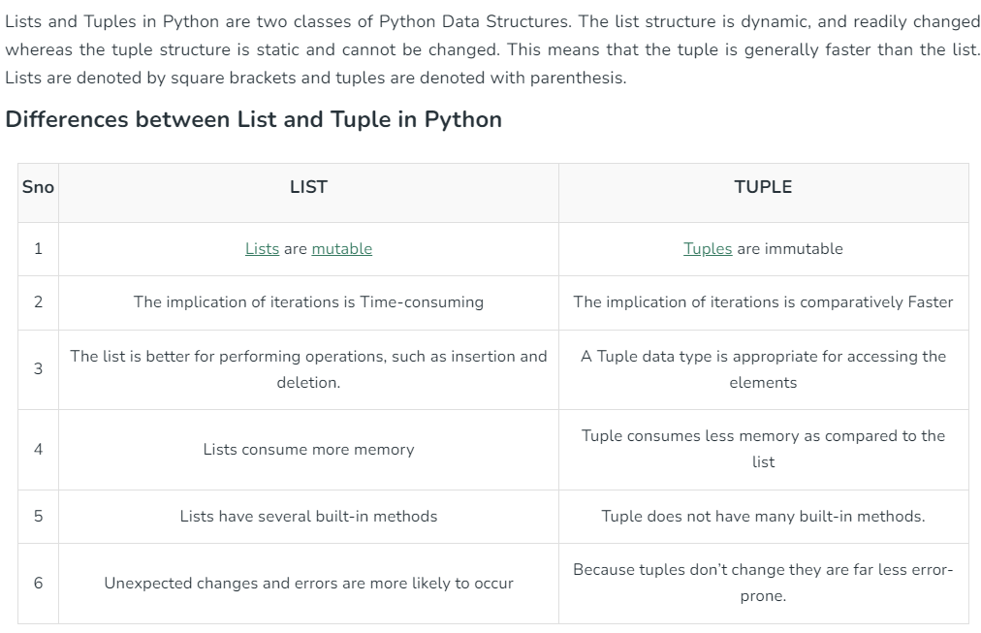
Differences between List[ ] and Tuple( ) in Python
#List can be modified:-
List = [1, 2, 4, 4, 3, 3, 3, 6, 5]
print("Original list ", List)
List[3] = 77
print("Example to show mutability ", List)
#Tuple cannot be modified.
tuple1 = (0, 1, 2, 3)
tuple1[0] = 4
print(tuple1)

Slide 13
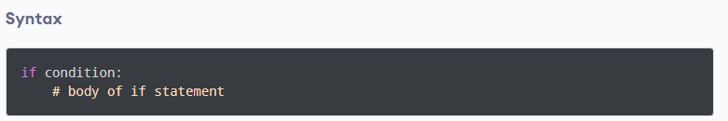
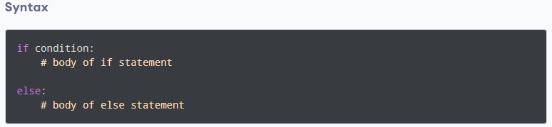
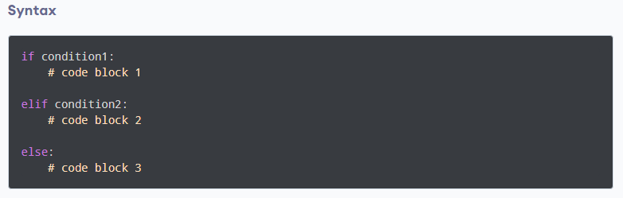
Python if...else Statement 1. Python if Statement 2. Python if...else Statement 3. Python if…elif…else Statement 4. Python Nested if Statements

Slide 14
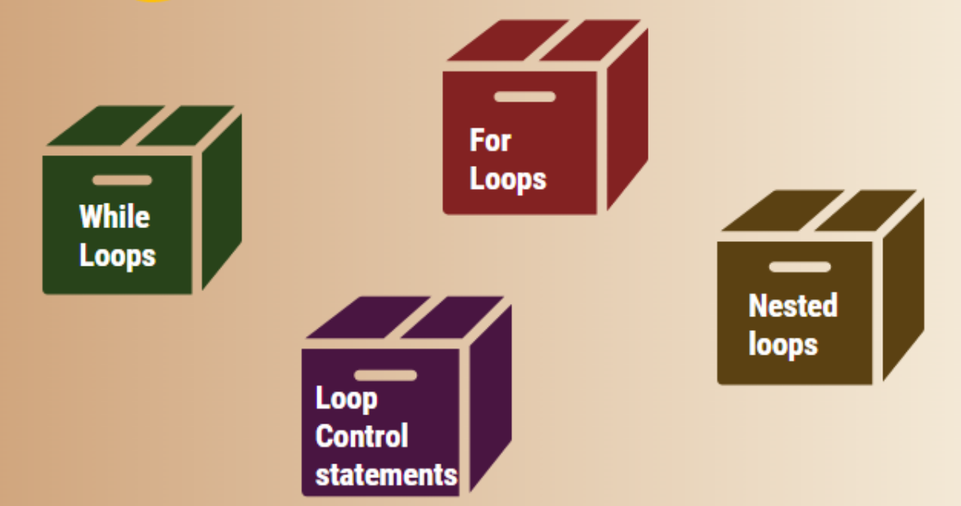
Loop in Python

Slide 15
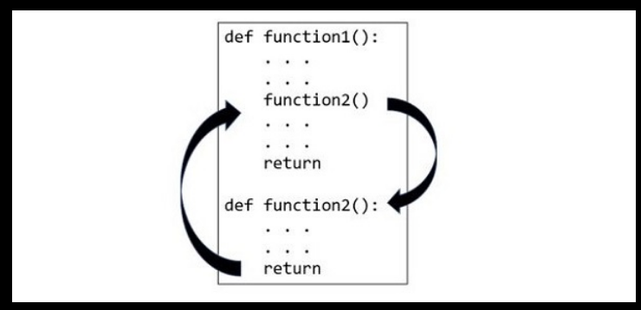
Function in Python

