Slide 1
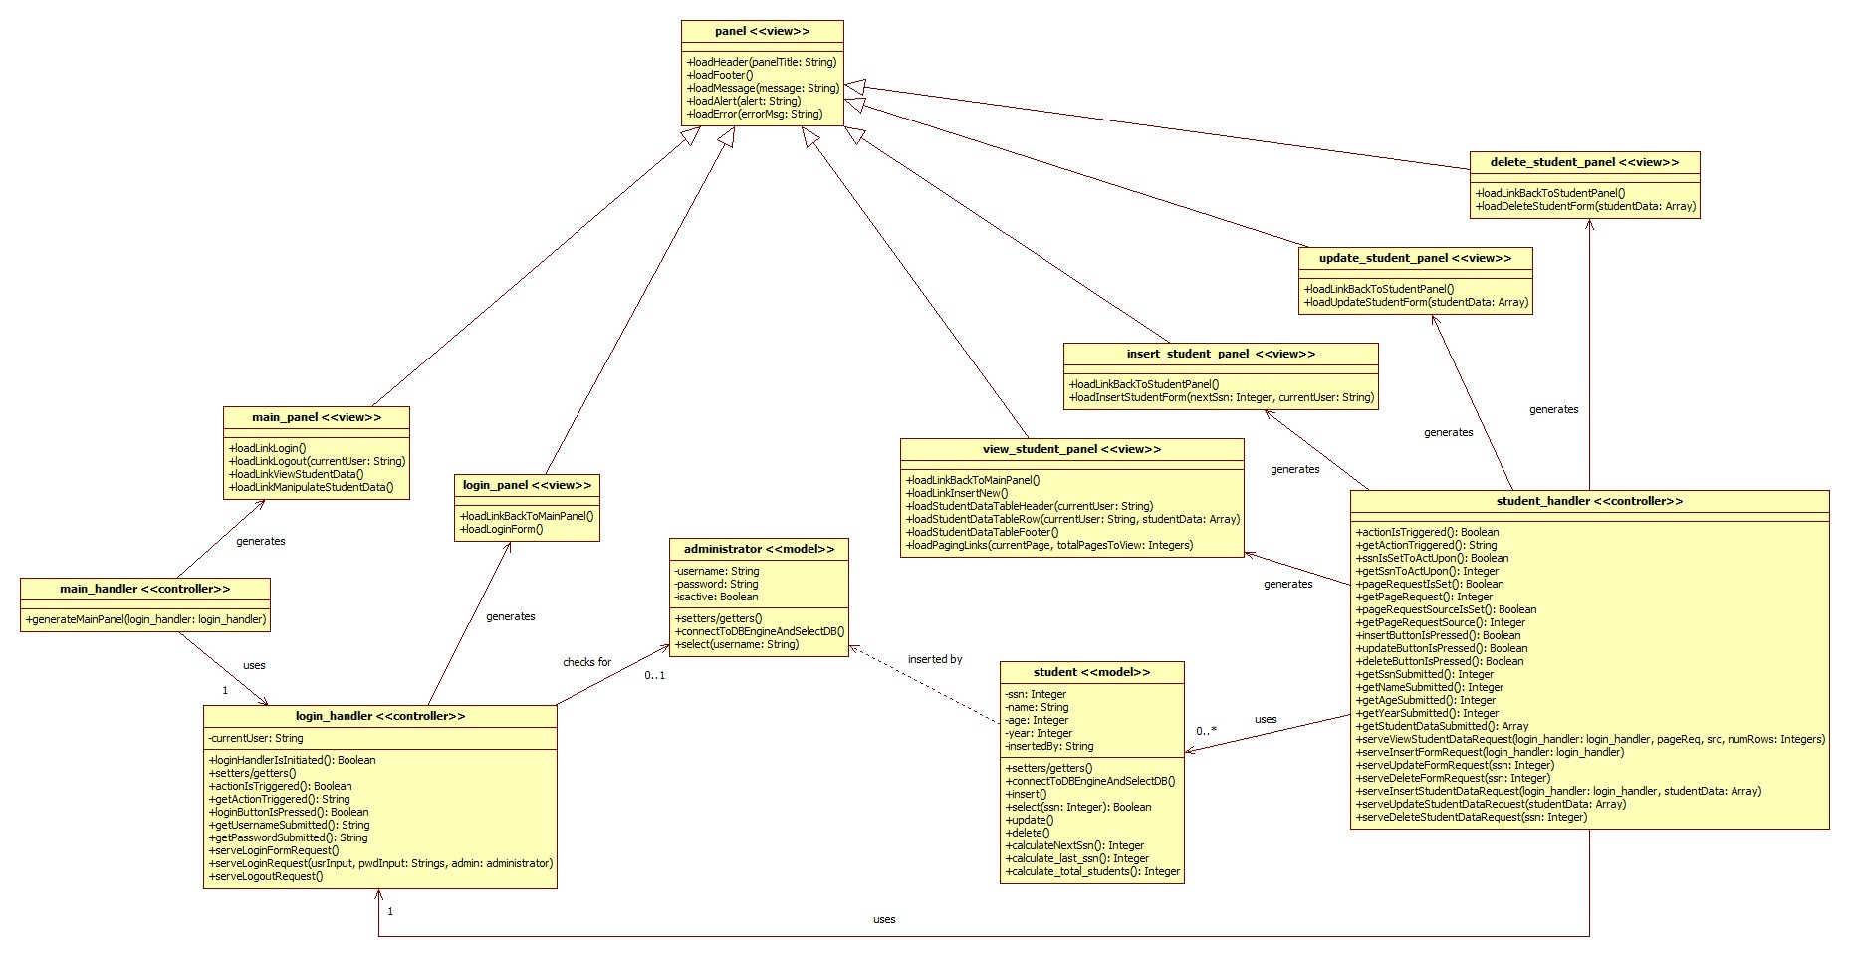
view
view
view
view
view
view
view
model
model
controller
controller
controller

