Slide 1


Student Details
Name: Sunit Soni
Skills-Build Email Id: sunit_soni@srmap.edu.in
College Name: SRM University AP
College State: Andhra Pradesh
Internship Domain and Internship Start and End Date: Artificial Intelligence and Machine Learning [3rd June- 31st July]

Slide 2
PROJECT TITLE/Problem Statement
Title:
Employee Burnout Prediction using Linear Regression
Problem statement:
Employee burnout is a significant issue that can lead to decreased productivity, increased turnover, and negative impacts on employee well-being. Identifying burnout early allows organizations to take preventive measures and support their employees effectively. This project aims to develop a predictive model using linear regression to forecast employee burnout based on various factors, enabling timely interventions and enhancing overall workplace health and productivity.

Slide 3
AGENDA
Introduction
Project Overview
End Users
Solution and Value proposition
Customization
Modeling
Results
Conclusion
Project Title, Problem statement
Brief description of the project
Identification of the end users
Description of predictive model, value proposition to the organization
How the project was customized.
Data preprocessing, EDA, feature selection, model training and evaluation
Performance metrics, interpretation of results, summary of findings
Summary of project, deployment plan

Slide 4
PROJECT OVERVIEW
Purpose:
Scope:
Develop a predictive model for employee burnout prediction using linear regression to enable early intervention and improve employee well-being and productivity.
Collect and preprocess employee data.
Perform EDA.
Select relevant features for burnout prediction.
Objectives:
Train and evaluate a linear regression model.
Provide actionable insights and recommendations.
Gather and clean data.
Conduct EDA to understand data patterns.
Identify significant features influencing burnout.
Train and validate the linear regression model.
Summarize findings and suggest improvements.

Slide 5
WHO ARE THE END USERS of this project?
Human Resource (HR) Departments
Management and Executives
Employees
Characteristics: Professionals responsible for employee well-being, productivity, and retention.
Benefits: Early detection of burnout, enabling timely interventions, improved employee satisfaction and productivity, and a healthier work environment.
Characteristics: Decision-makers focused on overall organizational performance and employee engagement.
Benefits: Data-driven decision-making, enhanced strategic planning, and a positive impact on the company’s bottom line.
Characteristics: Individuals working within the organization who may experience burnout.
Benefits: Improved mental health and well-being, enhanced job satisfactions, and a supportive workplace culture.

Slide 6
YOUR SOLUTION AND ITS VALUE PROPOSITION
Solution overview:
Value Proposition:
My solution involves developing a predictive model for employee burnout using linear regression. This model analyzes various factors contributing to burnout and provides early warnings, enabling timely interventions to support employee well-being.
Proactive Burnout Management
Enhanced Employee Well-being
Increased Productivity
Reduced Turnover Rates
Data-Driven Decisions

Slide 7
How did you customize the project and make it your own
Data Source Selection
Feature Engineering
Carefully selected and curated data sources that are most relevant to the user’s specific needs.
Developed unique features that are specifically indicative of burnout within the organization.
Tailored Model Parameters
Fine-tuned the linear regression model parameters to optimize performance based on the dataset.
Custom Reporting and Visualization
Designed custom reports and visualizations to present the model’s predictions and insights.

Slide 8
MODELLING
Modeling techniques and Methodologies
Technologies Utilized
Data collection and preprocessing
Exploratory Data Analysis (EDA)
Feature selection and engineering
Model development
Model evaluation
Programming languages: Python, for it’s extensive libraries and tools data analysis and machine learning.
Libraries and Frameworks:
Pandas and NumPy
Matplotlib and Seaborn
Scikit-Learn
Integrated Development Environment (IDE): Google Colab

Slide 9
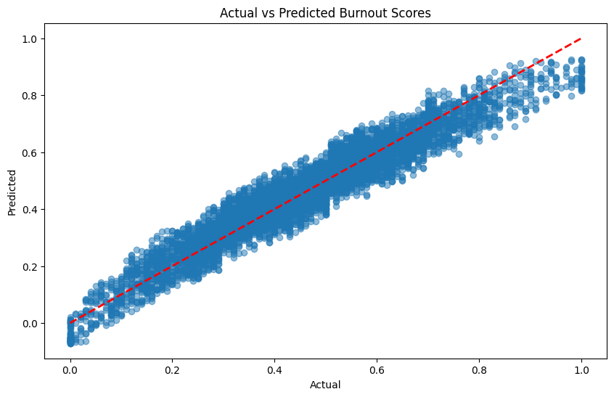
Results
This plot shows the relationship between the actual burnout scores and the predicted scores. The closer the points are to the red line, the better the model's predictions.

Slide 10
links
GitHub repository link :- https://github.com/SunitSoni/Employee-burnout-prediction-using-linear-regression

