Slide 1
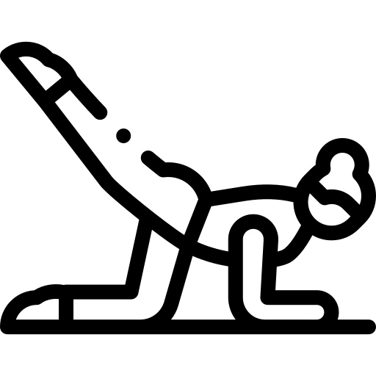
My Yoga Mate
Group 4 Shujun Wang, Yuan Zhang, Siyu Liu, Sunita Acharya

Slide 2
Introduction of Yoga and "My Yoga Mate"
Originated in ancient India
A kind of physical, mental, and spiritual practices
Aims to control and still the mind
Practice Yoga following the video is more convenient for people. However, there is a difficulty that no teacher can help to correct the people’s mistake in movement.
The purpose of “My Yoga Mate” is to help those people who follow the video practice Yoga correctly.

Slide 3
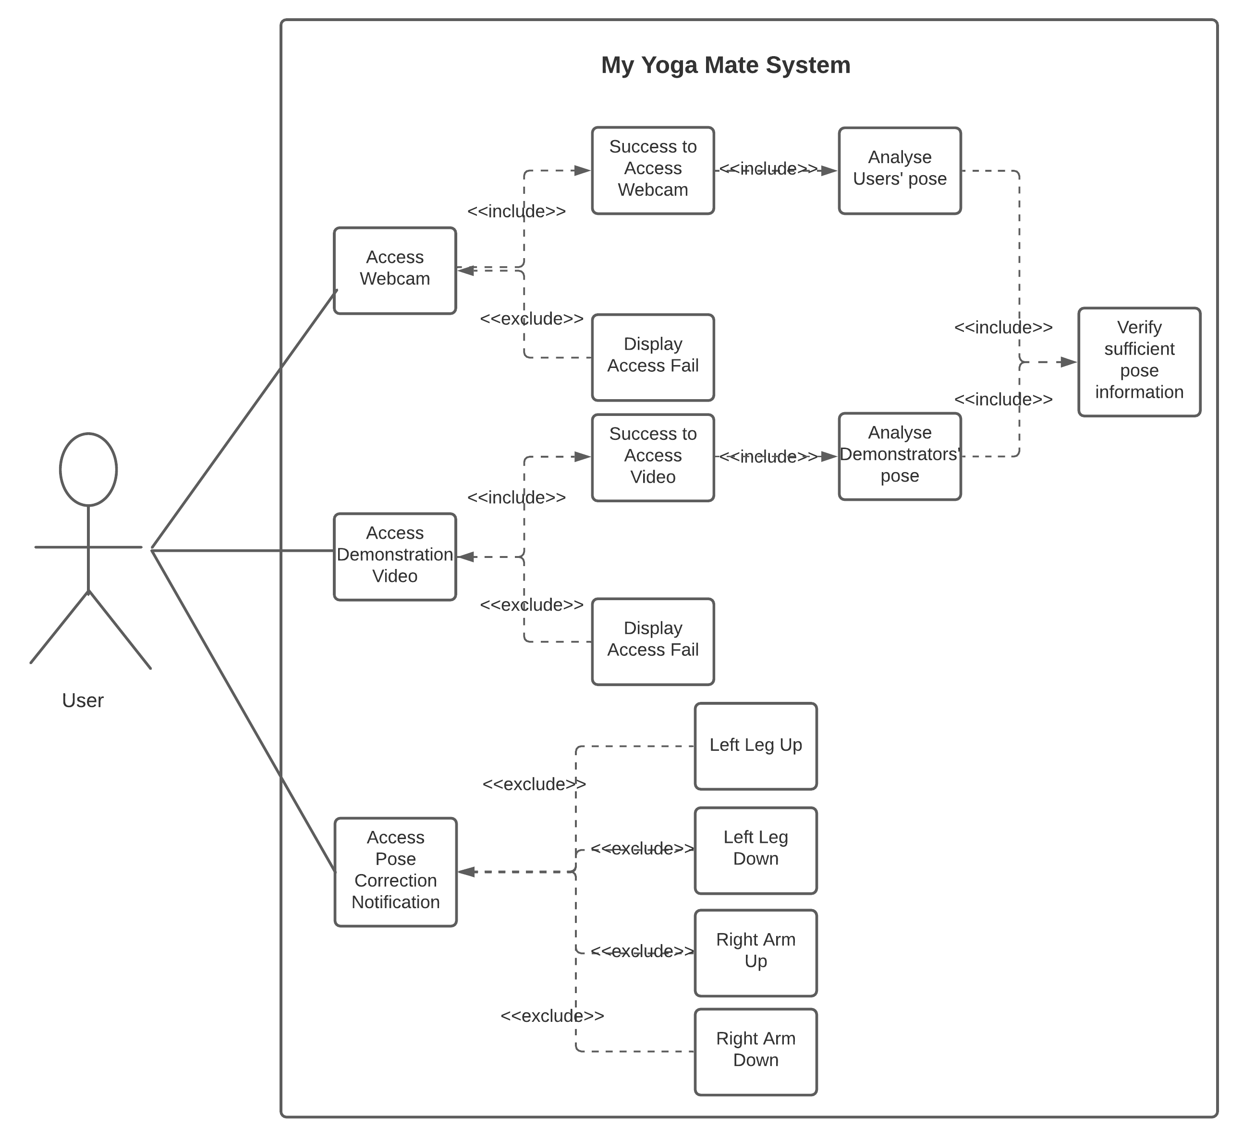
UML and Components
UML
Use Case Diagram
Hardware :
Webcam
Laptop with Linux OS (dual setup)
Software :
Ubuntu
OpenPose
C++ API

Slide 4
Thank You!

