Slide 1
An Intro to Terraform
Name: Charan Raj Kumar
Date: 2nd Nov 2022

Slide 2
What is Infrastructure as Code (IaC)?
It is the process of provisioning and managing the complete IT infrastructure using machine-readable definition files. It helps in automating the complete data center by using programming scripts.
Two approaches are for writing Infrastructure as Code
Declarative Approach. (Terraform, Puppet)
Procedural Approach. (Chef, Ansible)
Popular IAC Tools
Terraform
Ansible
AWS CloudFormation
Azure Resource Manager
Google Cloud Deployment Manager
Chef
Puppet
SaltStack
Vagrant

Slide 3
Terraform Core concepts
Below are the core concepts/terminologies used in Terraform:
Variables: Also used as input-variables, it is key-value pair used by Terraform modules to allow customization.
Provider: It is a plugin to interact with APIs of service and access its related resources.
Module: It is a folder with Terraform templates where all the configurations are defined.
State: It consists of cached information about the infrastructure managed by Terraform and the related configurations.
Resources: It refers to a block of one or more infrastructure objects (compute instances, virtual networks, etc.), which are used in configuring and managing the infrastructure.
Data Source: It is implemented by providers to return information on external objects to terraform.
Output Values: These are return values of a terraform module that can be used by other configurations.
Plan: It is one of the stages where it determines what needs to be created, updated, or destroyed to move from real/current state of the infrastructure to the desired state.
Apply: It is one of the stages where it applies the changes real/current state of the infrastructure in order to move to the desired state.

Slide 4
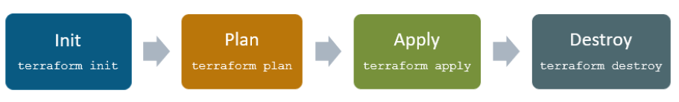
Terraform Lifecycle
Terraform lifecycle consists of – init, plan, apply, and destroy.
Terraform init initializes the working directory which consists of all the configuration files.
Terraform plan is used to create an execution plan to reach a desired state of the infrastructure. Changes in the configuration files are done in order to achieve the desired state.
Terraform apply then makes the changes in the infrastructure as defined in the plan, and the infrastructure comes to the desired state.
Terraform destroy is used to delete all the old infrastructure resources, which are marked tainted after the apply phase.

Slide 5
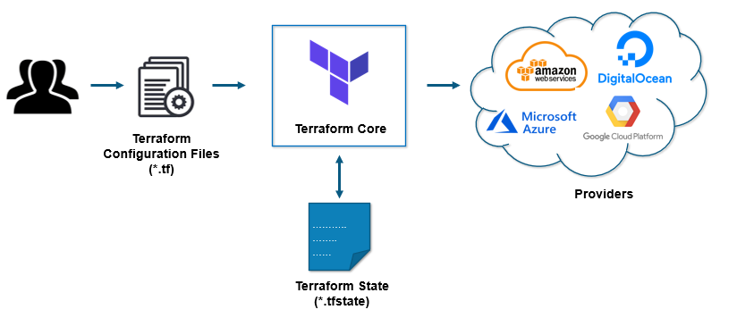
How Terraform Works?
Terraform has two main components that make up its architecture:
Terraform Core
Providers
Terraform core
Uses two input sources to do its job.
  Terraform Configuration Files
  Terraform State
Providers
The second component of the architecture are providers for specific technologies. This could be cloud providers like AWS, Azure, GCP, or other infrastructure as a service platform.

Slide 6
Thank You

