Slide 1




DEEP LEARNING DEMO · MLFLOW & DOCKER
Adult Census Income Prediction
Deep Learning Assessment and Application Demo
Saraswathi Lakshman
OBJECTIVE
TRACKING
DEPLOYMENT
Predict whether annual income is above $50,000 or $50,000 and below.
Compare neural networks and track experiments with MLflow.
Serve the selected model using FastAPI, Docker Compose and Streamlit.
Notes:
Introduce the project: an end-to-end deep learning assessment predicting whether individual annual income exceeds $50K using US Census data. Frame the workflow across model experimentation in MLflow to multi-container deployment.

Slide 2

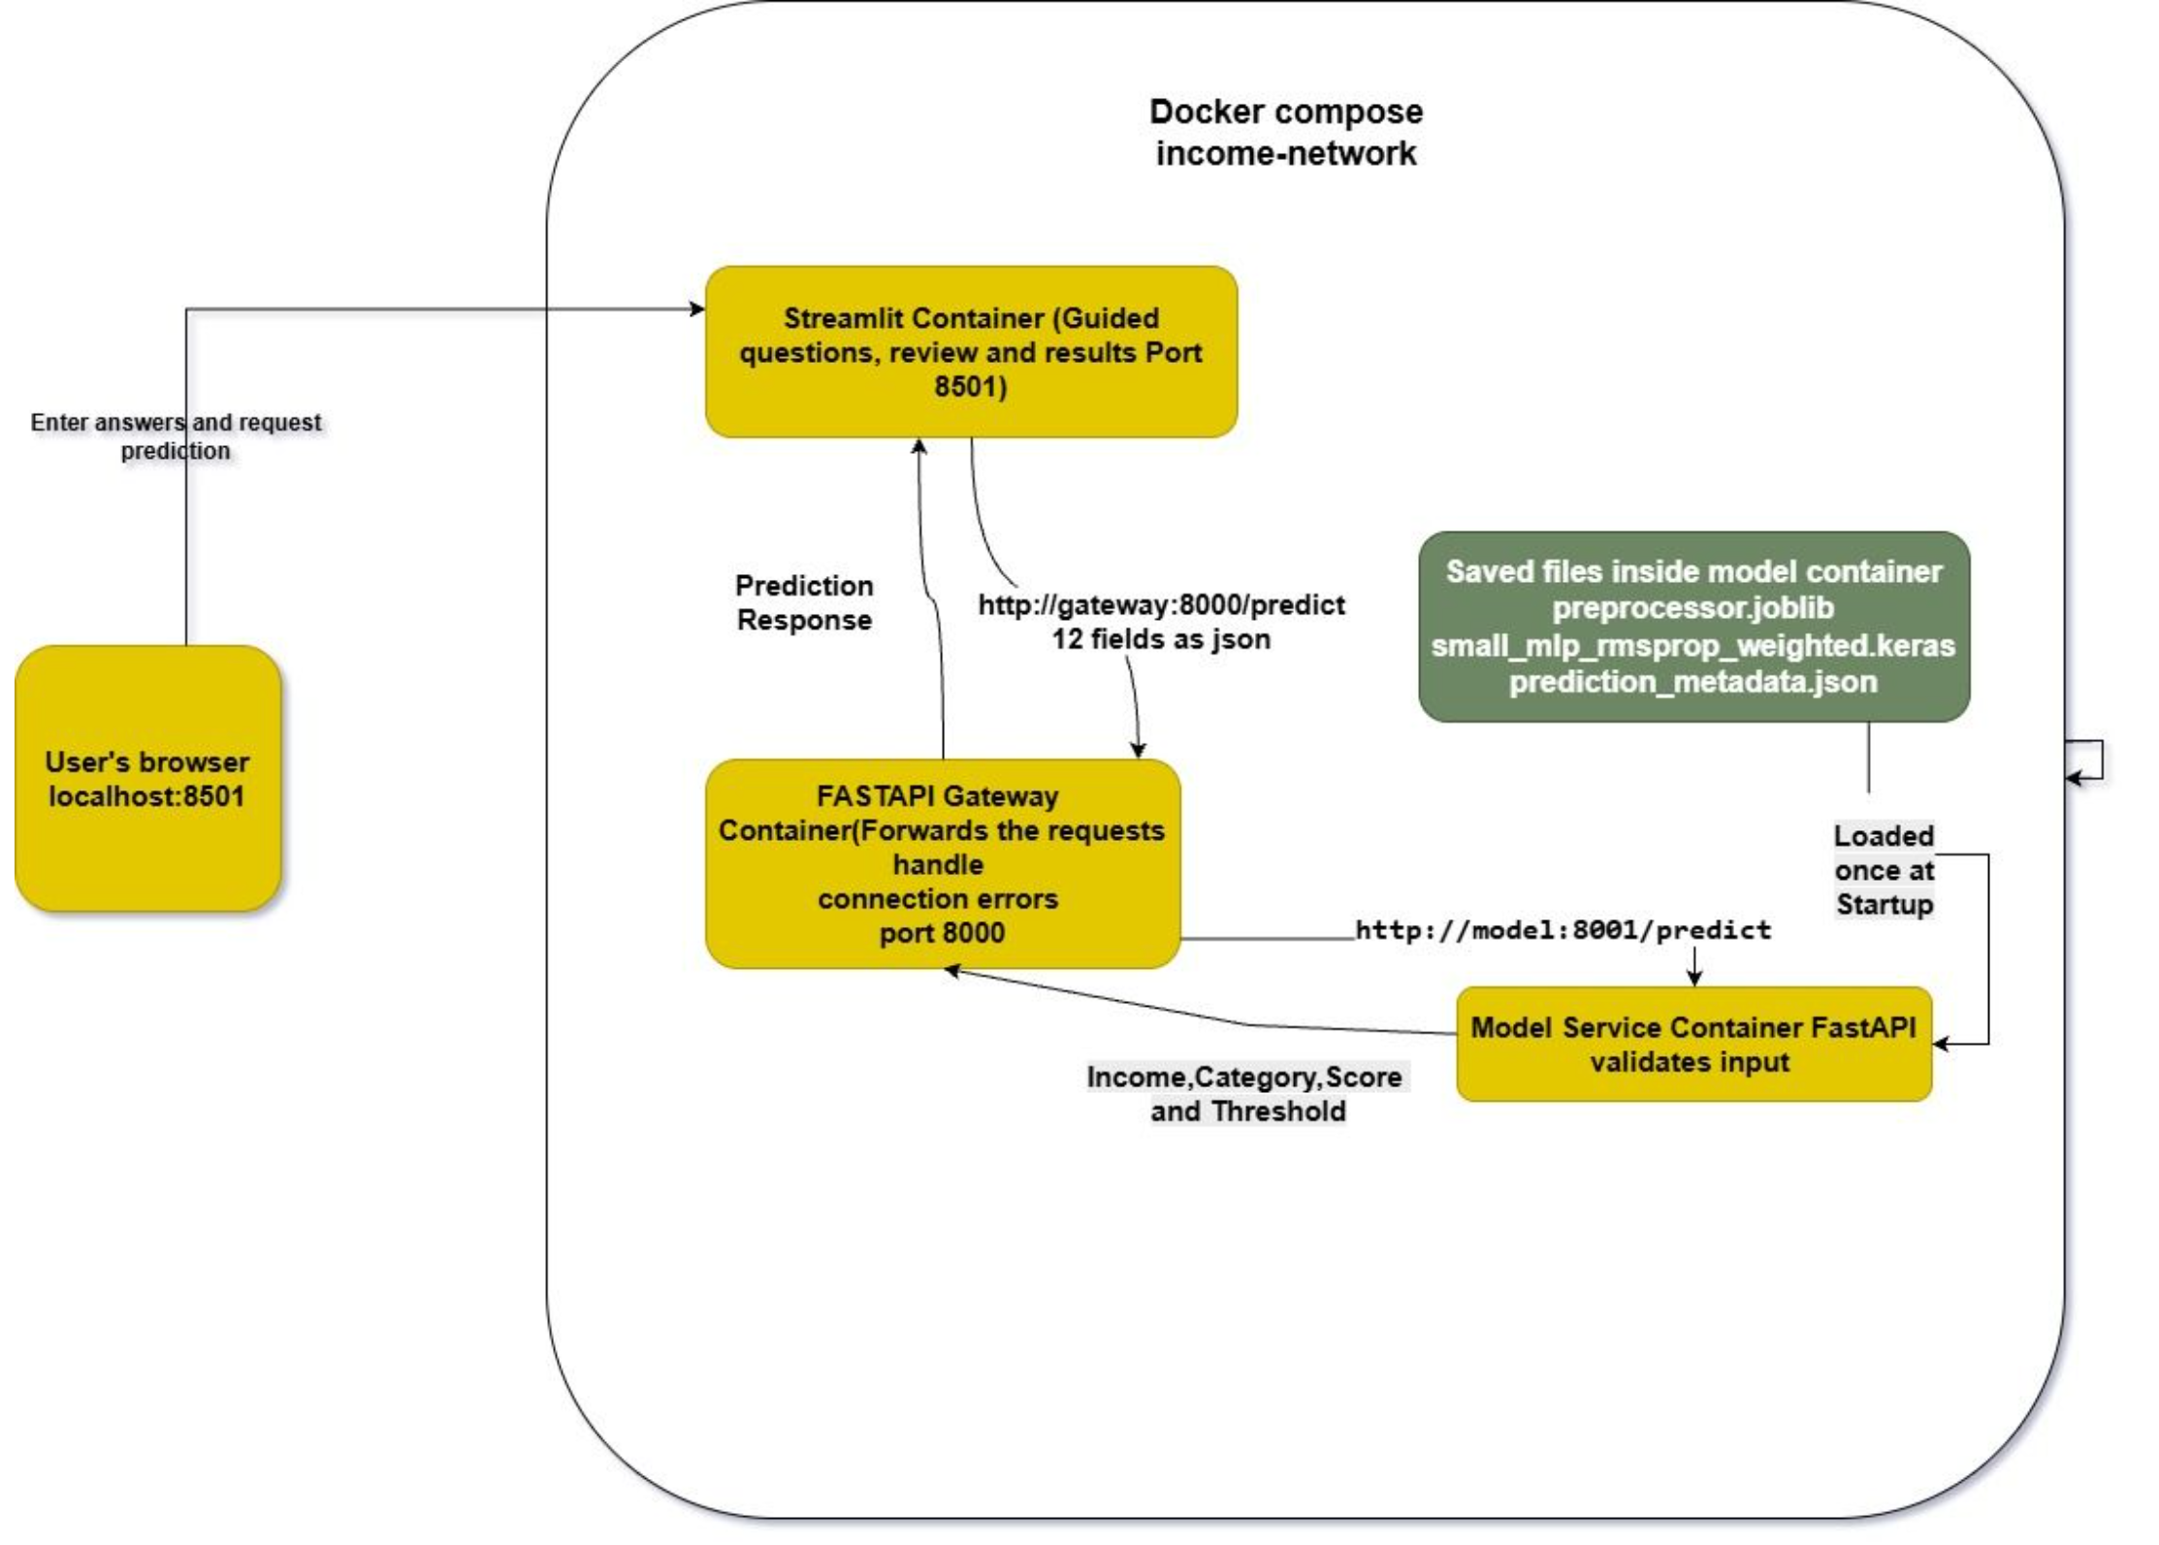
Application Architecture
Streamlit: collects answers and displays predictions.
FastAPI gateway: forwards requests and handles connection errors.
Model service: validates inputs, prepares features and runs inference.
Docker Compose: manages three containers and their shared network.
Saved model and preprocessing files live inside the model container and load once at startup.
Notes:
Walk through the multi-service architecture shown in the diagram. Highlight the separation of concerns: Streamlit frontend, FastAPI gateway, and the model inference container, all isolated in a unified Docker network.

Slide 3


Data Preparation and Training
32,537
70 / 15 / 15
12 → 90
No Leak
32,561 records, reduced to 32,537 after removing 24 exact duplicates.
Stratified split: 70% training, 15% validation, 15% testing.
Scaled numerical features and one-hot encoded categories: 12 fields became 90 inputs.
Fitted preprocessing on training data only to prevent leakage.
Architecture | Hidden layers
Small MLP | 32, 16
Larger MLP | 64, 32, 16
Larger MLP with dropout | 64, 32, 16 with 20% dropout
TRAINING STRATEGY
Six experiments: compared Adam, SGD with momentum, RMSprop and class weighting. Used early stopping to restore the best validation-loss checkpoint.
Notes:
Detail the data cleaning steps and feature pipeline. Mention how 12 demographic variables expand to 90 features after one-hot encoding, and explain the motivation behind comparing optimizer dynamics across three distinct network topologies.

Slide 4

Model Selection and Evidence
Selected: Small MLP with RMSprop and class weights
Training classes were approximately 76% lower income and 24% higher income. Class weights increased the minority class’s influence without creating synthetic records.
Small MLP experiment | Validation precision | Validation recall | Validation F1
Adam | 72.21% | 61.65% | 0.6651
RMSprop | 72.13% | 62.07% | 0.6673
RMSprop with class weights | 59.09% | 83.50% | 0.6920
Highest validation F1 among all six experiments at threshold 0.5.
Trade-off: identified more higher earners, with more false positives.
Final untouched test results: F1 0.6901, recall 83.42%, accuracy 81.95%.
DEMO NOTE
Show the MLflow dashboard during the demo to support the comparison.
Notes:
Present the model evaluation results. Highlight the severe class imbalance (76/24) and how class weighting shifted recall from ~62% to over 83%, producing the highest overall validation F1 score of 0.6920.

Slide 5

Live Demo and Key Learnings
STEP-BY-STEP
TAKEAWAYS
Demo sequence
Key learnings
Show the three services running in Docker Compose.
Open Streamlit and load the sample profile.
Review the answers and request a prediction.
Show API validation rejecting a negative age with HTTP 422.
Consistent preprocessing is essential for reliable inference.
Validation evidence guides model selection.
Separate containers communicate using service names and internal ports.
Limitations: historical census data, false positives and no established probability calibration. This is an educational application.
Notes:
Conclude with the demo walk-through: verify container health, demonstrate the web interface with realistic census inputs, and test input validation error handling. Reiterate key engineering lessons and ethical considerations regarding historical data biases.

