Slide 1
Housing Price prediction Assignment
Bandla Sunitha

Slide 2
Abstract:
A US-based housing company named Surprise Housing has decided to enter the Australian market. The company uses data analytics to purchase houses at a price below their actual values and flip them at a higher price. For the same purpose, the company has collected a data set from the sale of houses in Australia.

Slide 3
Objectives of Business:
Goal of the company:
Which variables are significant in predicting the price of a house
How well those variables describe the price of a house.

Slide 4
Problem solving methodology:
Step 1: Importing Data Set and Understanding data as per the Business point of view
Step 2: Data Cleaning, missing value treatment and outliers treatment
Step 3: Exploratory Data Analysis (EDA), univariate analysis
Step 4: Applying Linear regression and build a model
Step 5: Applying Ridge and lasso to find the optimal value of lambda
Step 6: Using RFE choose the metrics
Step 7: Model evaluation

Slide 5
Data Cleansing:
Dropped the columns where 70% null’s exists in dataset and handled other less % null column independently.
Imputing the values where null values exist below < 50% and checked whether imputing values giving valid information or not
Change the datatype for Garageyrblt.
Change the street values 1 and 0
Change the few columns datatype from float to int
Change excellent -5, good -4, Ta-3, Fa-2, po -1

Slide 6
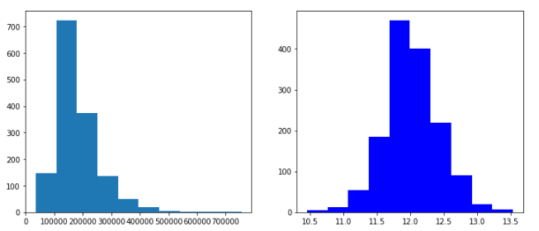
EDA: Univariate Analysis
Target column : Sale Price
Inference:
Sales price is right skewed. So, we perform log transformation so that the skewness is nearly zero

Slide 7
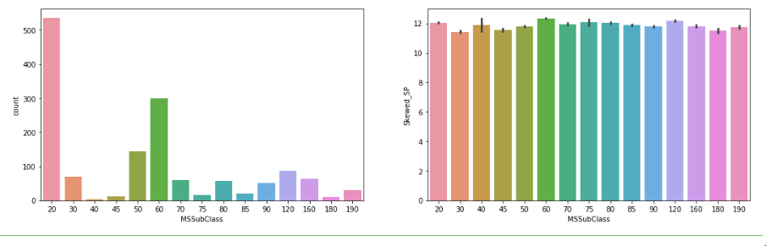
EDA: Univariate Analysis
MSSubClass Metric
Inference:
Here MSSubClass=20 is most highest sale next stands on MSSubClass=60, i.e 201 story occupies high sales and next comes to 602

Slide 8
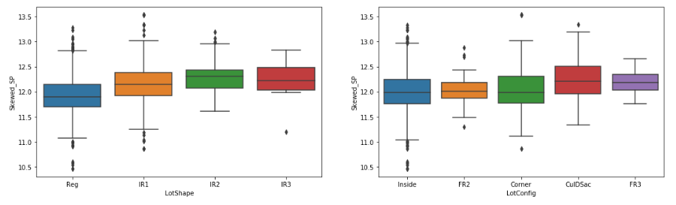
EDA: Univariate Analysis
Lot shape and Lotconfig Metric
Here in lotshape IR3 i.e Irregular is in high sales, in lotconfig 'Culdsac' is in high sales

Slide 9
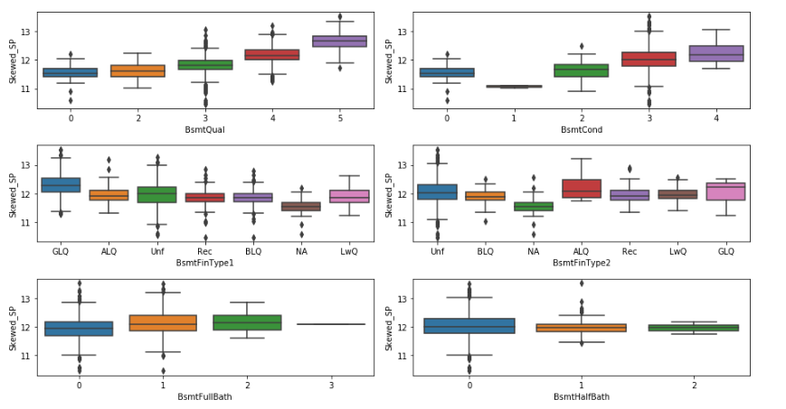
BsmtQual, Bsmt Cond, BsmtFinTYpe1, BsmtFintpe2, BsmtFullBath and BsmtHalfBath Metrics

Slide 10
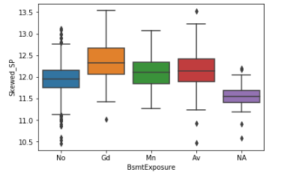
Basement Metrics and its observations
Here we can notice that Basement Quality and Basement condition are excellent and good respectively
1. High sales taking place when Basement Quality either excellent or good and Basement condition is good.
2. In BsmtFinType1: Rating of basement finished area i.e GLQ (Good Living Quarters) are giving high sales
3. In BsmtFinType2: Rating of basement finished area (if multiple types) i.e ALQ (Average Living Quarters) are giving high sales
4. In BsmtFullBath: Basement full bathrooms, high sales are getting if atleast one full bathroom available
5. In BsmtHalfBath: Basement half bathrooms, sales are so attracting in this area.
6. In BsmtExposure: Refers to walkout or garden level walls, Sales are high where Bsmtexposure is good exposure or average

Slide 11
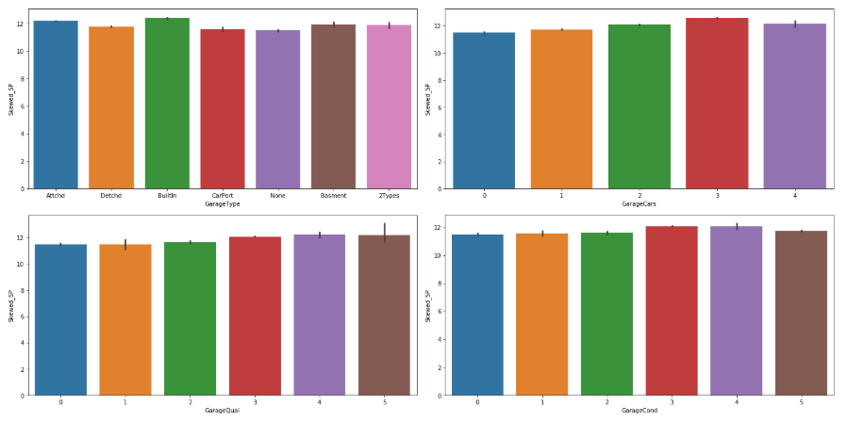
EDA: Garage’s metrics and its observations
Observations:
1. In Garatype BuiltIn Built-In (Garage part of house - typically has room above garage) has more attractive sales and next comes to option of Attached to home
2. High sales took place if Garage car place has more than 2
3. High sales took place if Garage quality either excellent or good
4. High sales took place if Garage condition is fair and also excellent and good

Slide 12
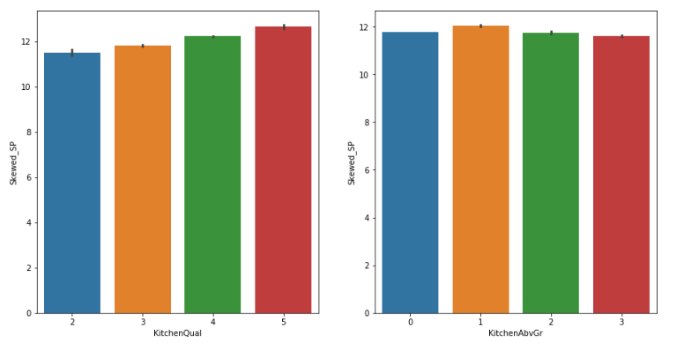
EDA: Kitchen Metric’s and its observations
Sales are more attractive, if Kitchen quality are excellent and good and if kitchen above grade of 1 also attracting more sales

Slide 13
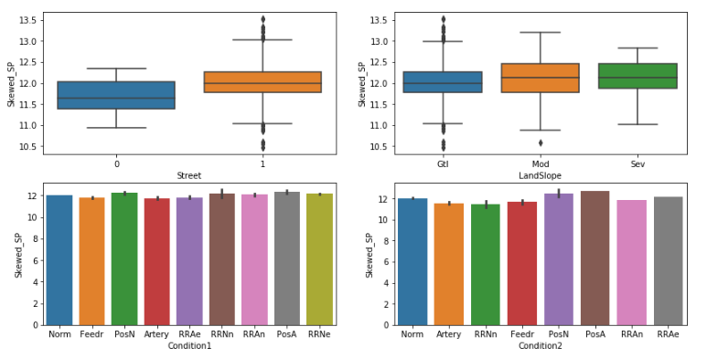
EDA: Street, Land, condition metrics
Inference:
1. In Street of 'Paved' have more attractive for sales rather than Gravel
2. In Land slope, Modearte slope and Gentle slope occupies more sales rather than severe slope
3. In Condition1 and Condition2--> Proximity to various conditions occupies more sales on PosA i.e Adjacent to postive off-site feature and PosN i.e Near positive off-site feature--park

Slide 14
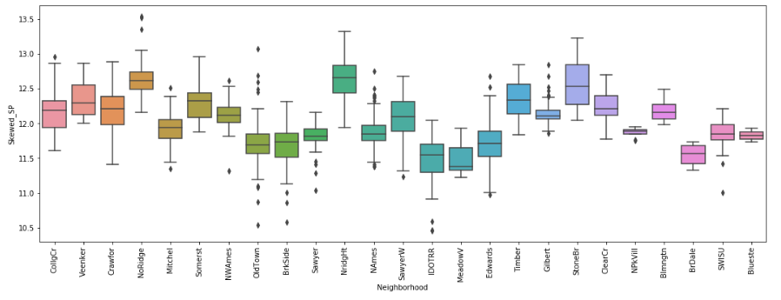
EDA: ‘What_matter_choosing_course’ Metric
Inference: We will see the if Neighborhood have NoRidge i.e Northridge, NridgHt Northridge Height, StoneBr Stone Brook have high sales

Slide 15
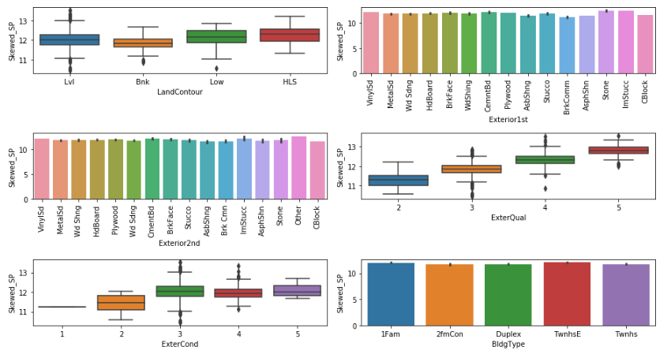
EDA:Land contour, Exterior quality and condition, building type Metric’s
If HLS Hillside - Significant slope from side to side and Low Depressio as LandContour sales are attracting more
In Exterior1st: Exterior covering on house all specification are playing an vital role expect Brick common and Asphalt Shingle
In Exterior2nd: Exterior covering on house (if more than one material) all specification are playing an vital role expect Brick common, Cinder Block and Asphalt Shingle
Sales are high if Evaluates the quality of the material on the exterior are excellent and good
Sales are high if Exterior condition are excellent and good
Sales are high only if building type must be 1Fam Single-family Detached and Townhouse End Unit

Slide 16
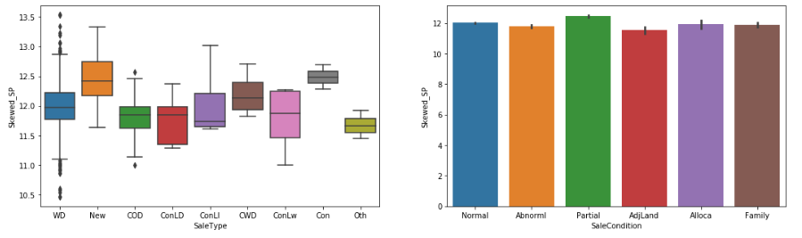
EDA:Sale type and condition Metric
Inference:Sales are high if house has Contract 15% Down payment regular term and if it is New Home just constructed and sold and also if we see sale condition it has Partial Home was not completed when last assessed (associated with New Homes) and - two linked properties with separate deed

Slide 17
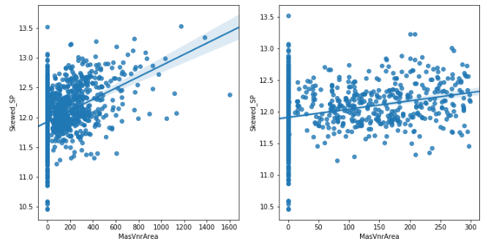
MasVnrArea before and after treating outliers
Inference:Here sales are attracting when MasVnrArea is very low, if its value is increasing sales also not so good

Slide 18
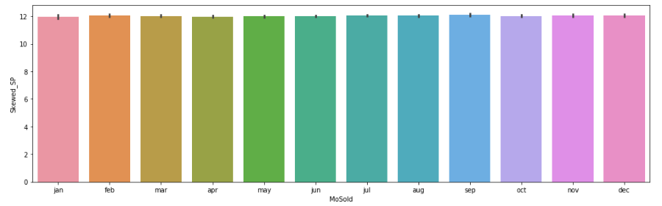
EDA: MoSold Metric
Inference: In Month of Sep,Nov and dec sales are more high

Slide 19
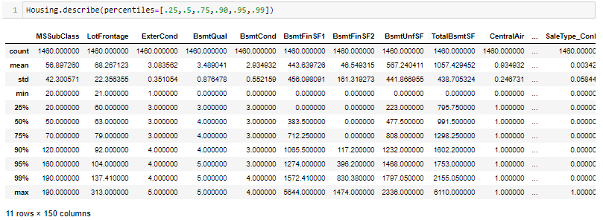
Scale

Slide 20
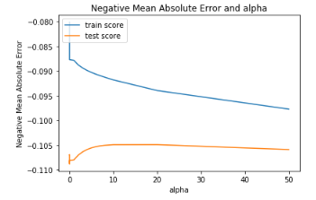
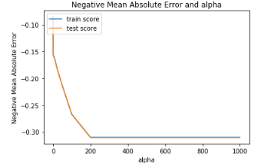
Ridge and Lasso Regression

Slide 21
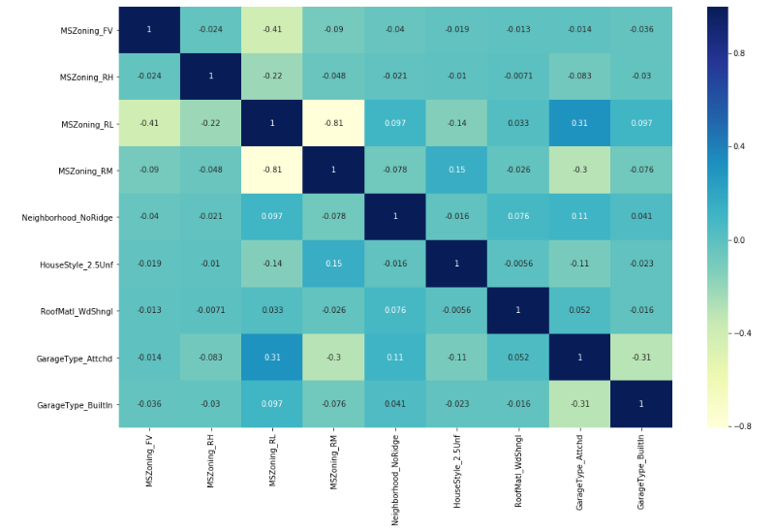
Correlation matrix with selecting 15 features thru RFE
As per VIF, choosen metrics falls below 5 where it satisfies VIF rule.

Slide 22
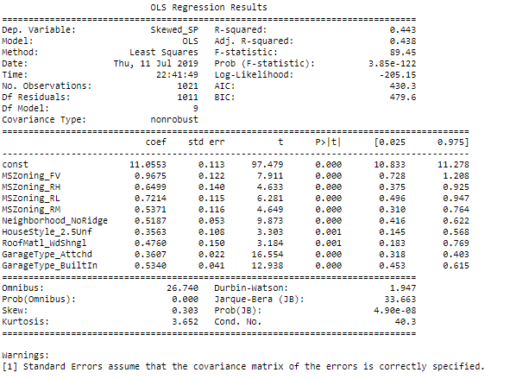
Building the model

Slide 23
Conclusions & Recommendations
Here we can say the most of the sales are depending on zone of the area where house exists, MS-Zoning with FV, RH, RL and RM occupies more sales.
Next sales attracting where Neighborhood is type of ‘No Ridge’
Sales are also completely depending the style of House i.e 2.5Unf
Sales are also attracting more if RoofMat is woodshalang
Sales are also more attractive if Garage attached and Garage built-in with the house.
Sales will attract more if we concentrate the above specification.

