Slide 1
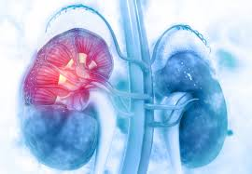
Insurance Payments Analysis on Dialysis Claims data
Sunitha Bussa
June 11th 2020

Slide 2




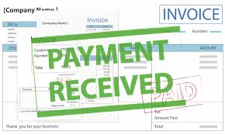


Can We Predict Future Payments?

Slide 3
Contents:
Data source
Exploratory Data Analysis
Payment Predictions

Slide 4
DATA
Data has been extracted from DCI’s database
Data cleaning
Data wrangling
About 12000 rows of data spanning over 3 years
Data belonging to 13 payors
3 major Modalities/Treatment types
Data has been de identified for privacy purposes

Slide 5
Exploration

Slide 6
Summary Analysis

Slide 7
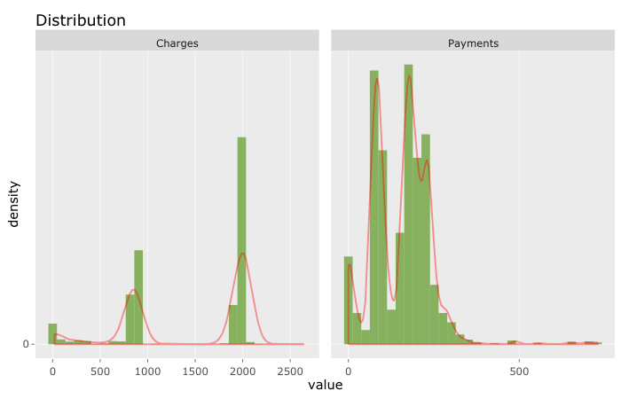


Distribution

Slide 8
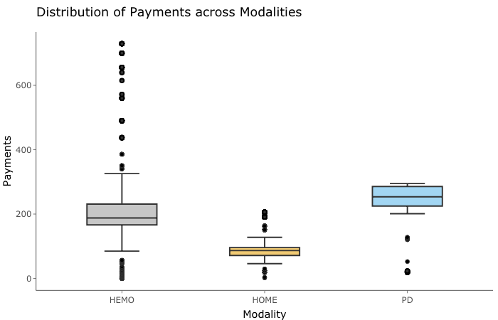
Payment Distribution by Modality
Avg

Slide 9
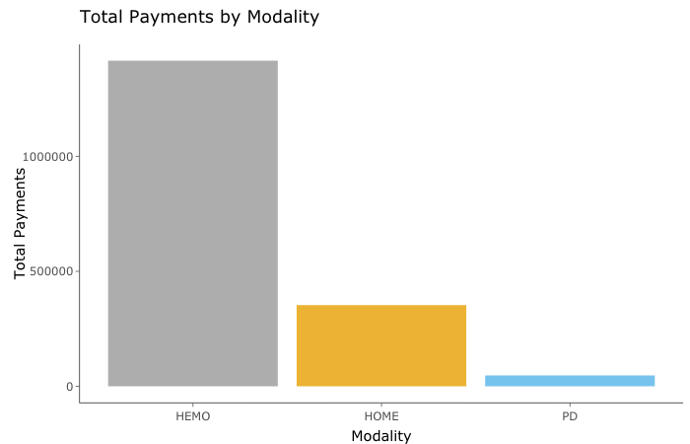
Payments by Modality

Slide 10
MODALITY to Concentrate
HEMO

Slide 11
Detail Analysis
Payors
Treatments
Medications
Modifiers

Slide 12
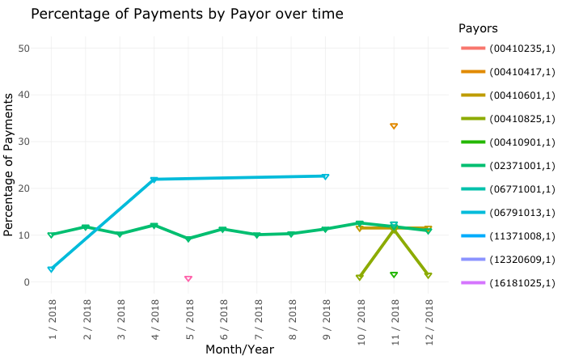
Over Time 2018

Slide 13
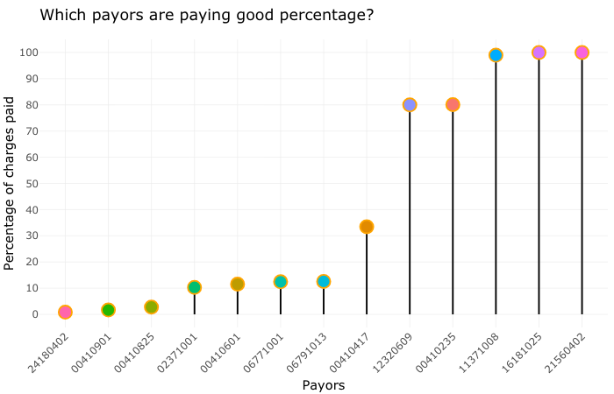
Payors paying high percentage

Slide 14
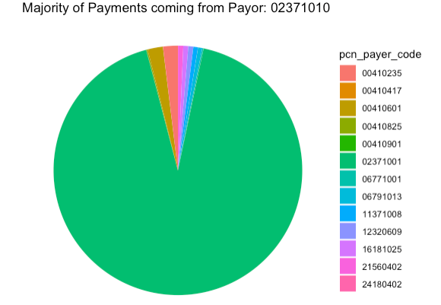
Which payor is major contributor towards payments?
92.58%

Slide 15
Payor to concentrate
02371001

Slide 16
Treatments

Slide 17
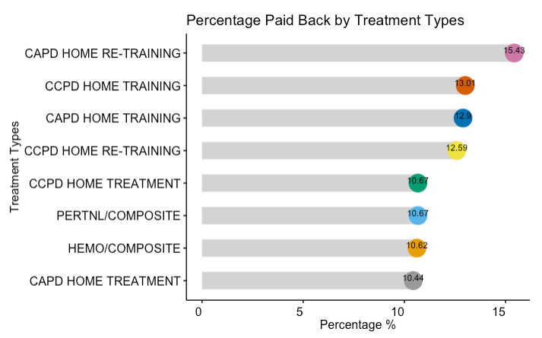
Treatment types with good percentage paid back on charges

Slide 18
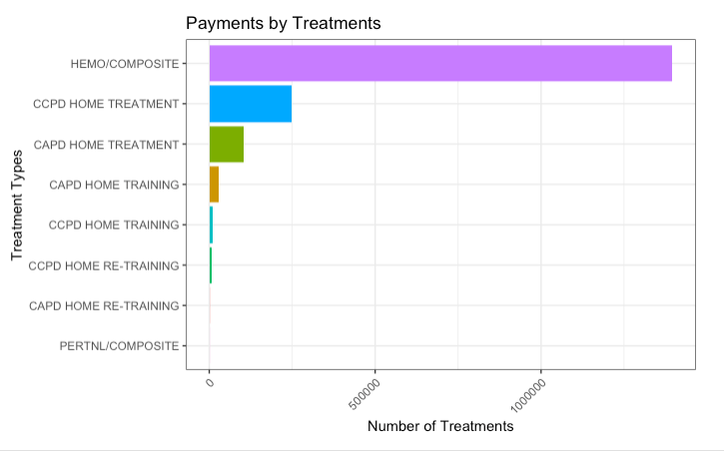
Major payments are coming from HEMO TREATMENT followed by CCPD HOME TREATMENTS

Slide 19
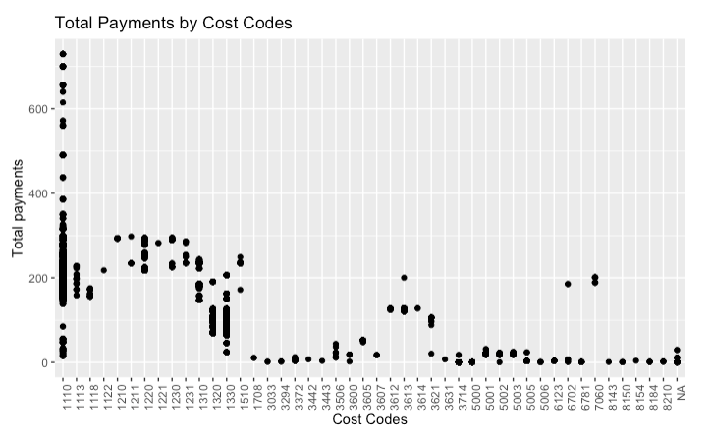
Payments by Cost Code

Slide 20
Treatment Type to Concentrate
HEMO/Composite
Cost code :1110

Slide 21
Medications

Slide 22
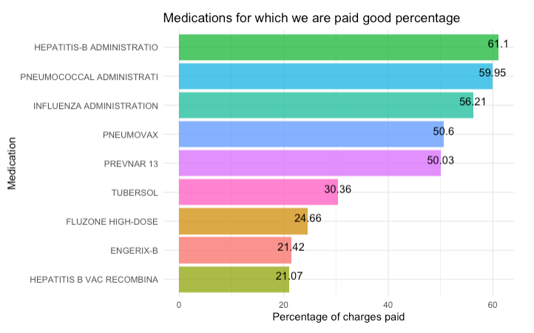
Medications with High Percentage paid back
Medications

Slide 23
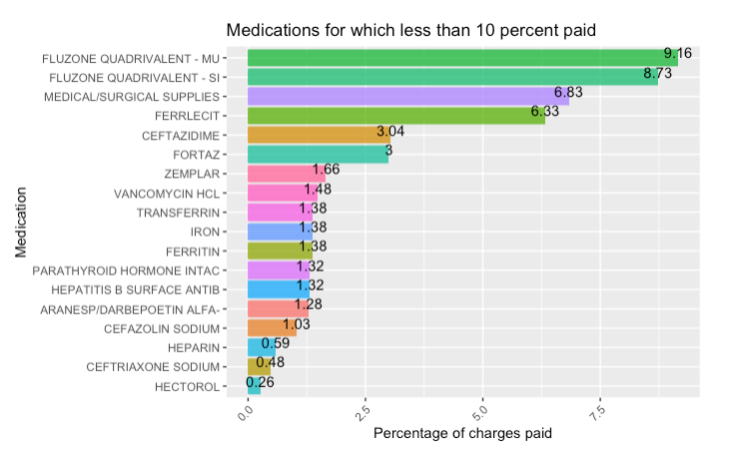
Medications with less than 10% paid back

Slide 24
Medication to Concentrate
PNEUMOVAX

Slide 25
Is the percentage payment on medications same across all treatment types?

Slide 26
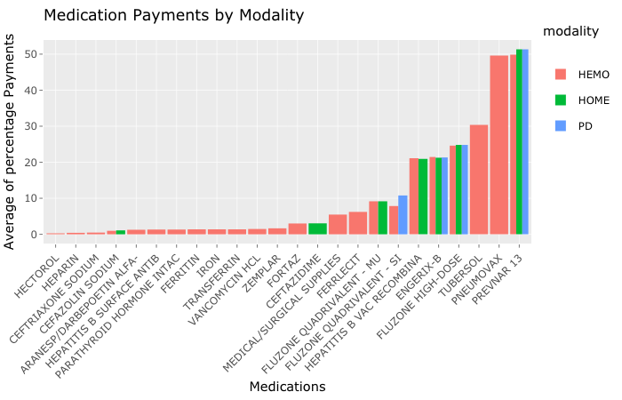

Slide 27
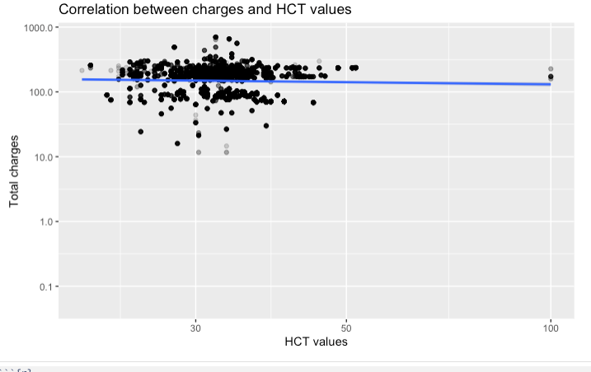
No Correlation

Slide 28
Modifiers

Slide 29
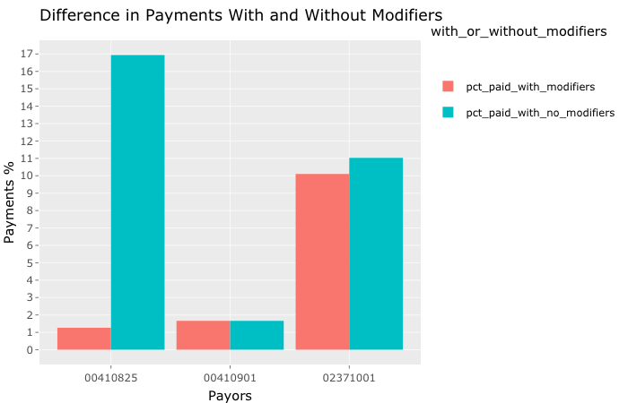
Difference in Payments With & Without Modifiers

Slide 30
Payment Predictions

Slide 31
Data
Trying to predict a continuous variable (Percentage of charges)
Regression algorithm
A Supervised machine learning algorithm is used because we have a labeled response variable.
Most of the predictors/ features are categorical(except 2). Hence, created dummy (binary) columns.
No correlation between any predictor and response variable.

Slide 32
Machine Learning Algorithm
LASSO REGRESSION

Slide 33

LASSO SUMMARY
How did my model do?
GOOD SCORES!!
But, Can I do better?
Results from TRAINING SET
Results from TEST SET

Slide 34
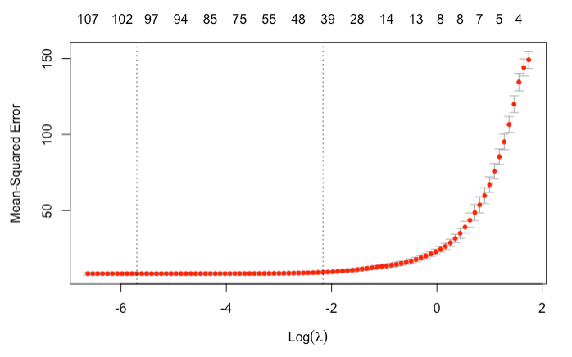
MSE AND LAMBDA

Slide 35
Machine Learning Algorithm
SIMPLE LINEAR REGRESSION

Slide 36
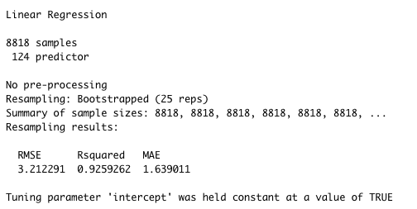
SIMPLE LINEAR SUMMARY

Slide 37
How did the model perform with test set?

Slide 38
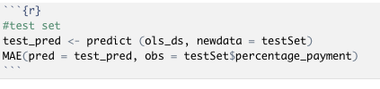

Great scores! Better results than Lasso

Slide 39
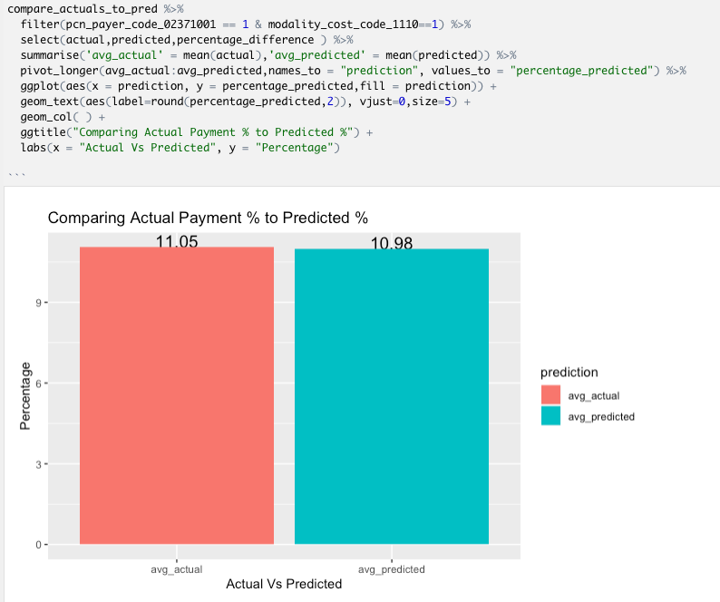
How close are our Predictions from
Actual values?
0.07%

Slide 40
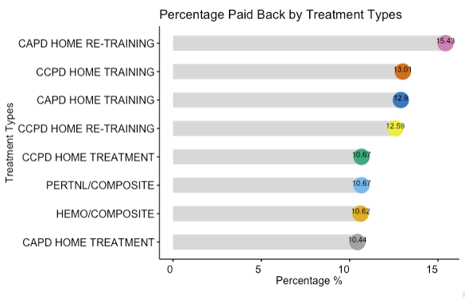
How close are our Predictions from
Actual values?
0.07%

Slide 41
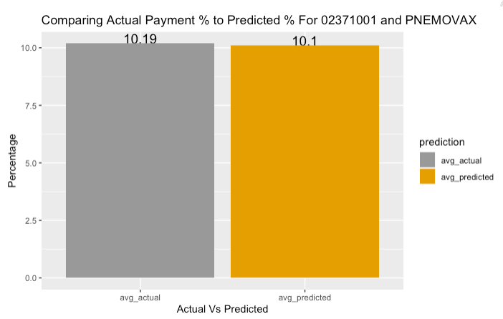
0.18%

Slide 42
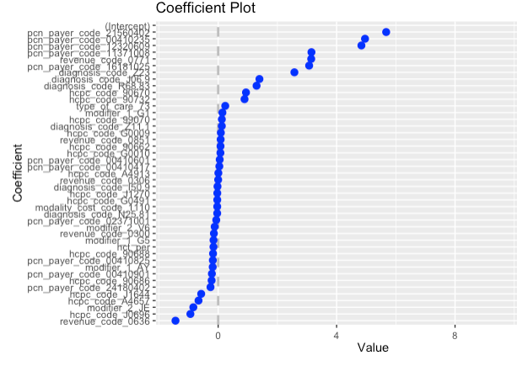
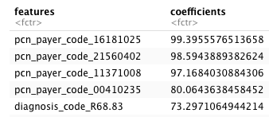
Coefficients
PAYMENTS mostly depend on Payors

Slide 43
THANK YOU

