Slide 1
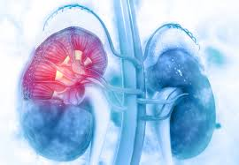
Insurance Payments Analysis on Dialysis Claims data
Sunitha Bussa
June 11th 2020

Slide 2




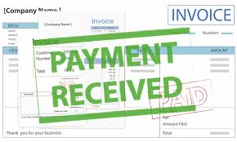


Can We Forecast Future Payments?

Slide 3
Contents:
Data source
Exploratory Data Analysis
Payment Predictions

Slide 4
DATA
Data has been extracted from DCI’s database
Data cleaning and formatted
About 12000 rows of data spanning over 2 years
Data belonging to 13 payors
3 Treatment types
Data has been de identified for privacy purposes

Slide 5
Goal
Understand the distribution of payments.
Identify Major Payors.
Identify Major Treatment Types.
Look for any other Revenue categories which can be used for predictions.
Predict the percentage of Charge, we will be getting paid.

Slide 6
Treatment Types

Slide 7
1. HEMO 2. PD 3. HOME

Slide 8
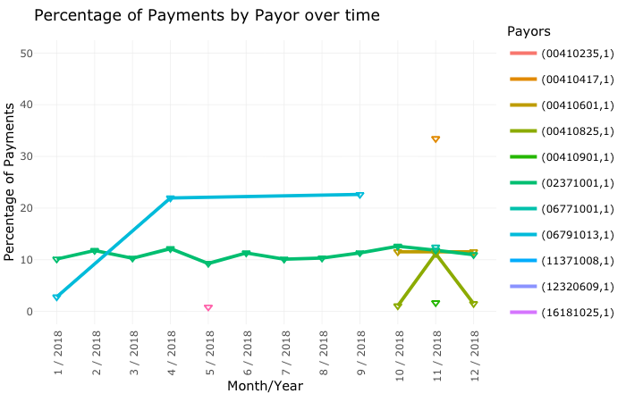
Over Time 2018

Slide 9
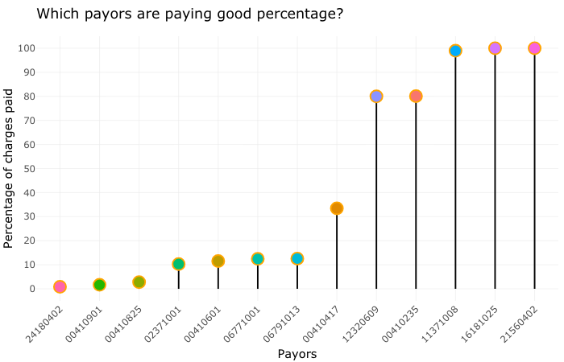
Some Payors Pay 100% of charges while other others pay as low as 1%

Slide 10
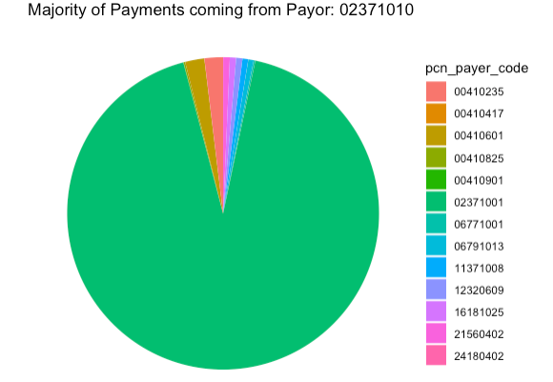
Major contributor towards payments?
92.58%

Slide 11
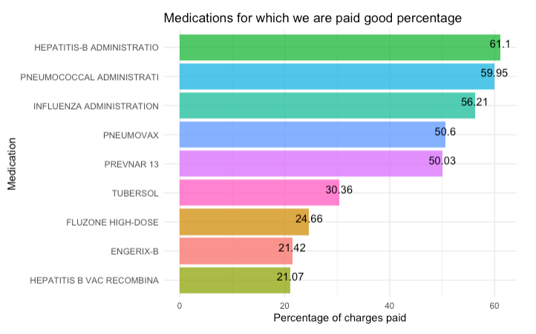
Medications with High Percentage paid back
Medications

Slide 12
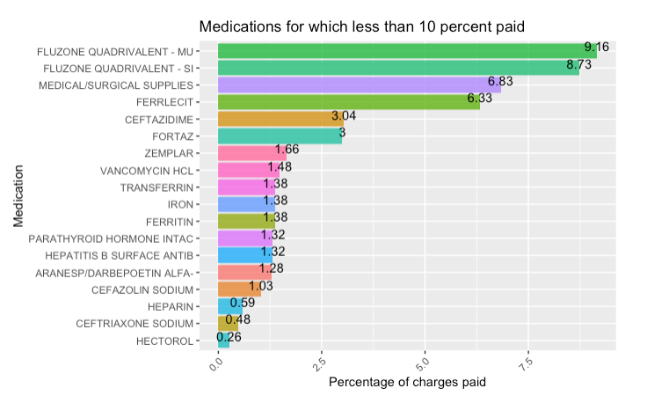
Medications with less than 10% paid back

Slide 13
Payment Predictions

Slide 14
Data
Trying to predict Percentage of charges
Continuous variable, so Regression algorithm
A Supervised machine learning algorithm.
125 categorical features.

Slide 15
Machine Learning Algorithm
LASSO REGRESSION

Slide 16

LASSO SUMMARY
How did my model do?
GOOD SCORES!!
But, Can I do better?
Results from TRAINING SET
Results from TEST SET

Slide 17
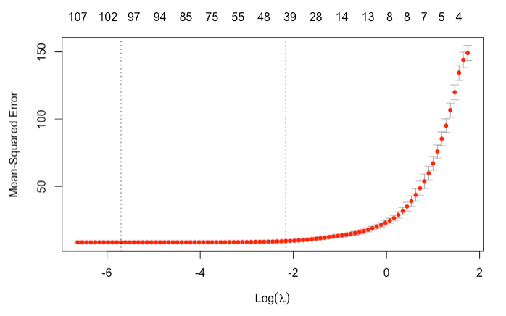
MSE AND LAMBDA

Slide 18
Machine Learning Algorithm
SIMPLE LINEAR REGRESSION

Slide 19
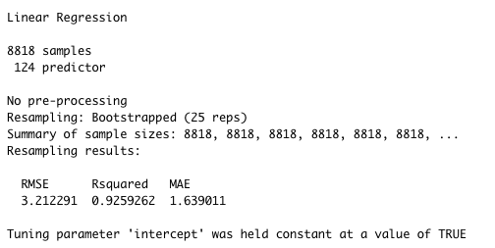
SIMPLE LINEAR SUMMARY

Slide 20
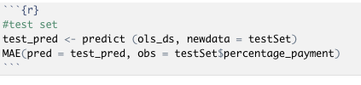

Model Performance using Test Set
Great scores! Better results than Lasso
Average magnitude of error is as low as 1.5 %

Slide 21
THANK YOU

