Slide 1
IPL 2015 – 2024: Data Insights and Analysis Author Sunitha Mekala

Slide 2
Overview:
Welcome to the IPL Data Analysis Project!
This project contains the analysis and insights derived from ten years of IPL data spanning from year 2015 to year 2024.
Using Python numpy and matplotlib we have meticulously analyzed 10 players, their team performance, trends and patterns over the past 10 years.

Slide 3
Features:
Visualize team performance over multiple seasons.
Analyze match results and trends such as
- Players salary
- Number of games played and
- Also how 10 players have been playing over the past 10 years.

Slide 4
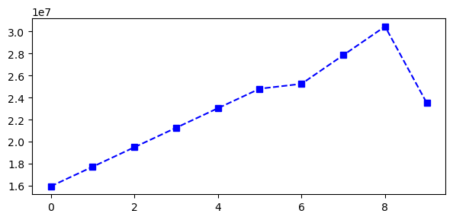
Insights of the Match:
1. As per the salary report of Sachin, Sachin’s salary has been constantly increasing and it has decreased at the end of the season.
Please observe the below visualization plot of player Sachin:

Slide 5
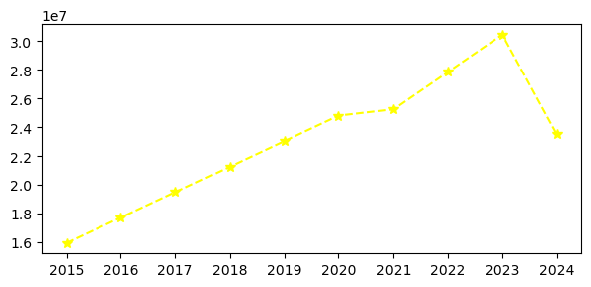
Insights of the Match:
2. As per the below salary report, we can visualize that the salary of the player Sachin has been checked across each year(season) from 2015 to 2024 with a sudden decrease in 2024.

Slide 6
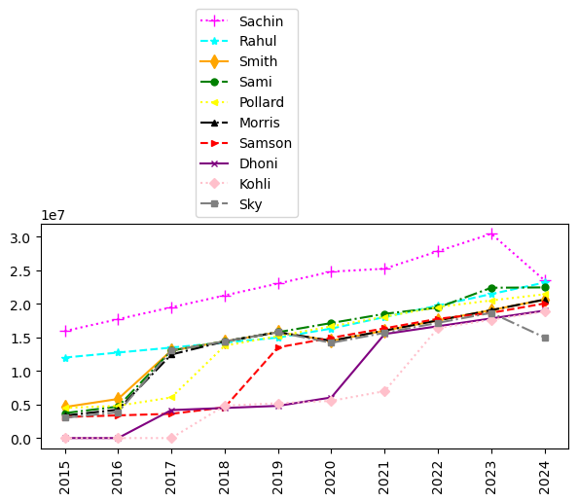
Insights of the Match:
3. Visualizing the salary’s of all players at once and analyzing their performance based on salary across all years (seasons). You can easily identify the players using legends used in the plot.

Slide 7
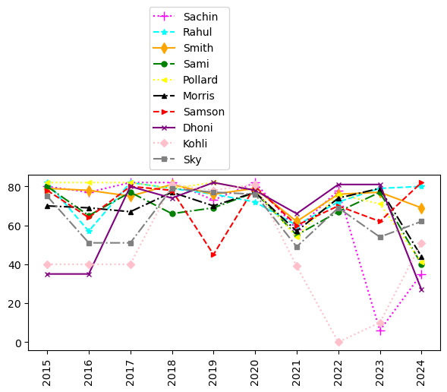
Insights of the Match:
4. Visualizing the performance and how many games are being played by each player across all the years.

Slide 8
OBSERVATION:
As we have observed the graph of all players at once in a single report which is huge – so for more visualization of data ,i.e bigger data we can go for Power BI (or) Tableau Tool and for lesser data visualization i.e. less data, we can go for Python.

Slide 9
THANK YOU!

