Slide 1
PROJECT NAME : Public Transportation Optimization
Phase 4 : DEVELOPEMENT
INTRODUCTION
Public transportation optimization refers to the process of improving the efficiency, effectiveness, and overall quality of public transportation systems to better meet the needs of passengers and the communities they serve. This optimization involves a combination of strategies and techniques aimed at enhancing the reliability, convenience, cost-effectiveness, and sustainability of public transit services. The primary goal is to make public transportation a more attractive and competitive option compared to private vehicle use, thereby reducing traffic congestion, minimizing environmental impact, and providing better mobility options.
Uses of Public Transportation Optimization:
        Reducing Traffic Congestion
        Enhanced Reliability
        User-Friendly Experience
        Economic Development
        Public Safety

Slide 2
In this phase, we have used web development technologies such as HTML, CSS, JavaScript to create
a platform that displays real-time air quality data.
CODE:
IOT_project-4.html
<!DOCTYPE html>
<html lang="en">
<head>
<meta charset="UTF-8">
<meta name="viewport" content="width=device-width, initial-scale=1.0">
<title>Public Transportation Optimization</title>
<style>
body {
background-image: url('https://tse3.mm.bing.net/th?id=OIP.4X4MucxVgx6Xo3VNzFyUnQHaFj&pid=Api&P=0&h=180s');
background-size: cover;
background-repeat: no-repeat;
}

Slide 3
</style>
</head>
<body>
<header>
<h1>Public Transportation Optimization</h1>
</header>
<nav>
<ul>
<li><a href="C:\Users\rishe\Desktop\phase 4\gps.html">GPS</a></li>
<li><a href="C:\Users\rishe\Desktop\phase 4\weight_measuring.html">Weight Measuring</a></li>
</ul>
</nav>
<main>

Slide 4
<section>
<h2>Welcome to Public Transportation Optimization</h2>
<p>We are dedicated to making public transportation more efficient, accessible, and eco-friendly. Our solutions include real-time data, route planning, and optimization to improve your daily commute.</p>
</section>
</main>
<footer>
<p>&copy; 2023 Public Transportation Optimization Solutions</p>
</footer>
</body>
</html>

Slide 5
gps.html
<!DOCTYPE html>
<html>
<head><title>GPS Tracker</title><meta charset="utf-8">
<style>
input, textarea { -webkit-box-sizing: border-box; }
input { width: 100%; font-size: 20px; }
textarea { width: 100%; height: 500px; }
input[type="button"],
input[type="submit"] { width: 24%; }
body { text-align: center; }
</style>
<body>

Slide 6
<form action="" method="post">
<input name="t_action" value="http://192.168.1.64/gps/save.php">
<textarea readonly name="coords"></textarea>
<input value="Start Tracking" type="button" onclick="startTracking();this.disabled=true;">
<input value="Reset Trip" type="button" onclick="resetTrip();">
<input value="Use Server" type="button" onclick="this.form.t_action.value = 'savetrip.php';">
<input type="submit" onclick="this.form.action = this.form.t_action.value='';">
</form>
<script>
var ta = document.querySelector('textarea');
var lt = 0;
var ls = false;
var track = false;
(

Slide 7
function() {
var tr = localStorage.getItem('trip');
if (tr != '' && tr != null) {
ta.value = tr + '\n';
}
})();
function addHeader() {
ta.value += '-- tracking started: ' + (new Date().toString()) + '\n';
ta.value += (new Date().getTime()) + ' // start\n';
localStorage.setItem('trip', ta.value);
}
function resetTrip() {
if (!confirm('Are you sure you want to clear your trip?'))
return false;
localStorage.setItem('trip', '');

Slide 8
ta.value = '';
addHeader();
}
function startTracking() {
track = true;
addHeader();
navigator.geolocation.watchPosition(
function(position) {
var now = new Date().getTime();
if (ls != 1 || now - lt > 10000) {
ta.value += now + ' // ' + position.coords.latitude + ' // ' + position.coords.longitude + '\n';
localStorage.setItem('trip', ta.value);
lt = now;
ls = 1;
}
},

Slide 9
function() {
var now = new Date().getTime();
if (ls != 0 || now - lt > 10000) {
ta.value += now + ' // fail\n';
localStorage.setItem('trip', ta.value);
lt = now;
ls = 0;
}},
{
enableHighAccuracy: true,
maximumAge: 60000,
timeout: 15000
}
);}
</script>
</body>

Slide 10
weight_measuring.html:
<!DOCTYPE html>
<html lang="en">
<head>
<meta charset="UTF-8">
<meta name="viewport" content="width=device-width, initial-scale=1.0">
<title>Bus Weight Monitoring</title>
<link rel="stylesheet" type="text/css" href="style.css">
</head>
<body>
<h1>Bus Weight Monitoring</h1>
<div id="weight-display">
<p>Current Weight: <span id="current-weight">0 kg</span></p>
</div>

Slide 11
<script>
// Simulated weight values (replace with actual sensor data)
let currentWeight = 0;
const maxWeight = 50; // Set the maximum allowable weight in kg
// Function to update weight and check for alerts
function updateWeight() {
// Simulate weight changes (replace with actual sensor data)
currentWeight += Math.random() * 10;
// Update the displayed weight
const weightDisplay = document.getElementById("current-weight");
weightDisplay.textContent = currentWeight.toFixed(2) + " kg";

Slide 12
// Check if the weight exceeds the maximum
if (currentWeight > maxWeight) {
// Trigger an alert when the weight exceeds the maximum
alert("Warning: Maximum weight exceeded!");
// Play an alert sound
const audio = new Audio('alert-sound.mp3'); // Replace with the path to your alert sound file
audio.play();
}
}
// Simulate weight updates every 5 seconds
setInterval(updateWeight, 5000);
</script>
</body>
</html>

Slide 13
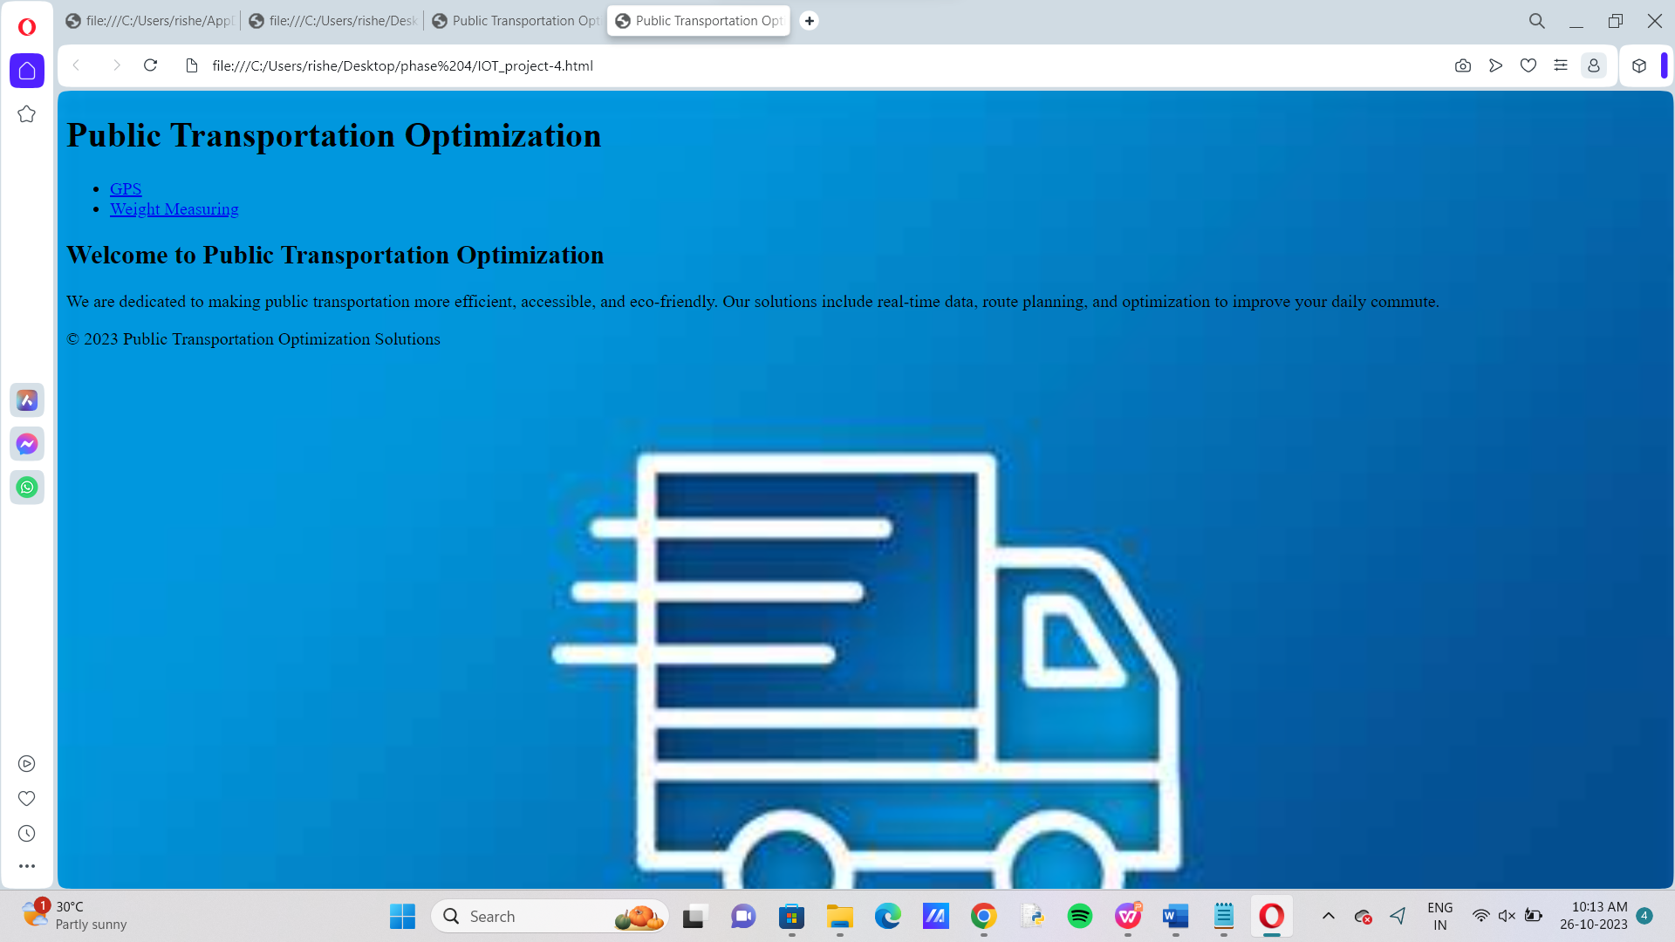
OUTPUT:

Slide 14
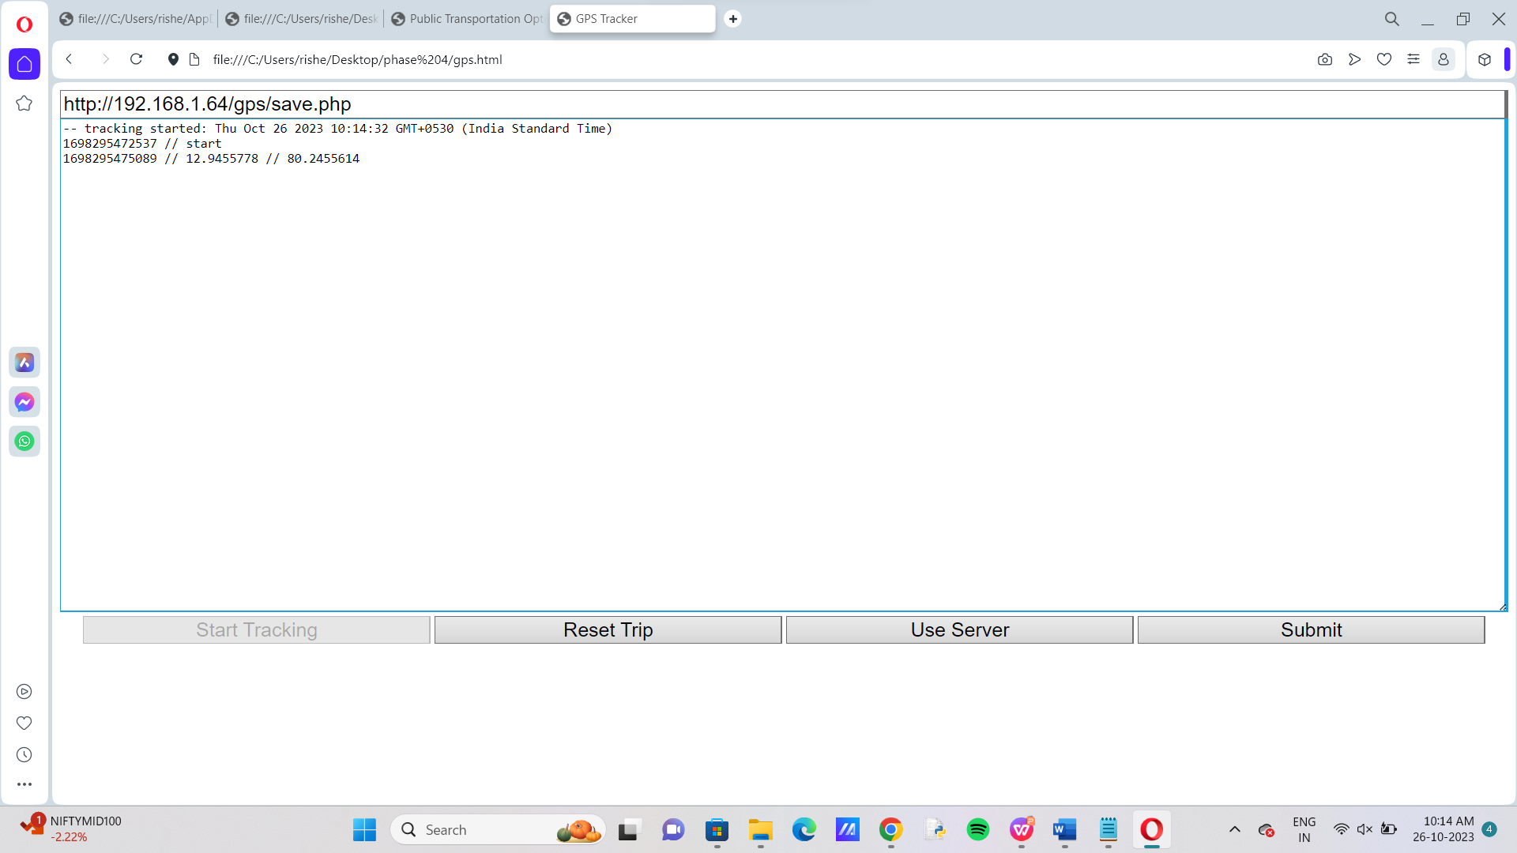

Slide 15
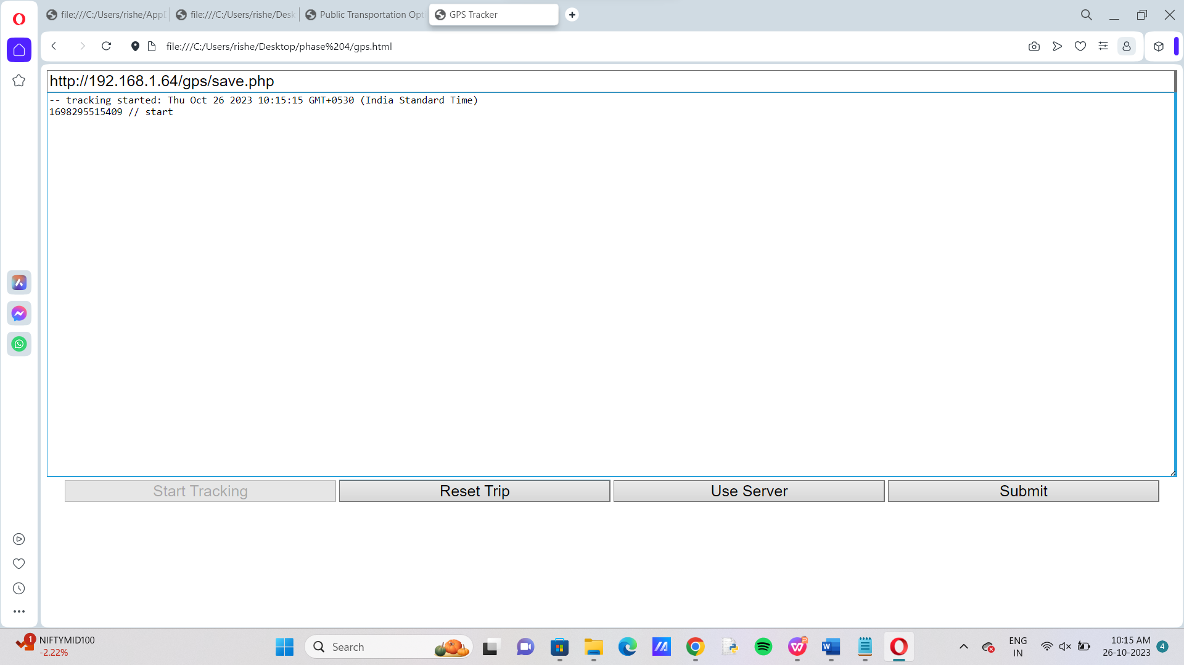

Slide 16
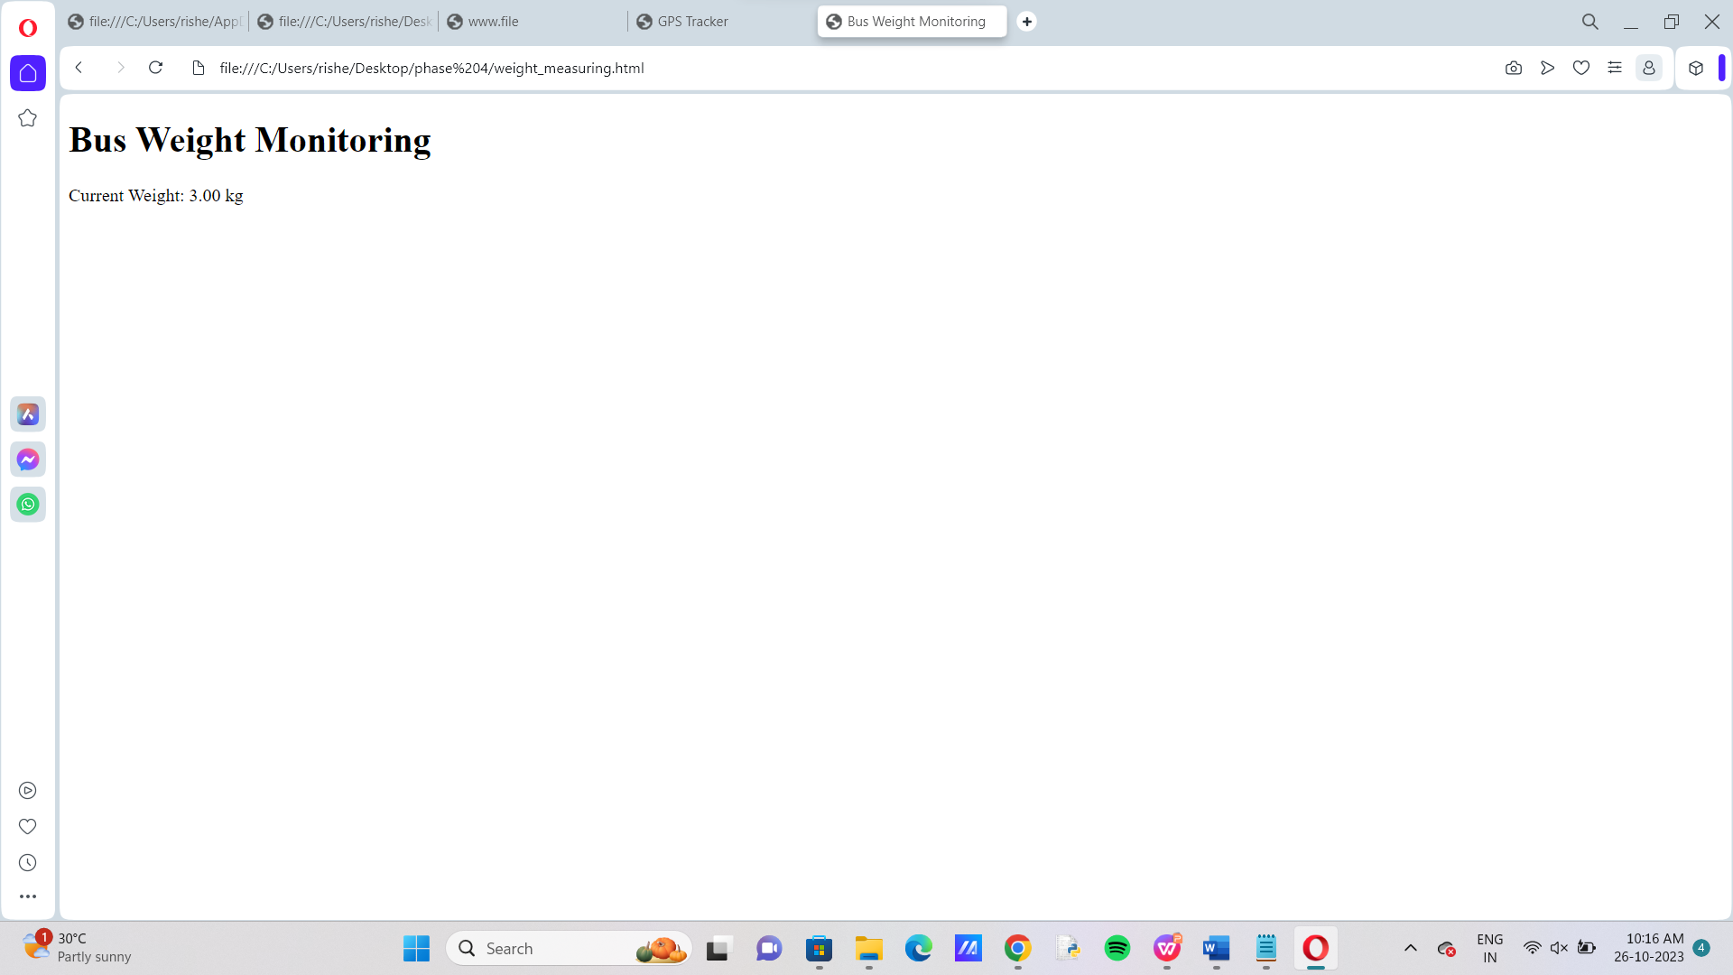

Slide 17
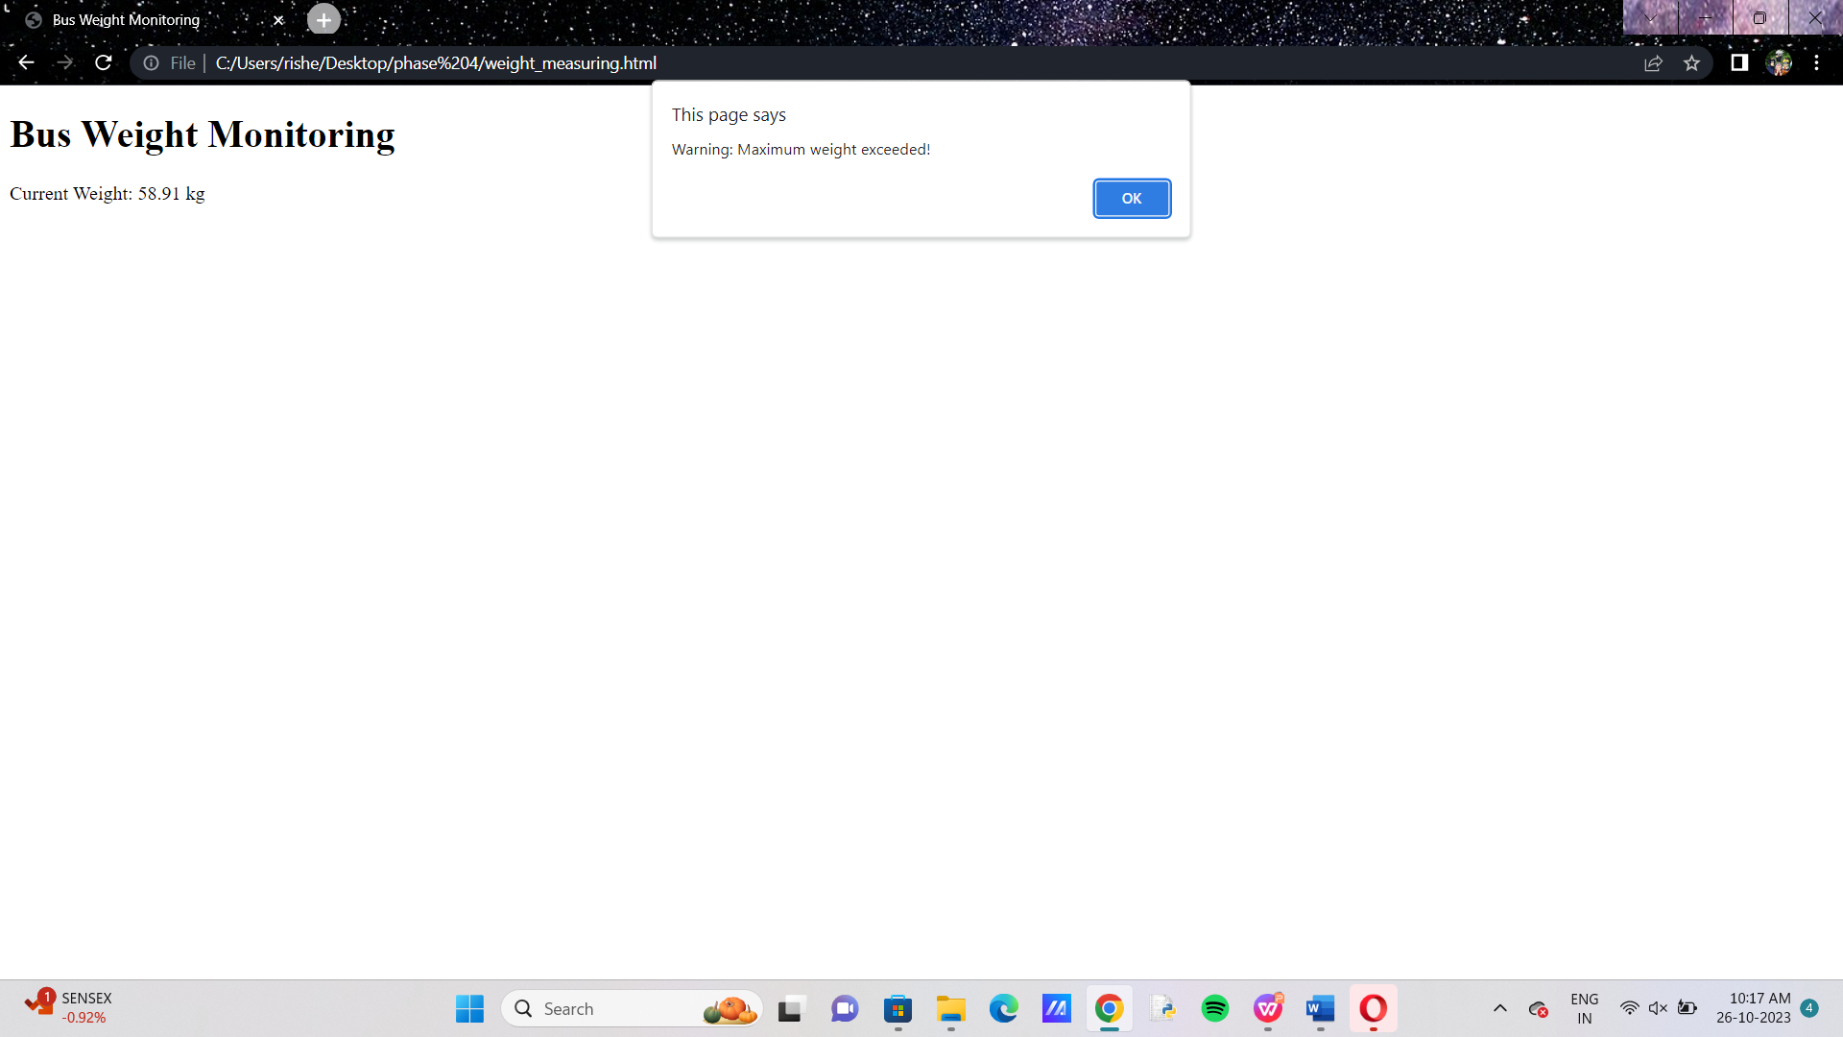

Slide 18
Conclusion:
Public transportation optimization using IoT is a promising field that can improve the passenger experience by offering real-time vehicle tracking, improved responses in the event of an unexpected event, and personalized travel information
A proposed system aims to provide better bus management that is capable of bus tracking, route scheduling, E-ticketing via IoT, eventually making commuter’s journey peaceful, saving paper through digitalization

