Slide 1
INTRODUCTION:
Smart transportation are called as intelligent transportation or smart mobility, refers to the use of advanced tecnology and data-driven solution to improve the efficiency, safety,subtainability, and overall effectiveness of transportation systems. It is used with sensors, advanced communication technologies, automation and high-speed networks.
BENEFITS OF SMART TRANSPORTATION:-
    Smart Transportation is safer and better managed.
    It is more efficient and cost effective.
    One major fear among smart city skeptics is its vulnerability to cyber attacks.Proper software updates, encrypted communications through virtual private network (VPN) tunnels and other multilayered security practices can mitigate the risk of cyber attacks.
    Environmental considerations are the history of transportation is inexorably tied to the environment. From steam vehicles that burned coal and wood to today’s gasoline hungry combustion engines, transportation takes a toll on the planet’s resources and atmosphere.

Slide 2
Smart transportation can generally be divided into two sectors become “smart” when networked sensors are integrated into infrastructure and vehicles in an effort to accomplish the goals of remote management and control, safety, and efficiency.
FOR EXAMPLE:
  Pedestrians are trying to cross. The streetlights are regulating flow of traffic. Drivers in vehicles are busily trying to get to their destination.Both the drivers and the pedestrians are responsible for paying attention to the traffic signals. If any of these nodes fail, however, both efficiency and safety drop.In a smart intersection, however, this all changes. A vehicle may use a combination of bluetooth and LIDAR (Light Detection and Ranging) to detect pedestrians and can automatically begin breaking to avoid an accident. Streetlights can pick up the individual signals sent from vehicles to determine how many cars are waiting and in which direction far more accurately and efficiently than pressure plates and timers.

Slide 3
SMART SENSING:
In transportation, sensor technology supports the design and development of a wide range of applications for traffic control, safety, and entertainment.
Monitor the traffic conditions in specific zones, gathering data that improves the traffic management. For example cameras, radars, ultrasonic, proximity.
Intelligent Traffic Management:-
Intelligent Traffic Management System (ITMS), is one of the advanced solution to the congested traffic conditions face by many cities. As a result of rapid industrialization and urbanization, many cities are facing increased volume of population which resulted in an unplanned city infrastructure.Unplanned infrastructures includes Road & Junctions, Sewerage Networks, and Utility Ducts etc.
Increased population will be requiring Multi-mode Transport System for seamless daily commute.

Slide 4
CONNECTED VEHICLES:-
A connected vehicle is one that is capable of connecting over wireless networks to nearby devices. Connected vehicles are an important factor in the advance of IoT. The use cases range from connected entertainment systems that connect with the driver’s mobile phone to Internet-connected vehicles that have bi-directional communication with other vehicles, mobile devices and city intersections.
SUBTAINABLE MOBILITY:-
Sustainable mobility is another trend in the smart transportation market, with a growing focus on reducing emissions and promoting alternative modes of transportation such as electric vehicles, bike-sharing programs, and public transportation.

Slide 5
INNOVATION:-
Smart public transportation optimization involves the use of various technologies and systems to enhance the efficiency, safety, and accessibility of public transit services. Here are details on the components and technologies commonly used in smart public transportation optimization.
After thorough research, we came up with an innovative idea to solve the
problems that we have mentioned in phase 1 of our project.
Sensor
  Cameras, Lidar, Radar, Ultrasonic sensors
  GPS, Patient Monitoring Devices, Collision Detection Sensors
  Axle Counters, Train Health Monitoring Sensors, Speed Sensors
  Passenger Counting Sensors, Environmental Sensors, Door Sensors
Connectivity
  DSRC
  MDTs, ESN, Satellite Communication
  Trackside Communication
  Wireless Communication Networks

Slide 6
Cloud
  Alert Generation, Data Sharing
  Data Analytics and Reporting
Protocol
  IEEE 802.11p
  EMS, Communication Protocols
  Train control Protocols
  ITS
Public Platform
  Smart City Initiatives, TMA,
  Public Alert Systems, IHS
  Passenger Information Systems
  Transit Apps

Slide 7
SENSORS:
  Cameras: Vehicles are often equipped with cameras that can capture images and videos of the surroundings. These cameras can be used for pedestrian detection and recognition.
  Lidar (Light Detection and Ranging): Lidar sensors use laser beams to create detailed 3D maps of the environment around the vehicle. They can accurately detect pedestrians and their movements.
  Radar: Radar sensors emit radio waves and measure the time it takes for the waves to bounce back after hitting objects. Radar is effective at detecting pedestrians, even in adverse weather conditions.
  Ultrasonic Sensors: These sensors use sound waves to detect nearby objects and can contribute to proximity sensing, especially at lower speeds.
  GPS (Global Positioning System): GPS sensors provide real-time location data for ambulances, enabling dispatchers to track their positions, optimize routing, and provide accurate estimated arrival times to emergency scenes and hospitals.
  Patient Monitoring Devices: Ambulances may be equipped with advanced patient monitoring devices that can continuously track a patient's condition during transport and transmit this data to healthcare providers in real-time.

Slide 8
  Axle Counters: Axle counters are used for train detection and to maintain accurate train spacing. They help prevent collisions and manage train traffic.
  Train Health Monitoring Sensors: Sensors can be installed on trains to monitor the condition of critical components such as brakes, bearings, and suspension systems. This data helps in predictive maintenance and reduces downtime.
  Speed Sensors: Speed sensors are used to monitor train speed, ensuring that trains adhere to speed limits and operate safely.
  GPS (Global Positioning System): GPS sensors are used to track the real-time location of buses. They enable route planning, schedule adherence, and accurate arrival time predictions.
  Passenger Counting Sensors: Sensors placed at bus doors or inside the vehicle count passengers as they board and disembark. This data aids in optimizing routes and resource allocation.
  Door Sensors: These sensors detect door opening and closing, ensuring safe boarding and alighting of passengers
  Collision Detection Sensors: These sensors can detect accidents or sudden deceleration and trigger emergency alerts or safety measures, such as airbag deployment.

Slide 9
CONNECTIVITY:
  Dedicated Short-Range Communications (DSRC): DSRC is a wireless communication protocol designed for V2X communication, including V2P. It operates in the 5.9 GHz frequency band and allows vehicles to exchange safety-related information with pedestrians and other road users.
  Mobile Data Terminals (MDTs): MDTs provide a link between ambulances and dispatch centers, hospitals, and healthcare professionals. They enable the exchange of patient information, routing instructions, and communication with medical experts.
  Satellite Communication: In areas with poor or no cellular coverage, ambulances may rely on satellite communication to maintain connectivity.
  Emergency Services Network (ESN): Some regions have dedicated emergency services networks that prioritize communication for first responders, including ambulances, ensuring they have reliable connectivity during emergencies.
  Trackside Communication: Fiber-optic or wireless communication networks along the tracks enable data transfer between trains and control centers. These networks are used for signaling, train control, and real-time updates.
  Wireless Communication Networks: Buses use wireless networks, including cellular and Wi-Fi, for passenger Wi-Fi access, real-time data exchange with control centers, and fleet management.

Slide 10
CLOUD:
  Alert Generation: Cloud services can generate alerts and warnings for drivers and pedestrians based on real-time V2P data
  Data Sharing: Cloud platforms may facilitate data sharing between vehicles, infrastructure, and pedestrians to enhance safety.
  Data Analytics and Reporting: Cloud-based data analytics platforms can analyze ambulance operations data, including response times, routes, and patient outcomes, to identify areas for improvement and optimize services….. Cloud platforms analyze data from various sensors and systems to provide insights into train operations, passenger flow, and system efficiency….. Cloud-based platforms analyze data from sensors, passenger counts, and vehicle locations to optimize bus routes, schedules, and resource allocation.

Slide 11
PROTOCOL:
  IEEE 802.11p: This is a standard designed for wireless access in vehicular environments (WAVE) and is commonly used for V2X communication, including V2P.
  Emergency Medical Services (EMS) Protocols: EMS protocols define the procedures and guidelines that paramedics and emergency medical technicians (EMTs) follow during patient assessment, treatment, and transportation. Optimization efforts may involve streamlining these protocols for efficiency.
  Communication Protocols: Ambulance crews follow established communication protocols to ensure clear and efficient communication with dispatch centers, hospitals, and other first responders.
  Train Control Protocols: Train control systems use various protocols for communication between trains and the central control center. Common protocols include European Train Control System (ETCS), Positive Train Control (PTC), and others.
  Intelligent Transportation System (ITS) Protocols: ITS protocols enable communication between buses, traffic management centers, and passenger information systems, allowing for real-time updates and coordination.

Slide 12
PUBLIC PLATFORM:
  Smart City Initiatives: Smart cities may invest in infrastructure that supports V2P communication, including sensors, roadside equipment, and data platforms.
  Traffic Management Authorities(TMA): Traffic management authorities can use V2P data to enhance pedestrian safety and improve traffic flow.
  Public Alert Systems: Public alert systems and mobile apps may provide real-time information to the public about emergency situations, including ambulance responses and safety instructions.
  Integrated Healthcare Systems(IHS): In regions with integrated healthcare systems, ambulances are part of a larger network that coordinates pre-hospital care, emergency departments, and follow-up care for patients.
  Passenger Information Systems: These systems provide real-time information to passengers regarding train schedules, delays, and platform changes. Public information displays and mobile apps are common interfaces.
  Transit Apps: Transit apps provide real-time information to passengers, allowing them to plan routes, check schedules, and receive alerts about delays or disruptions.

Slide 13
SENSORS USED:-
HC-SR04
Working Principle: The HC-SR04 sensor operates on the principle of echolocation, similar to how bats navigate. It emits ultrasonic sound waves (inaudible to the human ear) and measures the time it takes for the sound waves to bounce back after hitting an object. By knowing the speed of sound in the air, it can calculate the distance to the object.
Components: The HC-SR04 module consists of several key components, including:
  Ultrasonic Transmitter: Emits high-frequency sound waves.
  Ultrasonic Receiver: Detects the reflected sound waves.
  Control Circuit: Manages the timing and distance calculation.
Arduino and Raspberry Pi Compatibility: The HC-SR04 sensor is widely used with microcontrollers like Arduino and single-board computers like Raspberry Pi. Libraries and code examples are available for easy integration into your projects.
Applications: The HC-SR04 sensor is versatile and finds applications in various projects, including obstacle avoidance for robots, measuring liquid levels in tanks, parking assist systems, and distance measurement in IoT applications.

Slide 14
ESP32
Dual-Core Processor:
The ESP32 features two Tensilica Xtensa LX6 microprocessor cores. These dual cores can be used to handle different tasks simultaneously, making it suitable for multitasking applications.
Wireless Connectivity:
The ESP32 is known for its extensive wireless capabilities. It supports both Wi-Fi (802.11b/g/n) and Bluetooth (Bluetooth Classic and BLE) communication. This makes it suitable for IoT projects requiring wireless connectivity.
Integrated Peripherals:
It includes a variety of peripherals such as GPIO pins, UART, SPI, I2C, PWM, and more, making it suitable for interfacing with various sensors and actuators.
Ultra-Low Power Consumption:
The ESP32 is designed for power efficiency and offers different power modes to conserve energy, making it suitable for battery-powered applications.

Slide 15
Rich Development Ecosystem:
There are various software development platforms and IDEs available for programming the ESP32, including the Arduino IDE, PlatformIO, and the official Espressif IDF (IoT Development Framework).
Security Features:
The ESP32 has built-in security features like secure boot and flash encryption to protect your applications and data.
Support for Over-the-Air (OTA) Updates:
This feature allows you to update the firmware of your ESP32 remotely, making it easier to maintain IoT devices in the field.
Wide Operating Voltage Range:
The ESP32 can operate within a wide voltage range, typically from 2.2V to 3.6V, making it compatible with a variety of power sources
Bluetooth Audio and Dual Mode:
It supports both classic Bluetooth and Bluetooth Low Energy (BLE), making it suitable for audio streaming and IoT applications.

Slide 16
Hardware Security Acceleration:
Some versions of the ESP32 include hardware acceleration for cryptographic operations, which enhances the security of your applications.
Variants:
There are several variants of the ESP32, each with its specific features and capabilities. For example, the ESP32-WROOM-32 is a common module used for development.
The ESP32 is widely used in various IoT and embedded systems projects, including home automation, smart devices, environmental monitoring, and more. Its versatility, low cost, and extensive development ecosystem have contributed to its popularity among developers and makers.
Specifications:
Operating Voltage: Typically operates at 5V DC.
Measurement Range: The HC-SR04 can measure distances accurately within a range of 2 cm (0.79 inches) to 4 meters (13.1 feet) with a resolution of about 3 mm.
Accuracy: It provides reasonably accurate distance measurements, but the precision may decrease with highly reflective or irregularly shaped objects.
Operating Angle: The sensor has a wide-angle of approximately 15 degrees, which can be important for some applications.
Trigger and Echo Pins: The module has two pins, namely Trigger (Trig) and Echo, which are used for controlling the sensor and receiving measurement data, respectively.

Slide 17
Operating Procedure:
To measure the distance, you need to send a short 10-microsecond pulse to the Trigger pin, which initiates the ultrasonic transmission.
The sensor will then wait for the sound waves to bounce back. When it detects the reflected waves, it sets the Echo pin to a high state.
You can measure the time between the trigger pulse and the moment when the Echo pin goes high to calculate the distance.
Preprocessor Directives:
This section defines some constant values such as template ID, template name, and authentication token for connecting to the Blynk IoT platform.
Library Inclusions:
The program includes several libraries for WiFi connectivity, Blynk integration, and client management.

Slide 18
Global Variables:
Various global variables are declared, including variables for storing distances, counters for entering and leaving an area, and pin assignments for LEDs and ultrasonic sensors.
BlynkTimer:
The program defines a BlynkTimer named "timer." This timer is used to trigger a specific function at regular intervals.
Distance Measurement Functions:
Two functions, get_distance1() and get_distance2(), are defined for measuring distances using ultrasonic sensors. These functions are called periodically by the timer.
myTimer Function:
This function is called at regular intervals by the Blynk timer. It performs the following tasks:
Measures the distance from the two ultrasonic sensors.
Compares the distances and keeps track of the number of times someone enters and leaves the area.
Updates the Blynk app with the counts and the current state of being inside or outside the area.

Slide 19
Setup Function:
In the setup() function, the program initializes the following:
Serial communication for debugging.
Pin modes for LED and ultrasonic sensor trigger and echo pins.
Sets the timer interval for calling the myTimer function every 1000 milliseconds (1 second).
Loop Function:
The loop() function mainly runs the Blynk and timer services by calling Blynk.run() and timer.run().
Blynk Template Settings:
The program starts by defining three constants, BLYNK_TEMPLATE_ID, BLYNK_TEMPLATE_NAME, and BLYNK_AUTH_TOKEN. These are related to the Blynk IoT platform and are used for authenticating and connecting your device to the Blynk cloud service.
Variable Declarations:
The code declares various integer variables to store the duration and distance measurements from two distance sensors (distance1 and distance2). It also tracks the number of objects that have entered, left, and are currently inside the monitored area.

Slide 20
Pin Definitions:
The program defines several constants that represent the pins for LEDs, trigger and echo pins of two ultrasonic distance sensors (HC-SR04). For example, LED is set to pin 2, and PIN_TRIG1, PIN_ECHO1, PIN_TRIG2, and PIN_ECHO2 correspond to pins 15, 14, 13, and 12, respectively.
Wi-Fi and Blynk Configuration:
The setup() function initializes serial communication, sets the pin modes, and connects to the Wi-Fi network using the specified SSID and password. It then establishes a connection with the Blynk cloud using the provided authentication token, SSID, and password.

Slide 21
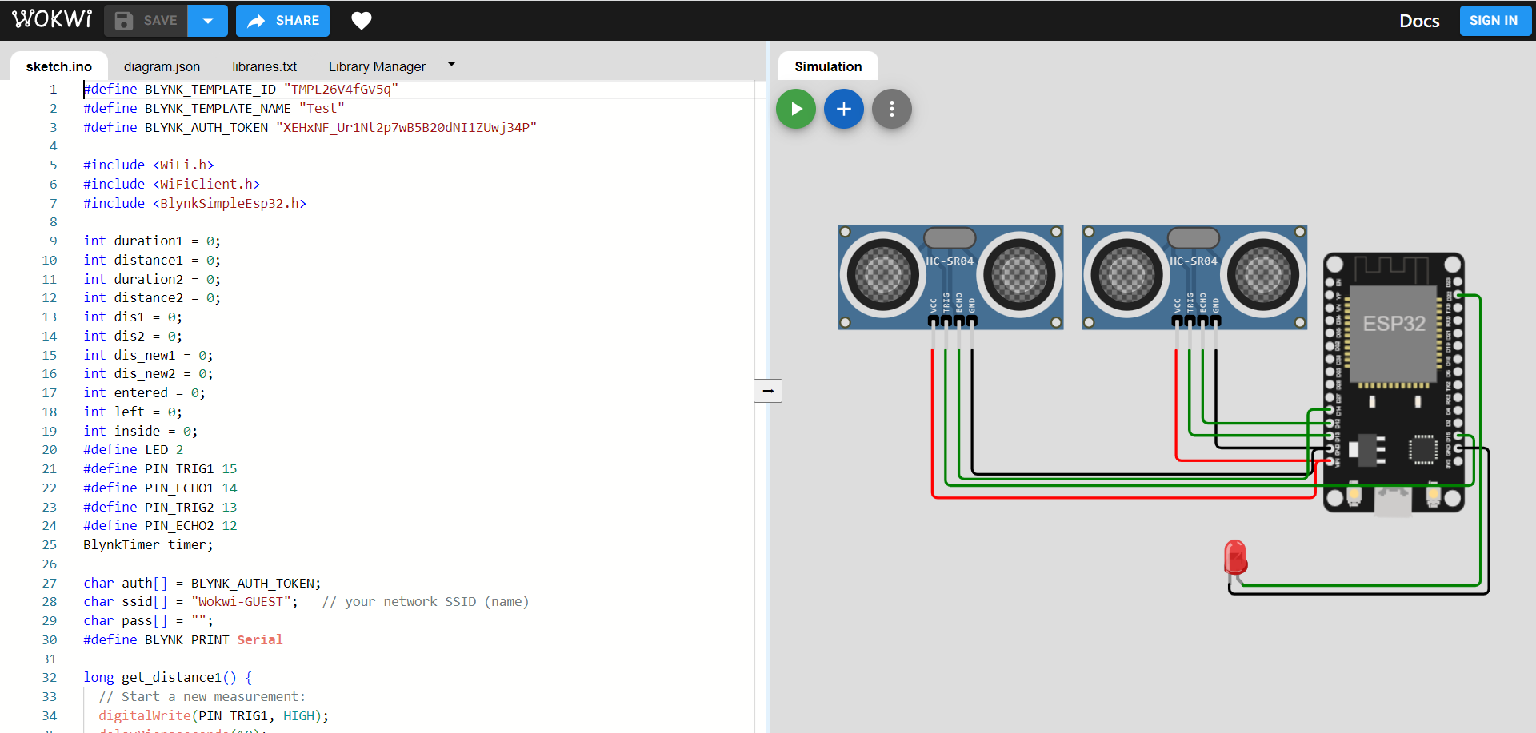
C++

Slide 22
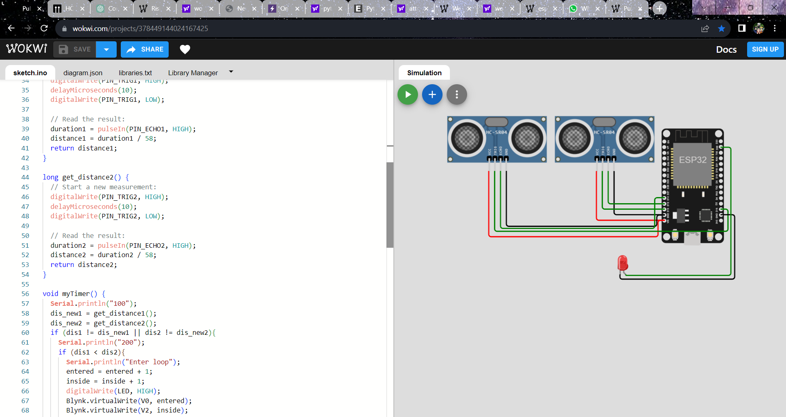

Slide 23
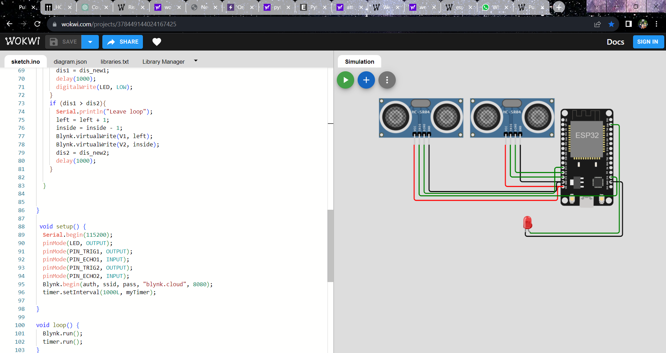

Slide 24
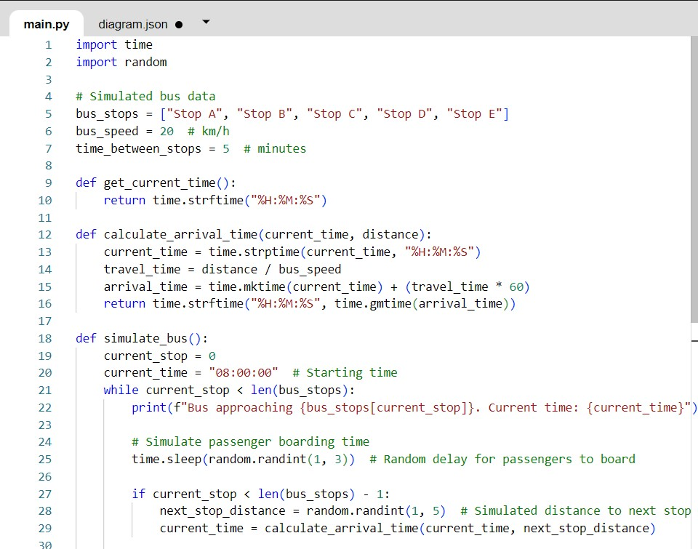
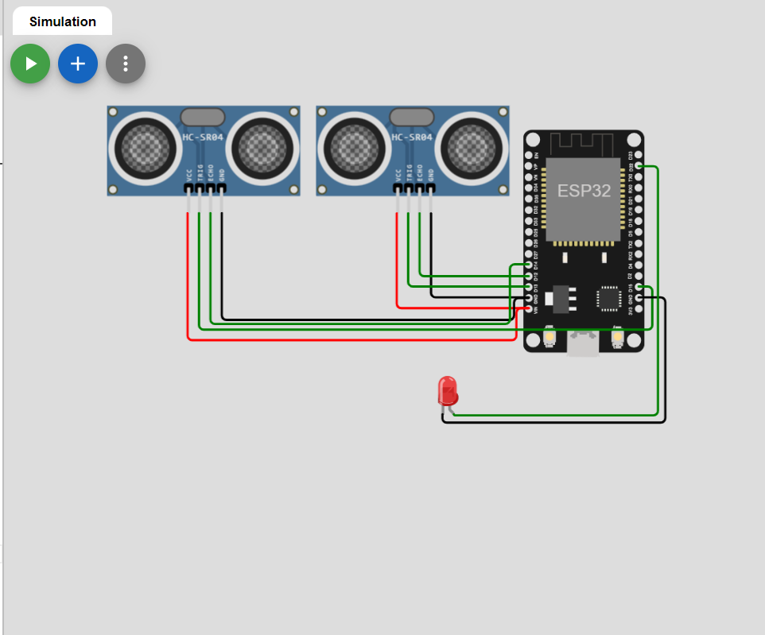
PYTHON

Slide 25
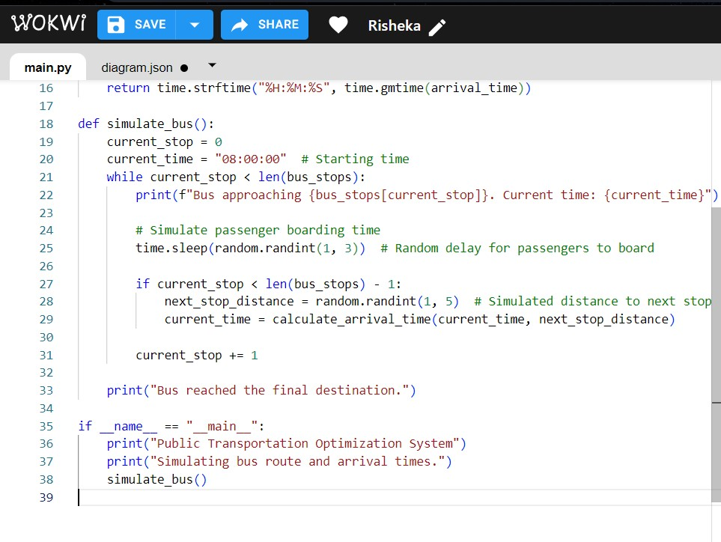

Slide 26
DEVELOPEMENT:-
INTRODUCTION
Public transportation optimization refers to the process of improving the efficiency, effectiveness, and overall quality of public transportation systems to better meet the needs of passengers and the communities they serve. This optimization involves a combination of strategies and techniques aimed at enhancing the reliability, convenience, cost-effectiveness, and sustainability of public transit services. The primary goal is to make public transportation a more attractive and competitive option compared to private vehicle use, thereby reducing traffic congestion, minimizing environmental impact, and providing better mobility options.
Uses of Public Transportation Optimization:
        Reducing Traffic Congestion
        Enhanced Reliability
        User-Friendly Experience
        Economic Development
        Public Safety

Slide 27
CODE:
<!DOCTYPE html>
<html lang="en">
<head>
<meta charset="UTF-8">
<meta name="viewport" content="width=device-width, initial-scale=1.0">
<title>Public Transportation Optimization</title>
<style>
body {
background-image: url('https://tse3.mm.bing.net/th?id=OIP.4X4MucxVgx6Xo3VNzFyUnQHaFj&pid=Api&P=0&h=180s');
background-size: cover;
background-repeat: no-repeat;
}

Slide 28
</style>
</head>
<body>
<header>
<h1>Public Transportation Optimization</h1>
</header>
<nav>
<ul>
<li><a href="C:\Users\rishe\Desktop\phase 4\gps.html">GPS</a></li>
<li><a href="C:\Users\rishe\Desktop\phase 4\weight_measuring.html">Weight Measuring</a></li>
</ul>
</nav>
<main>

Slide 29
<section>
<h2>Welcome to Public Transportation Optimization</h2>
<p>We are dedicated to making public transportation more efficient, accessible, and eco-friendly. Our solutions include real-time data, route planning, and optimization to improve your daily commute.</p>
</section>
</main>
<footer>
<p>&copy; 2023 Public Transportation Optimization Solutions</p>
</footer>
</body>
</html>

Slide 30
gps.html
<!DOCTYPE html>
<html>
<head><title>GPS Tracker</title><meta charset="utf-8">
<style>
input, textarea { -webkit-box-sizing: border-box; }
input { width: 100%; font-size: 20px; }
textarea { width: 100%; height: 500px; }
input[type="button"],
input[type="submit"] { width: 24%; }
body { text-align: center; }
</style>
<body>

Slide 31
<form action="" method="post">
<input name="t_action" value="http://192.168.1.64/gps/save.php">
<textarea readonly name="coords"></textarea>
<input value="Start Tracking" type="button" onclick="startTracking();this.disabled=true;">
<input value="Reset Trip" type="button" onclick="resetTrip();">
<input value="Use Server" type="button" onclick="this.form.t_action.value = 'savetrip.php';">
<input type="submit" onclick="this.form.action = this.form.t_action.value='';">
</form>
<script>
var ta = document.querySelector('textarea');
var lt = 0;
var ls = false;
var track = false;
(

Slide 32
function() {
var tr = localStorage.getItem('trip');
if (tr != '' && tr != null) {
ta.value = tr + '\n';
}
})();
function addHeader() {
ta.value += '-- tracking started: ' + (new Date().toString()) + '\n';
ta.value += (new Date().getTime()) + ' // start\n';
localStorage.setItem('trip', ta.value);
}
function resetTrip() {
if (!confirm('Are you sure you want to clear your trip?'))
return false;
localStorage.setItem('trip', '');

Slide 33
ta.value = '';
addHeader();
}
function startTracking() {
track = true;
addHeader();
navigator.geolocation.watchPosition(
function(position) {
var now = new Date().getTime();
if (ls != 1 || now - lt > 10000) {
ta.value += now + ' // ' + position.coords.latitude + ' // ' + position.coords.longitude + '\n';
localStorage.setItem('trip', ta.value);
lt = now;
ls = 1;
}
},

Slide 34
function() {
var now = new Date().getTime();
if (ls != 0 || now - lt > 10000) {
ta.value += now + ' // fail\n';
localStorage.setItem('trip', ta.value);
lt = now;
ls = 0;
}},
{
enableHighAccuracy: true,
maximumAge: 60000,
timeout: 15000
}
);}
</script>
</body>

Slide 35
weight_measuring.html:
<!DOCTYPE html>
<html lang="en">
<head>
<meta charset="UTF-8">
<meta name="viewport" content="width=device-width, initial-scale=1.0">
<title>Bus Weight Monitoring</title>
<link rel="stylesheet" type="text/css" href="style.css">
</head>
<body>
<h1>Bus Weight Monitoring</h1>
<div id="weight-display">
<p>Current Weight: <span id="current-weight">0 kg</span></p>
</div>

Slide 36
<script>
// Simulated weight values (replace with actual sensor data)
let currentWeight = 0;
const maxWeight = 50; // Set the maximum allowable weight in kg
// Function to update weight and check for alerts
function updateWeight() {
// Simulate weight changes (replace with actual sensor data)
currentWeight += Math.random() * 10;
// Update the displayed weight
const weightDisplay = document.getElementById("current-weight");
weightDisplay.textContent = currentWeight.toFixed(2) + " kg";

Slide 37
// Check if the weight exceeds the maximum
if (currentWeight > maxWeight) {
// Trigger an alert when the weight exceeds the maximum
alert("Warning: Maximum weight exceeded!");
// Play an alert sound
const audio = new Audio('alert-sound.mp3'); // Replace with the path to your alert sound file
audio.play();
}
}
// Simulate weight updates every 5 seconds
setInterval(updateWeight, 5000);
</script>
</body>
</html>

Slide 38
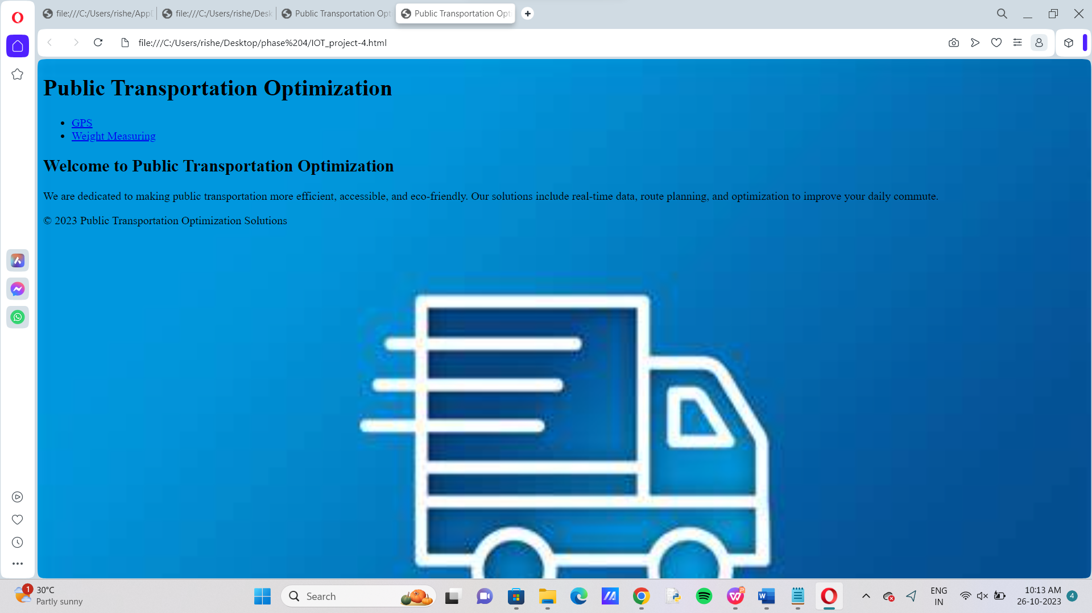
OUTPUT:

Slide 39
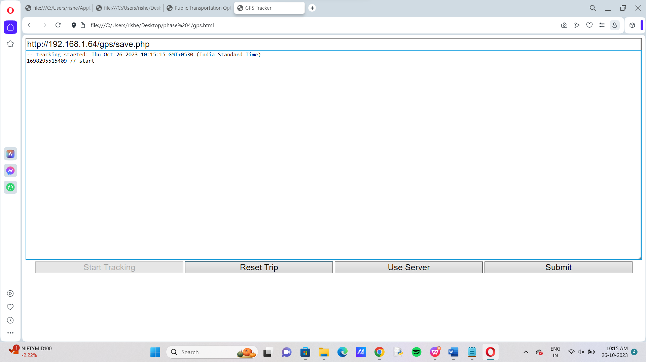

Slide 40
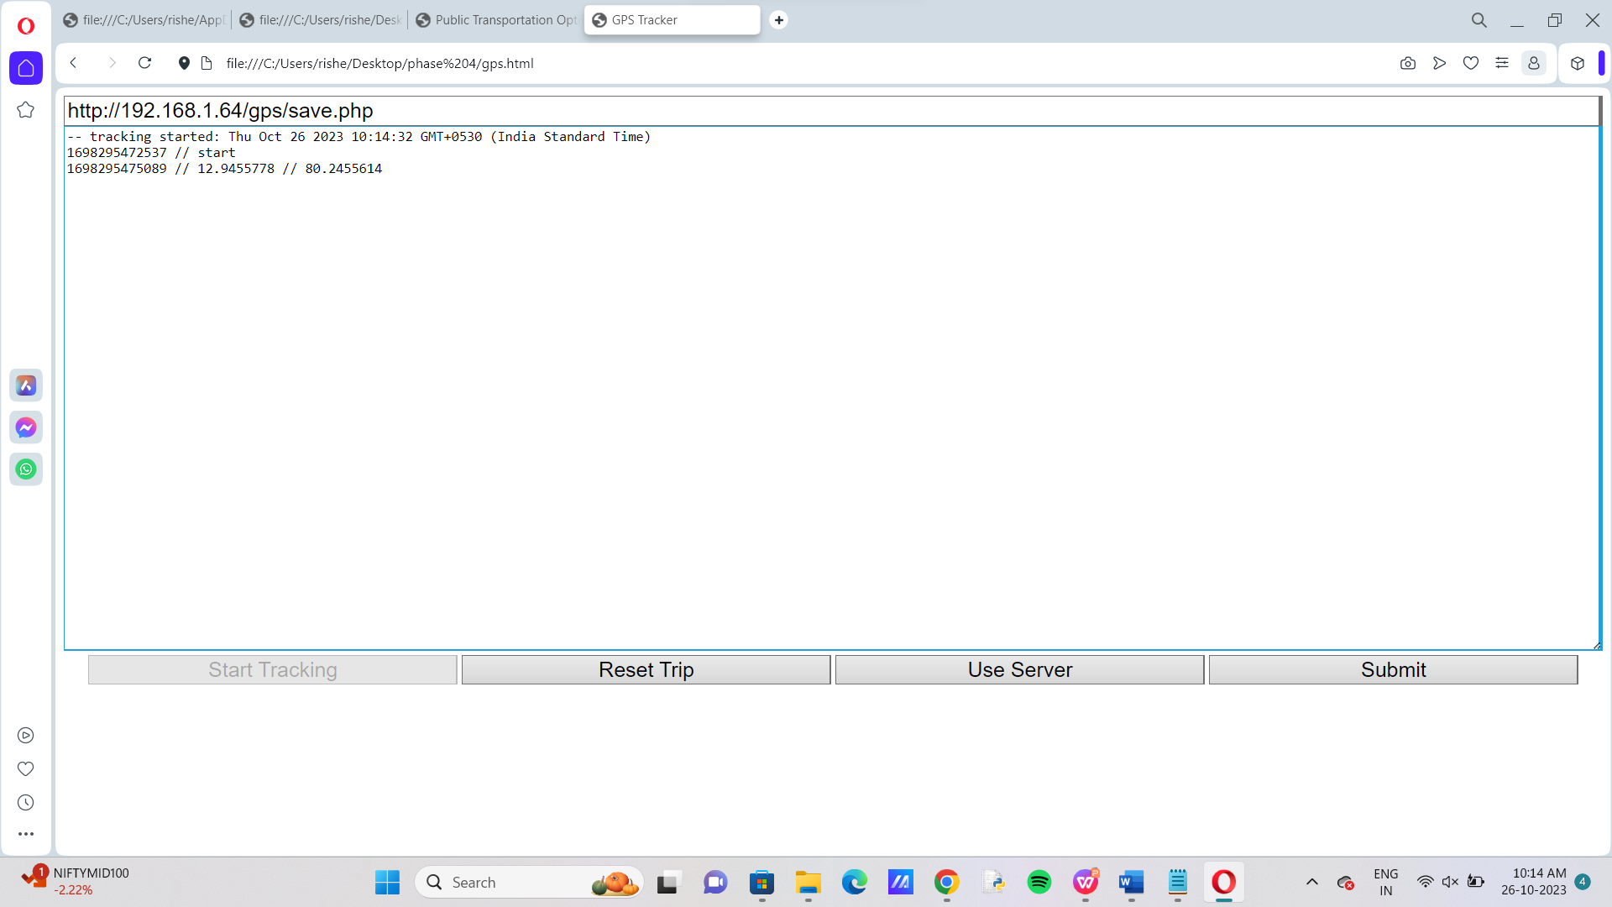

Slide 41
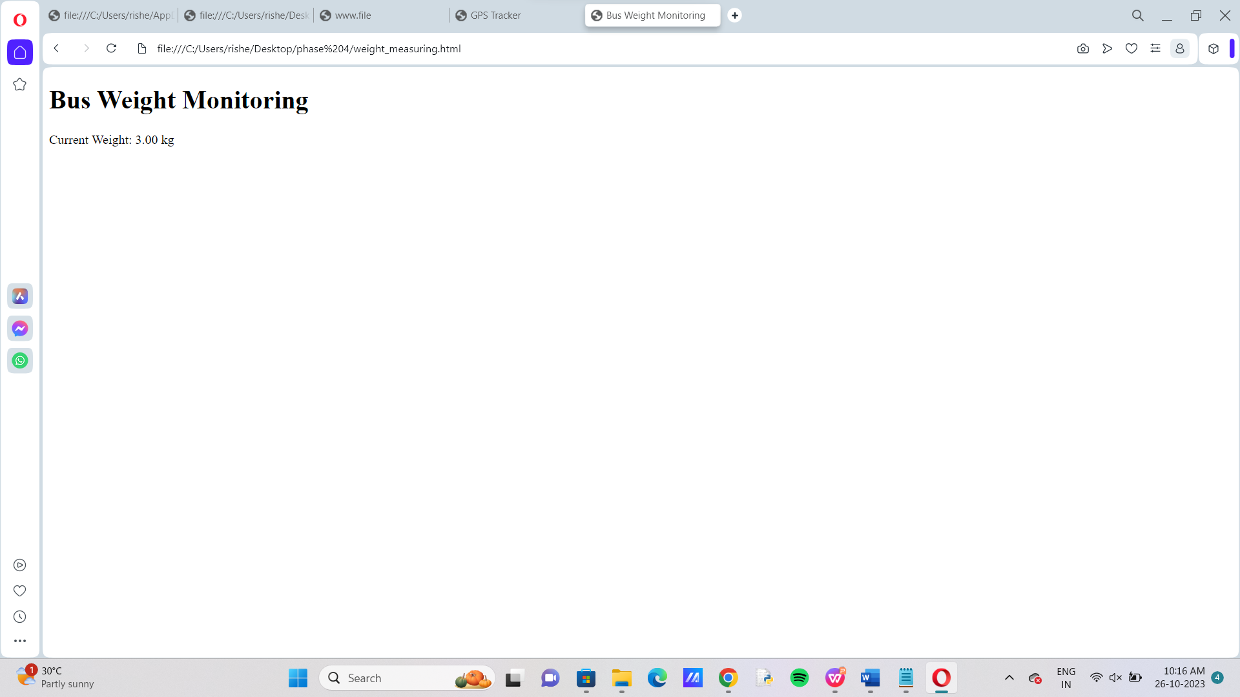

Slide 42
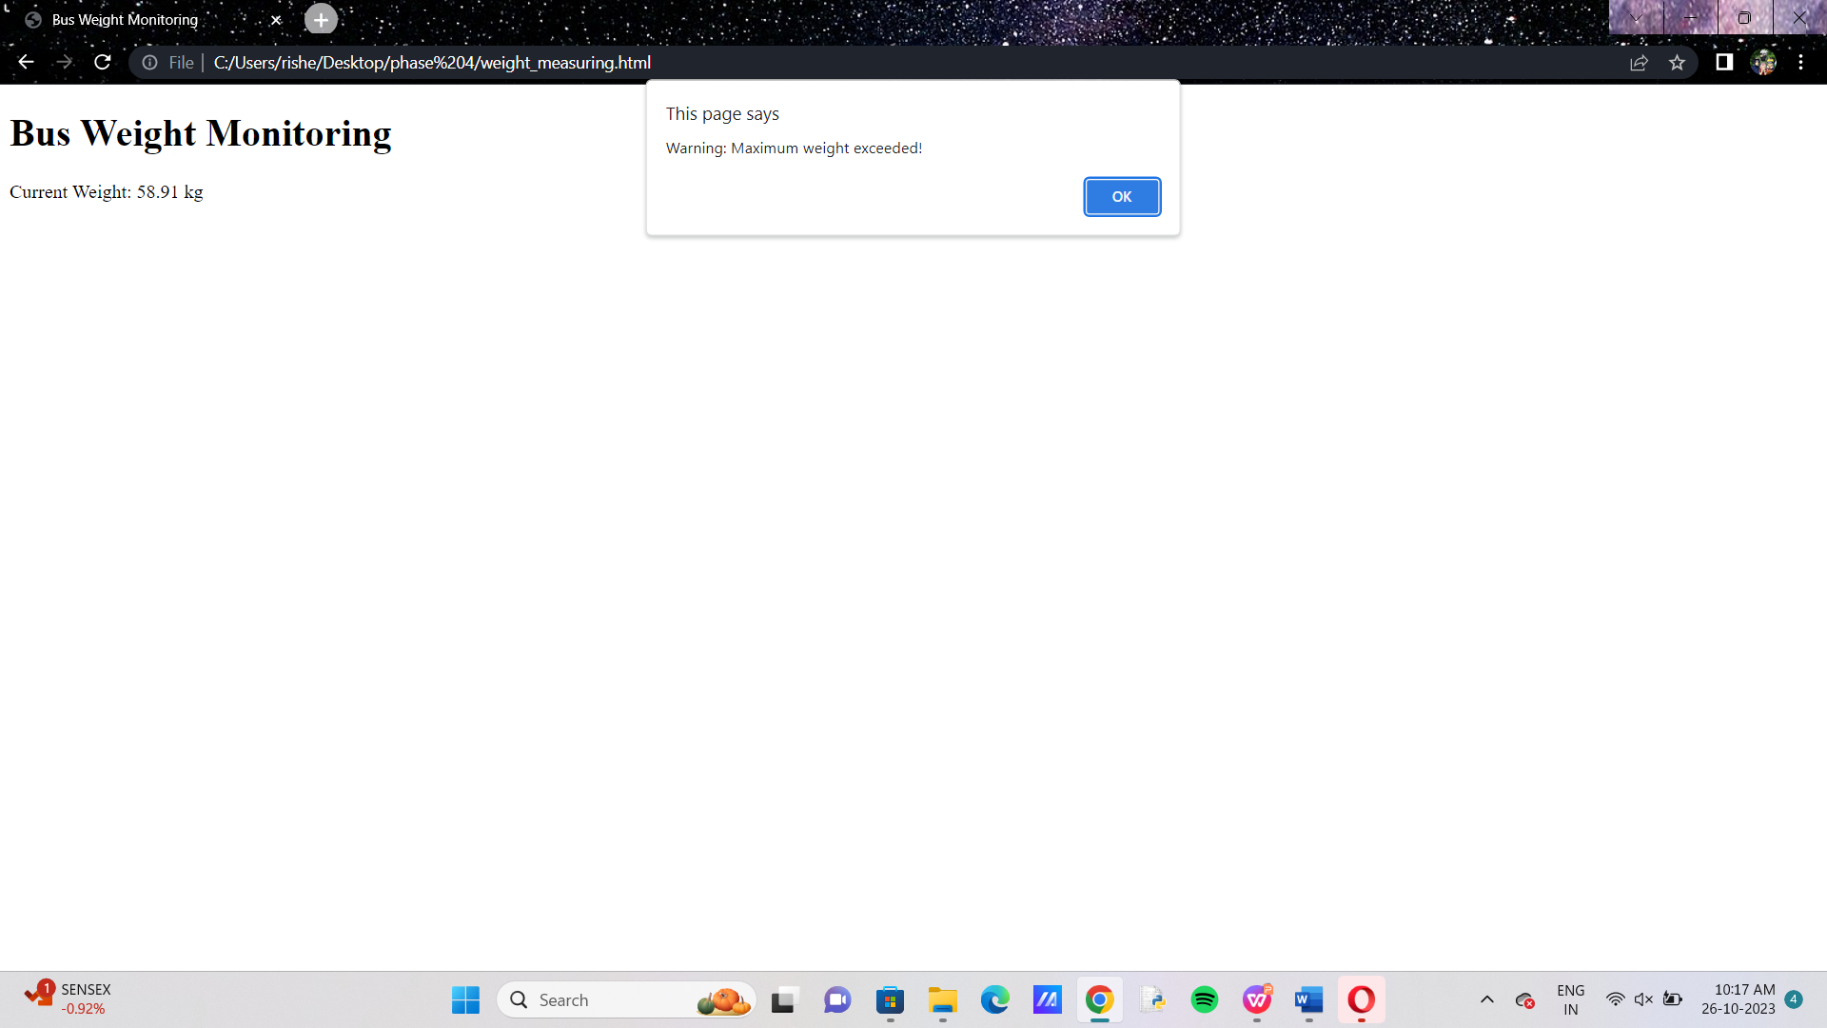

Slide 43
Conclusion:
Public transportation optimization using IoT is a promising field that can improve the passenger experience by offering real-time vehicle tracking, improved responses in the event of an unexpected event, and personalized travel information
A proposed system aims to provide better bus management that is capable of bus tracking, route scheduling, E-ticketing via IoT, eventually making commuter’s journey peaceful, saving paper through digitalization

