Slide 1


Mudra “responsible” bot catering to women returning to work after a career break

Slide 2

Research Study about Women Empowerment:
According to a study conducted by the “Genpact Centre for Women’s Leadership”, about 50 percent of working women in India leave their jobs to take care of their children at the age of 30. Even among those who manage to return, a huge fraction drops out within four months of rejoining the workforce which is very alarming. The report added that after becoming mothers, only 27 percent of women advance in their careers and continue to be part of the workforce.
Nearly half of all women said the pandemic had negatively impacted their career paths. 58 percent are in the process of rejoining the workforce, 48 percent had quit their jobs before COVID-19, 32 percent quit during, and another 20 percent were between jobs.

Slide 3
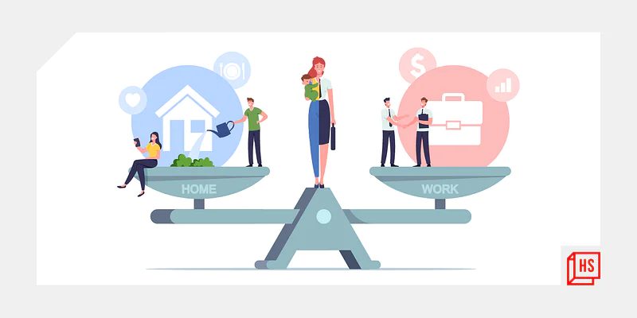
Present Situation :
More women than men are often forced to take a career break due to personal reasons, including but not limited to pregnancy, childbirth, taking care of children or the elderly. Another reason is the lack of expected career growth or development.
Many of the women does not gets a second chance to reclaim her career. Returning to work after a break still remains tough for a lot of women employees.

Slide 4
Real stories of women to rejoin the workforce after a break
Sirisha -
Who had her first child as the pandemic struck in March 2020, found it difficult to return to work in the new normal.
Sumithra -
Tried — at various points — to go back to work but it didn’t work out. The fear of leaving her child with unknown strangers, or in a daycare far away were too much of a risk for her. However, this prompted her to think in a different direction.

Slide 5
Stake holders underlying thought’s :
Will I be able to return to my old position at work?
How do I develop new skills?
Will I be able to cope with changes in the industry?
How will I manage both work and home?

Slide 6
Our Solution: Powering women to return to work with help of Azure responsible conversational AI
So after doing rigorous market research and found that the existing solutions / platforms (like job portals, career websites etc) are not tailor made as per their requirements.
Transparency is not maintained. So, they often stop taking the initiative itself.
UI is not user friendly.
No personalization
So, the solution to this problem can be an AI-based responsible chatbot called Mudra where women from urban and even rural/remote areas can chat with it and:
Find relevant job opportunities nearby
Know more details about the job.
provide access to resources, education based on the location

Slide 7
So why choose a "responsible" bot? Reason being:
Available 24/7
Scalable with lower costs
Greater personalization
Ideal for a repetitive and transactional use case with a testable result
Transparent
Trustworthy

Slide 8
Mudra- The Chat Bot :
Mudra will make an impact for empowering our women by promoting
their rights and skills and opportunities. With "Mudra" want to see “A
woman as the full circle. Within her is the power to create, nurture and
transform.”
Bot goals:
Intelligent
Fast & Accurate
Secure
Easy to access

Slide 9
Sample output
Follow the script below for a sample conversation with Mudra.
Mudra: Welcome to Mudra. I am a bot who can help in finding the best career options for you regardless of the reason or the length of your break.
User Reply: I am housewife, want to restart my career
Mudra: You have come to the right place. I will help you in guiding the career path, Before that could you let me know few questions ?
What is your educational background ?
User Reply: Degree
Mudra: What kind of jobs are you interested in? Like Software & IT, Data Science, Sales, Marketing
User Reply: Data Science
Mudra: How much work experience do you have ?
User Reply: I am a Fresher
Mudra: Alright! Which cities are you looking for jobs in? Like Mumbai, Pune
User Reply: Mumbai
Mudra: Thank you, we found the details below, based on your technology selection :
you can see the insights of the hiring trends of the technology to have selected :

