Slide 1
Converting NFAs to DFAs

Slide 2
NFA to DFA: Approach
In: NFA N
Out: DFA D
Method: Construct transition table Dtran (a.k.a. the "move function"). Each DFA state is a set of NFA states. Dtran simulates in parallel all possible moves N can make on a given string.
Operations to keep track of sets of NFA states:
  ε_closure(s) set of states reachable from state s via ε
  ε_closure(T) set of states reachable from any state in set T via ε
  move(T,a) set of states to which there is an NFA transition from states in T on symbol a

Slide 3
NFA to DFA Algorithm
Dstates := {ε_closure(start_state)}
while T := unmarked_member(Dstates) do {
mark(T)
for each input symbol a do {
U := ε_closure(move(T,a))
if not member(Dstates, U) then
insert(Dstates, U)
Dtran[T,a] := U
}
}

Slide 4
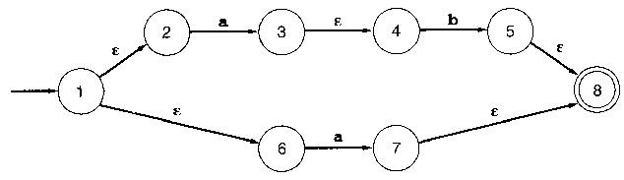
NFA to DFA Practice #1

Slide 5
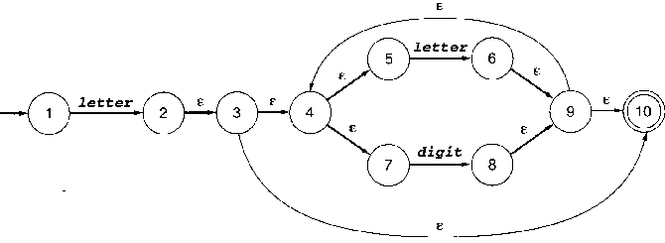
NFA to DFA Practice #2

Slide 6
Lexical Tables
Memory management components of a compiler interact with several phases of compilation, starting with lexical analysis.
Efficient storage becomes helpful on large input files.
There is colossal duplication in lexical data:
  variable names, strings and other literal values
What token type to use may depend on previous declarations (Why?)
A hash table can avoid this duplication, or help decide what token type to use. The software engineering design pattern is called the "flyweight".

Slide 7
Literal Table Example
id [a-zA-Z_][a-zA-Z_0-9]*
num [0-9]+(\.[0-9]+)?
%%
[ \t\n] { /* discard */ }
if { return IF; }
then { return THEN; }
else { return ELSE; }
{id} { yylval.id = install_id(); return ID; }
{num} { yylval.num = install_num(); return NUMBER; }
"<" { yylval.op = LT; return RELOP; }
">" { yylval.op = GT; return RELOP; }
%%
install_id() { /* insert yytext into the literal table */ }
install_num() { /* insert binary # computed from yytext into table */ }

Slide 8
Major Compiler Data Structures
Token
  integer category, lexeme, line #, column #, filename...
  leaves in a tree structure:
syntax tree
  grammar information about a sequence of tokens.
  leaves contain lexical information (tokens).
  internal nodes contain grammar rules and pointers to tree nodes.
symbol table
  variable names
  data types used in semantic analysis
  address, or constant value used in code generation
intermediate & final code
  link lists or graphs
  sequences of machine instructions, register use information…

Slide 9
Construct Tokens Inside yylex()
Can’t do the malloc/new inside main()
Next compiler phase, main() calls yyparse() which calls yylex()
yylex() has to do all of its own work
Stick pointer to token struct in a global
Code in parser will insert it as leaf in a tree

Slide 10
Things to Look for in HW
Adding reserved words is trivial.
  clex.l was for C
  add some of the C++ reserved words for 120++.
any new data types (bool) and literal constants?
  New literals can require new nontrivial regular expressions in your lex file.
bugs in the clex.l file you were given?
  check the regular expressions for literal constants
  close scrutiny and painstaking attention to detail...

