Slide 1
On the Decoder Bottleneck in
Physics-Based Emotion-Conditioned
Motion Generation
EmoMoconvq Presentation
Kangwei Sun | 524531910006
Intelligent Robot — Final Project

Slide 2
Problem & Motivation
Physics-based text-to-motion models (MoConVQ) produce dynamically plausible motion but expose only one control: free-text.
Limitation
Our question
Emotion lives in the prompt wording.
Brittle (exact words matter), entangled (mixes with content), and unreachable for unseen action × emotion pairs.
Can we attach a small discrete emotion interface to MoConVQ so the same prompt can be rendered in different emotional styles by flipping a flag?
EmoMoconvq
2 / 9

Slide 3
Background
MoConVQ (Yao et al., 2023)
Physics-based text-to-motion. Residual-VQ + GPT + MoE tracker over an ODE simulator. We build on it; backbone stays frozen.
T2M-GPT, MDM
Kinematic-only text-to-motion. No physics; no explicit emotion control.
Style / emotion transfer
ACTOR (action labels); Holden, Aberman (style transfer on mocap). Need style-labelled motion data, which we do not have for MoConVQ's skeleton.
LoRA / adapters
Inspiration for parameter-efficient adaptation. Our emotion module is ~0.8M params on a 194M backbone.
EmoMoconvq
3 / 9

Slide 4
Method — Architecture
EmoMoconvq plugs a tiny trainable emotion branch into MoConVQ's frozen text → tokens → latent → physics pipeline.
Emotion label c
E_e (5 × 512) → MLP_proj (→ 1024)
T5-large
T2M-MoConGPT
ConvVQ decoder
Physics decoder
text →
+
→ BVH
encoder · frozen
12-layer autoreg. transformer · top-K tuned · emits RQ tokens
RQ tokens → motion latent z
MoE tracker + ODE simulator
MoConVQ pipeline (everything outside the teal box is frozen): T5 encodes the prompt; T2M-MoConGPT autoregressively emits a residual-VQ token sequence; ConvVQ decodes those tokens to a continuous motion latent z; the MoE tracking policy then drives an ODE simulator that follows z and outputs physically valid BVH motion.
f_cond = f_T5 + MLP_proj( E_e (c) )
0.8 M trainable emotion params • zero-init last linear → step 0 = baseline (graceful degradation)
EmoMoconvq
4 / 9

Slide 5
Method — Progressive distillation
Distil emotion knowledge by running the baseline on text with emotion adverbs; train EmoMoconvq from stripped text + label. Tighten the design at each step until the label is the only useful signal.
v1
Uncontrolled
47.3M (24.3%)
463 emotion-bearing captions • one emotion / caption • top-4 layers tuned
Text can memorise; label may be ignored
v2
5-variant compositional
24.0M (12.4%)
100 base × 5 emotions = 500 • base-stratified split • top-2 layers
Same text forces label use
B
Emotion-module only
0.79M (0.41%)
v2 dataset • every temporal layer frozen • only E_e + MLP_proj
Module is the only thing that can learn
D'
3-class focus
3-class • chance 33.3%
{neutral, happy, fearful} • 300 samples • pre-registered fallback
Drop classes baseline confuses
EmoMoconvq
5 / 9

Slide 6
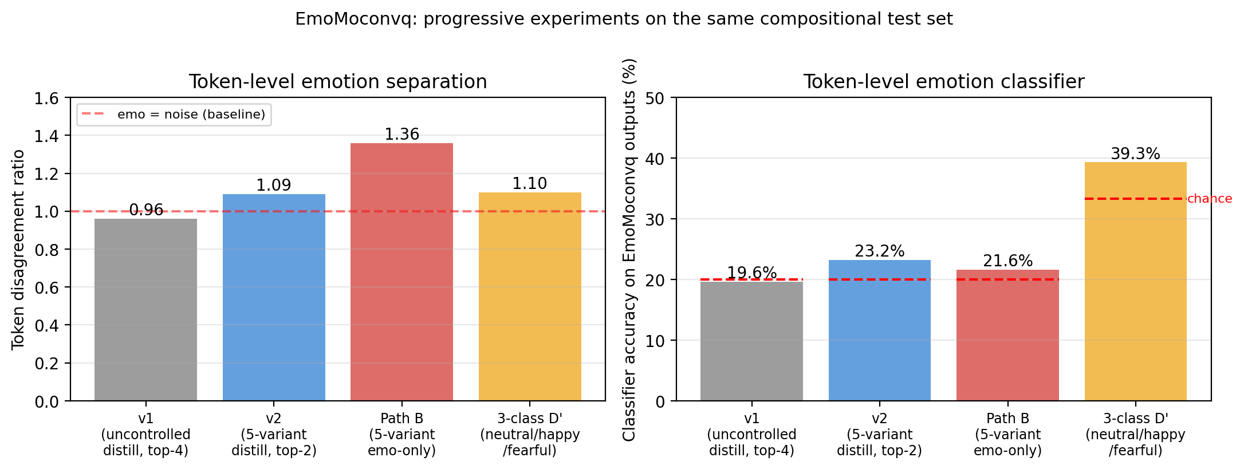
Result A — Token-level evaluation
On 50 held-out neutral captions, EmoMoconvq's outputs differ across emotion labels by 1.36× baseline stochasticity, and a 3-class classifier picks up the conditioned emotion above chance.
1.36×
Token disagreement vs.
baseline noise (Path B)
v1 → v2 → B → D' : tightening the design steadily increases the emotion-induced variation.
39.3 %
3-class classifier acc.
chance 33.3% — happy 50%
EmoMoconvq
6 / 9

Slide 7
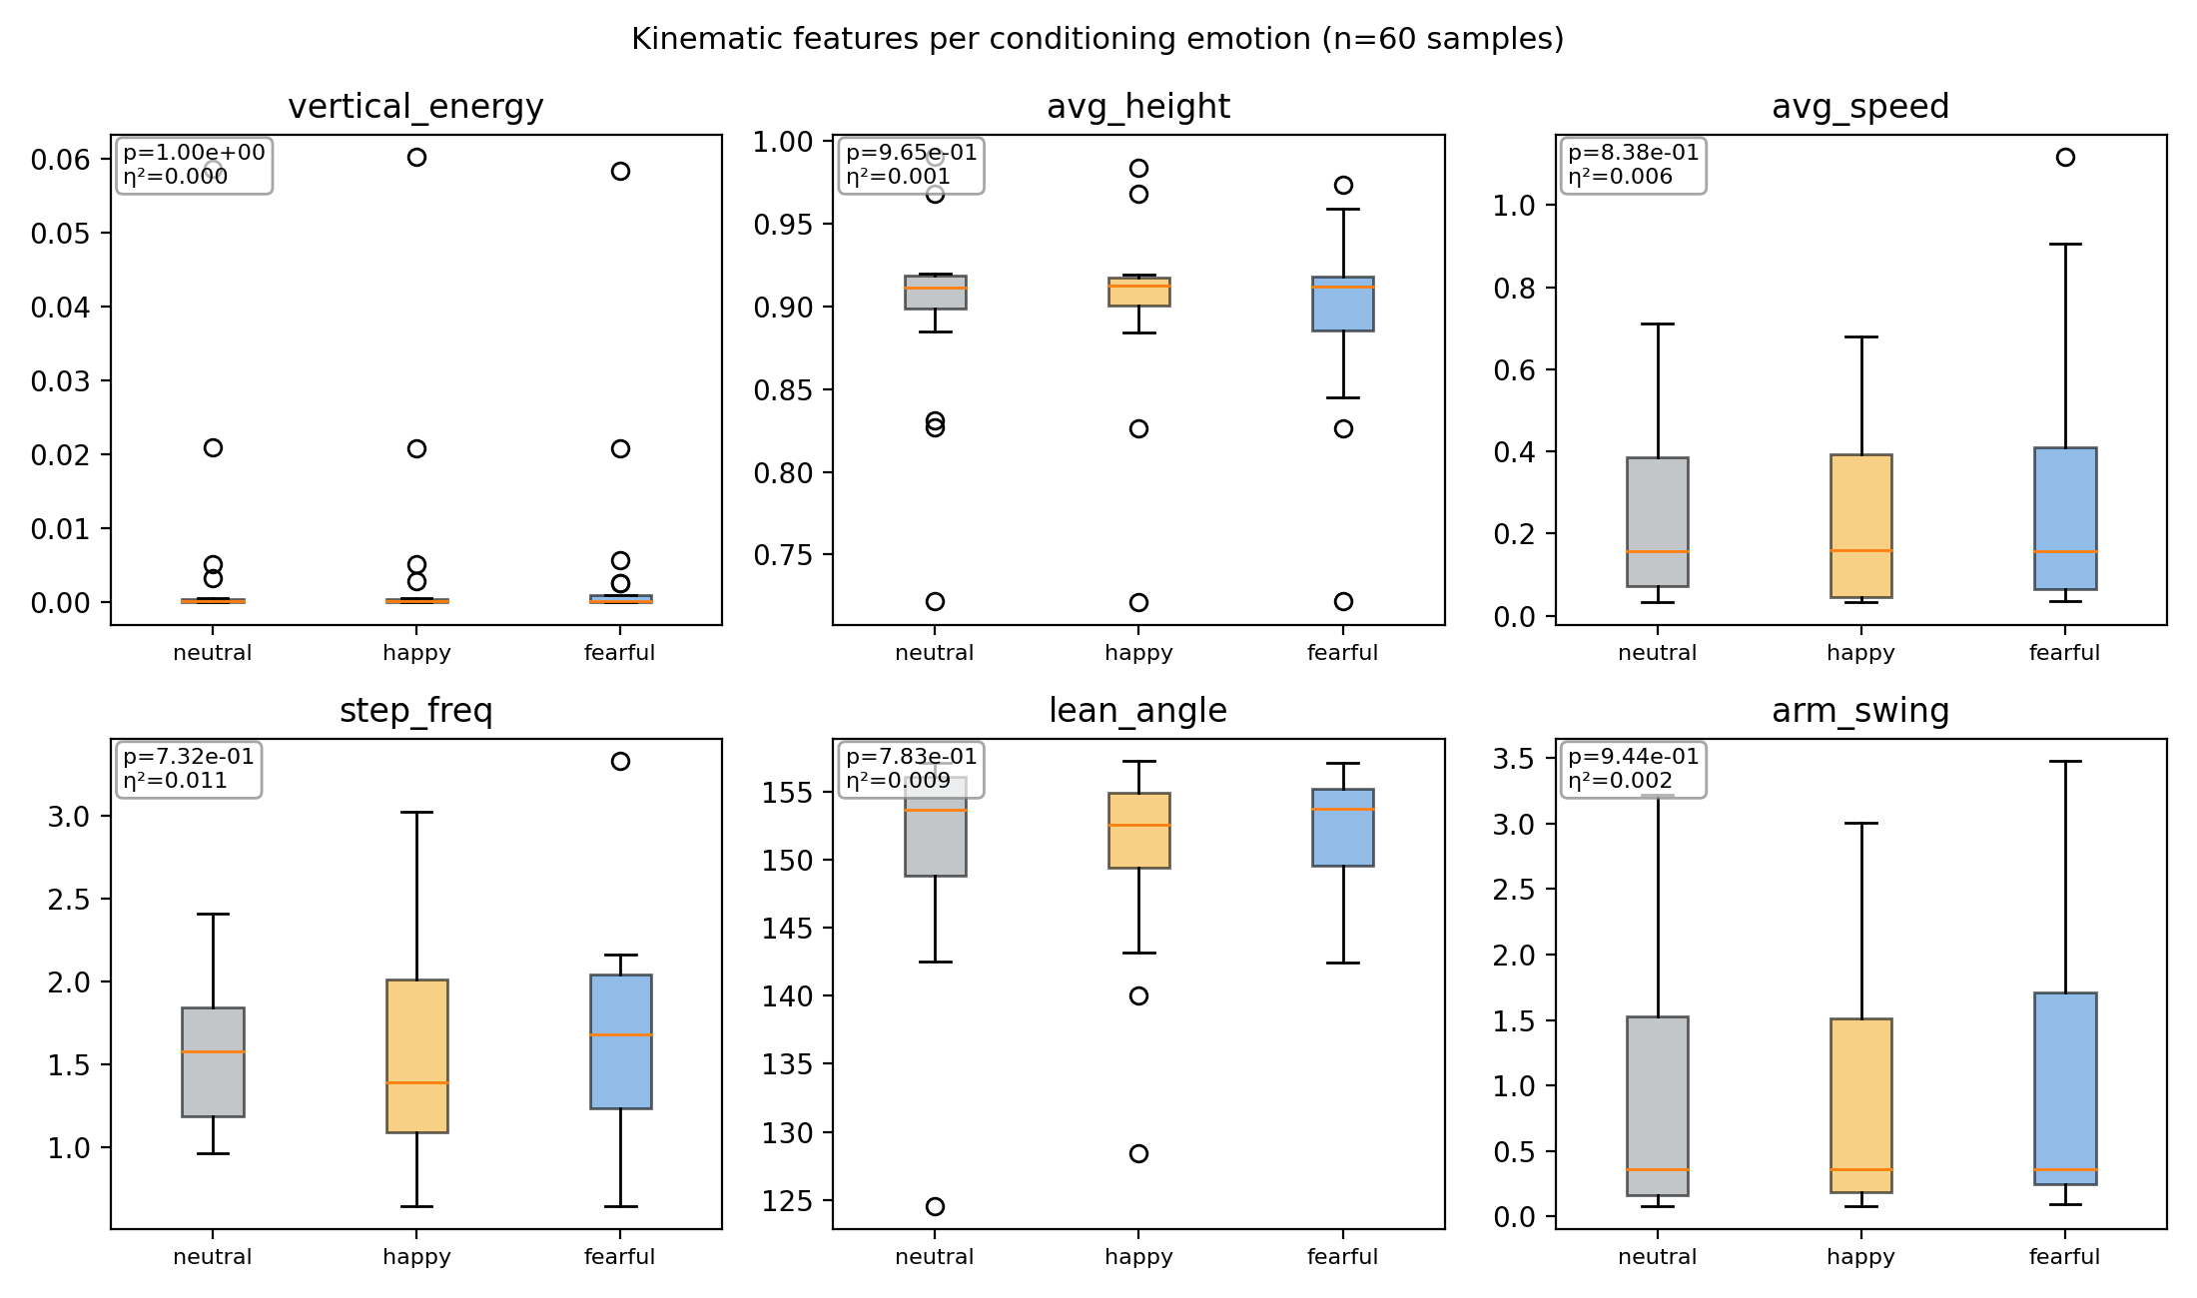
Result B — Motion-level: null result
Decoded through MoConVQ's physics simulator, 6 affective kinematic features show no significant per-emotion effect.
One-way ANOVA across 20 captions × 3 emotions — all p > 0.7, all η² ≤ 0.011.
Diagnosis
Decoder bottleneck.
MoConVQ's tracking policy was trained to follow latents within a fixed physical manifold. The emotion-conditioned signal lives in the latent but is projected back to the tracker's prior — emotion is normalised out of the physical motion.
EmoMoconvq
7 / 9

Slide 8
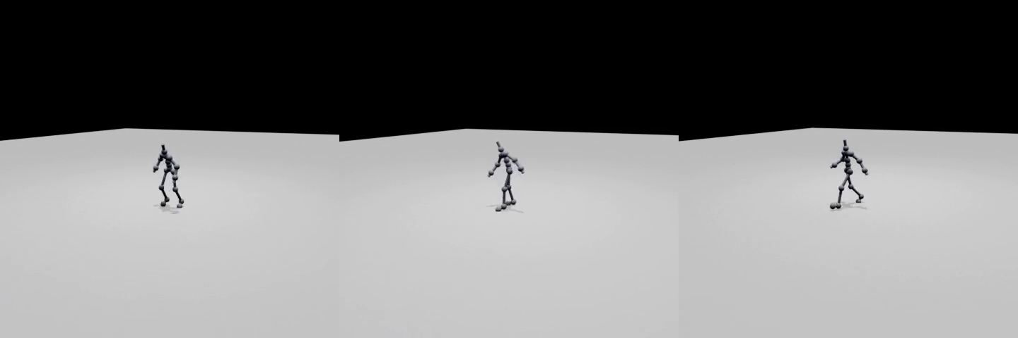
Qualitative output & live demo
Released artefacts
5 × 3 side-by-side comparison videos
3 trained EmoMoconvq checkpoints
v1 + v2 distillation datasets
Gradio interactive web demo
LIVE DEMO
Prompt + emotion → physics-simulated BVH in ~10s.
Script/gradio_demo.py
3-emotion comparison on "a person runs forward" — left: neutral · middle: happy · right: fearful (click to play)
github.com/Sunkw1224/EmoMoconvq
EmoMoconvq
8 / 9

Slide 9
Takeaway
The emotion module learns. The frozen tracker erases what it learnt.
What we found
Future directions
Token-level emotion control is real (1.36×; happy 50%).
Motion-level effect is null (ANOVA p > 0.7).
Bottleneck localised to the frozen physics tracker.
Joint fine-tuning of the tracker (differentiable physics).
Emotion-preservation loss in the tracking objective.
End-to-end training on real emotion-labelled motion (needs retargeter).
Thank you.
github.com/Sunkw1224/EmoMoconvq

