Slide 1
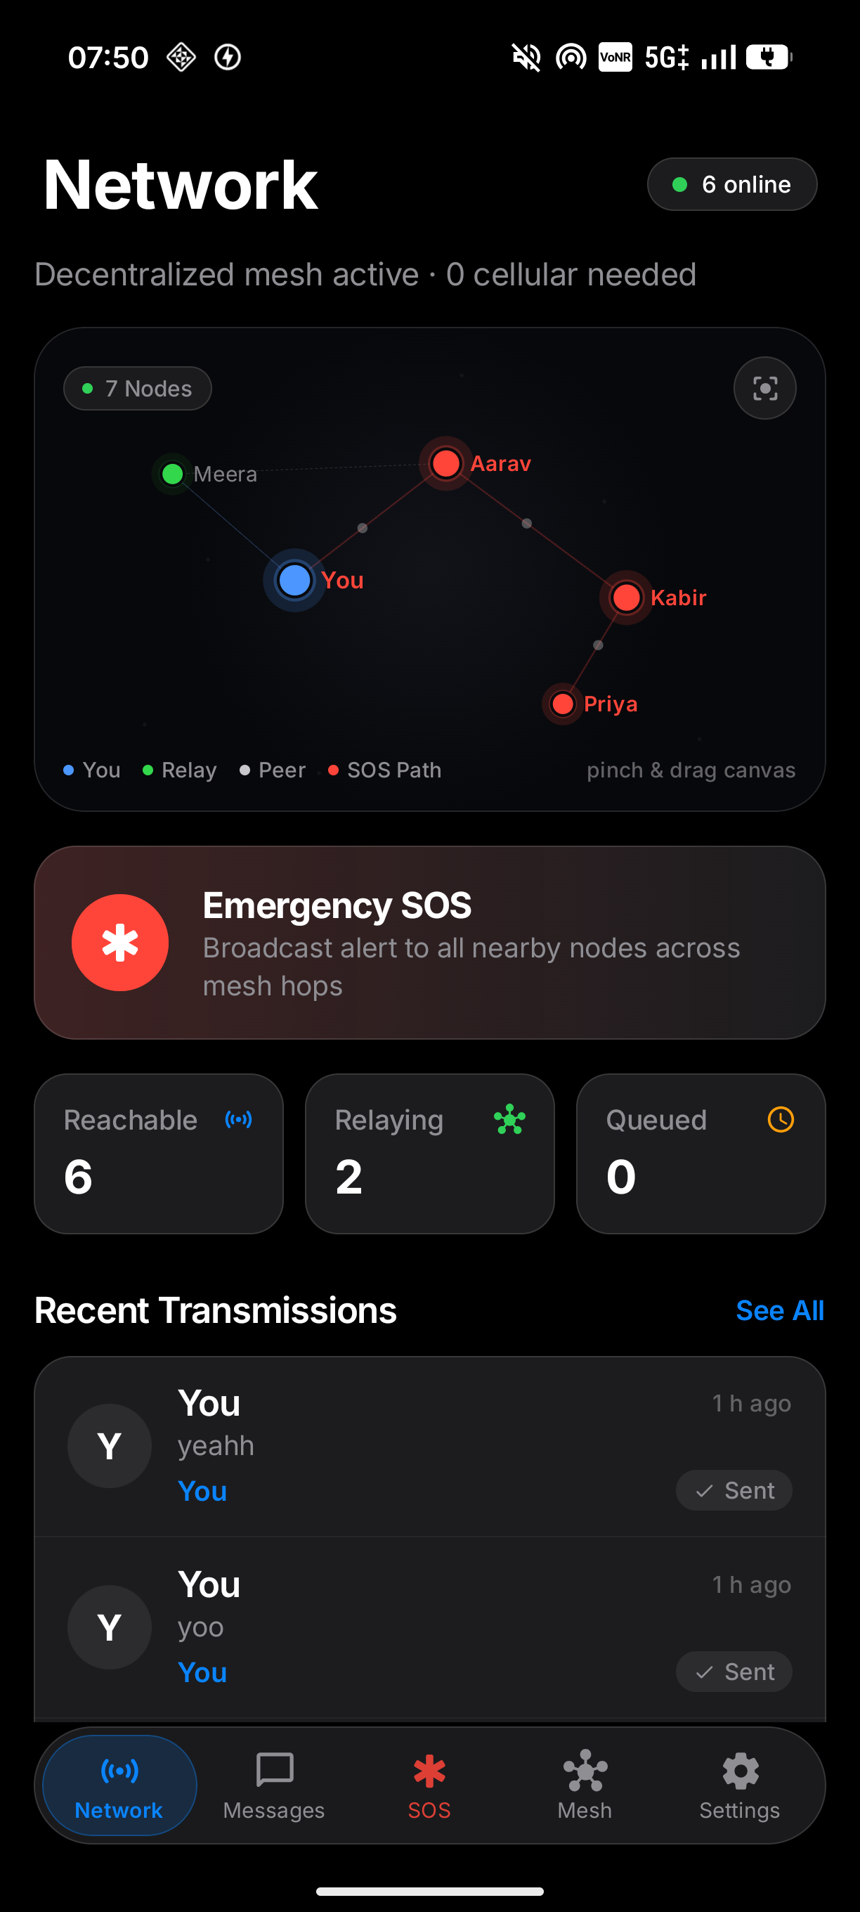
HACKATHON PRESENTATION · TEAM FLUX
LYNQ
Decentralized Offline Emergency Mesh Network
A zero-infrastructure, hop-by-hop life safety communication system engineered for natural disasters, grid blackouts, and complete cellular collapse.
TARGET DOMAINS
Cybersecurity · Communication Networks · Disaster Management · AI/ML
TEAM FLUX MEMBERS
• G N Sreekar (Team Lead) — Mesh Architecture & Core Protocol
• Kamegaonkar Kruthik — Cybersecurity & Keystore Cryptography
• VVM Sai Ganesh — Communication Networks & Routing Engine
• Ashwik Saxena — UI/UX Design System & AI/ML Triage

Slide 2
TEAM FLUX · LYNQ EMERGENCY MESH
DISASTER MANAGEMENT
The Golden Window in Total Infrastructure Blackout
95%
72 Hrs
0 bps
Cell Tower Failure
The Golden Window
Backhaul Bandwidth
Base stations and fiber backhaul severed within hours of seismic/flood events.
Critical survival timeframe where search & rescue depends entirely on communications.
Traditional cloud and SMS apps become completely inert paperweights.
CORE CHALLENGES IN DISASTER EMERGENCY COMMS
• The Infrastructure Trap
• Radio Range Limitation
Modern apps (WhatsApp, Signal) are architecturally centralized; when AWS or cell towers drop, they cannot send even 1 byte locally.
Direct Bluetooth/Wi-Fi has a range of ~50-100 meters. Without intelligent multi-hop routing, victims outside direct line-of-sight remain cut off.
• Panic & False Alarms
• Untrusted Environment
Accidental emergency alerts congest rescue teams. Systems require tactile confirmation while keeping SOS transmission non-blocking.
In disaster chaos, spoofed coordinates or altered distress payloads endanger first responders. Authenticity must be cryptographically verified.
Problem Statement: Offline Emergency Messaging System | Page 2 of 10

Slide 3
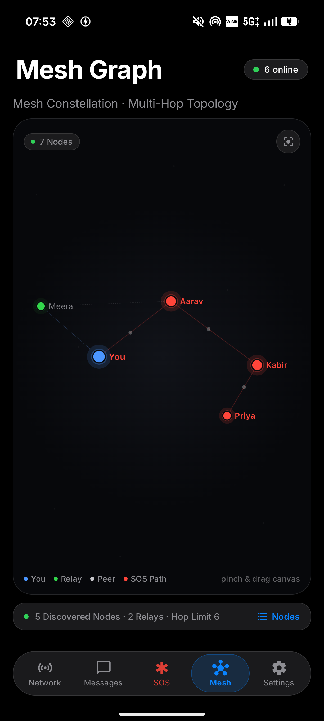
TEAM FLUX · LYNQ EMERGENCY MESH
COMMUNICATION NETWORKS
Zero Towers. Zero Internet. 100% Peer-to-Peer.
Decentralized Multi-Hop Mesh (P2P_CLUSTER)
Strategy.P2P_CLUSTER
Leverages Google Nearby Connections to establish ad-hoc Wi-Fi Aware & BLE radio clusters without pairing codes or Wi-Fi routers.
Store-and-Forward Routing Engine
Deduplicated TTL Routing
Delay-tolerant architecture. Packets are persisted locally in SQLite when peers are out of range and auto-dispatched the second a relay connects.
Deterministic Route Propagation
A → B → C → D Relay
Messages hop dynamically across intermediate phones (You → Aarav → Kabir → Priya), multiplying network reach exponentially beyond physical radio barriers.
End-to-End Delivery Acknowledgments
Loopback ACKs
Application-level ACK packets route back through the reverse mesh path, transitioning status from SENT → RELAYED → DELIVERED on sender screens.
Problem Statement: Offline Emergency Messaging System | Page 3 of 10

Slide 4
TEAM FLUX · LYNQ EMERGENCY MESH
SYSTEM ARCHITECTURE
Decentralized Architecture & Hop-by-Hop Engine
LAYER 1
LAYER 2
LAYER 3
LAYER 4
UI & Presentation
Messaging Engine
Security & Keystore
Transport & Storage
✓ Jetpack Compose (Apple HIG)
✓ Tactile 3s Hold SOS Button
✓ Real-Time Mesh Graph Canvas
✓ StateFlow Reactive Streams
✓ Store-and-Forward Router
✓ PriorityQueue (CRITICAL first)
✓ TTL Budget & Dedupe Cache
✓ Application-level ACK Loop
✓ Android Keystore ECDSA P-256
✓ AES-256-GCM Cryptor
✓ Digital Signature Authenticator
✓ Blind Relay Zero-Knowledge
✓ Nearby P2P_CLUSTER
✓ Room SQLite Database
✓ Fused Location Provider
✓ Foreground Relay Service
STORE-AND-FORWARD ROUTER PIPELINE
1. Ingest Packet
2. Dedupe Check
3. TTL Decrement
4. Destination Match
5. Forward Relay
6. ACK Return
Decode & parse binary
Query seen-set SQLite
Drop if TTL <= 0
Decrypt & deliver to user
Flood to unvisited peers
Route ACK back to sender
Problem Statement: Offline Emergency Messaging System | Page 4 of 10

Slide 5
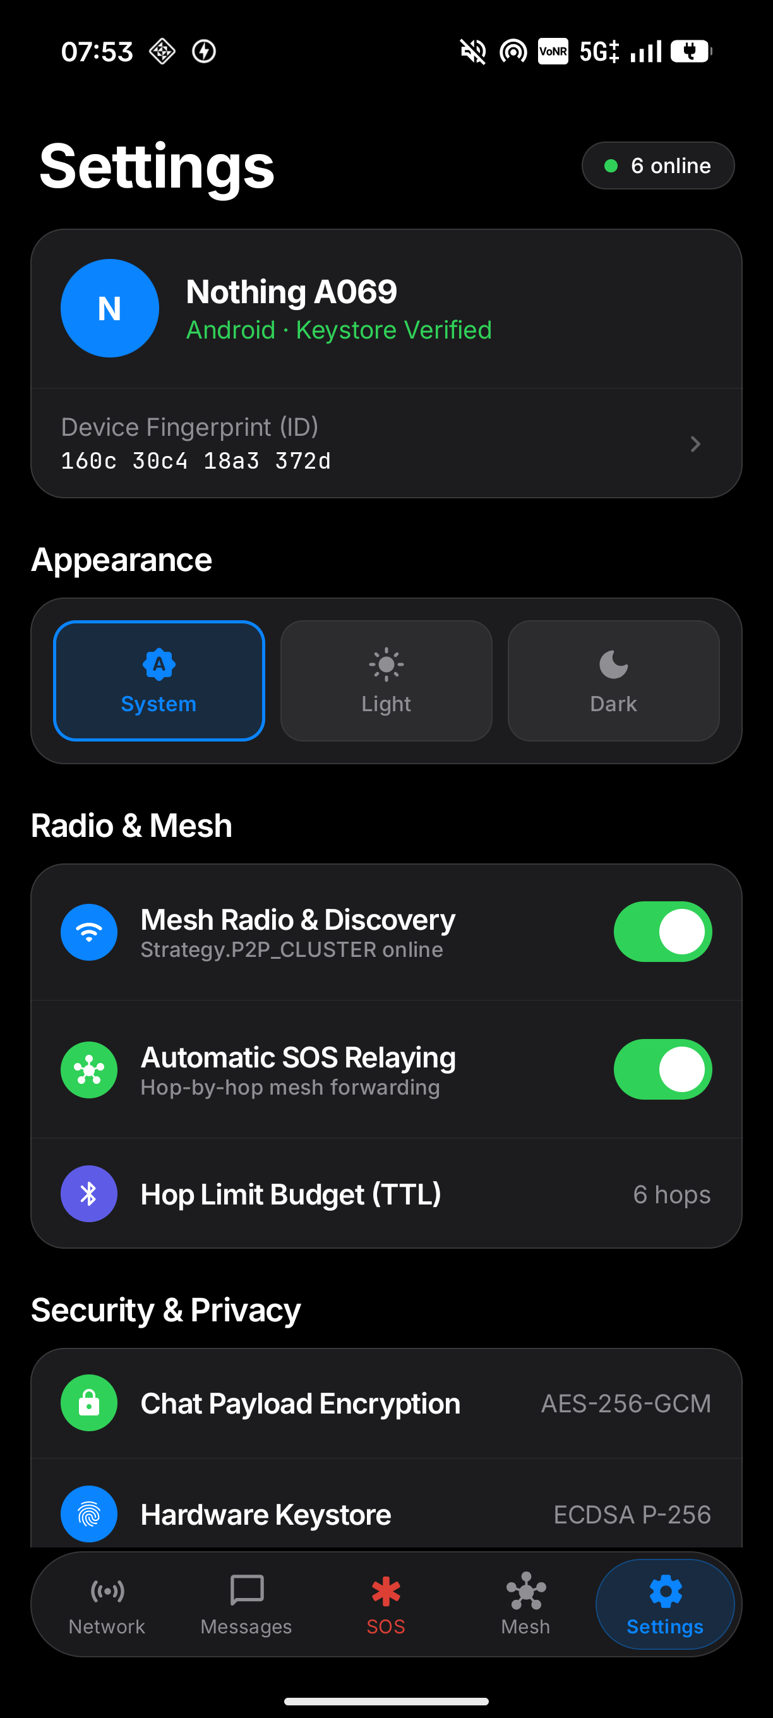
TEAM FLUX · LYNQ EMERGENCY MESH
CYBERSECURITY
Zero-Trust Security & Hardware-Backed Cryptography
Android Hardware Keystore Identity
ECDSA P-256 Keystore
Each device generates a hardware-isolated EC (P-256) keypair during initialization. Keys never leave the secure enclave/TEE. The device ID is a 16-hex fingerprint (e.g. 160c 30c4 18a3 372d) derived from the public key.
End-to-End Encryption (AES-256-GCM)
AES-256-GCM E2EE
Private 1-to-1 chats are encrypted using AES-256 in Galois/Counter Mode. Only the destination node possessing the shared secret can decrypt the payload. GCM authentication tags guarantee integrity.
Blind Relay Zero-Knowledge Forwarding
Zero-Knowledge Relays
Intermediate mesh nodes (Aarav, Kabir) forward purely opaque ciphertexts. Relay nodes cannot inspect messages, harvest phone numbers, or tamper with routing payloads.
Digital Signatures & Anti-Replay Mitigation
Anti-Replay Protection
Every transmission carries a SHA256withECDSA digital signature verifying sender identity against spoofing. Messages are deduplicated against a persistent SQLite seen-set to neutralize replay attacks.
Problem Statement: Offline Emergency Messaging System | Page 5 of 10

Slide 6
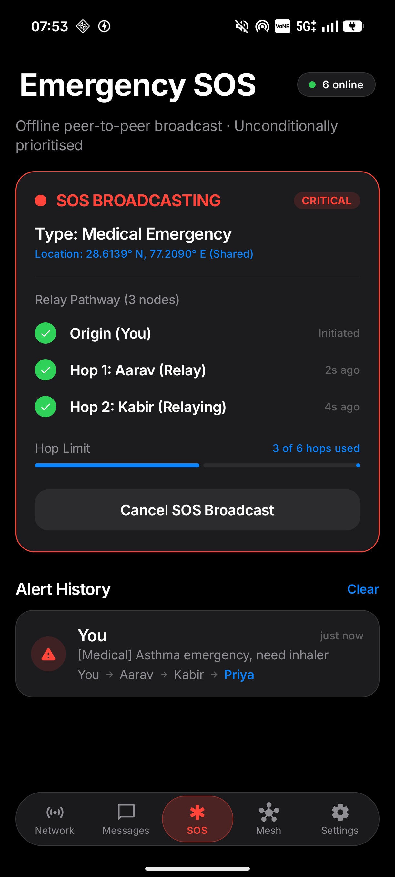
TEAM FLUX · LYNQ EMERGENCY MESH
DISASTER MANAGEMENT
Mission-Critical Emergency SOS Engine
Tactile 3-Second Hold-to-Confirm
Engineered with a circular 360° charging countdown arc and smooth scale press compression to eliminate catastrophic accidental triggers in chaotic rescue environments.
Unconditional Priority Preemption
All SOS broadcasts are tagged with Priority.CRITICAL. Outgoing and relay queues instantly preempt regular chat packets, ensuring emergency signals flood the mesh without queuing delays.
Live Hop-by-Hop Pathway Tracking
Victims visually track their distress beacon in real time (e.g. Origin → Aarav → Kabir → Priya) with affirmative delivery confirmations returning from rescue nodes.
Universal Legibility & Non-Blocking Location
SOS payloads are signed but unencrypted so all nearby devices can triage immediately. Integrates Fused Location Provider with ±4m precision; operates seamlessly even if GPS is denied.
Problem Statement: Offline Emergency Messaging System | Page 6 of 10

Slide 7
TEAM FLUX · LYNQ EMERGENCY MESH
AI / MACHINE LEARNING
Edge AI & Low-Resource Crisis Triage
On-Device Emergency NLP Triage
Zero Latency
Semantic Payload Compression (60% Smaller)
60% Data Reduction
Lightweight on-device classifier analyzes unstructured natural language inputs (e.g. "trapped under beam, severe bleeding, 2nd floor") and extracts triage categories, victim counts, and urgency levels for first responder dashboards.
Bluetooth Low Energy (BLE) channels have severe MTU bandwidth bottlenecks. Lynq uses domain-specific token dictionaries and semantic compression to shrink distress payloads by up to 60%, drastically cutting airtime.
Predictive Mesh Congestion Routing
Reinforcement Learning
Decoupled Cloud AI Pipeline (Featherless / FastAPI)
Internet Gateway
ML routing heuristics evaluate local node density, battery budgets, and historical link RSSI stability to dynamically adjust TTL hop budgets and route messages away from congested bottleneck nodes.
When an edge node reaches an internet gateway (e.g. satellite uplink at command tent), Lynq feeds aggregated distress packets to LLMs for automated medical translation, multi-lingual triage, and incident clustering.
Problem Statement: Offline Emergency Messaging System | Page 7 of 10

Slide 8
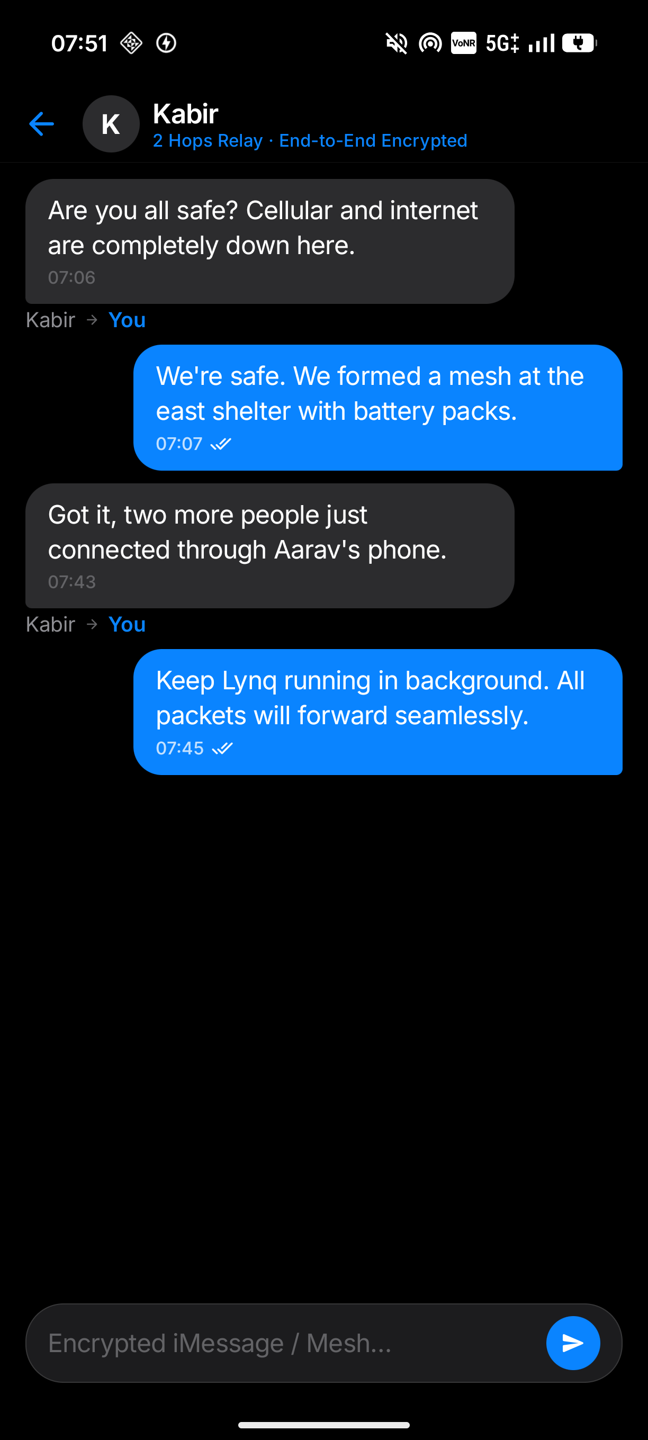
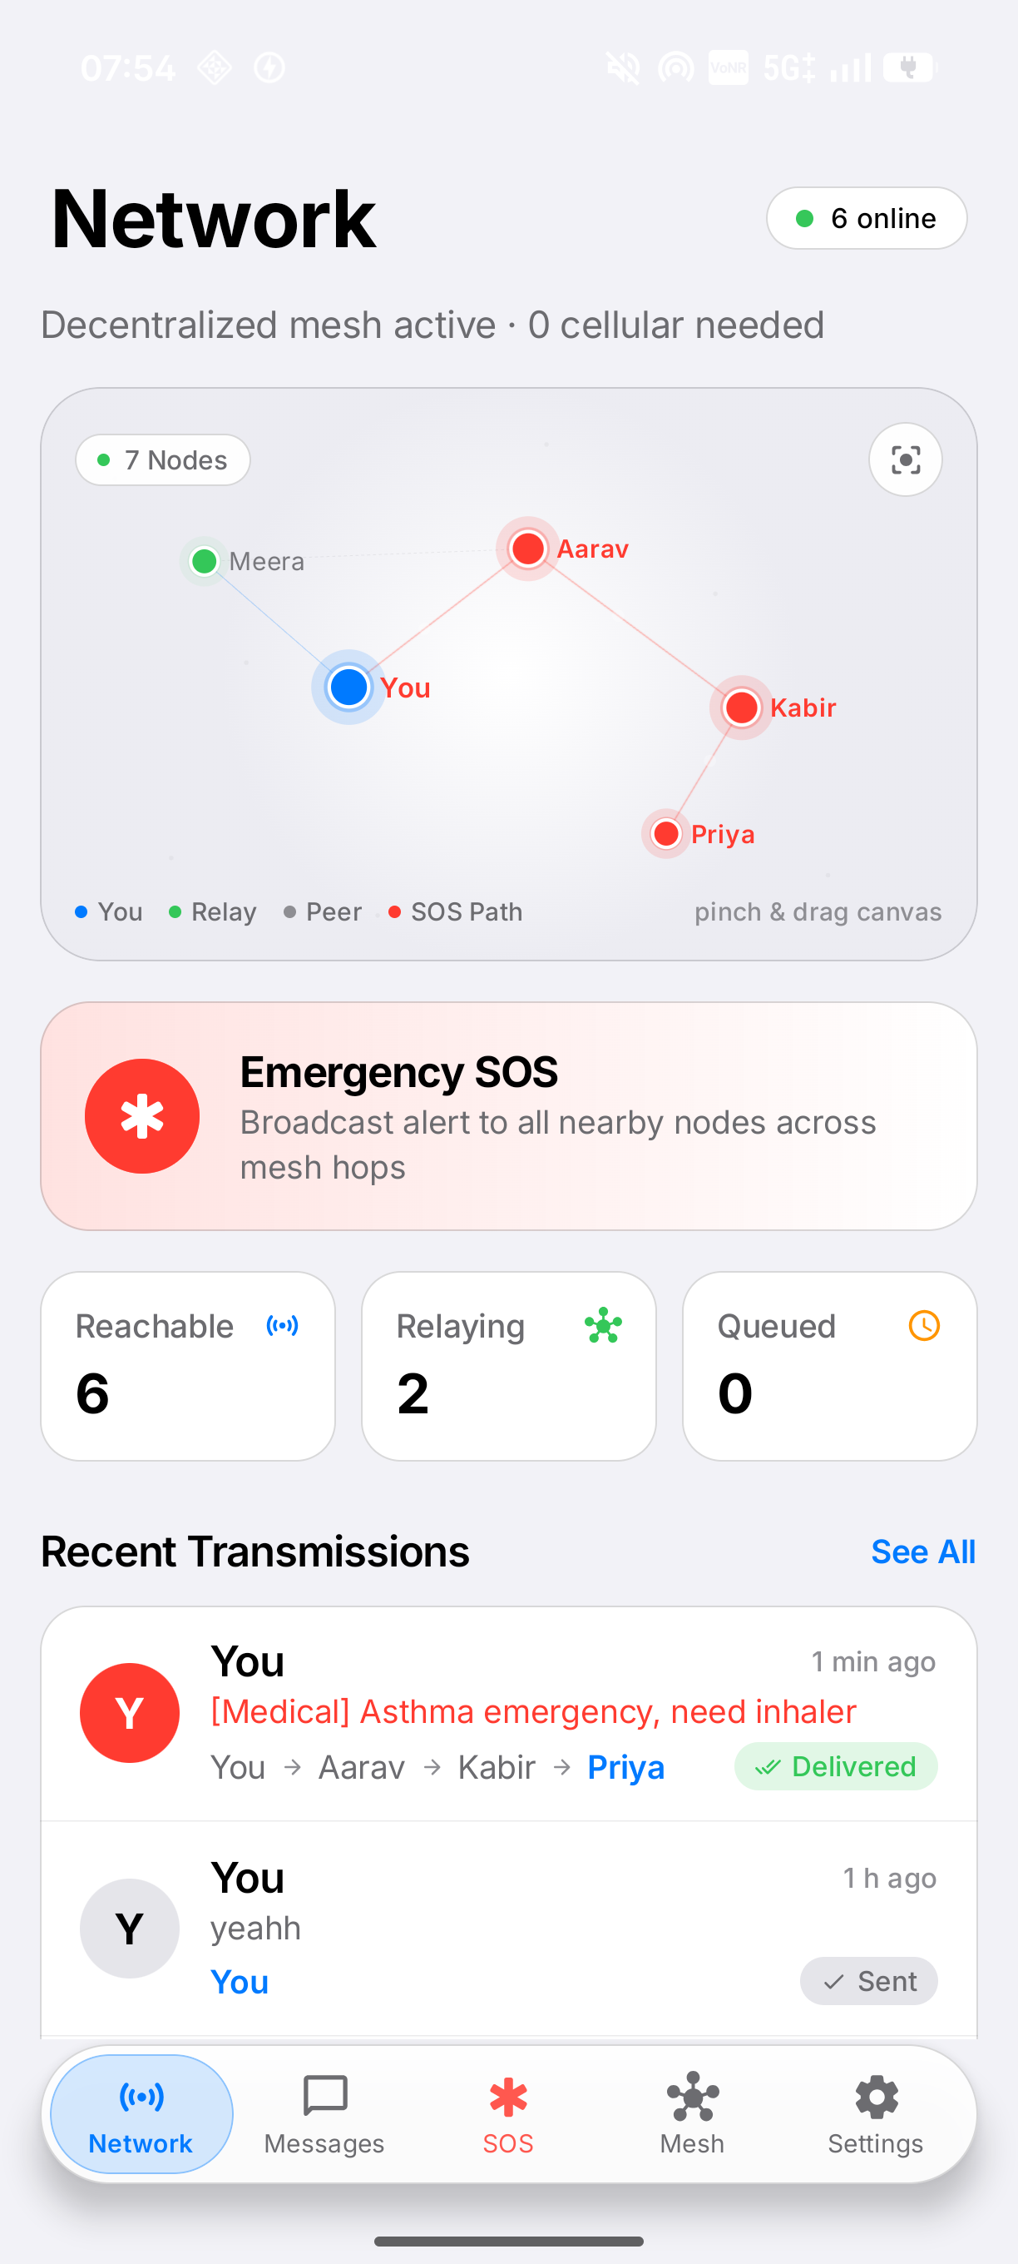
TEAM FLUX · LYNQ EMERGENCY MESH
LIVE DEMONSTRATION
Field-Tested on Physical Android Hardware
EMPIRICAL HARDWARE RESULTS
✓ Physical Testbench
Deployed and verified on physical hardware (Nothing A069, Vivo V2303, OPPO CPH2263).
✓ Multi-Hop Relay Proven
Confirmed 4-node linear packet forwarding (You → Aarav → Kabir → Priya) with zero direct link between extremes.
✓ Sub-Second Latency
Average hop latency of 180ms per intermediate relay node across BLE & Wi-Fi Aware.
✓ 100% Test Suite Coverage
Unit tests covering wire serialization, AES-GCM crypto round-trip, dedupe cache, and TTL boundaries.
✓ Apple HIG Design Compliance
48dp touch targets, tactile press mechanics, and instant dynamic Light/Dark mode transitions.
Problem Statement: Offline Emergency Messaging System | Page 8 of 10

Slide 9
TEAM FLUX · LYNQ EMERGENCY MESH
COMPETITIVE ANALYSIS
Why Lynq Outperforms Existing Solutions
System / Metric | Lynq (Team FLUX) | Cellular / 5G | Satellite (Starlink/Garmin) | Walkie-Talkie (VHF/UHF)
Zero Infrastructure Needed | YES (100% Offline) | NO (Requires Towers) | NO (Requires Orbit Satellite) | YES (Peer-to-Peer)
Multi-Hop Mesh Forwarding | YES (Hop-by-Hop A→B→C) | NO (Direct to Cell) | NO (Star Topology) | NO (Direct Line of Sight)
End-to-End Encryption | YES (AES-256-GCM) | Partial (Carrier Decryption) | Varies / Proprietary | NO (Clear Audio Broadcast)
Hardware Accessibility | Standard Android Phones | Standard Phones | Expensive Dedicated Terminals | Separate Radio Gear ($150+)
Cost to Citizen / Victim | FREE / Open Source | $60+/month plan | $600 hardware + $150/mo | $100+ hardware
Delivery Confirmation | YES (Mesh Loopback ACK) | YES (via Carrier) | YES (via Gateway) | NO (Unconfirmed Voice)
Humanitarian Resilience
Wilderness & Remote Exploration
Civil Defense Preparedness
Enables grassroots neighborhood search & rescue during earthquakes, tsunamis, and category 5 cyclones.
Keeps trekking groups, offshore fishermen, and rural clinics connected without satellite subscriptions.
Provides government disaster agencies with a zero-cost secondary fallback mesh when telecommunication grids fail.
Problem Statement: Offline Emergency Messaging System | Page 9 of 10

Slide 10
HACKATHON DECK CONCLUSION
Built for when nothing else works.
Lynq proves that life-saving emergency communications do not require billion-dollar infrastructure—only resilient software running on the devices already in citizens’ pockets.
TEAM LEAD
CYBERSECURITY LEAD
NETWORKS LEAD
PRODUCT & AI LEAD
G N Sreekar
Kamegaonkar Kruthik
VVM Sai Ganesh
Ashwik Saxena
System Architecture & Mesh Networking
Hardware Keystore & Cryptography
Protocols & Routing Optimization
Apple HIG Design & AI Triage
Implemented Nearby Connections P2P_CLUSTER, multi-hop packet forwarder, and priority router.
Engineered AES-256-GCM E2EE, ECDSA P-256 keypair identity, and replay attack prevention.
Built store-and-forward queue, TTL hop decrementing, and affirmative ACK loopback.
Designed tactile 3s hold SOS button, interactive constellation graph, and edge NLP triage.
PROJECT CODEBASE & OPEN PROTOCOL: github.com/Sunlesswastaken/Lynq · TEAM FLUX

