Slide 1


Fishing Out Phishing Websites
AI Academy Capstone | Sunmisola Ogundairo

Slide 2
Agenda
1
Project Motivation
2
Data Understanding
3
Modelling Approach
4
Model Evaluation and Recommendation
5
Proposed Improvements/Expansion

Slide 3
Project Motivation
Business problem and project goal
“
Online shoppers lose money, time, and personal identifiable information to malicious websites because they are often unable to differentiate between a legitimate website and a phishing site.
This project builds a model that classifies websites as legitimate or as phishing websites.
The final machine learning model can differentiate between a legitimate website from its phishing counterpart about 90% of the time.
”

Slide 4
Modelling Approach
Overview of machine learning models used
Introduction
Problem Statement
Classification Problem
Using labeled data to predict outcomes
Using the phishing data, can we predict which website is a phishing or legitimate?
Model I
Model II
Model III
Model IV
Logistic Regression
Decision Trees
Random Forest
XGBoost
Binary prediction using mathematics to find relationship between two data factors
Makes predictions based on a previous set of established (and all-inclusive) patterns of outcomes
Also makes its prediction based on learned patterns by combining multiple decision trees to reach a single conclusion
Uses sequentially built shallow decision trees to provide flexible training methods that avoids overfitting

Slide 5
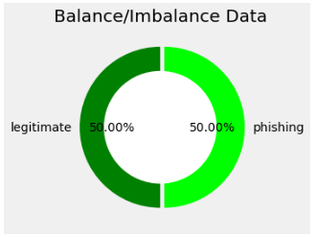

Data Understanding
Data source and description
Data Description Contains data of 11430 URLs from both phishing and legitimate websites Data came with 89 columns extracted from the websites page content, structure and URL syntax The dataset is balanced, i.e., it contains 50% phishing and 50% legitimate URLs

Slide 6
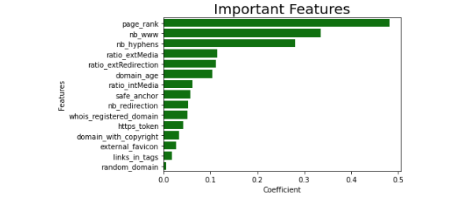
Data Understanding
Features that influence website legitimacy
Using lasso regularization as the feature selection methodology, the dataset features was filtered from the initial 87 to 15 that contributed the most to this desired target
The graph above shows how much each feature contributes to detecting if a website is a legitimate or a phishing website based on features with coefficients higher than the mean coefficient of all 89 features
Notes:
Important features

Slide 7
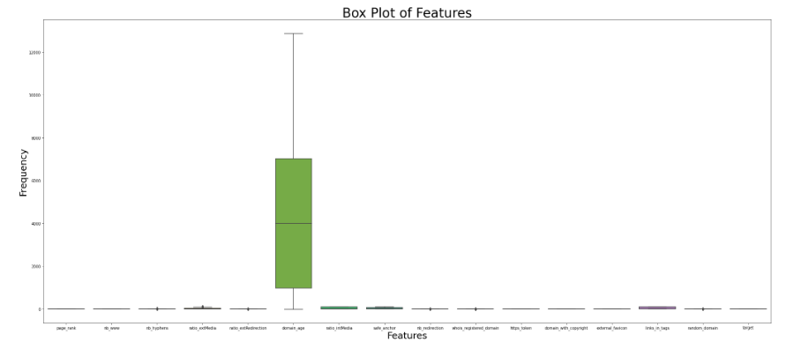
Data Understanding
Features selection for modelling
Exploratory data analysis is used to dive deeper and select the final features to be used for modelling
Assessing variability using the box plot, domain age is removed from the list of features due to high variance compared to other features
Furthermore, random domain is also removed due to little contribution to the model
This leaves the model with 13 total features that contributes well to the target and has comparable amount of variance so that there is no one feature that might cause the model to not generalize well on unseen data

Slide 8
Model Evaluation and Recommendation
4.
XGBoost
3.
Random Forest
2.
Decision Tree
Best Performing Model
Accuracy: 91%
Precision : 91%
1.
Logistic Regression
Accuracy: 88%
Precision : 88%
Accuracy: 86%
Precision : 85%
Baseline Model
Accuracy: 83%
Precision: 82%
Interpretation
Accuracy measures how much the ML model was correct in classifying websites overall
Precision measures how well the ML model predicted legitimate websites from all the predictions classified as legitimate

Slide 9
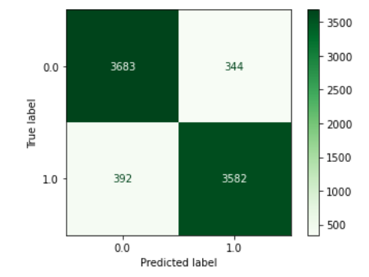
Model Evaluation and Recommendation
XGBoost—Evaluation Deep Dive
Based on the data and methodologies adopted, the XGBoost ML model had the best evaluation metric and as such should be used to detect phishing websites.
Among all the URL predicted as legitimate websites, 91% of them are truly legitimate.

Slide 10
Proposed Improvements/Expansion
01
Email Phishing
02
Scam Text
03
Shortened URL
Other ways to expand the project to detect phishing
04
Browser Embedded
05
Increased Data
06
Actionable Detection

Slide 11
Questions

Slide 12
Data Understanding
More details on data source
Data Source Data was downloaded from Kaggle, an online platform for data scientists Kaggle sourced the dataset originally from Engineering Application of Artificial Intelligence, an academic journal Dataset was constructed in May 2020 The data used for this project is from the latest dataset publication in July 2021
Data Description Contains data of 11430 URLs from both phishing and legitimate websites Data came with 87 columns extracted from the websites page content, structure and URL syntax The dataset is balanced, i.e., it contains 50% phishing and 50% legitimate URLs Some of the features in the dataset include domain age, WHOIS registered domain, page rank, ratio internal /external redirection, page rank (from open PageRank) among others

Slide 13
Features Selected
Features and their definition
Final features include;
Page_rank: How search engines ranks a particular website when browsed on the internet
Nb_www: Number of "www" in the URL or URL is missing "www"
Nb_hyphens: Number of hyphens in the URL
Ratio_extMedia: ratio of external media file links
Ratio_ExtRedirection: Ratio of external redirection
Ratio_intMedia: Ratio of internal media file links
Safe_anchor: Presence of ‘#’, ‘JavaScript’, or ‘mail to’ tags
Nb_redirection: Number of redirections before loading the website
Whois_registered_domain: Whether domain matches WHOIS database
Https_token: The use of https in URL
Domain_with_copyright: Presence or absence of copyright logo
External-favicon: Short for favorite icon, websites with external favicon are trying to mimic legitimate ones
Links_in_tags: Link tags that do not point to URL represents phishing

Slide 14
Work Consulted and Additional Resources
Dataset Journal
Data Source Kaggle
Lasso Regularization
Evaluation Metrics
Confusion Matrix

