Slide 2
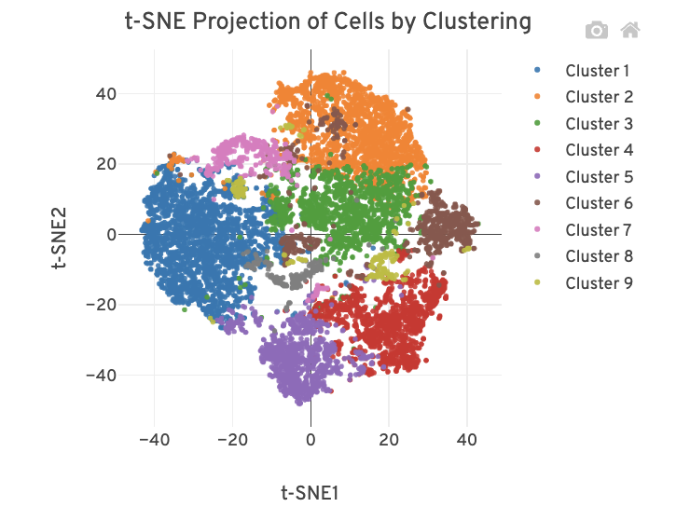
Direct Ligation in 25 vs 40
25 C
40 C
DNAJB1_c.558C>A_wt 1000
DNAJB1_c.558C>A_mt 622
KRAS_c.34G>T_wt 501
KRAS_c.34G>T_mt 69
TP63_c.1090G>A_wt 301
TP63_c.1090G>A_mt 84
FGFR1_c.719G>A_wt 1
FGFR1_c.719G>A_mt 69
PTPRC_c.2306T>A_wt 77
PTPRC_c.2306T>A_mt 4
DNAJB1_c.558C>A_wt 59652
DNAJB1_c.558C>A_mt 13479
KRAS_c.34G>T_wt 70694
KRAS_c.34G>T_mt 2706
TP63_c.1090G>A_wt 24380
TP63_c.1090G>A_mt 6410
FGFR1_c.719G>A_wt 30
FGFR1_c.719G>A_mt 20780
PTPRC_c.2306T>A_wt 6035
PTPRC_c.2306T>A_mt 683
Liming, Julia

Slide 3
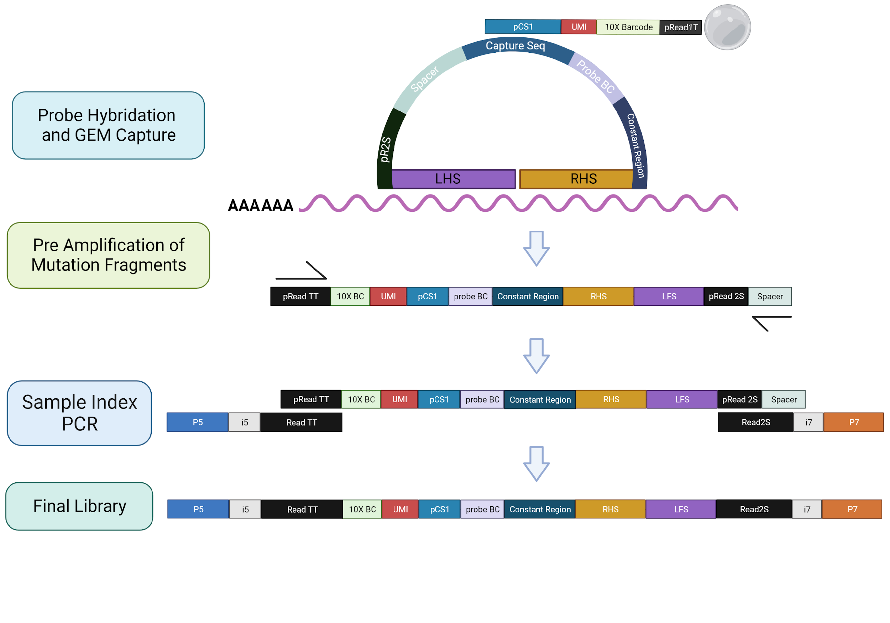
Gap Filing and Ligation to improve the mutation detection accuracy
Gap Fil
Single cell
DNAJB1_c.558C>A_wt 2448
DNAJB1_c.558C>A_mt 2
FGFR1_c.719G>A_wt 0
FGFR1_c.719G>A_mt 0
KRAS_c.34G>T_wt 3815
KRAS_c.34G>T_mt 3537
PTPRC_c.2306T>A_wt 0
PTPRC_c.2306T>A_mt 0
TP63_c.1090G>A_wt 0
TP63_c.1090G>A_mt 198
DNAJB1_c.558C>A_wt 257705
DNAJB1_c.558C>A_mt 6935
FGFR1_c.719G>A_mt 7460
FGFR1_c.719G>A_wt 1
KRAS_c.34G>T_mt 1988118
KRAS_c.34G>T_wt 177244
PTPRC_c.2306T>A_mt 0
PTPRC_c.2306T>A_wt 0
TP63_c.1090G>A_mt 137087
TP63_c.1090G>A_wt 305828
Hyb Mutaiton Probe with Gap
RT with ddNTP
Blocker removal
Ligation
Hyb 10x GEX probes
10x droplet generation
Lib construction for GEX and Mutation
Sequencing and call mutations
Liming, Julia

