Slide 1
Cup2
Computer Vision Final Project
Participate: SunnerLi, Tim Yang, Kevin Hsiao
Date: 2017/06/16

Slide 2
Acquirement
Get the edge of object
Draw the bounding box
Classify the type of object

Slide 3
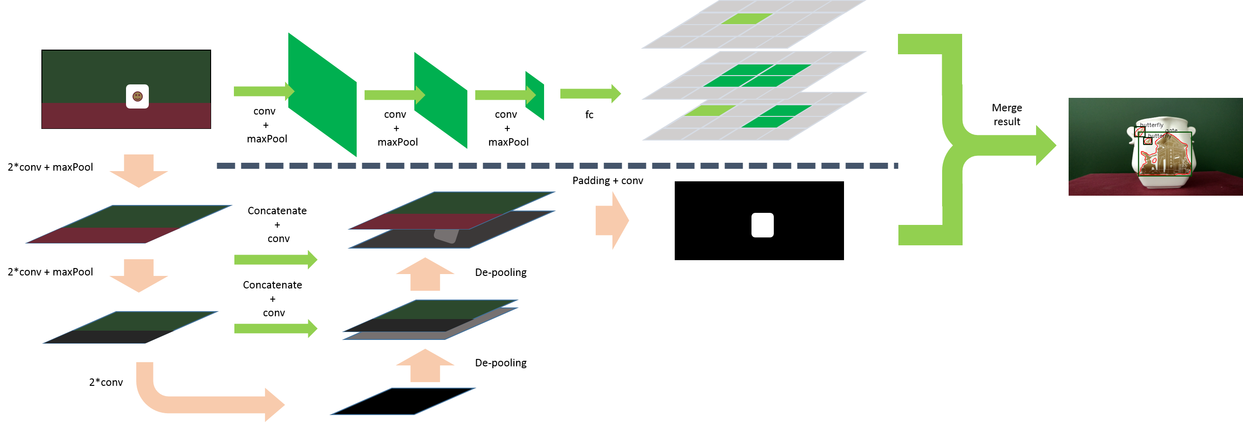
Idea

Slide 4
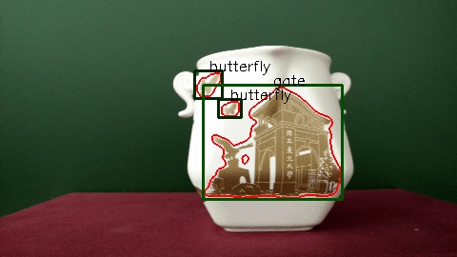
Result

