Slide 1
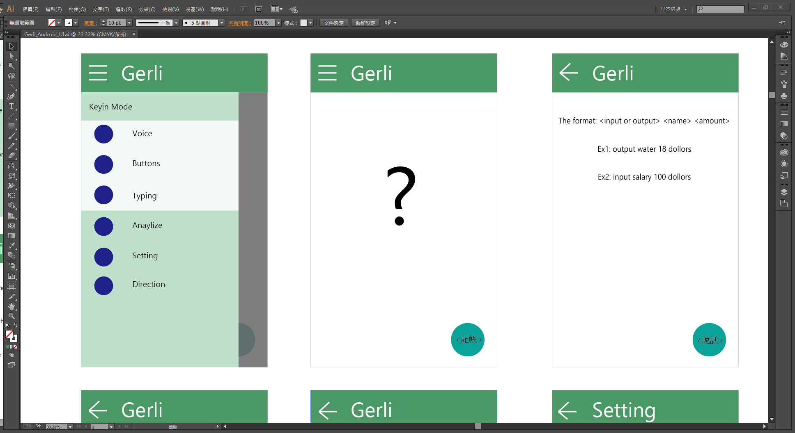
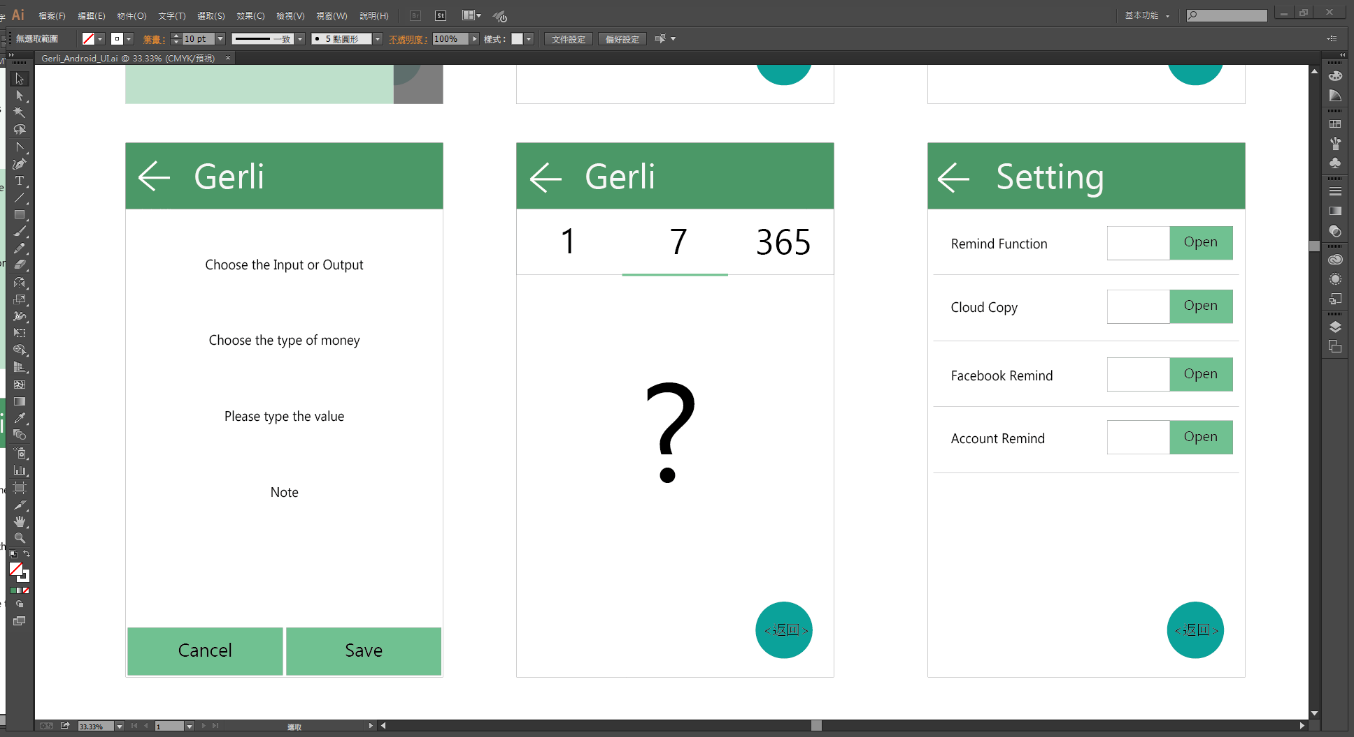
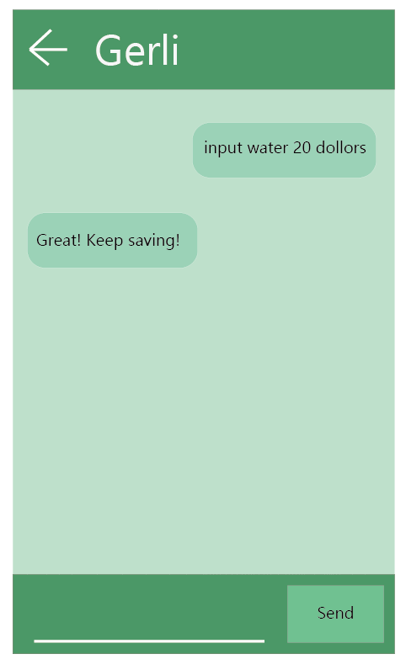
Start
Open the STT function
Slide right
Get the string of the speech
MoneyHandler work
Check the input method
voice
buttons
typing
Generate the row object
Get the previous setting
MoneyHandler work
Show the corresponding widget
MoneyHandler work
input
MoneyHandler
Check the input type
Parsing the string
string
Get the row object
If the row object is invalid
Row object
Valid row object
Invalid row object
Save into SQLite
Invalid input
If open the remind function
Voice remind
If open the cloud copy
Upload to cloud platform
If open the FB remind
Post a article

