Slide 1
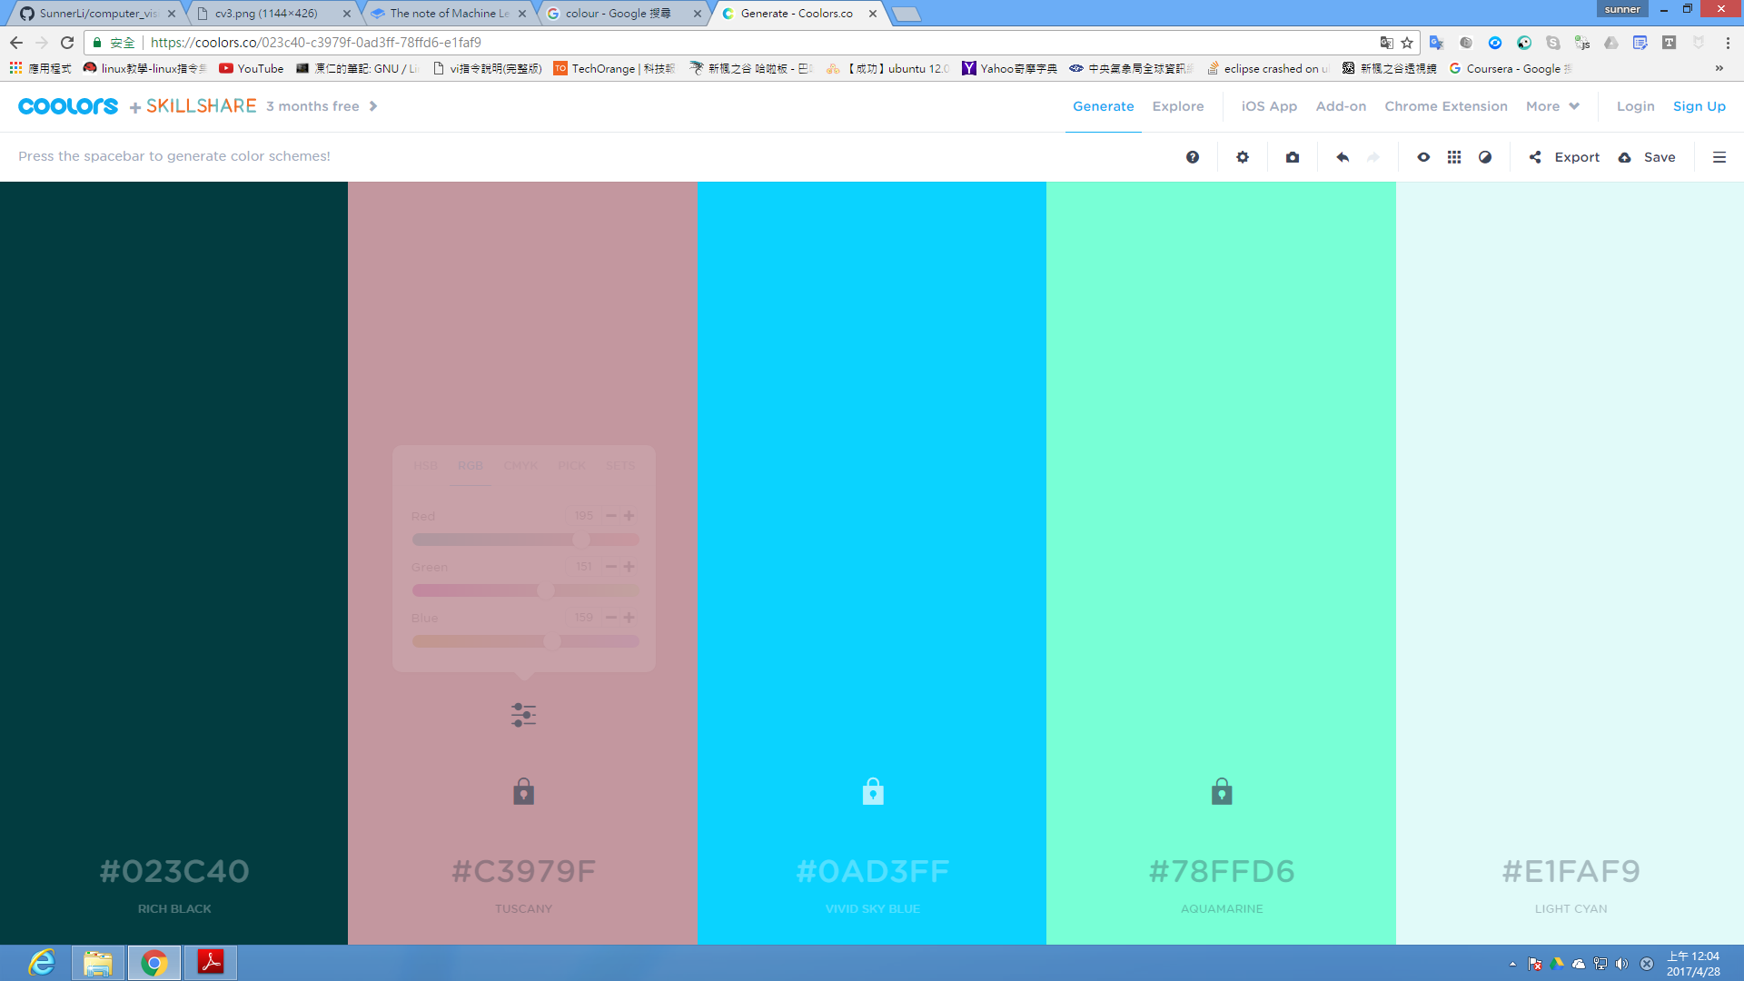
The Computer Vision Mid-term Demo
Template matching corner detection
Name: SunnerLi ID: 410285045 Date: April 27, 2017

Slide 2
Outline
Basic template matching
FAST algorithm
Result
CNN based

Slide 3
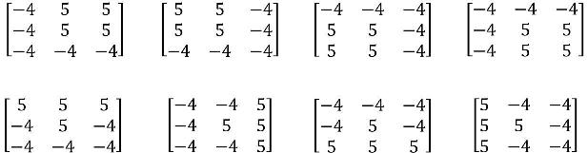
Template Matching Corner Detection

Slide 4
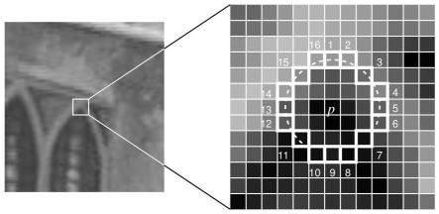
Features from Accelerated Segment Test

Slide 5
CNN Structure
conv1
relu1
pool
drop
conv1
relu1
fc

Slide 6
Result
Time
Performance

Slide 7
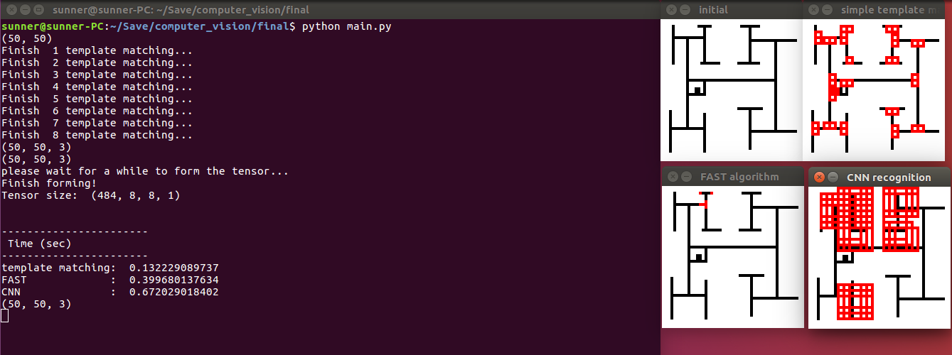
Image with single width and rigid corner

Slide 8
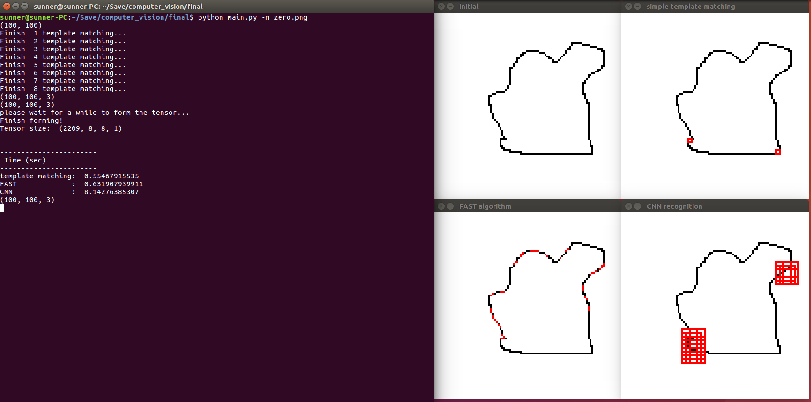
Image with single width and various corner

Slide 9
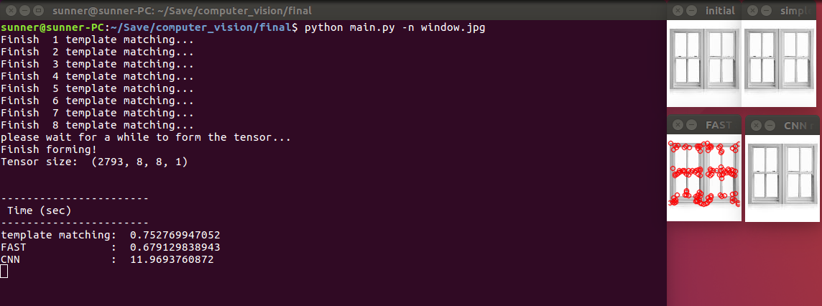
Natural Image

Slide 10
Demo

