Slide 1
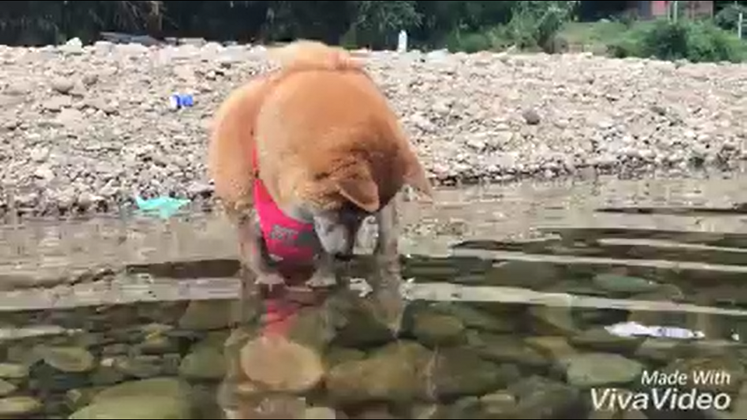
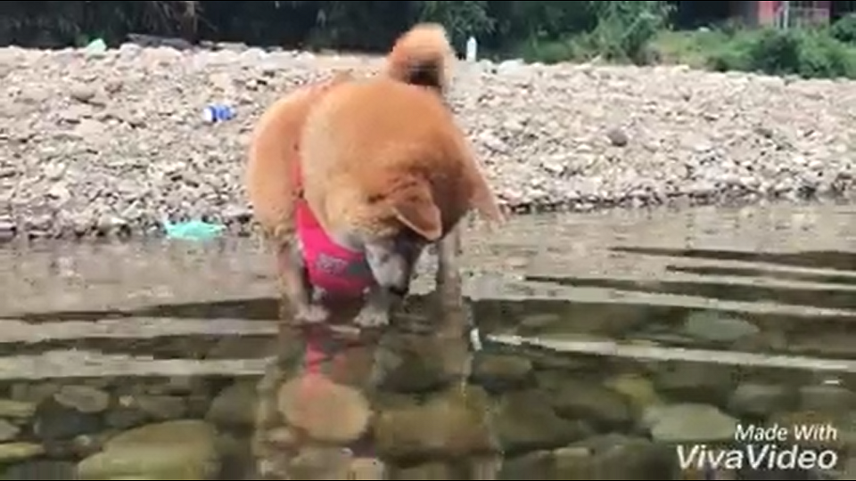
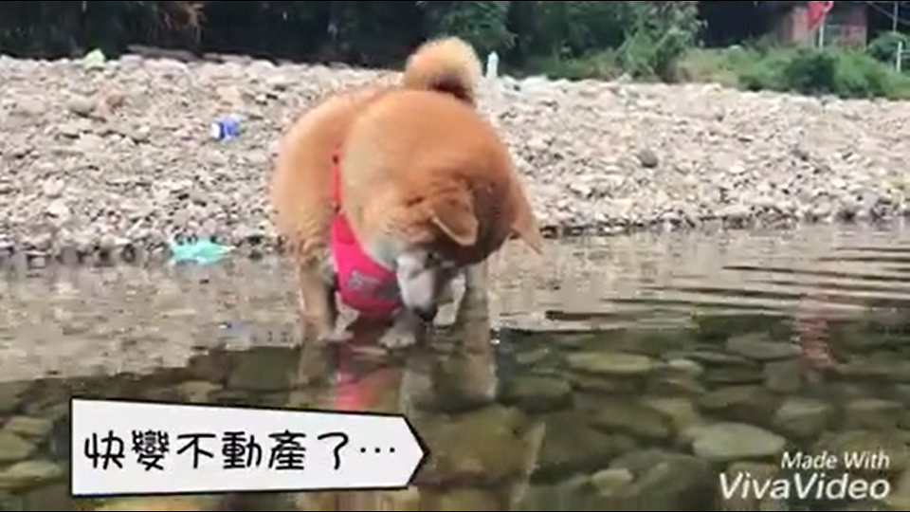
1. Train the residual encoder-decoder (RED) to obtain the render capability
Inverse
Discriminator
2. Fix the variable, and render the detail
toward the corresponding input frame
Current true frame
True? False?
Current frame with render mask
Current completed frame
3. Train the D2GAN-like structure
with RED hint concatenated
Current true frame
True? False?
Generator
Discriminator
4. Looping deal with the image
with random mask
Complete testing frame

