Slide 1

@Li Zhuoxuan, Sunneverset

Slide 2
Content
What
Why
How

Slide 3
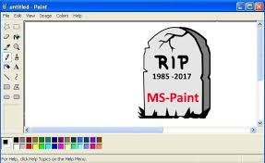
What is SVG
SVG is a markup language for describing two-dimensional graphics applications and images, and a set of related graphics script interfaces.
SVG是一种基于XML的图像格式。SVG支持的对象包括矢量显示对象，嵌入式外部图像及文字对象，并可通过ECMAScript实现动态及交互功能。
For more: https://www.w3.org/Graphics/SVG/

Slide 4
Why
Open source standard
Scalable
File Size
Support by many mature tools
Search Engine Optimization
…
https://www.sitepoint.com/9-reasons-why-svgs-are-important-for-the-web/

Slide 5
Concerns
SVG is supported by all modern browsers for desktops and mobiles.
(But still, what you see may different from others..
Some features, such as SMIL animation and SVG Fonts are not as widely supported.
(well, for some browsers..
There are many SVG authoring tools, and export to SVG is supported by all major vector graphics authoring tools.
(Like Sketch or Adobe family

Slide 6
Examples..
waysToIncludeSVG.html
examples.html

Slide 7

Thank You

