Slide 1
MediGemm – AI Diagnosis
Sunnidhya Roy Samarpita Bhaumik

Slide 2

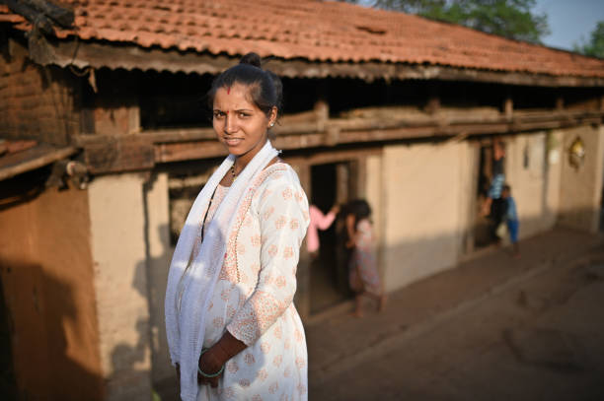

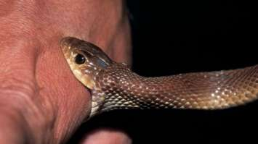
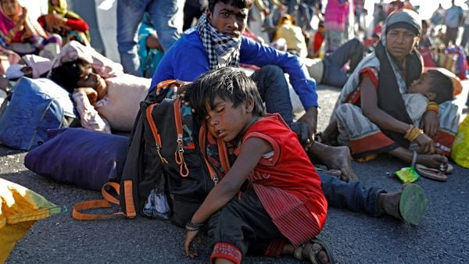
THE CHALLENGE
Limited medical access in remote areas
No internet; distant healthcare centers
Common issues often neglected
High rate of preventable deaths

Slide 3
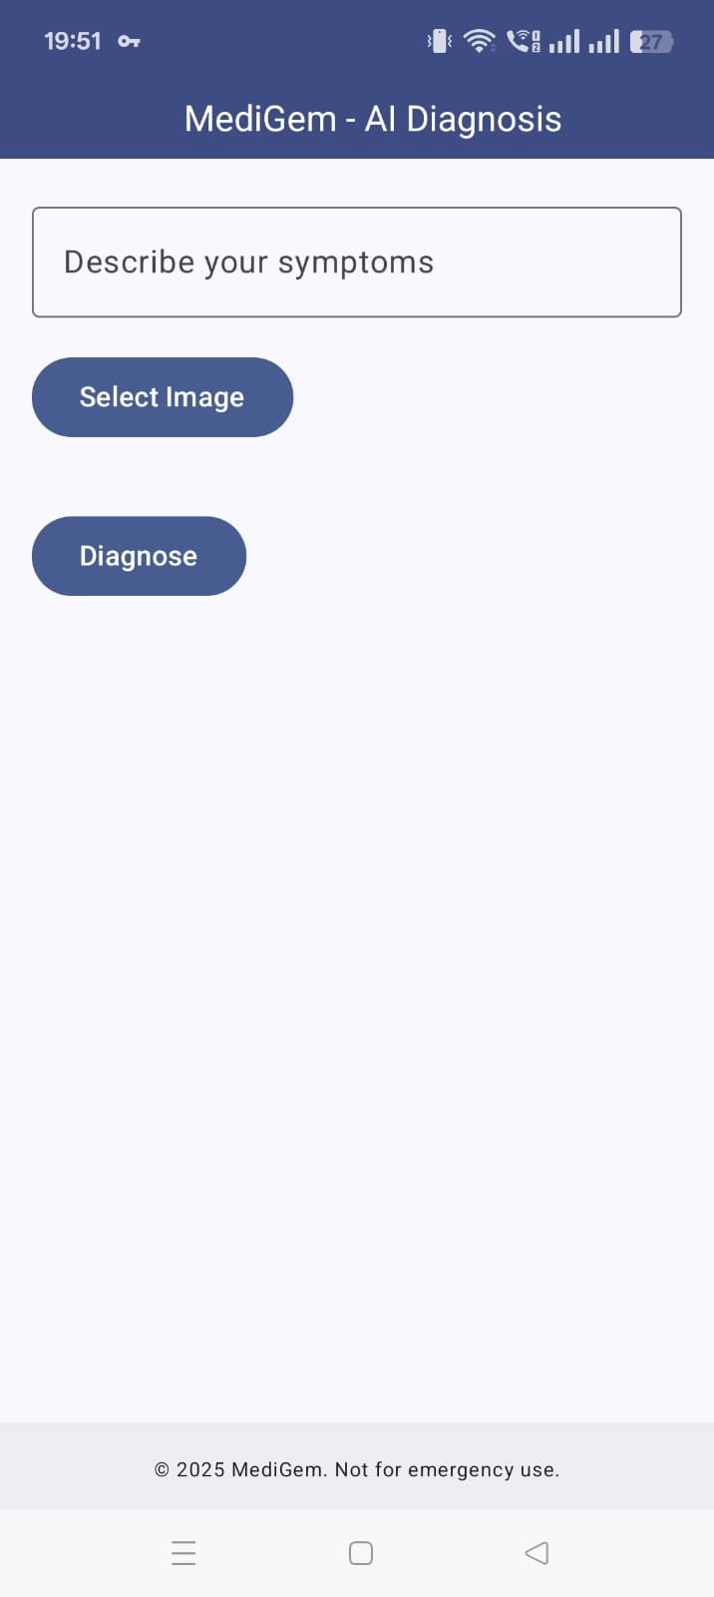

Solutions

Slide 4



Future Scope
Ongoing improvements
Faster response time
Support older Android versions
Better CPU efficiency
Wider device compatibility

Slide 5
Thank You

