Slide 1


INFORMATION SECURITY & Cybersecurity
:
What is the Difference?

Slide 2


INFORMATION SECURITY
VS.
CYBERSECURITY
10
Notes:
In today’s interconnected world, the protection of information has become a critical priority. However, terms like Information Security and Cybersecurity are often used interchangeably, leading to confusion

Slide 3

WHAT IS INFORMATION Security
A set of practices and protocols and technologies used to protect sensitive information from unauthorized access, use, disclosure, disruption, modification, or destruction
06

Slide 4

Importance ?
To prevent misuse of data.
To ensure business continuity and trust.
INFOSEC
Protected information may take any form, such as :
electronic or physical
tangible or intangible
05

Slide 5
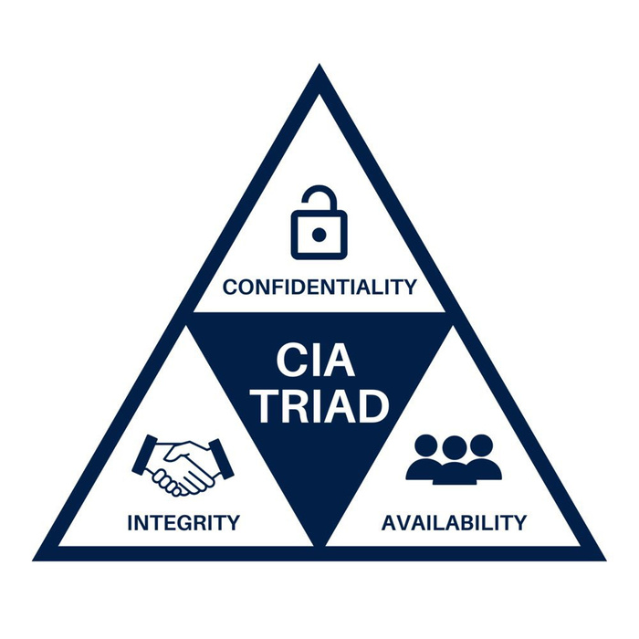
INFOSEC FUNDAMENTALS
07

Slide 6
INFOSEC FUNDAMENTALS
Protection of data against unauthorized access (cryptography, passwords)
07

Slide 7
INFOSEC FUNDAMENTALS
Maintaining Accurency, making sure that data is not tampered with
07

Slide 8
INFOSEC FUNDAMENTALS
Constant accessibility for authorized users
07

Slide 9

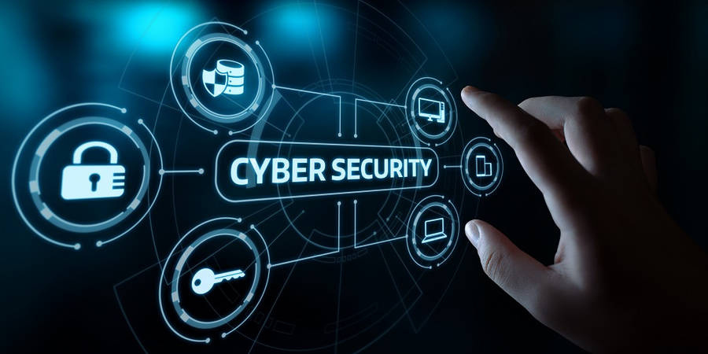
WHAT IS CYBERSECURITY?
02

Slide 10
WHAT IS CYBERSECURITY?
Cybersecurity refers to the practices and measures taken to protect computer systems, networks, and sensitive information from unauthorized access, use, disclosure, disruption, modification, or destruction
02

Slide 11
TARGETS OF CYBERSECURITY THREATS INCLUDE
04

Slide 12
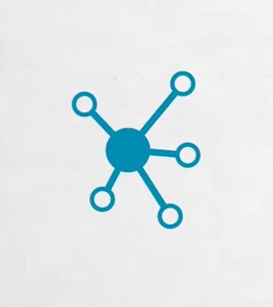
Networks
04

Slide 13

Devices
04

Slide 14

Applications
04

Slide 15
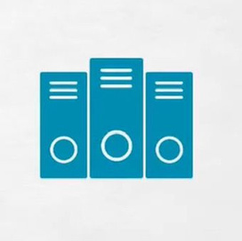
04
Data centers

Slide 16
TARGETS OF CYBERSECURITY THREATS INCLUDE
04

Slide 17
COMMON TYPES OF CYBER THREATS
04

Slide 18
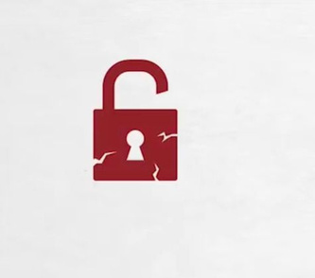
Data breaches
04

Slide 19

Identity theft
04

Slide 20
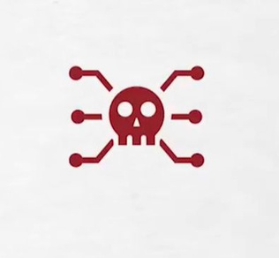
Malware
04

Slide 21
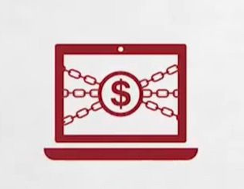
Ransomware
04

Slide 22

Phishing attacks
04

Slide 23

Social engineering
04

Slide 24
COMMON TYPES OF CYBER THREATS
04

Slide 25
SPECIALIZED AREAS OF CYBERSECURITY
04

Slide 26

Application security
04

Slide 27
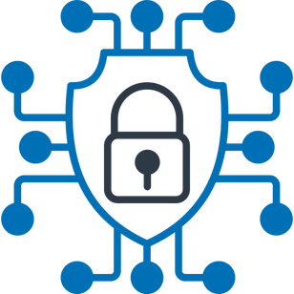
Network security
04

Slide 28

Cloud security
04

Slide 29
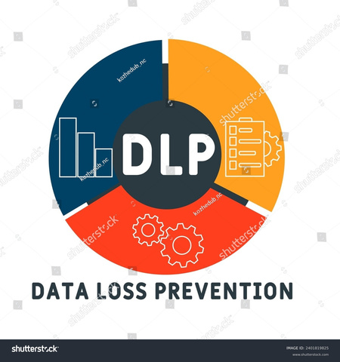
Data loss prevention (DLP)
04

Slide 30
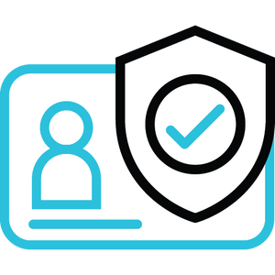
Identity and Access Management (IAM)
04

Slide 31

Mobile and endpoint security
04

Slide 32
SPECIALIZED AREAS OF CYBERSECURITY
04

Slide 33
THREE KEY COMPONENTS OF CYBERSECURITY
04

Slide 34

People
End-users: Understand best practices, data backup, training.
Professionals: Roles include CISO, engineers, architects, analysts.
04

Slide 35
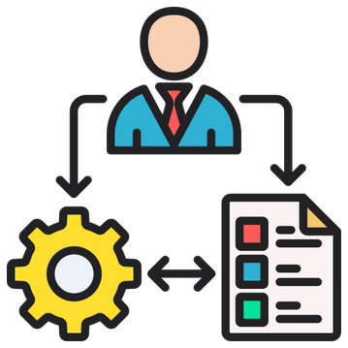
Processes
Business Continuity & Disaster Recovery frameworks.
Policies: Password rules, mandatory updates.
04

Slide 36

Technology
Tools: Firewalls, anti-malware, DNS filters, intrusion detection.
04

Slide 37
THREE KEY COMPONENTS OF CYBERSECURITY
04

Slide 38

BRIDGING THE GAP BETWEEN INFOSEC AND CYBERSECURITY
09

Slide 39
CONCLUSION
10

Slide 40
THANK YOU FOR YOUR ATTENTION
10

