Slide 1

Blackhawks IoT Project
What we’ve been up to

Slide 2
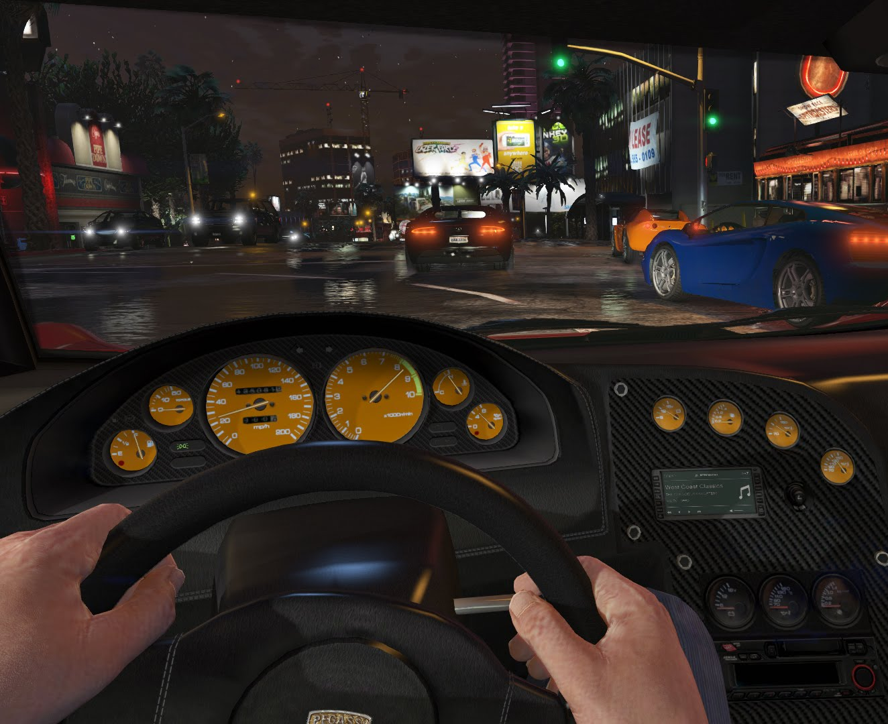
The assignment
Create abstractions using sensor data
Abstract measures
Notes:
Driving Experience, Safety enforcement, Intelligent Cruise Control, Comfort Management, etc.

Slide 3
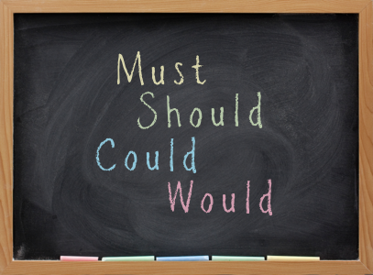

Step 1: Finding our requirements
Find requirements
Functional
Non functional
Actors
Prioritize
Use cases
Notes:
Trace those requirements to use cases. When prioritizing we analyzed them in the basis of what is a must have, should have, could have, and want to have.

Slide 4
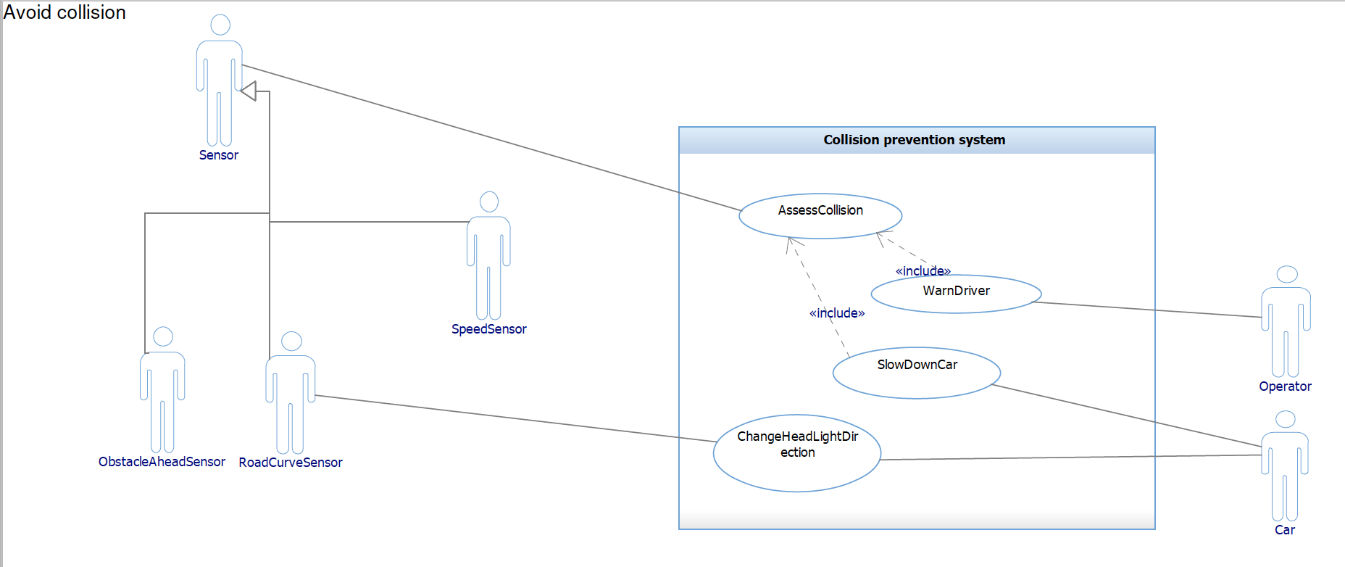
Use case example

Slide 5
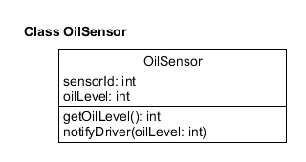
Step 2: Analysis
Capture desired system behavior –hard
Go from what to how
Capture the essential
NoiseSensors
Temperature
Radio
Considered inheritance
Minimize coupling
Notes:
Hard because we have been given a set of disparate data and we are required to make sense of it.
Used ch. 6 as guideline:
Considered inheritance for Person class (passenger, driver)
Mention that we are currently trying to minimize coupling

Slide 6
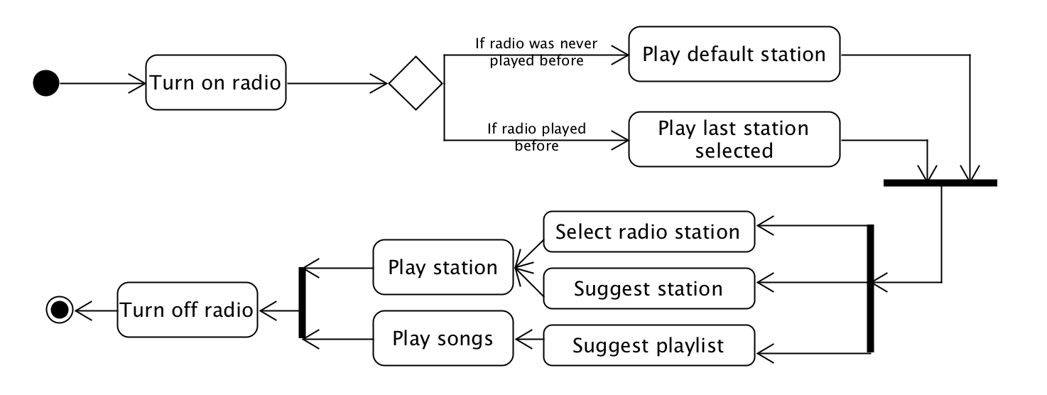
Activity diagrams
Notes:
Helped our understanding of the system and identify classes because they help us better understand how the system should behave.

Slide 7
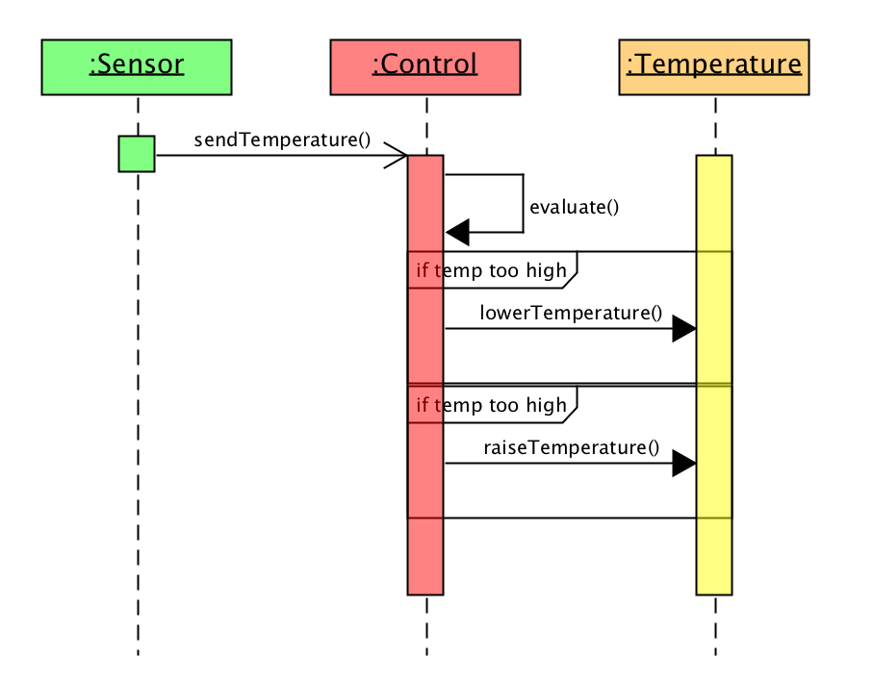
Use case realization
Sequence diagrams
Interaction between our classes
Help eliminate redundancies
Identify inheritance possibility
Identify interfaces
Abstract classes

