Slide 1
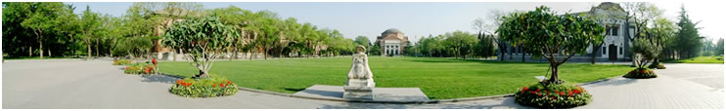
ρ-Approximation DBSCAN

Slide 2
1、 DBSCAN algorithm
Algorithm 1 DBSCAN(D, ε, minPts）
———————————————————————————————
1: {D is a set of unclassified points}
2: {ε is the maximum distance}
3: {minPts is the minimum points to form a cluster}
4: Initialize cluster id C = 0
5: for each unclassified point p ∈ D do
6: Nε(p) = RangeQuery(p, ε)
7: if |Nε(p)| ≥ minPts then
8: Set p’s cluster id to C
9: ExpandCluster(p,Nε(p), C, ε, minPts)
10: C ← C + 1
11: else
12: Label p as noise

Slide 3
1、 DBSCAN algorithm
Algorithm 2 ExpandCluster(p,NeighborPts,C, ε, minPts)
———————————————————————————————
1: for each point q ∈ NeighborPts do
2: if q is unclassified then
3: Nε(q) = RangeQuery(q, ε)
4: if |Nε(p)| ≥ minPts then
5: NeighborPts = NeighborPts ∪Nε(q)
6: if q does not belong to any cluster then
7: Set q’s cluster id to C
Regardless of ε and minPts, the algorithm actually runs in O(n²)worst case time, not O(nlogn).^{[1]}
A new 2D algorithm truly runs in O(nlogn)——gridDBSCAN
[1] Junhao Gan and Yufei Tao. Dbscan revisited: mis-claim, un-fixability, and approximation. In SIGMOD,2015

Slide 4
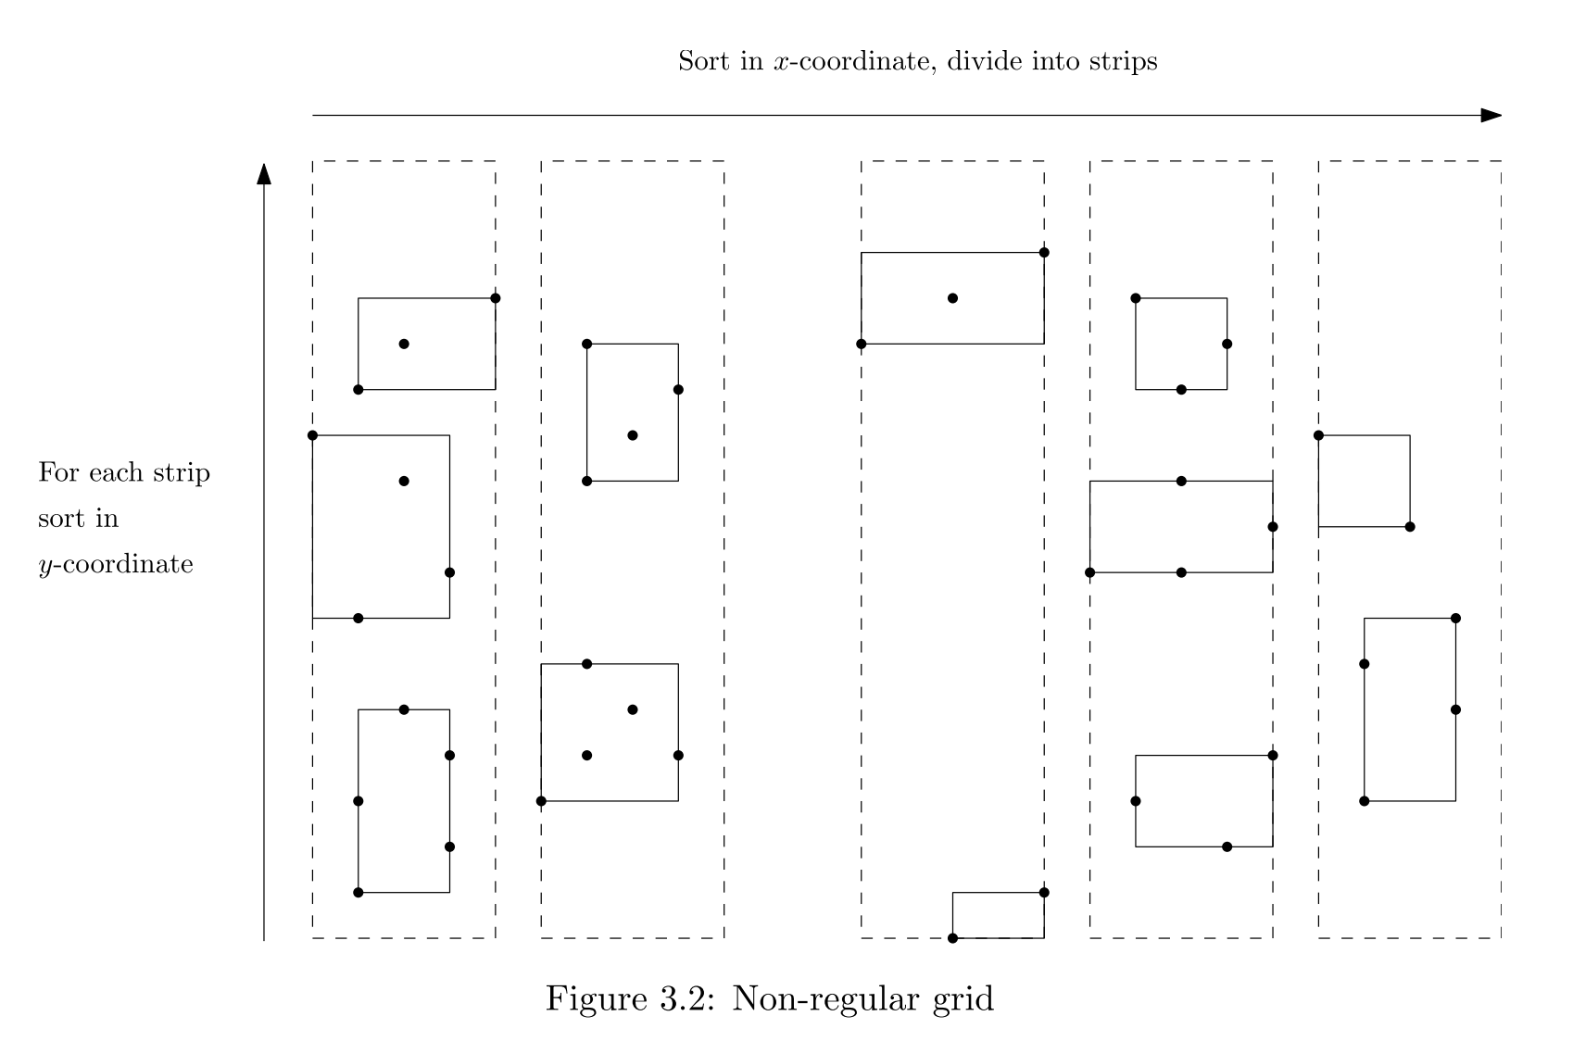
2、 2d-GridDBSCAN ^{[2]}
Step 1: Sorting based Partitioning
[1]Gunawan, A. A faster algorithm for DBSCAN. Master’s thesis

Slide 5
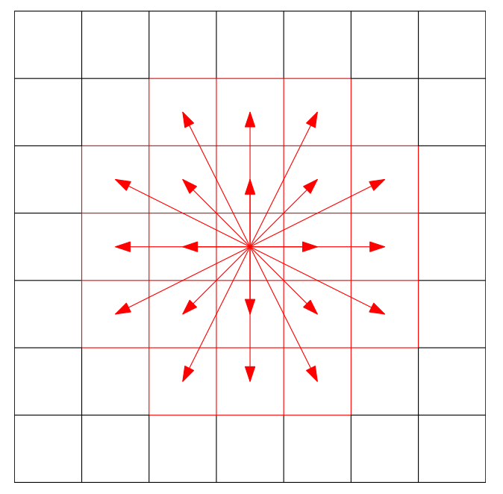
2、 2d-GridDBSCAN
Step 2: Determining Core points
traverse each cells，if |cells| >minPts, mark all points core points.
else search neighbor cells

Slide 6
2、 2d-GridDBSCAN
Step 3: Merging clusters
Build Voronoi diagram, it only takes O(log n) to find the nearest point from a neighboring cell’s points
Total merging time is O(nlogn )
Step 4：Determining border points and noise
Total time is O(nlog n)

Slide 7
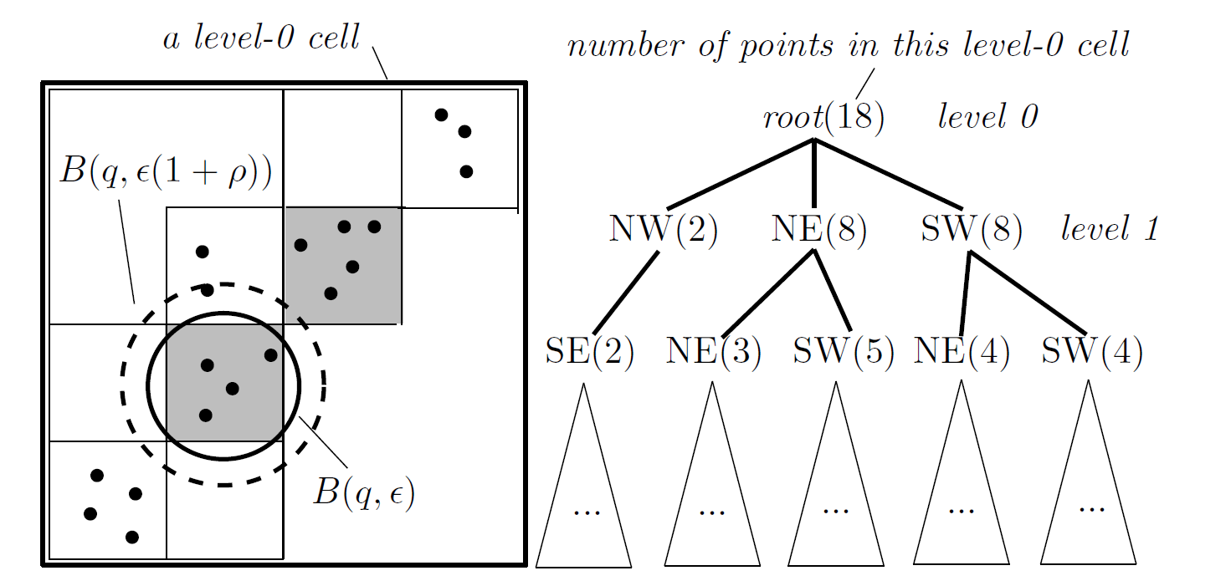
3、 ρ-Approximation DBSCAN
Query will cost lots of time(Ologn)→ how to decrease query time cost
GridDBSCAN precision is low→ how to improve the precision
Further Grid partition, quadtree-like hierarchical grid partitioning

Slide 8



3、 ρ-Approximation DBSCAN
How to divide Grid further？
Divide to single point→ high time cost
Consider both precision and partition → new parameter: ρ
ρ decides the length of side of of smallest Grid, and the maximum error
Conclusion: devide recursively until the smallest length of side $\frac{ε ρ}{\sqrt{d}}$.
$$ε ρ$$
$$\frac{ε ρ}{\sqrt{d}}$$

Slide 9
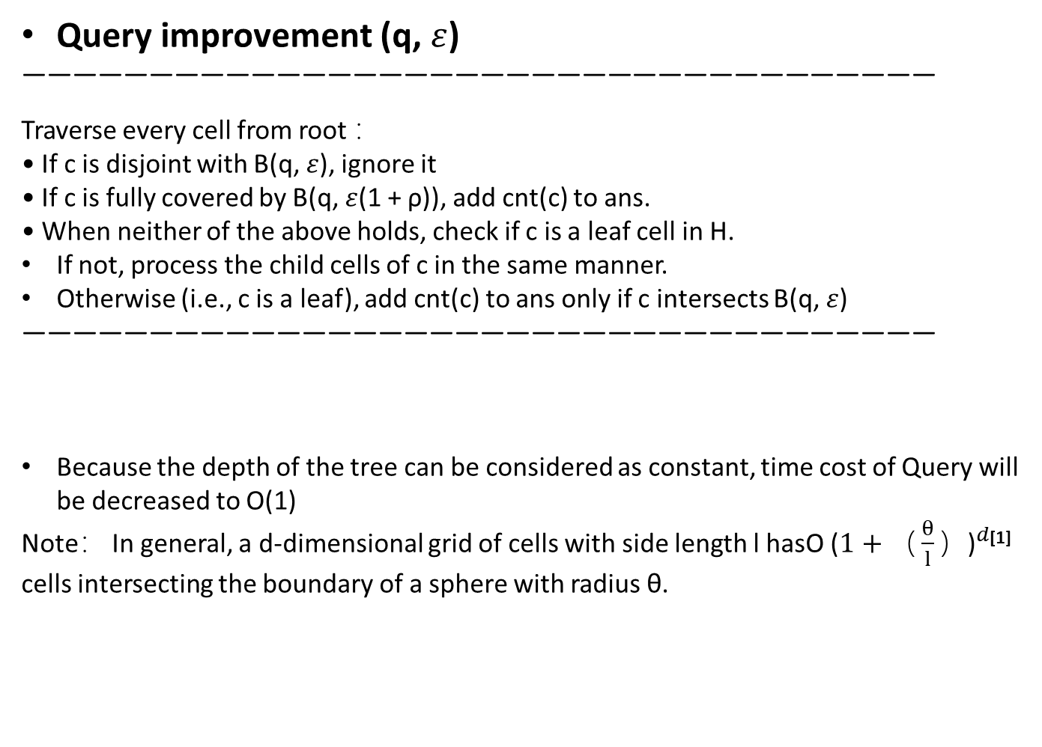
3、 ρ-Approximation DBSCAN
Query improvement (q, $ε$)
————————————————————————————————————
Traverse every cell from root ：
• If c is disjoint with B(q, $ε$), ignore it
• If c is fully covered by B(q, $ε$(1 + ρ)), add cnt(c) to ans.
• When neither of the above holds, check if c is a leaf cell in H.
If not, process the child cells of c in the same manner.
Otherwise (i.e., c is a leaf), add cnt(c) to ans only if c intersects B(q, $ε$)
————————————————————————————————————
Because the depth of the tree can be considered as constant, time cost of Query will be decreased to O(1)
Note： In general, a d-dimensional grid of cells with side length l hasO ($1+{（\frac{θ}{l}）\text{)}}^{d}$^{[1]} cells intersecting the boundary of a sphere with radius θ.
[1] Junhao Gan and Yufei Tao. Dbscan revisited: mis-claim, un-fixability, and approximation. In SIGMOD,2015

Slide 10
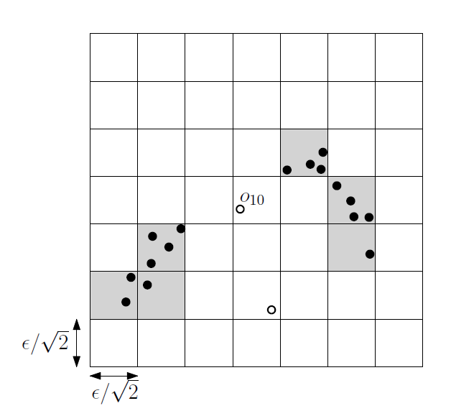
3、 ρ-Approximation DBSCAN
Solve ρ-approximation DBSCAN
For every points, do Query
Determine core points and core cells。
Construct edge: for every cell， Traverse all neighbor cell and construct edges.
Time cost O(n) because of fast Query operation.

Slide 11
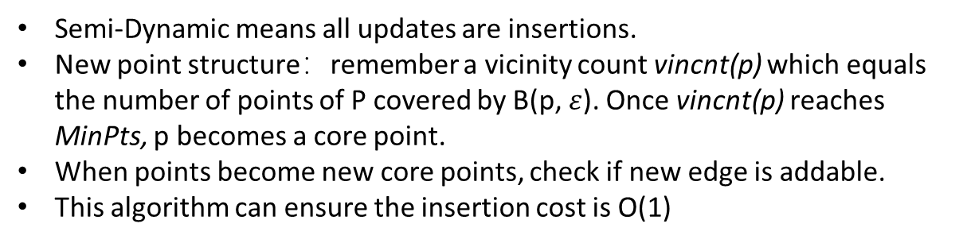
4、Semi-Dynamic Insert-only
Semi-Dynamic means all updates are insertions.
New point structure：remember a vicinity count vincnt(p) which equals the number of points of P covered by B(p, $ε$). Once vincnt(p) reaches MinPts, p becomes a core point.
When points become new core points, check if new edge is addable.
This algorithm can ensure the insertion cost is O(1)

Slide 12
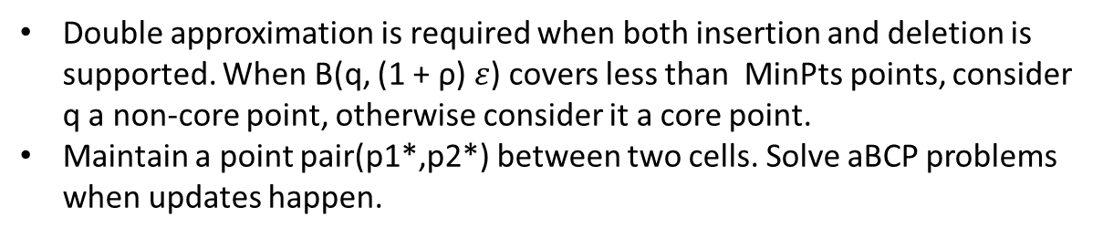
4、Fully-Dynamic Insert&Deletion
Double approximation is required when both insertion and deletion is supported. When B(q, (1 + ρ) $ε$) covers less than MinPts points, consider q a non-core point, otherwise consider it a core point.
Maintain a point pair(p1*,p2*) between two cells. Solve aBCP problems when updates happen.
————————————————————————————————————————
The most important imporvment of Approximation-DBSCAN algorithm is the new query method.

Slide 13
5、Experiment
To construct d-dimension Cells: Hashing.
my experiment:
2-D algorithm
Insert points and build GridCells level by level
Use new query method to determine core points
Build edges between GridCells.
Clustering : Assign cluster ID by DFS.
Determine noises.
Project:
https://github.com/Sunny-Island/DBSCAN_Insert

