Slide 1
Harnessing OCaml for
Parallel Programming
Implementation & Study Project:
Team Number 4:
Keshav Chandak (IMT2021003)
Sunny Kaushik (IMT2021007)
Rohit Shah (IMT2021027)

Slide 2
Domains in Multicore OCaml
In Ocaml-5, domains represent the fundamental units of parallelization. Each domain corresponds to an operating system thread and can execute computations concurrently.
Each domain has its own runtime state, which includes private memory areas - the minor heap and the major heap segments.
The Multi-Core OCaml runtime (version 5.0.0) employs a work-stealing scheduling algorithm to maximize CPU utilization and overall system throughput by distributing tasks across available CPU cores.
The Domain.spawn function is utilized to execute computations in parallel with the calling domain and Domain.join function is employed to synchronize the completion of the spawned domain’s execution.

Slide 3
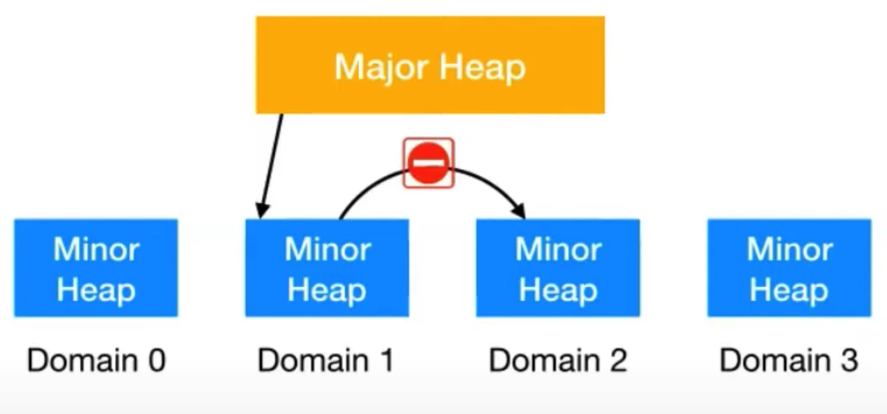
Working of Domains - Memory Management

Slide 4
Working of Major and Minor Heap
Minor Heap and Per-Domain Allocation:
--> Each domain in OCaml has its own minor heap for short-lived objects.
--> Multiple threads (domains) can allocate memory independently, reducing contention.
2. Stop-the-World GC:
--> When a domain's minor heap is full, a "stop-the-world" garbage collection process is triggered.
--> All execution across all domains is paused during this process.
3. Major Heap and Object Promotion:
--> Objects surviving the minor GC are promoted to the major heap.
--> The major heap contains longer-lived objects and is shared among domains.
4. Concurrent Major Heap GC with Brief Pauses:
--> Major heap GC is concurrent, allowing domains to continue execution.

Slide 5
Frameworks/Libraries for Parallelization in other Languages
C and C++:
POSIX Threads (Pthreads): Standard for thread management in UNIX-like OS, enabling creation, control, and cleanup of multiple threads in C/C++.
OpenMP (Open Multi-Processing): API supporting shared-memory parallel programming in C, C++, and Fortran, facilitating parallelization of loops and sections through pragmas.(for e.g. using "#pragma omp parallel for" we can parallelise)
Java:
Executor Framework: Part of java.util.concurrent, manages pools of worker threads for asynchronous task execution, handling thread management, task scheduling, and thread lifecycle.
Fork/Join Framework: Introduced in Java 7, efficiently executes parallel divide-and-conquer algorithms using a work-stealing algorithm for task distribution and result aggregation.
Python:
concurrent.features: Introduced in Python 3.2, manages pools of threads or processes using ThreadPoolExecutor and ProcessPoolExecutor, enabling parallel execution of callable objects with a high-level interface.

Slide 6
High level API's provided by OCaml Multicore
Task.setup_pool:
Creating & destroying new domains incurs additional overhead. So, we create a pool of domains & reuse them, for different task.
Takes "n_domains" & creates a pool of that many domains which can be utilized by other API's.
IMP: if all domains are being used & some parallel code wants to run it will be blocked till a domain is freed and returns to pool.

Slide 7
High level API's provided by OCaml Multicore
Task.parallel_for:
Parallelizes iterative tasks where order of execution is not important.
Provides implicit barrier eliminating need of synchronization barriers.
Multiple runs of same code doesn't guarantee same arbitrary order of execution.

Slide 8
High level API's provided by OCaml Multicore
Task.async & Task.await:
Very beneficial in parallelizing recursive algos (divide & conquer)
Create parallel tasks that run in background & will returns a Promise (a computation yet to be completed).
Can await on the promises and do further computation on outputs of those parallel tasks.

Slide 9
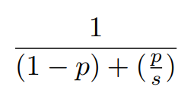
Amdahl’s law for parallel programs
Formula for Amdahl's law:
Here,
p = proportion of code that can be parallelized
s = degree of parallelism (number of threads running in parallel)

Slide 10
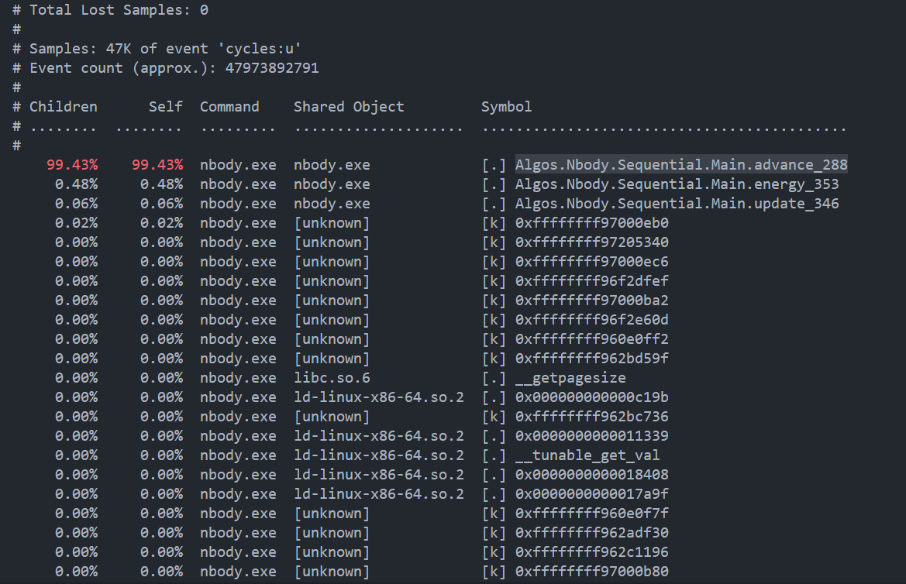
Perf tool – on nbody.exe
Provides insights into:
Program execution
CPU usage
Function call traces (IMP)
advance function of nbody.exe
accounts for 99.43% of total execution time

Slide 11
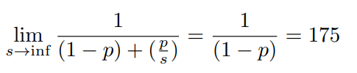

Amdahl's law for nbody.exe
We have (p = .943) and assuming infinite degree of parallelism (s —> ∞)
However, considering practical scenario (s = 8)
For (p < .9) max speedup possible is only 2 times.

Slide 12
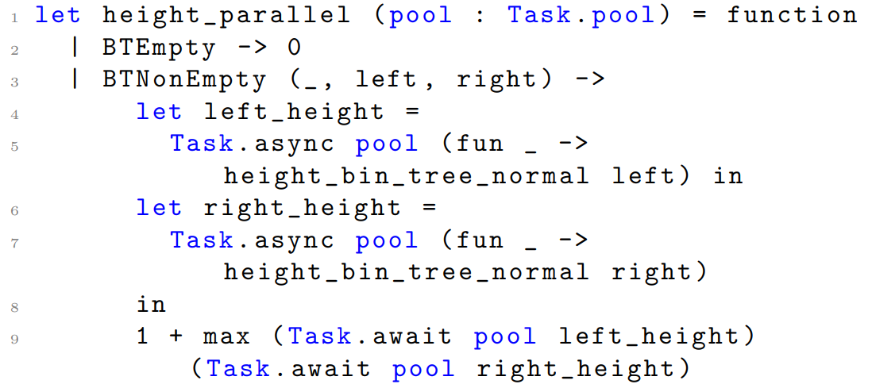
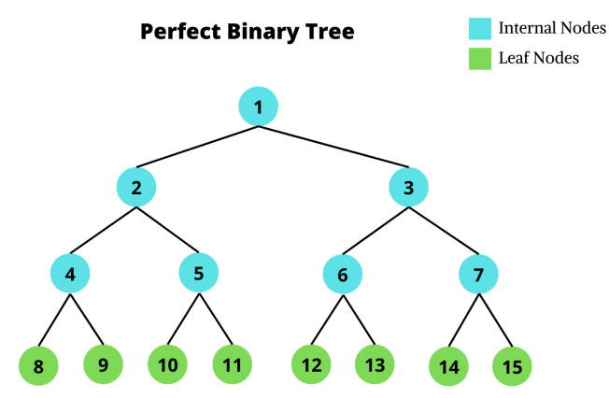


Limitations of divide & conquer approach in recursive algorithms (height of binary tree)
Working of parallel recursive algorithm – leading to deadlock
threads_left = 8
threads_left = 6
threads_left = 2
Say node 8 uses - 2 threads to find height for nodes 16, 17. They're waiting for free thread to call height on lower.

Slide 13
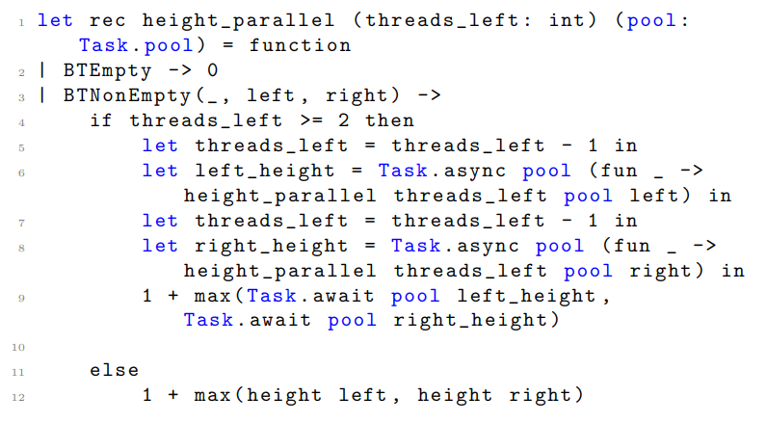
Solution proposed for recursive parallel only divide and conquer algos (height of binary tree)
Maintain a "threads_left" variable.
Decrement by one on each parallel call to "height_parallel" (when sufficient threads exists).
Else call normal "height".

Slide 14
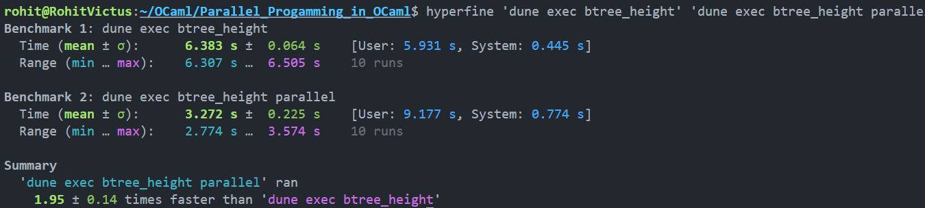
Benchmarking Results for Binary Tree Height

Slide 15
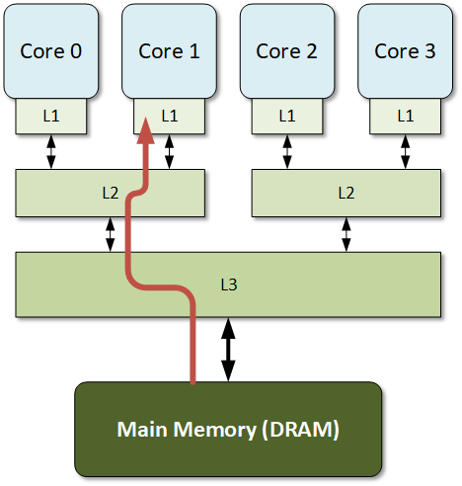
Exploiting Shared State Contention Issue in Multicore architectures for better performance
Each CPU maintains it's own copy of data in local cache (L1) .
Writes (in one core) lead to cache invalidation of same data in other cores.
Leads to subsequent cache misses.
Additional overhead for next read across all cores.

Slide 16
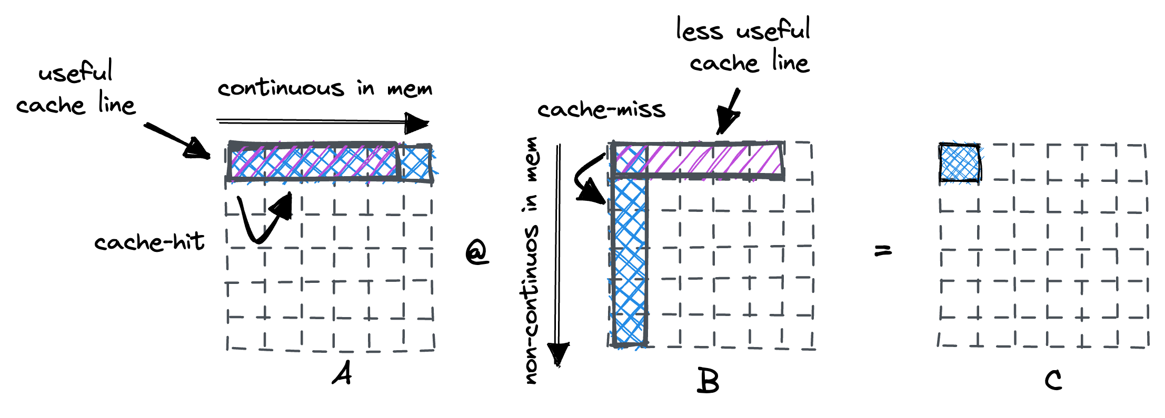
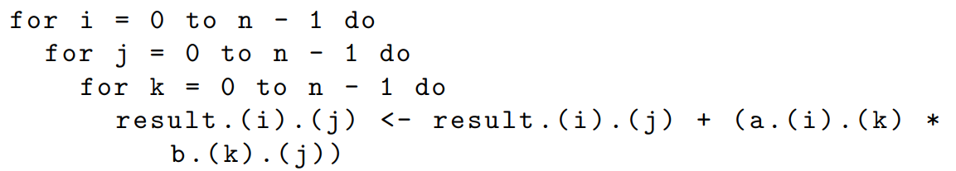
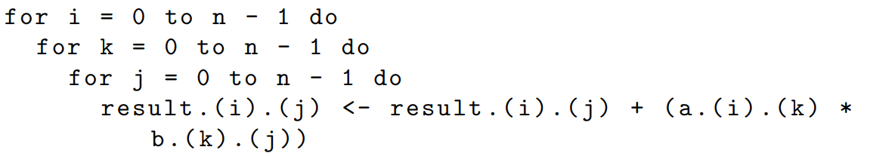
Contention issue – Ex: Matrix Multiplication
We traverse column in B
We traverse row in B

Slide 17
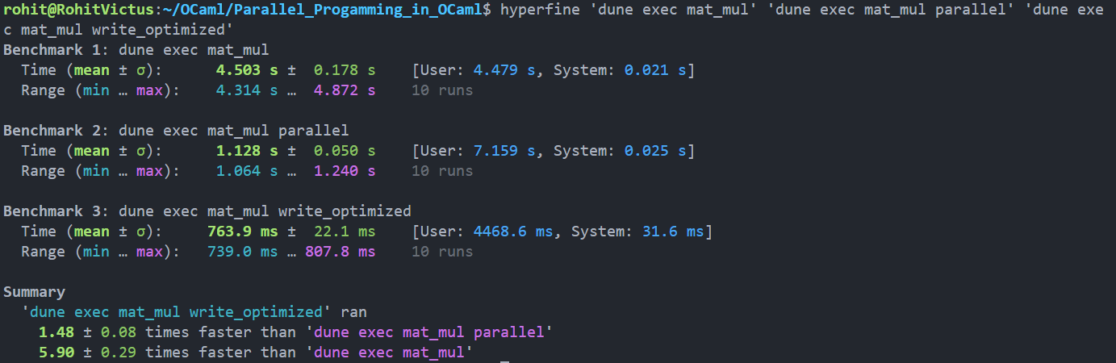
Benchmarking Results for Matrix Multiplication

Slide 18
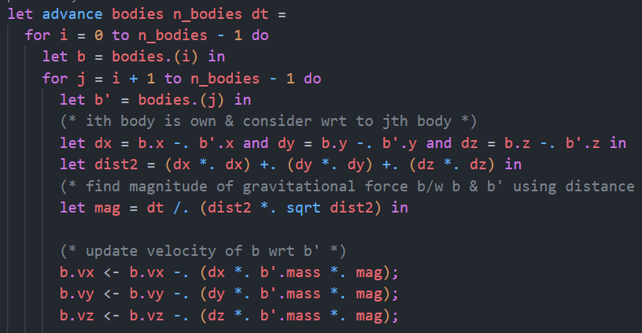
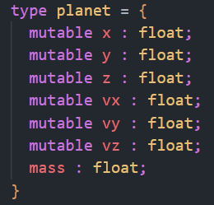
Contention issue – Ex: NBody Problem

Slide 19
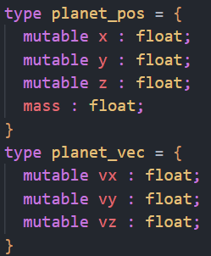
Contention issue 1 – Ex: NBody Problem
Array of planets with (x, y, z) coordinates & (vx, vy, vz) velocity vector magnitudes.
• Frequent reads & infrequent writes (x, y, z)
• Infrequent reads & frequent writes to (vx, vy, vz)
Split planets array into arrays of planet_pos (x, y, z) & planet_vec (vx, vy, vz). We're able to minimize cache invalidations for planet_pos array.

Slide 20
Contention issue 2 – Ex: NBody Problem
Velocities magnitudes (vx, vy, vz) of body b = bodies.(i) are being updated wrt body b' for n times.
Create x3 ref variables (vx, vy, vz) & update them. At end of jth loop update actual body b.

Slide 21
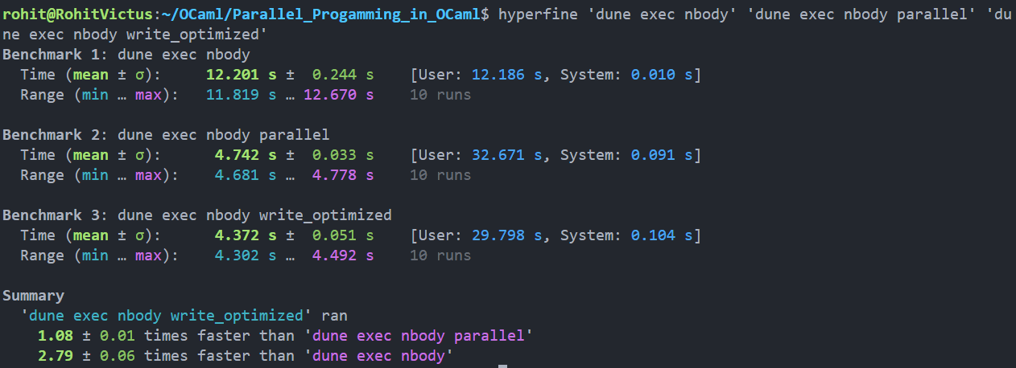
Benchmarking Results for NBody Problem

Slide 22
Divide And Conquer Algorithms

Slide 23
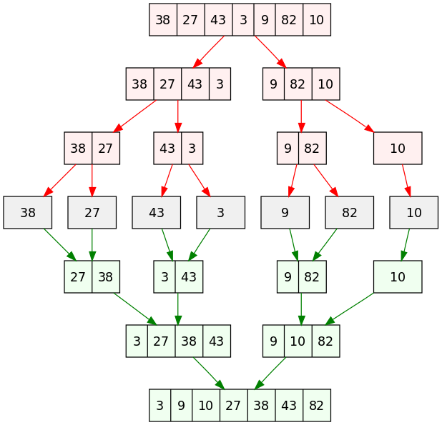
Merge Sort Algorithm
Merge sort algorithm works as follows:-
We recursively divide the array into two parts using middle element.
At last, when we get individual containers of elements, we compare the elements in the halves.
Now, we merge the arrays by placing the pointer on the left and right half, and we move pointers based on the smaller values coming in the array index.
Time Complexity:-
Best Case: O(n log n)
Worst Case: O(n log n)
Average Case: O(n log n)
Image Courtesy: Wikipedia

Slide 24
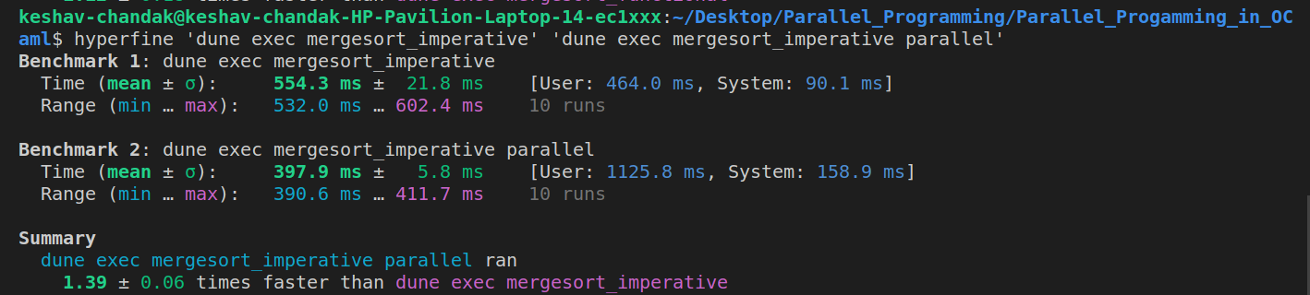
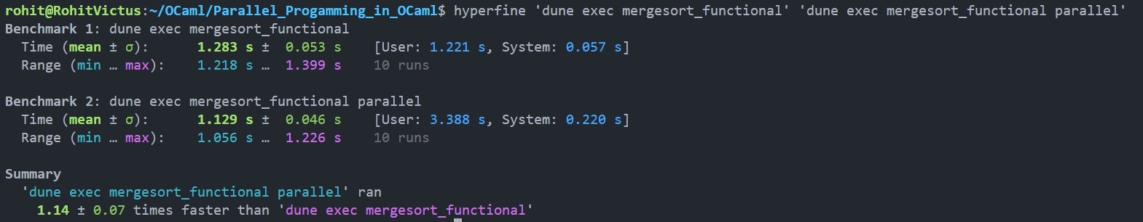
Benchmarking Results For Merge Sort
Parallel code for imperative merge sort is approx 1.39 times faster.
Parallel code for functional merge sort is approx 1.14 times faster.
Imperative code is 2.31 and 2.84 times faster than functional code for unparallelized and parallelized codes respectively.

Slide 25
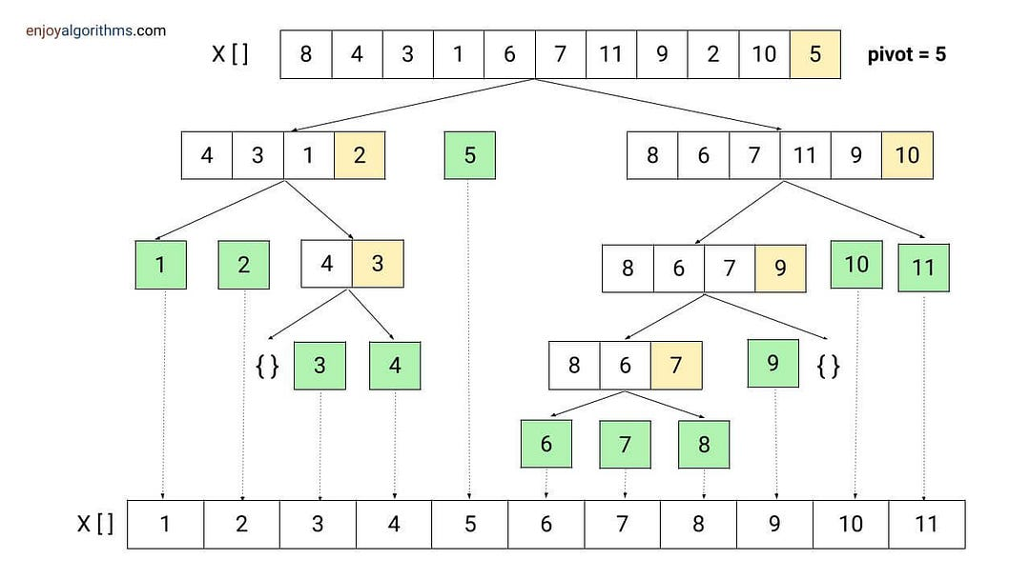
Quick Sort Algorithm
Like merge sort algorithm but partitions the array from the pivot instead of taking the middle element.
Code Complexity:
Worst Case: O(n²) - Occurs when the pivot is consistently chosen as the smallest or largest element.
Best Case: O(nlog n) - Occurs when each pivot is such that partition are of equal sizes.
Application: Sorting file directories, sort query results, especially when pivot can be approximated using median-of-three logic.
Image Courtesy: enjoyalgorithms.com

Slide 26
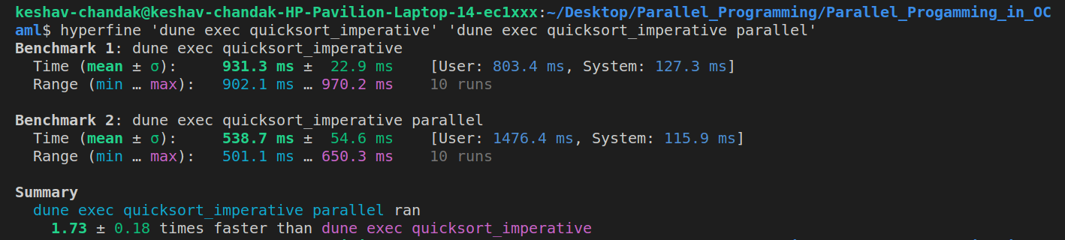
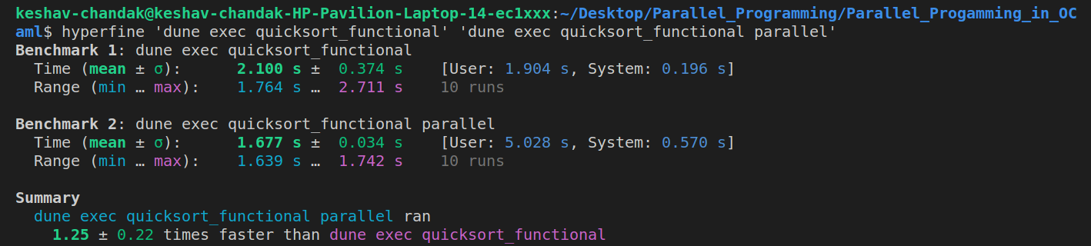
Benchmarking Results For Quick Sort
Parallel code for imperative quicksort is approx 1.73 times faster.
Parallel code for functional quicksort is approx 1.25 times faster.
Imperative code is 2.55 and 3.1 times faster than functional code for unparallelized and parallelized codes respectively.

Slide 27
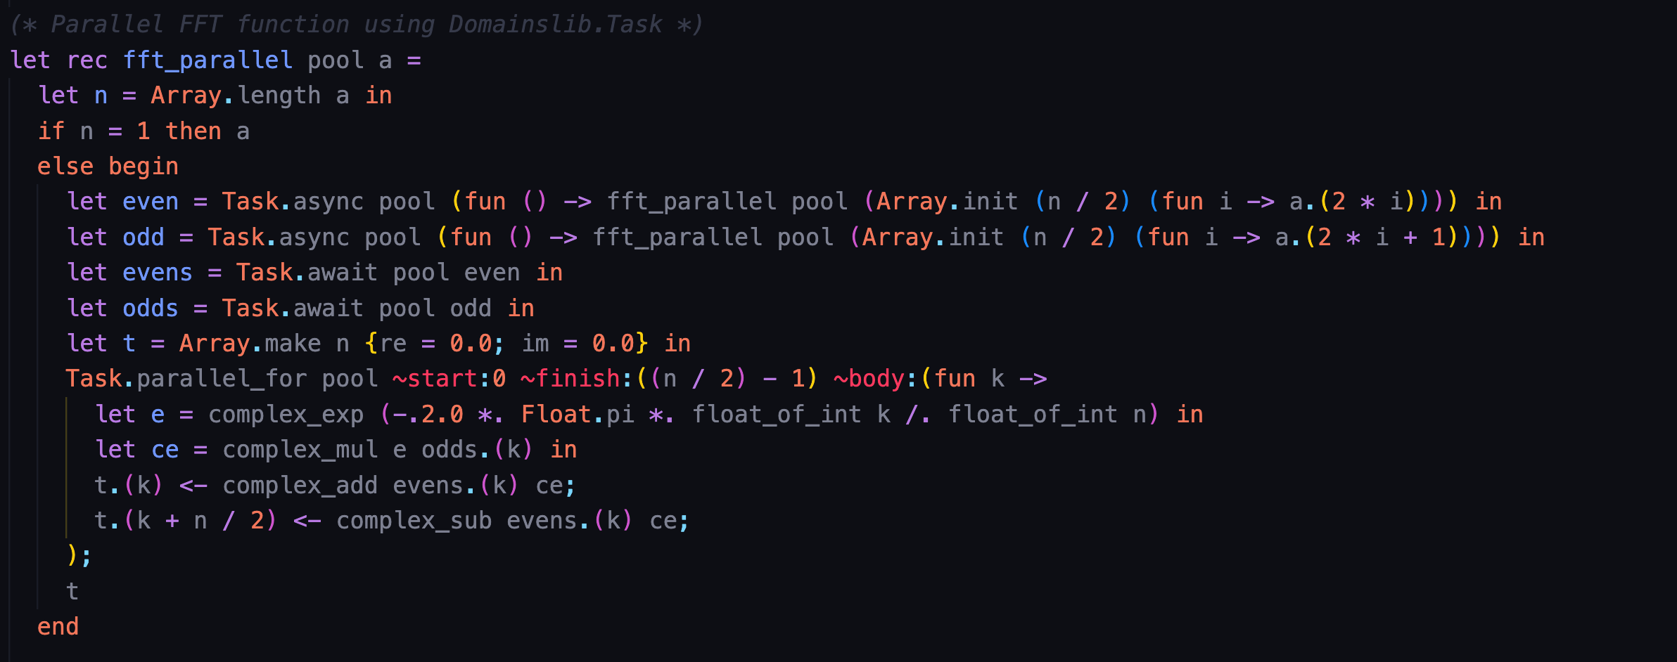
Fast Fourier Transform

Slide 28
Fast Fourier Transform
Recursive FFT Algorithm: The algorithm is a parallelized implementation of the Fast Fourier Transform (FFT). It decomposes the input array 'a' into its even and odd indices array, recursively applying FFT on each part.
After dividing the array into even and odd indices then, running loop 'k' and calculating the twiddle factor corresponding to each 'k' which is running for half the size of the array iterations.
Complex Multiplication of the ODD indexed numbers and the twiddle factor calculator for the corresponding 'k' is calculated and stored in a variable .
The resulting array 't' will have the following structure: The 0 to (n/2-1) indexed positions are complex additions of elements from the even array and the complex multiplication result obtained from the previous step.
The (n/2 to n-1) indexed positions are the complex subtractions of elements from the even array and the complex multiplication result obtained from the previous step.
This computation of resulting array 't' will be parallelized as the step 4 and step 5 can be calculated concurrently

Slide 29
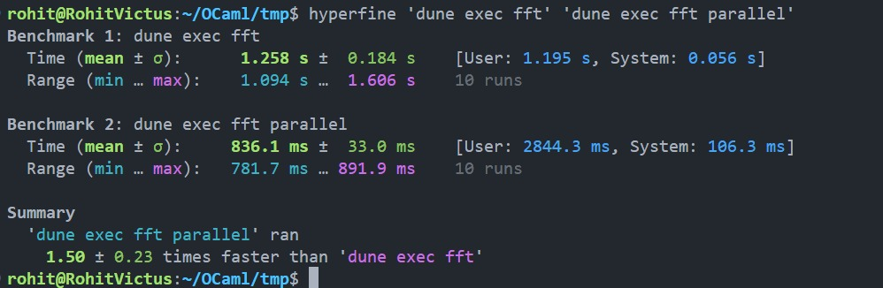
Benchmarking Results for FFT

Slide 30
Linear Algebra Algorithms

Slide 31
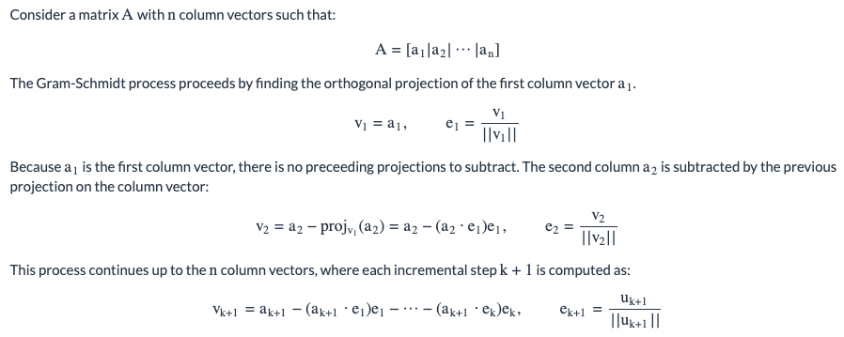
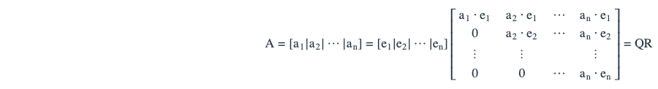
QR Decomposition using Gram Schmidt Process

Slide 32
Sequential Nature and Parallelizable Components of QR Decomposition
Sequential Nature:
1. Dependency on previous results, the orthogonalization of each vector is dependent on the results of all prior computations.
2. Calculating each new orthogonal vector relies on all previously calculated ones, slowing down the parallel execution because step need to wait for all other earlier steps to finish.
Parallelizable Component:
1. Computing the inner product of each column vector with each previously computed orthogonal vector can be parallelized as the product calculation is independent and can be performed concurrently.
2. Scalar multiplication and subtraction can be parallelized.

Slide 33
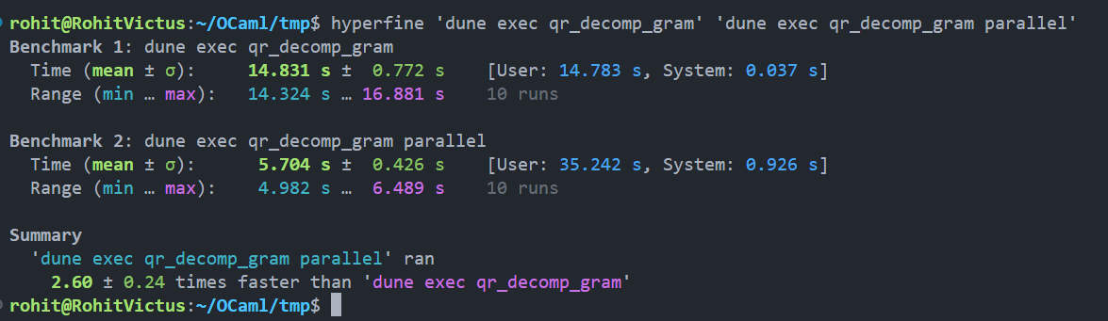
Benchmarking Results for QR Decomposition

Slide 34
Singular Value Decomposition(A=U*sigma*V^T)
The process starts with the calculation of A^T*A, which has been calculated using the matrix multiplication in parallel form. This step prepares for the subsequent QR decomposition, as it is required in SVD.
Then applying the QR-Decomposition to the matrix A^T*A, and the getting the matrices Q and R. The resulting orthogonal matrix 'Q' provides the left singular vectors or the 'U' matrix while the 'R' represents the diagonal matrix capturing singular values.
The transpose of Q serves the purpose of right singular vector in the Singular Value decomposition.
Example use case in Movie Recommendation System:
Let R represents the matrix containing user representation where element Aij represents the rating given by the 'i'th user to the 'j'th movie.
After applying SVD, we will get representation in the form of matrix multiplication of U, Sigma, V. Here the represents the latent variables associated with user for a movie, how much storyline is important for the user. The matrix V captures how much storyline is important for that movie.
The matrix sigma here represents the weights given to both elements.

Slide 35
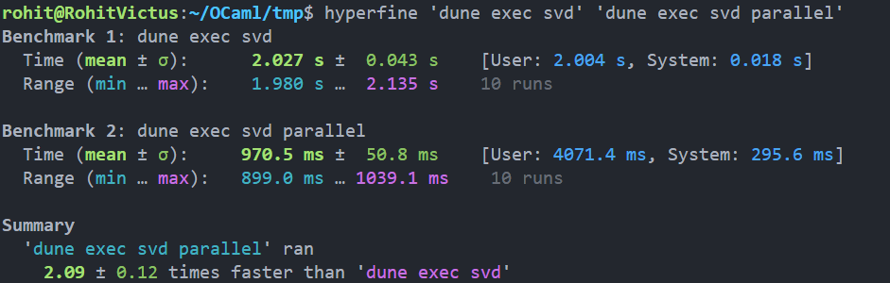
Benchmarking Results for SVD

Slide 36
LU Decomposition
LU Decomposition is a matrix manipulation technique.
It is used to solve solutions for system of linear equations or to find determinant of a square matrix.
In our project, we have tried to find the determinant of the square matrix.
It is done by finding the upper triangular matrix(L) and lower triangular matrix by performing operations on the rows of the matrix.
det(A) = det(LU), which is essentially the product of all diagonal elements of LU matrix.
It is very useful in simplifying large matrices.

Slide 37
Why it cannot be parallelized
LU Decomposition uses sequential manipulation technique.
Even when we use pivoting technique and maintain the matrix tracking the change, the rows are dependent on other rows for computation.
Thus, we can utilize mutex locks to wait until the state of a row in matrix can be used.
It will lead to decrease in performance.

Slide 38
Conclusion
Some of the algorithms are parallelizable, some are not.
There is only a degree to which a code can be parallelized.
While parallelizing, it is essential to look at it's correctness.
Some parallel algorithms are prone to race conditions leading to situations where we get "nan", "inf" etc.

