Slide 1
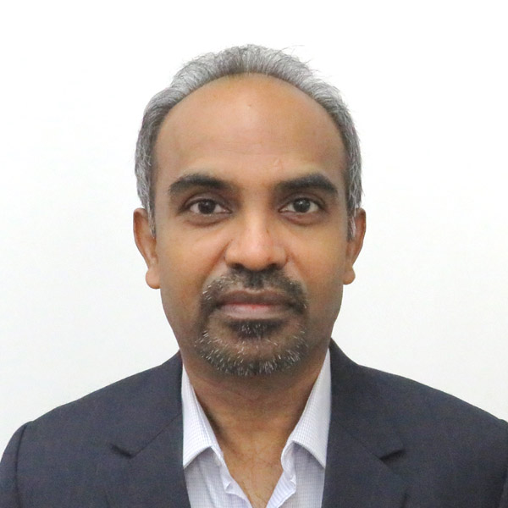
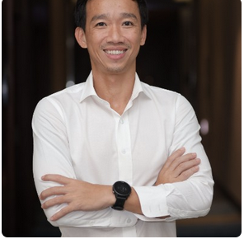

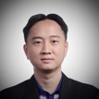

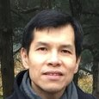


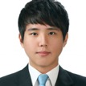

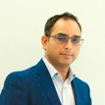

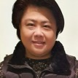


Introduction to the POC Team
CSM
Pre-sales SMEs
Software COE
John Isaac,
D&AI CSM
Sunny Panjabi,
D&AI SME
Tan Long Siau,
Storage SME
Bui Hung Le Senior D&AI SME
Hongwei Jia
Client Engineering
Exec sponsor
Derek WK Chan,
APAC D&AI CE Leader
Kanjinghat Nijesh,
Senior Data Scientist, CE
Ashutosh Gaur,
Senior Data Scientist, CE
Eddy Kim,
Data Engineer, CE
Vavarly Chong
Business Technology Leader, CE
Anup Kumar,
D&AI APAC CTO and DE
Account Team
A/C – UOB Account Team
SME – Subject Matter Expert
D&AI – Data & AI
DE – Distinguished Engineer
CSM – Customer Success Manager
CE – Client Engineering
Denise Seah,
UOB A/C Exec
Wai Leng Lee,
UOB A/C D&AI Sales
Michelle Shwe,
UOB A/C CSM
Sandesh Udupa,
UOB A/C Tech Lead

