Slide 1




Introduction to Soap UI
Q u a l i Te s t

Slide 2
Follow Along with the Slides
Slides are located on the Shared Drive at: \\nsx0862-dm08\AED-FTD\

Slide 3
Who are We?
Jamie Mitchell
Senior Test Specialist and QA Manager
Architected, Developed and Managed a number of projects with SoapUI
Over 20+ years experience in Testing – eCommerce, finance, healthcare, entertainment, defense, legal, travel, agriculture, education, state registries & databases, utilities, etc…
3

Slide 4
Introductions (ctd…)
Brian Van Stone
Senior Test Specialist
Three years experience automating business processes across varied infrastructure
- Load Balancers, Web Infrastructure, Windows/Unix/Linux platforms, Desktop and Web Applications, Source Control Systems
3

Slide 5

About QualiTest
World’s 2nd largest pure play independent testing company
(Nelson Hall - 2012)
QA & Testing focus
QA and testing is all that we do!
SLA based Managed Testing services (MTS)
Reducing costs, Raising quality, Driving continuous improvement
Right Shore! - Global Service delivery Model
Onsite, Onshore, Near-Shore and Offshore
Client centric solutions - Outcome-based testing and pricing
Client only pays for testing delivered
5

Slide 6




























Partial Customer List
5

Slide 7
Training Agenda
Day 1 – Intro to Protocols & Tool
Day 2 – Data Driven Testing & Assertions
Day 3 – Groovy scripting & Refactoring
Day 4 & 5 – Advanced Topics & Testing Multiple Protocols

Slide 8
Getting to Know You
Who are you?
What’s your background?
What do you do?
What is your experience with SoapUI?
What is your experience with testing web services?

Slide 9
Course Objectives
Strong understanding of Web Services (SOAP & REST)
Imparting the importance of Test Structure, Test Verification and Test Project Management (inputs, environments, results)
A firm understanding of SoapUI.

Slide 10
Key Lessons
Basic Test Creation
Transformation of Keyword Tests to scripted tests.
Basic SoapUI Functionality
Basic Managing a Suite of Tests
A solid understanding of testing web services.

Slide 11
Course Format
This is meant to be a learn along type environment.
The class structure will consist of introductory lessons coupled with on screen demonstration
Individual Exercises will be interspersed.
Questions are Strongly Encouraged!!

Slide 12
Introduction to Web Services
GETTING STARTED

Slide 13
What are Web services
A method of communicating between two devices
A software function provided at a network address over the web with the service always on
It has an interface described in a machine- processable format

Slide 14
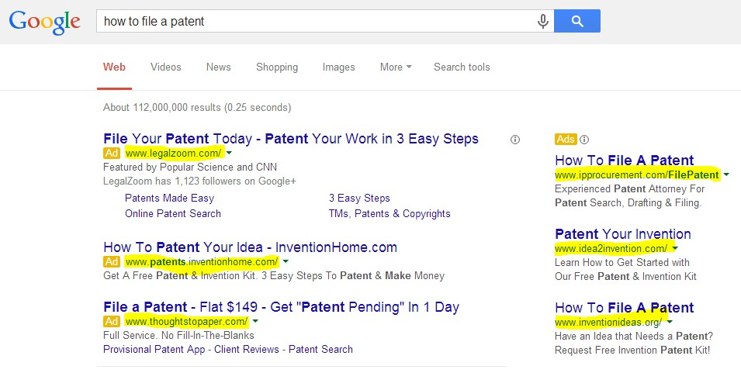
Some Examples

Slide 15
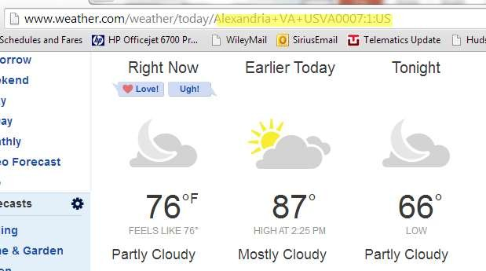
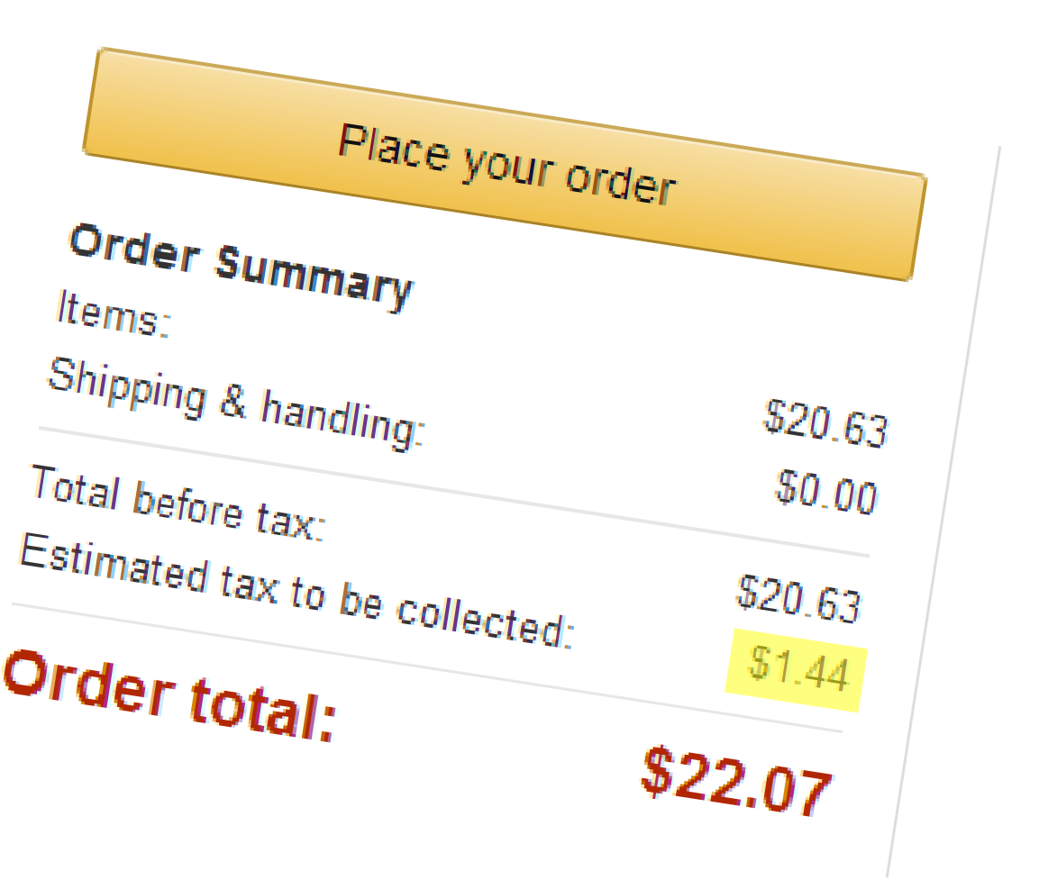
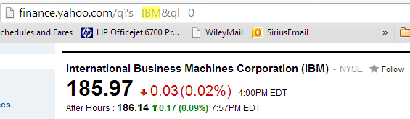
More examples

Slide 16
Protocols
There are multiple protocols and transport mechanisms for web services- this class will focus on:
SOAP
REST
Before looking at these web services, we need a basic understanding of XML and XML Namespaces

Slide 17
XML
XML stands for eXtensible Markup Language
XML is designed to transport and store data, not to display data
XML tags are not predefined
XML is designed to be self-descriptive
XML does not DO anything.
It is just information wrapped in tags
Need software to send, receive or display it.

Slide 18
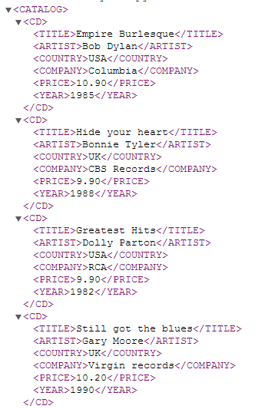
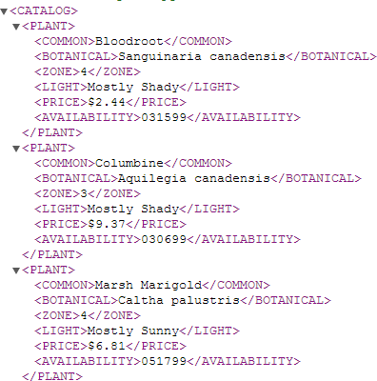
XML examples

Slide 19
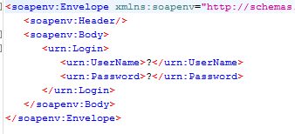
Another Example
Login is parent
start tag
end tag

Slide 20
XML Syntax Rules
All XML Elements Must Have a Closing Tag
<p>This is incorrect.
<p>This is a correct.</p>
<p></p> & <p /> are also correct
XML Tags are Case Sensitive
<Message>This is incorrect</message>
<message>This is correct</message>
XML Elements Must be Properly Nested
<b><i>This is incorrect</b></i>
<b><i>This is bold correct</i></b>

Slide 21
XML Rules (cont)
XML Documents Must Have a Root Element
<root>
<child>
<subchild>.....</subchild>
</child>
</root>
Only the characters "<" and "&" are strictly illegal in XML
<!-- This is a comment -->
White-space is Preserved in XML

Slide 22
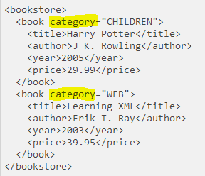
Elements and Attributes
Bookstore has an element book
Book has an attribute – category and elements: title, author, year, price

Slide 23
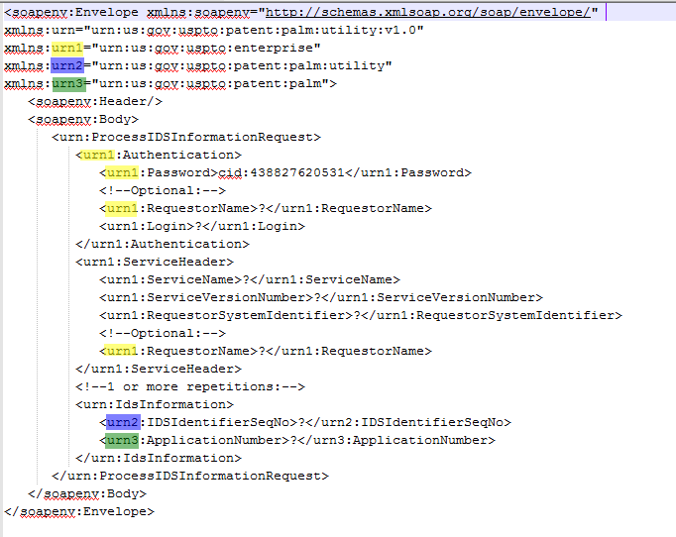
XML Namespaces
XML Namespaces provide a method to avoid element name conflicts and to provide for reusability of elements

Slide 24
Why do we care ?
Errors in XML documents will stop your XML applications
Many of the errors that we find in testing have to do with
Namespace issues
Schema data types
Case
Order
Whitespaces

Slide 25
XPath
XPath (the XML Path language) is a language for finding information in an XML document
XPath is a syntax for defining parts of an XML document
XPath uses path expressions to navigate in XML documents
XPath contains a library of standard functions

Slide 26
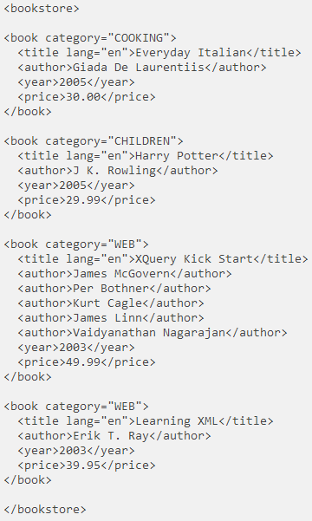
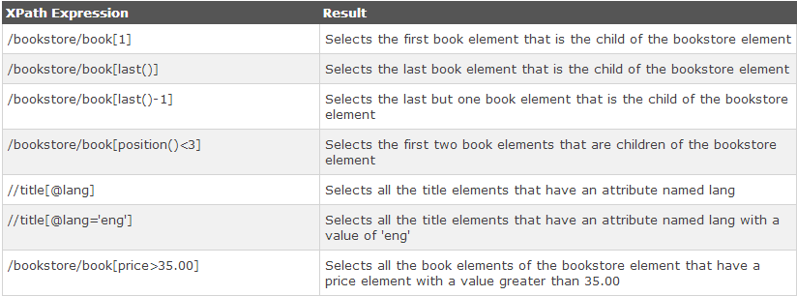
XPath examples

Slide 27
SOAP
SOAP stands for Simple Object Access Protocol
SOAP is an XML based protocol for accessing Web Services.
SOAP is based on XML

Slide 28
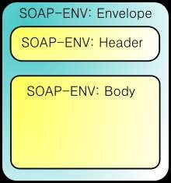
SOAP
A SOAP message is an ordinary XML document containing the following elements:

Slide 29
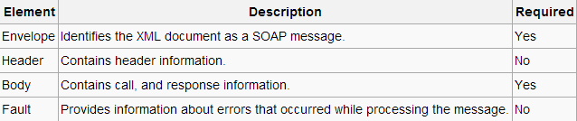
SOAP Elements

Slide 30
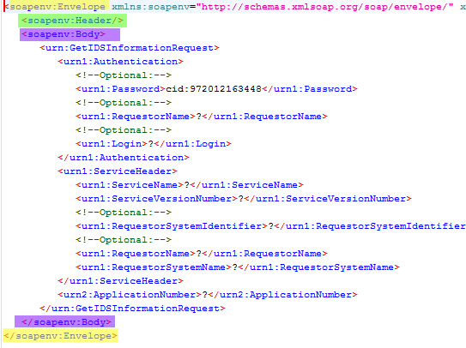
Example
operation name
body

Slide 31
SOAP Syntax Rules
Must be encoded using XML
Must use a SOAP envelope namespace
– xmlns:soap="http://www.w3.org/2001/12/soap- envelope"
Must not contain XML processing instructions

Slide 32
SOAP requests defined by WSDL
WSDL stands for Web Services Description Language
WSDL is an XML-based language for describing Web services.
WSDL is written in XML
WSDL is also used to locate Web services

Slide 33
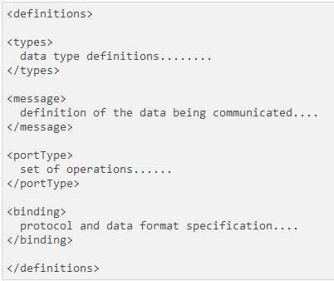
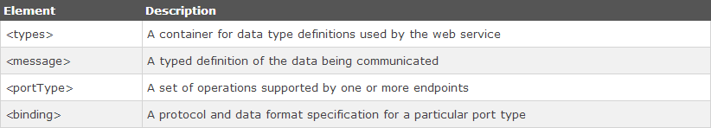
WSDL Document Structure

Slide 34
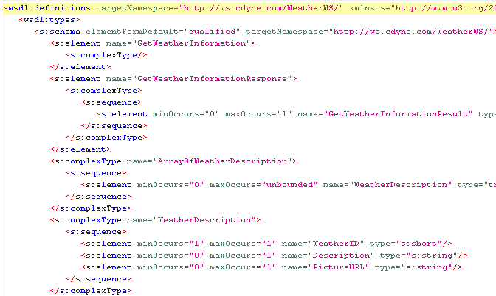
WSDL Example

Slide 35
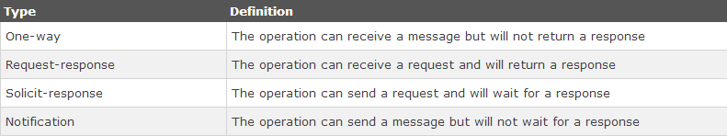
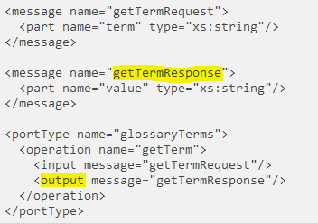
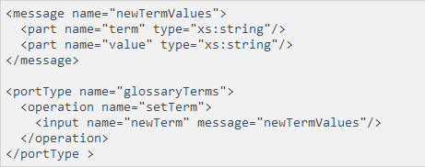
Operation Types
No output – one way

Slide 36




Operation Types
Request <> Response
One Way
Solicit < > Response
Notification

Slide 37
REST
REpresentational State Transfer (REST)
Resources are manipulated using a fixed set of four operations -create, read, update, delete : PUT, GET, POST, and DELETE.
PUT creates or updates a new resource, which can be then deleted by using DELETE.
GET retrieves the current state of a resource (read)
POST transfers a new state onto a resource (create).

Slide 38
Using PUT & POST
Either PUT or POST can be used to create a new resource (depends on how your service is defined)
For example creating a new chapter of MPEP (Manual of Patent Examining Procedure)
POST /manual/MPEP/current
PUT /manual/MPEP/current/d0e55397.xml
If you want to update an existing document on the server, then use PUT

Slide 39
Examples
URI: uniform resource identifiers (string of characters to identify resource)
Customer # 18 info:
http://www.thomas- bayer.com/sqlrest/CUSTOMER/18/
List of invoices
http://www.thomas-bayer.com/sqlrest/INVOICE/
List of products
http://www.thomas-bayer.com/sqlrest/PRODUCT/

Slide 40
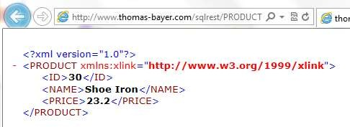
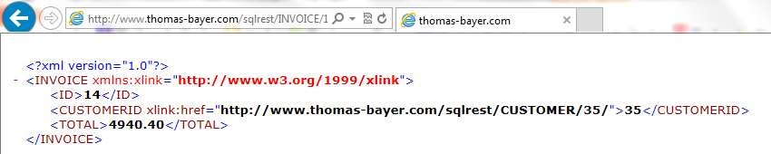
REST RESPONSES
PRODUCT/30
INVOICE/14

Slide 41
REST > WADL
Sometimes a REST service has documented information in a WADL
WADL = Web Application Description Language
XML in format
Not Standardized

Slide 42
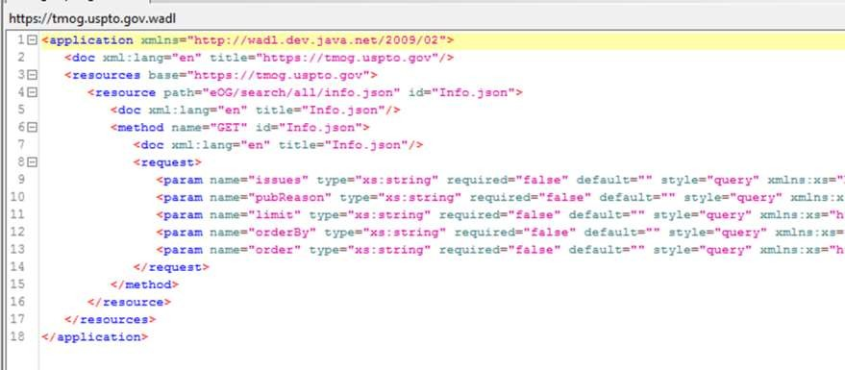
Sample WADL
URI:

Slide 43
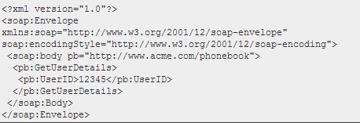
Differences
SOAP REQUEST
SAME AS A REST REQUEST

Slide 44
Differences
Attribute | SOAP | REST
Language/Platform | Language, platform, and transport independent | Only http
Environments | Works well in distributed enterprise environments | Requires point-to-point communication
Standardization | Standardized | Has some standards
Error handling | Built in error-handling | None
Format | Requires XML | Efficient – can use any format
Speed | Slower | Fast (no extensive processing required)

Slide 45
SOAP & REST Responses
REST doesn’t have to use XML to provide the response. REST-based Web services can output the data in
Command Separated Value (CSV)
JavaScript Object Notation (JSON) and
Really Simple Syndication (RSS)
Often when you find a REST service, one of the inputs is the requested format

Slide 46
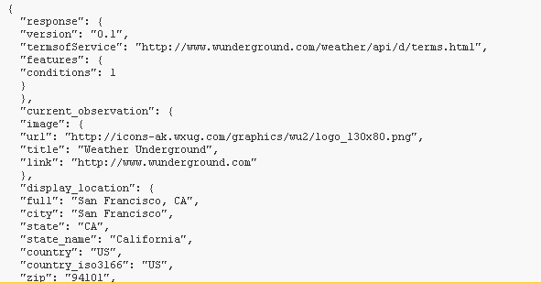
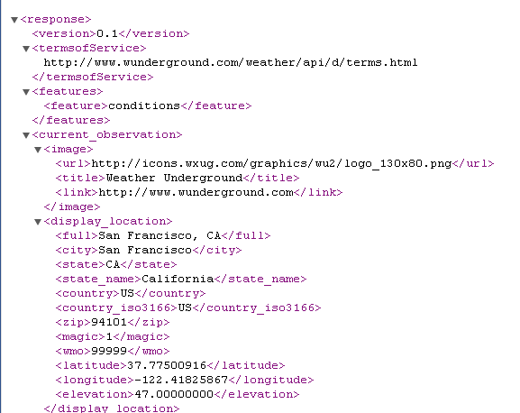
REST Example
http://api.wunderground.com/api/74e36bb7a 98f6a55/conditions/q/CA/San_Francisco.json
Json Response
XML response

Slide 47
Introduction to SOAPUI
USING SOAPUI

Slide 48
Introduction to SOAPUI
Create projects
Add WSDL from sample web service
Setup up security settings
Walk through structure of request and response.
Discuss faults from failed structure vs data errors.
Request structure
Request-level properties
Validating request inputs
Creating multiple requests
Response structure
Working with endpoints

Slide 49
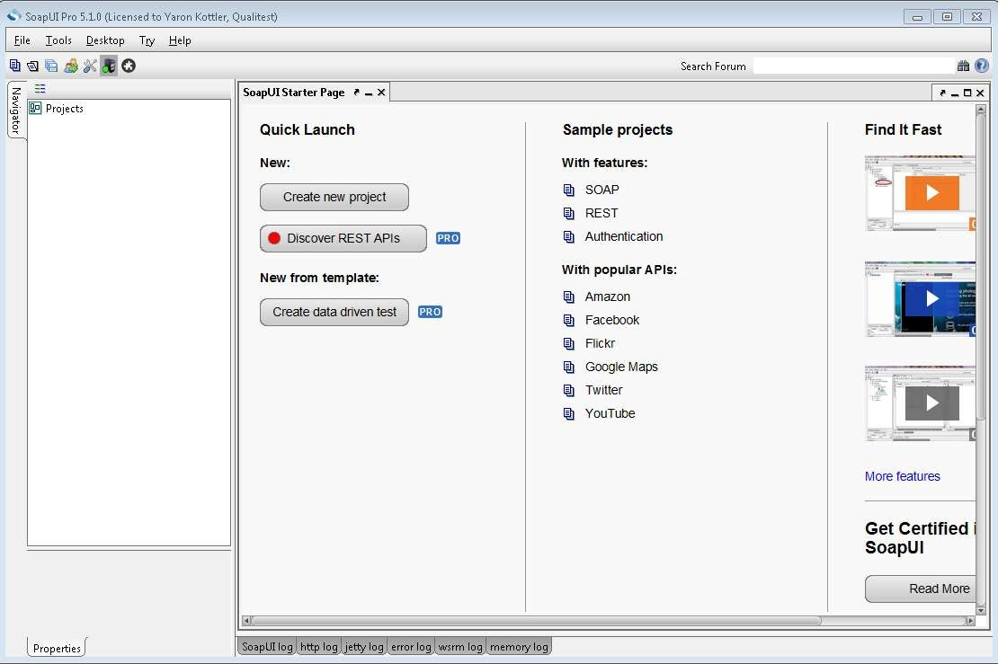
Dashboard

Slide 50
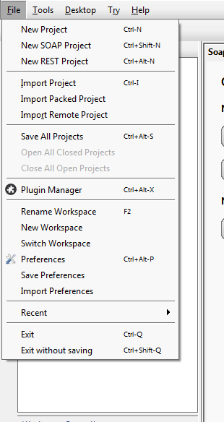
File Menu

Slide 51
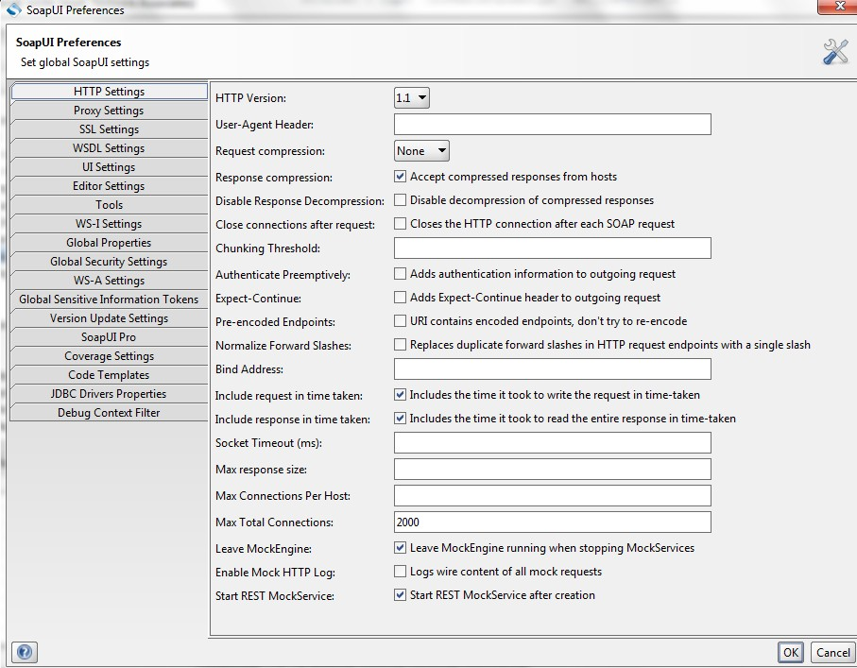

Slide 52
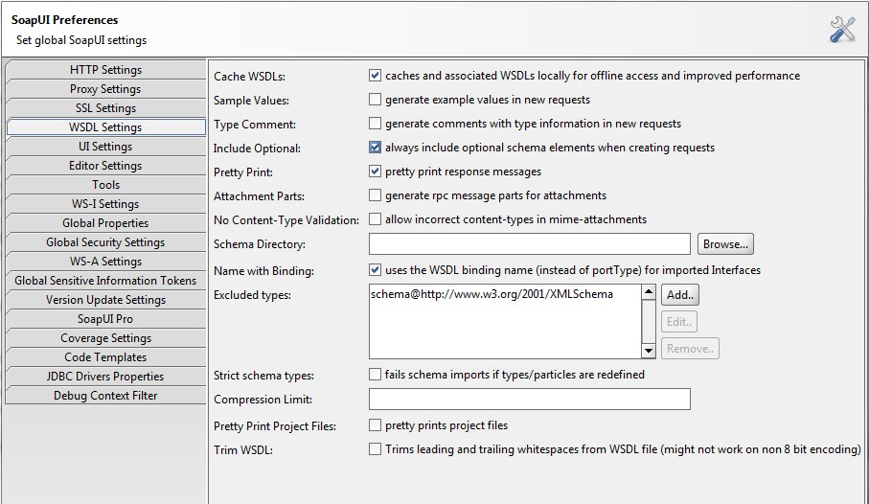
WSDL Settings

Slide 53
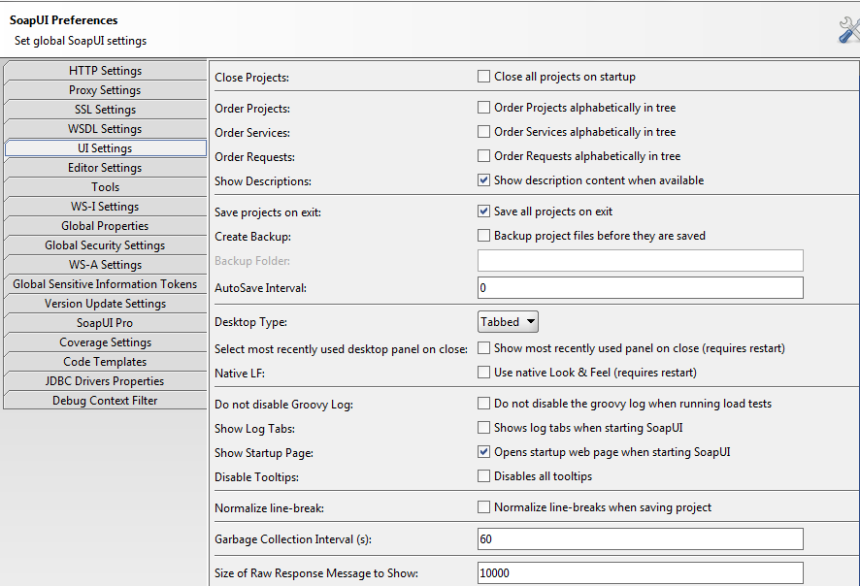
Preferences

Slide 54
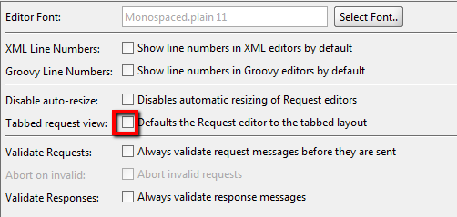


Editor Settings
Tabbed request/response
Toggle tabs on/off

Slide 55
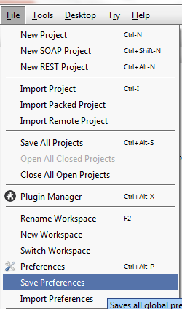
Preferences
Once done with changes,
Save Preferences
can also import preferences

Slide 56
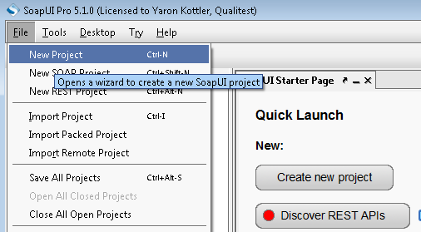
Create a New Project

Slide 57
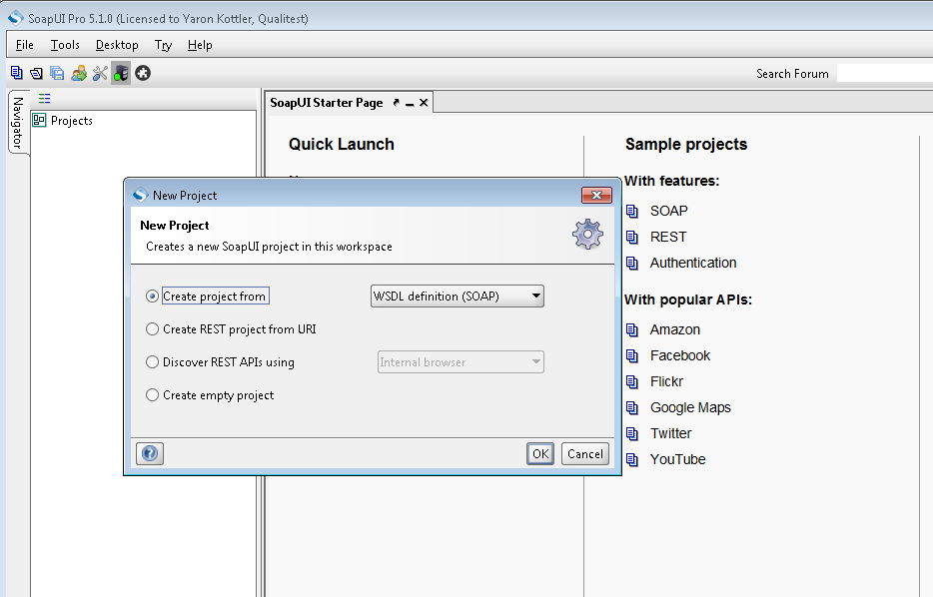

Slide 58
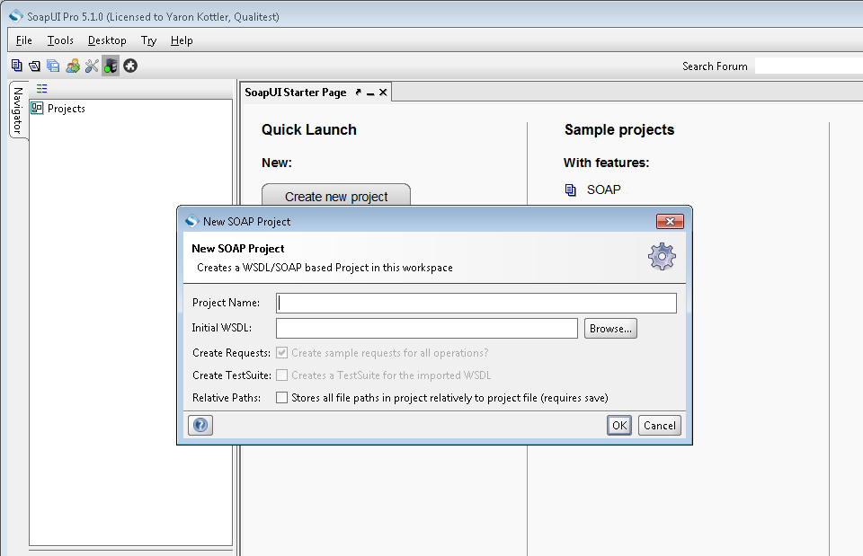

Slide 59
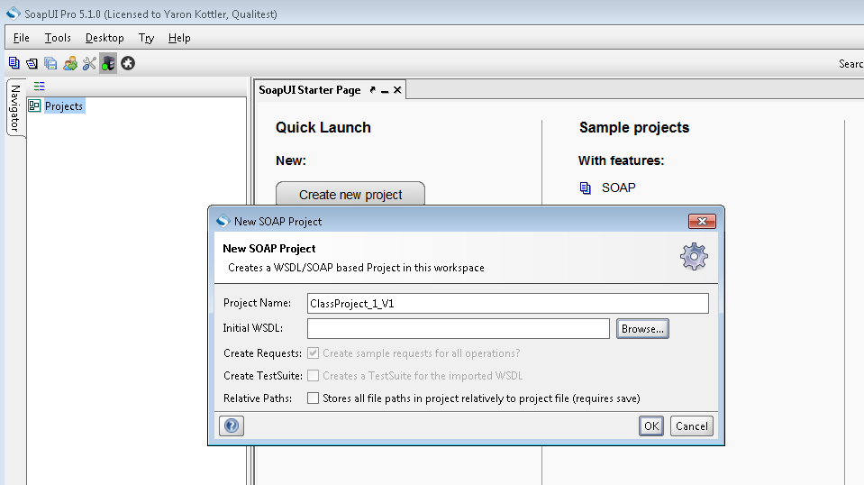
Can Create Empty Project at this point

Slide 60
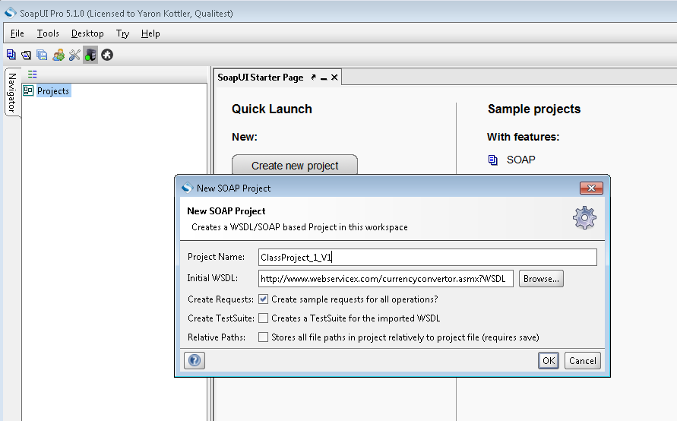
Or Add WSDL
http://www.webservicex.com/currencyconvertor.asmx?WSDL

Slide 61
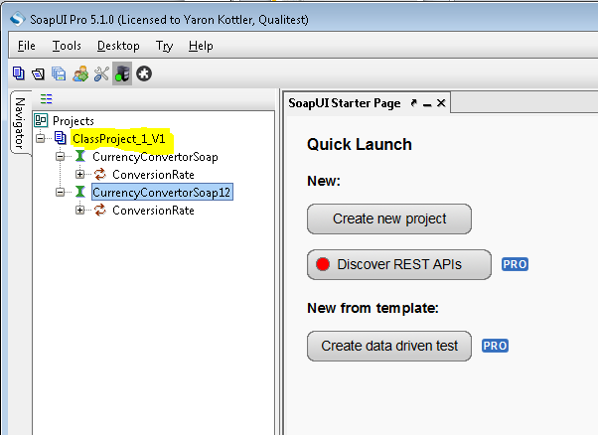
Project Created

Slide 62
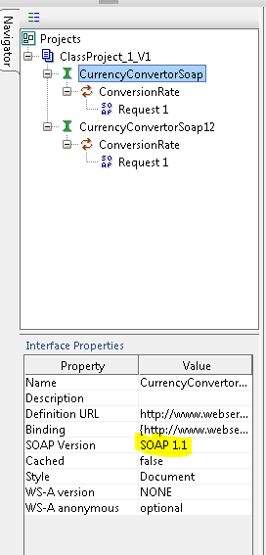
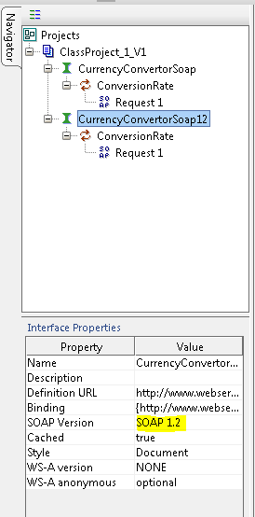
This Sample has 2 Versions

Slide 63
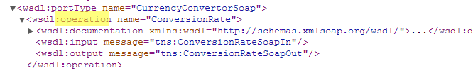
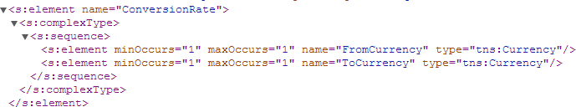
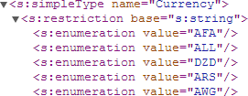
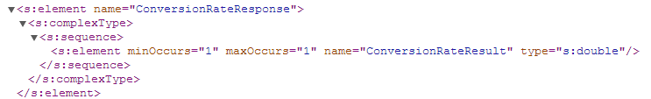
SoapUI Parses WSDL
SOAPUI looks for port & operation name(s)
Input Elements
Enums Response

Slide 64
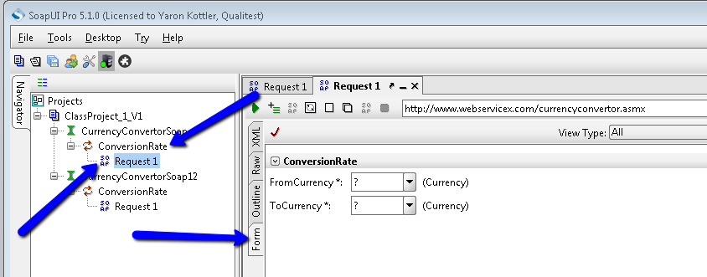
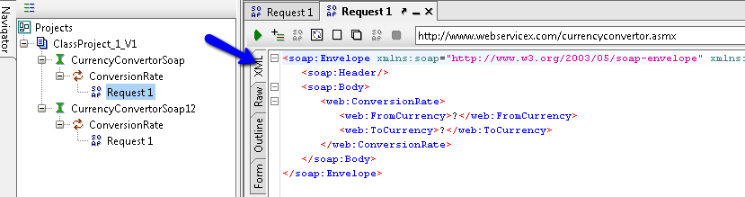
Components

Slide 65
Endpoints
An endpoint allows you to point to different environments for testing
Managing the endpoints can be difficult and it’s very, very easy to test against the wrong endpoint
Manage endpoints within a project
Manage by maintaining Multiple projects
Use environments to manage endpoints
Use workspaces to manage endpoints

Slide 66
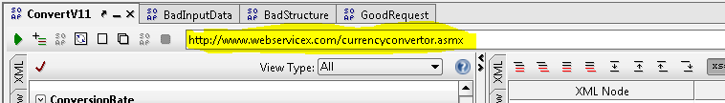
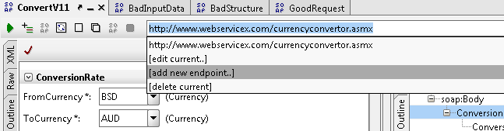
Endpoints

Slide 67
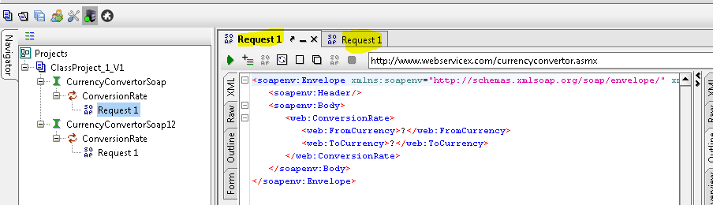

A Word About Requests

Slide 68


Renamed

Slide 69
A Word about Project Names
Projects get sorted alphabetically
You can name them anything you want
– Having a version or date included in the project name can save you lots of time/frustration later
By default, projects will be saved in My Documents
A saved project is an xml file with the format of project name-soapui-project.xml

Slide 70


Setting Passwords

Slide 71


Submitting a Request from the Form

Slide 72

Form Request
In the form view, you can filter the fields that you want

Slide 73


Response

Slide 74
Exercise
Create a new soap project and add this wsdl http://www.webservicex.com/currencyconver tor.asmx?WSDL
From the form view, select different currency types from the dropdown and submit the request
View the response in different formats

Slide 75

Structure of the Request

Slide 76

Navigating thru the Structure

Slide 77

Submitting Bad Data

Slide 78

Overview Results View

Slide 79


Complex Types

Slide 80


Faults Structure
Remove one element

Slide 81


Fault - Structure
Duplicate first element

Slide 82


Fault?
Duplicate the entire complex object

Slide 83


Complex Type - Response
Rules for both the request and response are provided in the wsdl

Slide 84

Quick Navigation

Slide 85

Operation Properties

Slide 86

Request Properties

Slide 87




Create Multiple Requests

Slide 88


Validate Requests

Slide 89

Validate Request
Double click on error to directly navigate

Slide 90

Structural Validation

Slide 91
Exercise
Create new project using wsdl - http://wsf.cdyne.com/WeatherWS/Weather. asmx?WSDL
Look at the structure of the wsdl and create multiple requests for
Valid request
Invalid requests (bad data/bad structure)
Validate the requests before submitting them
Save your work regularly
soap saves internally immediately but no auto
save unless you set it up
91

