Slide 1

TEAM 10
Praveen Allaka Ganesh Gangarajula Poonam Bhoite

Slide 2

What is SoapUI
World’s leading Open Source Functional
Testing
Tool
mainly used for API testing.
Developed by Eviware in 2005, later SmartBear in 2011
Cross platform desktop based application
acquired by
Leading automation tool for inspecting, invoking, monitoring, simulating and mocking
Used for functional testing, security testing, load testing, compliance testing and surveillance testing of both EST/WADL and SOAP/WSDL-based APIs.
Supports all the standard protocols and technologies.

Slide 3
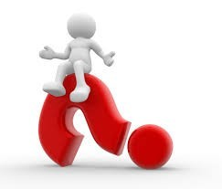
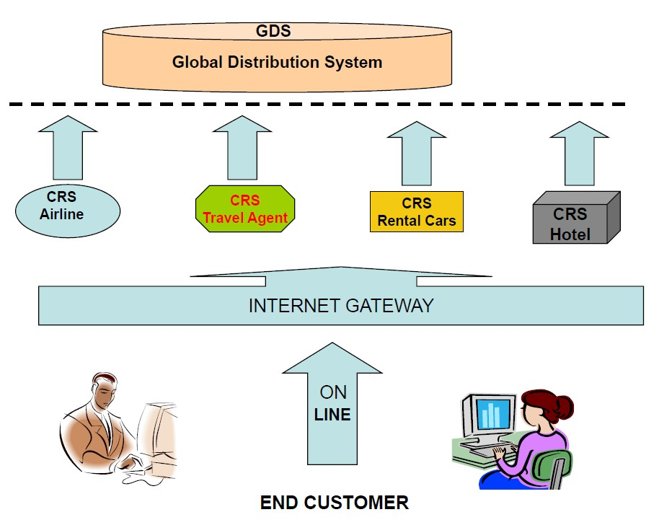
Why SoapUI

Slide 4
Features
Wide coverage of functional aspects of web services & applications:
Supports standards: HTTP, HTTPS, JMS etc. Also supports testing SOAP and RESTful web services.
Service mocking: Mocking of web services even before implementation to test them.
Functional testing: Do Functional verifications against web services & applications and JDBC sources.
Performance testing: Using GUI, can generate performance/load tests.

Slide 5
Features (…continued)
Security Testing: Testing of the system against malicious SQL commands, boundary limitation scanning, and against stack overflows.
Technology Support:
Supports all the protocols and standards : SOAP/WSDL, REST, WEB and HTTP(S), AMF, JDBC and JMS
Analytics:
Integrated analytics assist reporting, catergorically grouped metrics, exporting to multiple formats.
Ecosystem:
Allows to build own plug-ins for different open source environments.
Ex: IDEs supporting: NetBeans, Eclipse.

Slide 6
Pros
Very Simple and Easy to use Graphical Interface
Less cost compared to other tools in the market
Supports all standard protocols
Creates mocks where we can’t use real applications
Reduces the need to install and maintain hundreds of tools and databases locally on desktop(s)
Provides fast and efficient framework in generating a lot of tests.
Supports agile methodology as it helps in development of test cases even before the code is produced.
Teams can work in parallel – developers and testers
User friendly reporting

Slide 7
Cons
You have to do Double work (and sometimes quite a lot)
Deployment constraints
Differences between live and mocked environ

Slide 8
Market View
Awards
ATI Automation Honors
InfoWorld Best of Open Source Software Award
SOAWorld Readers' Choice Award
Competitors
FitNesse
QTP
Parasoft SOATest

Slide 9
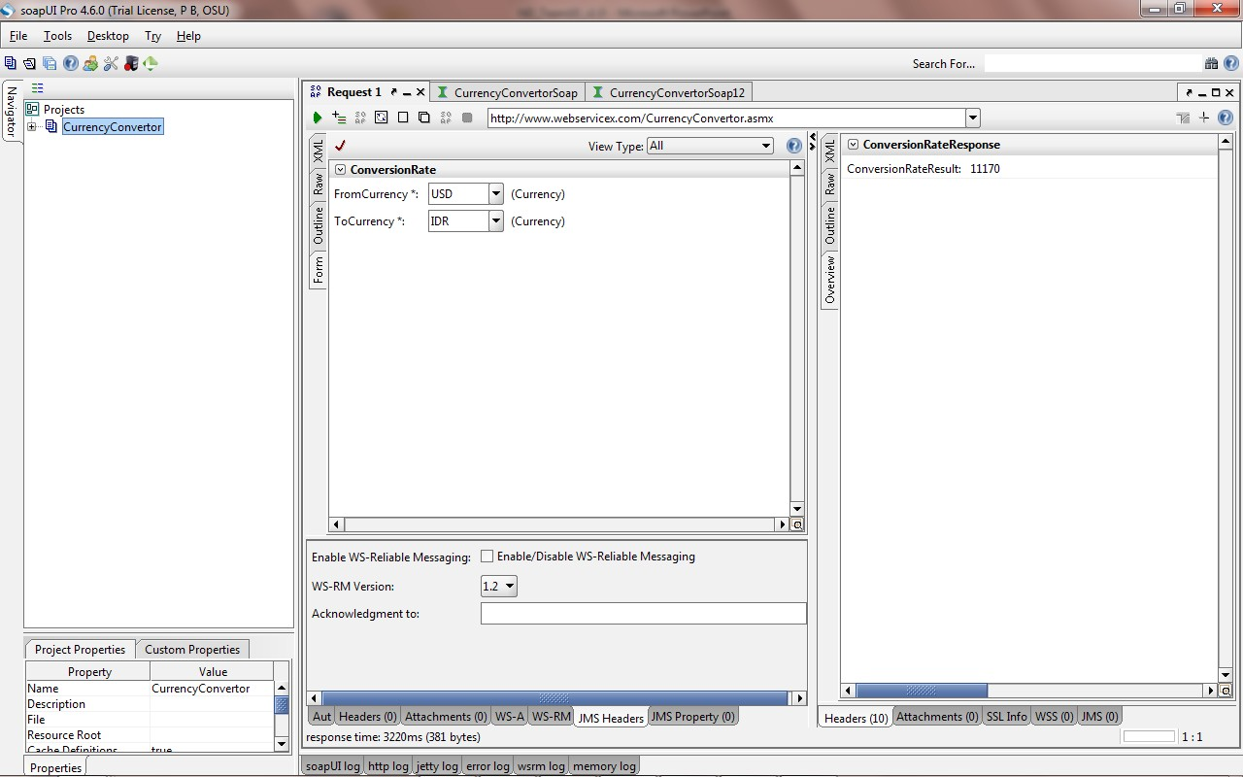
Demo
 http://www.soapui.org/Working-with-soapUI/point-and-click-testing.html

Slide 10

Questions
➢ For more information, do visit:-
http://www.soapui.org

Slide 11


Thank You

