Slide 1

NARRATIVE

Slide 2
Contents
Introduction
Overciew of data
Visualizing Platinum Prices
Visualizing Silver Prices
Comparative Analysis
Data Visualization for Industry 4.0
Modelling Techniques
Applications of Immersive Environments in Business
Immersive Visualization Techniques
Conclusion

Slide 3
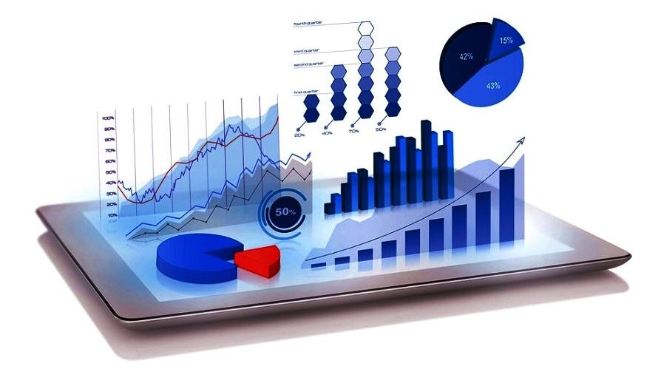
INTRODUCTION
Give a succinct synopsis of the main points of your report or presentation. Bring up the significance of data visualization and analysis in making wise business decisions.

Slide 4
Overview of Data:
Talk about the dataset or datasets that you will be utilising. Emphasise important factors, data sources, and any pertinent prior knowledge. This prepares the ground for the analysis that follow.

Slide 5
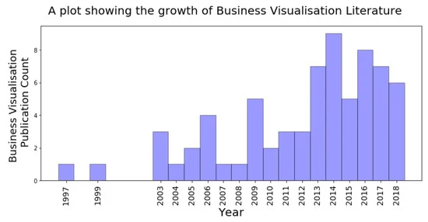
Visualizing Platinum Prices:
Examine several platinum price visualizations by clicking on this link. Line charts, candlestick charts, and other pertinent visual aids may be used for this. Examine patterns, trends, and any significant changes in platinum pricing.
(Argentum International, 2023)

Slide 6
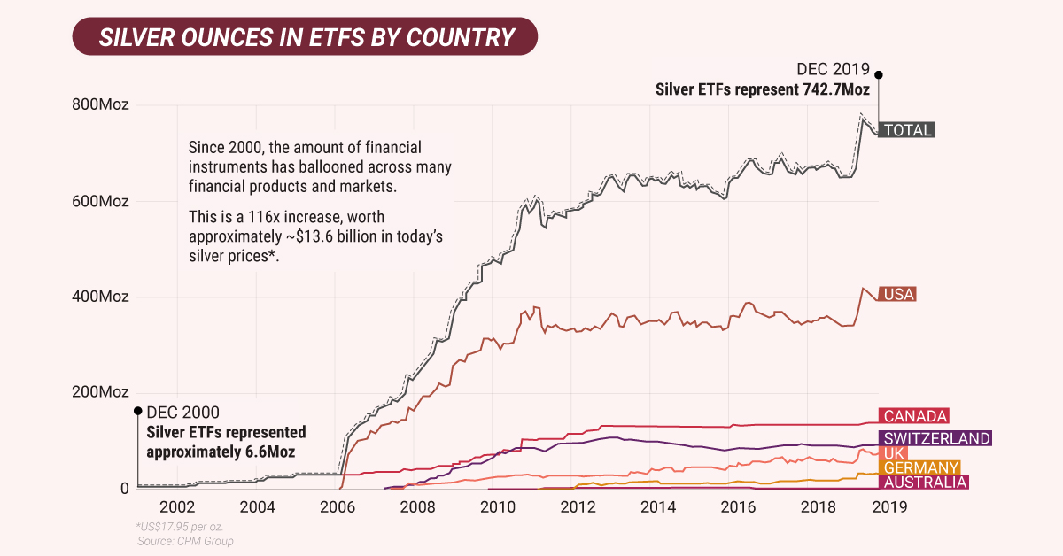
Visualizing Silver Prices:
Provide silver price visualization's in a similar manner. To find any possible connections or divergences, compare and contrast with platinum prices.
determining its value is relatively simple. If your piece has a lower purity than sterling silver, multiply the percentage by the weight, and multiply that product by the current price of silver.
(Dey, 2022)

Slide 7
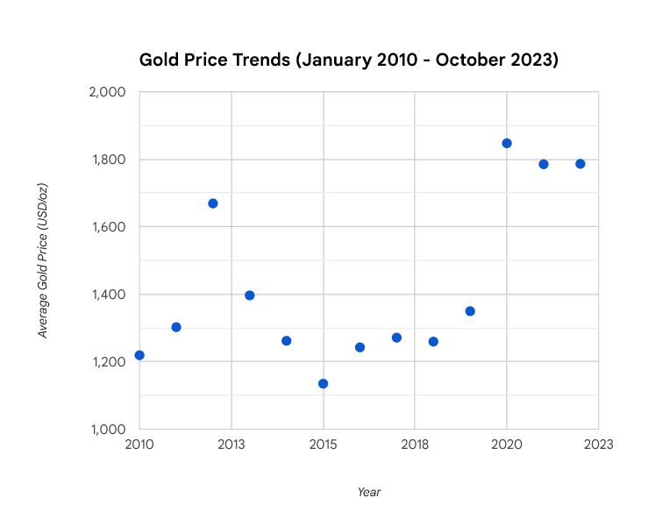
Visualizing GoldPrices:
Over the long run, gold prices have shown an overall upward trend, interspersed with times of volatility and stability.
A number of variables, such as supply and demand dynamics, geopolitical events, and economic conditions, can affect short-term swings in gold prices.
To show the historical trend of gold prices over time, use line charts.
Use trend lines to pinpoint possible turning points and the general direction of the price.
To record the opening, high, low, and closing prices of gold for each period, use candlestick charts.
(Bordo, M. D., & Sheridan, S. K. 2017)

Slide 8
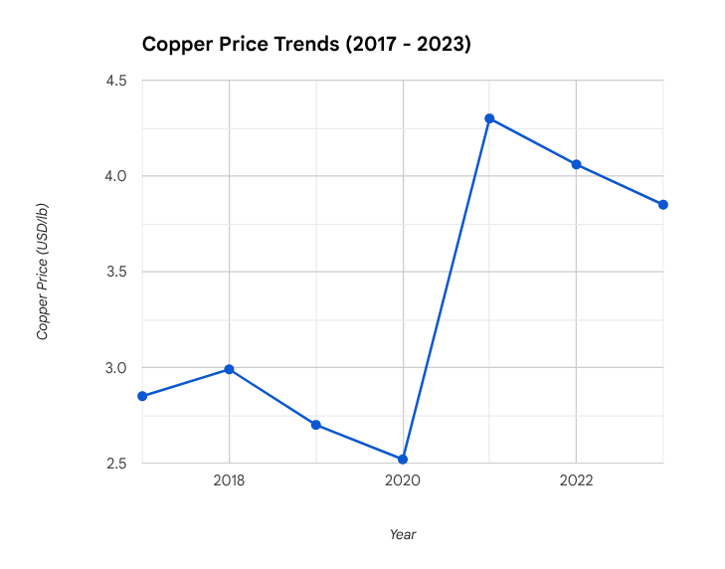
Visualizing Copper Prices:
Over the long run, copper prices have shown an overall upward trend, interspersed with times of volatility and stability.
A number of factors, such as industrial demand, geopolitical developments, and economic conditions, affect short-term fluctuations in copper prices.
Factors Affecting Changes in Copper Prices:
Economic Conditions
Industrial Demand
Geopolitical Events
Supply and Demand Dynamics
(Mishra, D., & Panda, S. K. 2020)

Slide 9
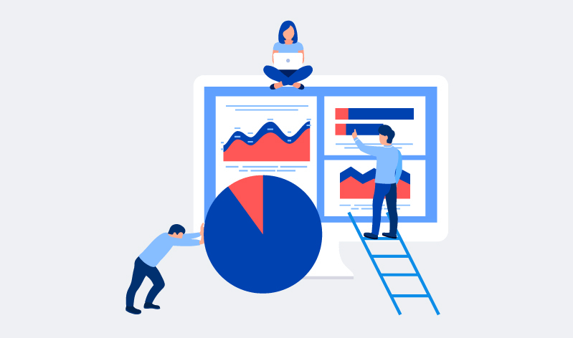
Comparative Analysis:
Conduct a thorough investigation of the prices
of silver and platinum. Examine variables like
market demand, geopolitical developments, or
economic indicators that may have an impact
on their patterns. Copper is a primarily
industrial metal whose price is influenced by
economic and industrial demand. Gold is a safe
haven asset whose price is affected by investor
sentiment, geopolitical events, and central bank
policies.

Slide 10
Data Visualization for Industry 4.0:
Move the emphasis to the idea of Industry 4.0 as a whole. Talk about
the importance of data visualisation in the context of the fourth
industrial revolution, which includes sophisticated analytics, automation,
and the usage of IoT.
(U.S. Geological Survey, 2023)

Slide 11
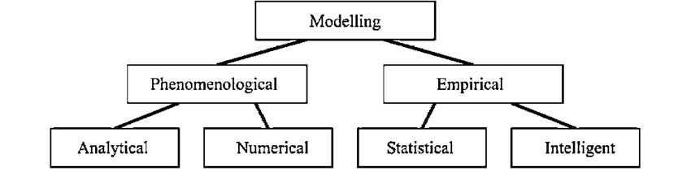
Modelling Techniques
Outline some modelling strategies that you may
use with your dataset. This might entail various
analytical techniques, machine learning algorithms,
or statistical models. Talk about the benefits and
drawbacks of each approach.

Slide 12
Applications of Immersive Environments in Business:
Examine how immersive environments, such as augmented and virtual reality, may be
used in a corporate setting. Emphasise certain uses, including staff training, product
development, or virtual meetings.
Immersive technology has enormous business potential. Immersive technology is creating
new opportunities for companies of all sizes, from enhancing customer experiences and
employee training to generating new revenue streams

Slide 13
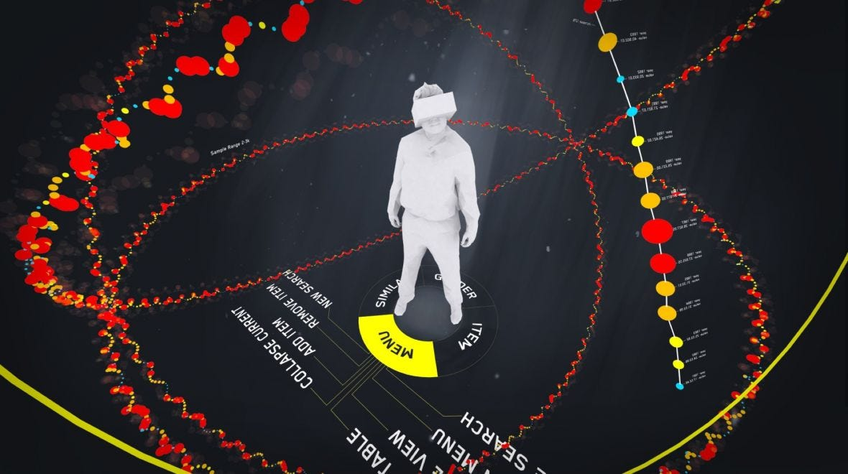
Immersive Visualization Techniques:
Examine certain methods for
producing immersive visualisations.
Talk about the technology,
difficulties, and possible
advantages for companies using
immersive visualisation.

Slide 14
Conclusion
Recap the main conclusions drawn from the assessments of silver and platinum and cooper and gold prices.
Link the findings to the more general business issues of modelling, data visualisation, and immersive technology. Talk about the possible ramifications for decision-makers as well as upcoming developments in these areas.
Your report or presentation should have a thorough and coherent flow thanks to this framework. Depending on your target audience and the level of analysis you want to accomplish, change the amount of detail.

Slide 15
References
Schultze, U., & Orlikowski, W. J. (2010). Research Commentary—Virtual Worlds: A Performative Perspective on Globally Distributed, Immersive Work. Information Systems Research, 21(4), 810–821. https://doi.org/10.1287/isre.1100.0321
Wang, J., Ma, Y., Zhang, L., Gao, R. X., & Wu, D. (2018). Deep learning for smart manufacturing: Methods and applications. Journal of Manufacturing Systems, 48, 144–156. https://doi.org/10.1016/j.jmsy.2018.01.003
Petrolo, M., & Carrera, E. (2020). On the use of neural networks to evaluate performances of shell models for composites. Advanced Modeling and Simulation in Engineering Sciences, 7(1). https://doi.org/10.1186/s40323-020-00169-y

