Slide 1
Parallel Coordinate Plot using RAW Graphs
Presented by
Sai Teja Mamidisetty
44-599 Introduction to Data Visualization
April 20, 2017

Slide 2
Outline
What is RAW?
What is Parallel Coordinate Plot Graph.
How is it different from line graph?
Example of Parallel Coordinate Plot Graph
Dataset.
Goals.
Demonstration.
Advantages and Disadvantages.
Lessons Learnt.

Slide 3
What is RAW
RAW is one of the online tool used to create various charts.
It is built on D3.js
The input data can be given in the form of
.csv
.excel
.tsv
And we can also directly import the data.
http://rawgraphs.io/

Slide 4
Features of RAW
Data is not stored anywhere, hence the data is safe.
Confidential data can be processed.
Its customizable.
Source code can be changed according to your convenience.
Custom layouts can be added and new layout can be designed from the existing layouts.

Slide 5
Advantages of RAW
Does not require registration.
The attributes can be dragged and dropped to visualize the chart.
Data can be imported easily.

Slide 6
Disadvantages of RAW
RAW can generated efficient charts for only small datasets.
Charts generated using large number of data cannot be downloaded.

Slide 7
Parallel Coordinate Plot Graphs
Parallel coordinate plot is a graph which maps each row in the data table as a line.
Each attribute of a row is represented by a point on the line.
Each attribute is represented on an axis with different readings.

Slide 8
How is it different from line graph
Line graph has only 2 axis. Only 2 attributes can be taken and represented in the graph.
Parallel Coordinate plot graph can take more than 2 attributes as axis.
5 to 10 attribute axis is recommended for better representation.

Slide 9
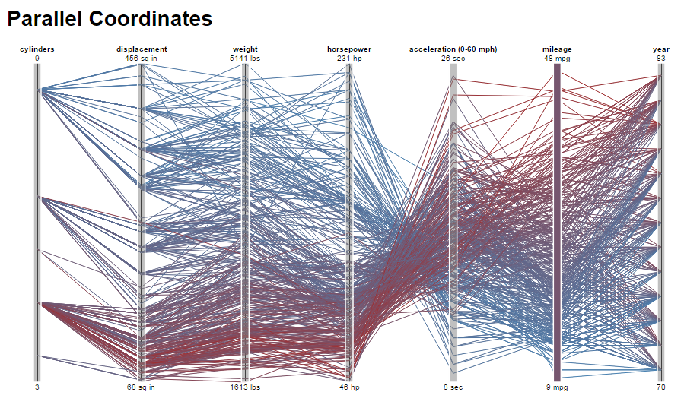
Example of Parallel Coordinate Plot
Example of Parallel Coordinate Plot Graph.
http://mbostock.github.io/protovis/ex/cars.html

Slide 10
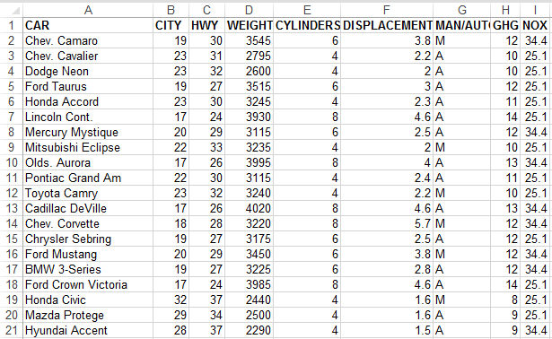
Dataset
Statistical Research
Data Processing
Data Science
Machine Learning
Total number of records for this dataset are 20
Cars Dataset
https://www.google.com/#q=cars.xls

Slide 11
Goal
To visualize the data on the Parallel Coordinate plot for 20 different vehicles according to their features and a comparison between them.
Statistical Research
Data Processing
Data Science
Machine Learning

Slide 12
Demonstration
Statistical Research
Data Processing
Data Science
Machine Learning

Slide 13
Advantages & Disadvantages
Advantages
Data can be categorized and distinguished easily using the parallel coordinate plot.
Large data with different attributes can be easily visualized.
Disadvantages
The color differentiation for data on the graph is unclear.
The data cannot be visible when we hover over the graph when we use RAW tool.

Slide 14
Lessons Learnt
How to choose the appropriate data for the charts.
Learned about tools such as protovis, RAW and anychart.
To do the work without postponing.

Slide 15
Thank you

