Slide 1
Ecommerce Sales Analysis
Finding the root cause of the 2025 revenue drop and estimating how much could be recovered
Sunny Yadav | Data Analyst
ysunny7600@gmail.com
github.com/Sunny7600
linkedin.com/in/sunny-yadav-180ba2227
Python • MySQL • Power BI

Slide 2
Business Problem & Approach
Dataset: 40,471 orders from Jan 2024 to Dec 2025
How I did it
The problem
1
Python (Jupyter)
Company sales dropped by about 18% YoY in 2025 compared to 2024. Management wants to:
Cleaned the raw CSV into an analysis-ready file
Identify the root cause
Quantify the losses
Simulate an action plan to recover lost revenue
2
MySQL
Loaded data, ran CTEs, CASE WHEN and YoY comparisons
3
Power BI
Built an interactive dashboard with slicers and KPIs
Sunny Yadav | Ecommerce Sales Analysis 2024-25
2

Slide 3
Headline Numbers
Net sales fell more than the 18% reported, while orders still grew
-21.03%
+2.22%
₹5.68 Cr
3.81
Lost to cancelled + returned orders in 2025 (₹5.53 Cr in 2024)
Net sales YoY (delivered orders)
Total orders YoY (20,013 to 20,458)
Average customer rating
What this means
Dashboard totals (2024-25)
More orders but less money, so the problem is not demand alone
Returned order losses went down, but cancelled order losses jumped in 2025
My calculation shows a 21.03% net sales drop, not the 18% in the brief, so I flagged the gap
Gross sales: 1.07bn
Net sales: 848.71M
Delivered: 89.05%, Returned: 6.12%
Sunny Yadav | Ecommerce Sales Analysis 2024-25
3

Slide 4
Root Cause 1: West Region Shipping Delays
Cancellations tripled where delivery got slower
2.01 to 6.23
3.91 to 3.14
Avg shipping delay (days)
Avg customer rating (-0.78)
Other regions had only small changes in cancellations
Other regions kept ratings stable at 3.86 to 3.92
Longer delays led to more cancellations and unhappy customers
Sunny Yadav | Ecommerce Sales Analysis 2024-25
4

Slide 5
Root Cause 2: Corporate Segment & Laptops
Corporate orders fell while other segments grew
-45.6%
Laptop orders
Paper also dropped in Corporate. Laptops cost the most, so their fall hurt revenue the most.
Sunny Yadav | Ecommerce Sales Analysis 2024-25
5

Slide 6
Root Cause 3: Heavy Discounts Did Not Work
Four furniture sub-categories got much bigger discounts in 2025
Most sub-categories stayed near 8 to 9% discount
These four jumped to about 20 to 21% in 2025
Chairs and Furnishings saw only slight net sales gains
Tables and Bookcases saw net sales fall even with the deeper discounts
Result: the discount strategy was largely ineffective
Sunny Yadav | Ecommerce Sales Analysis 2024-25
6

Slide 7
Recovery Simulation
How much revenue could have been saved if the issues were fixed
₹5.70 Crore
Total potential recovery (₹57,006,531)
₹1.43 Cr: 738 orders in 2025 cancelled after delays over 2 days
₹4.00 Cr: 573 lost Laptop orders (delivered 1,248 to 675) at the 2025 avg net price
₹26.73 L: Bookcases ₹8.88L + Tables ₹17.85L back to the 2024 baseline
Sunny Yadav | Ecommerce Sales Analysis 2024-25
7

Slide 8
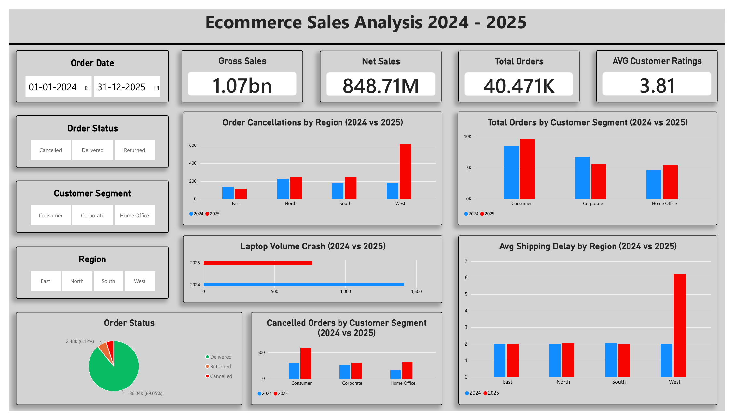
Power BI Dashboard
Interactive view with filters for date, order status, segment and region
Sunny Yadav | Ecommerce Sales Analysis 2024-25
8

Slide 9
Recommendations & Takeaways
What the business should do
Skills used
Fix West region logistics and keep delays under 2 days
Find why Corporate customers stopped buying Laptops and win them back
Stop blanket discounts on Tables and Bookcases
Track shipping delay and cancellations as early warning KPIs
Data cleaning in Python
SQL: CTEs, CASE WHEN, aggregations, YoY analysis
Power BI dashboards and storytelling
Turning data into recommendations
Let's connect
ysunny7600@gmail.com
github.com/Sunny7600
linkedin.com/in/sunny-yadav-180ba2227
Sunny Yadav | Ecommerce Sales Analysis 2024-25
9

